Slide 1
Top
Must
Have
Real Estate
Apps

Slide 2
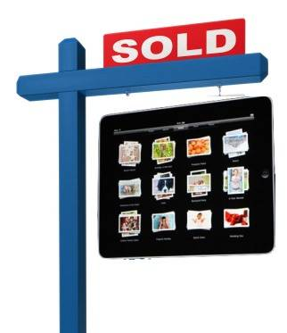

Slide 3
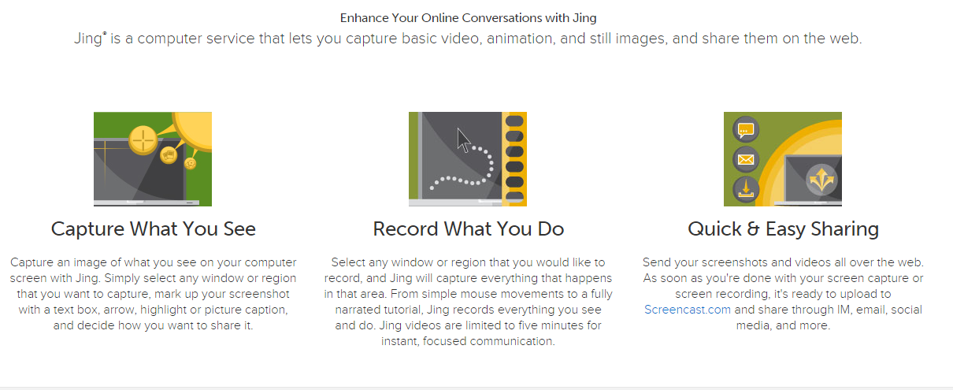
https://www.techsmith.com/jing.html
http://www.inman.com/next/jing-project-screen-capture-made-easy/

Slide 4
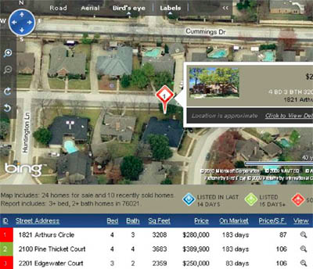
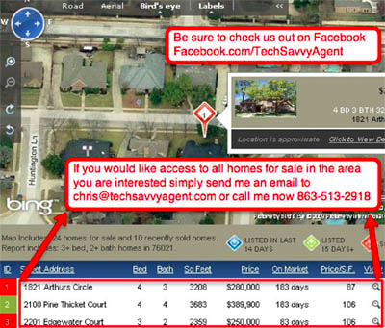
Jing Ideas ☺

Slide 5
Keep notes about every conversation in specific client notebooks
Create a customized property tour
Show homes and easily capture client feedback
Email notes, photos and audio to the buyer after the property tour
Forward all client-related emails directly to your Evernote account
https://evernote.com/

Slide 6
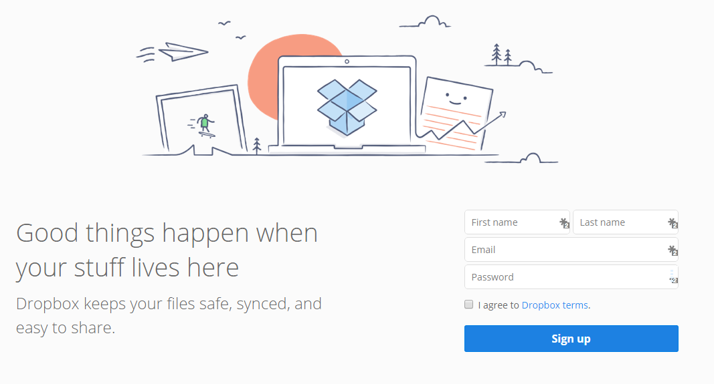
https://www.dropbox.com/
http://www.jasonpantana.com/dropbox

Slide 7
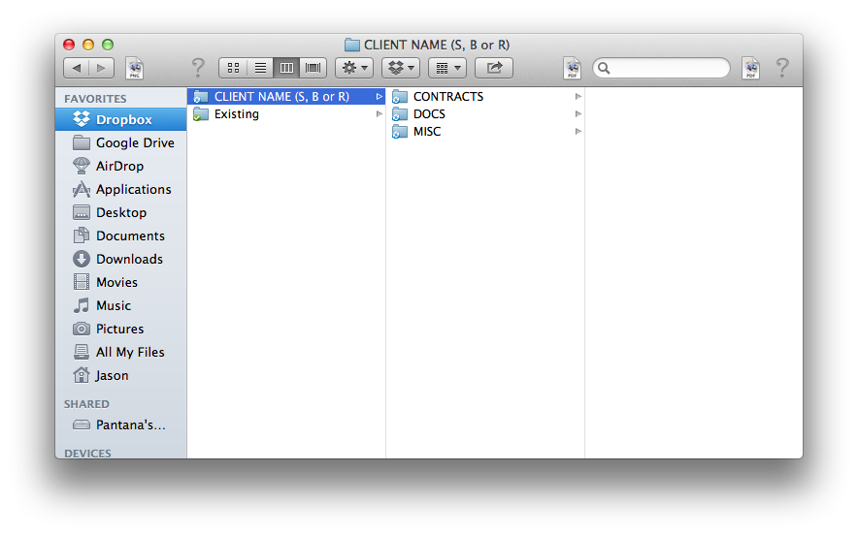
CREATE A LOGICAL FILE-NAMING SYSTEM:

Slide 8
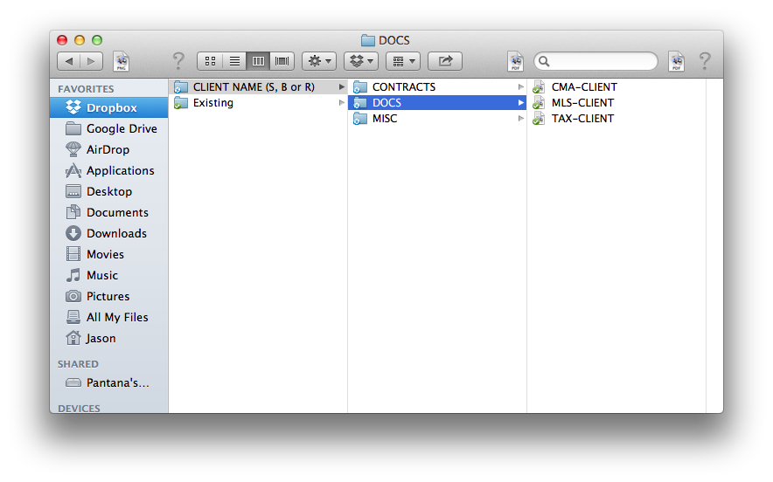
CREATE FOLDERS FOR EACH STAGE OF THE CLIENT RELATIONSHIP:

Slide 9
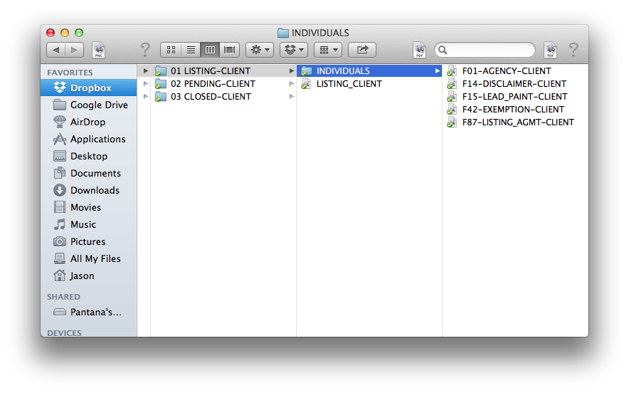
EVERY FORM OR CONTRACT SHOULD BE SEPARATED FOR EASY SHARING:

Slide 10
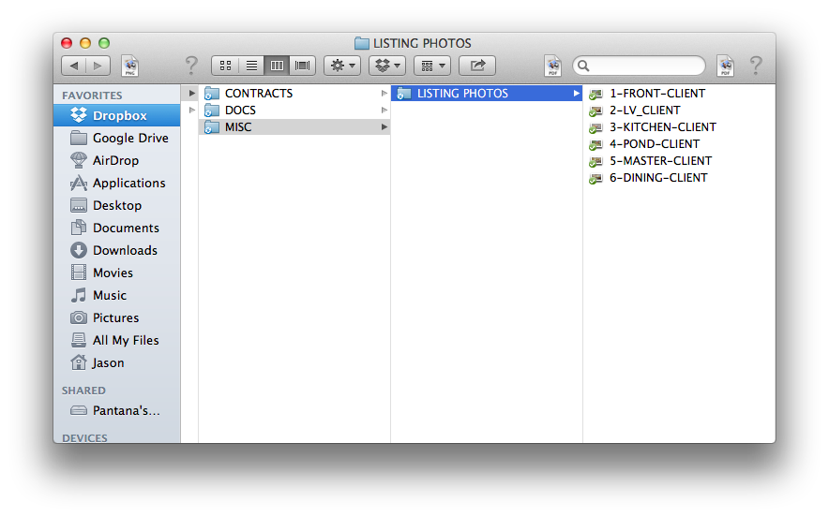
COLLABORATING WITH CLIENTS ON LISTING PHOTOS:

Slide 11
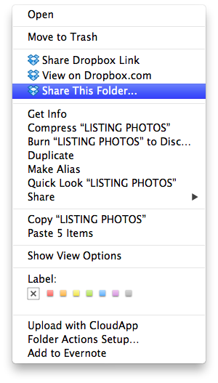

Slide 12
Make fun videos wherever you are, with photos and video clips from your Camera Roll. Choose from one of our sleek video styles, add a song, and you’re done! Share via Messages, email, Twitter, and Facebook and impress the socks off your friends and family
https://animoto.com/features#mobile
Animoto's new mobile app promises easy video slideshow creation
iPhone and Android owners, download our free app! Create and share videos using your phone's pictures and video clips, or watch and download the ones you've made on your computer. It's easier, faster and dare we say, a bit more fun.
https://animoto.com/blog/business/real-estate/real-estate-marketing-videos-top-5/

Slide 13
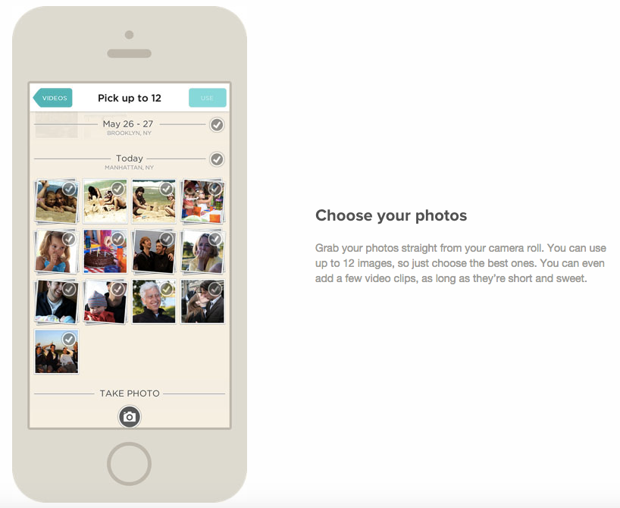

Slide 14
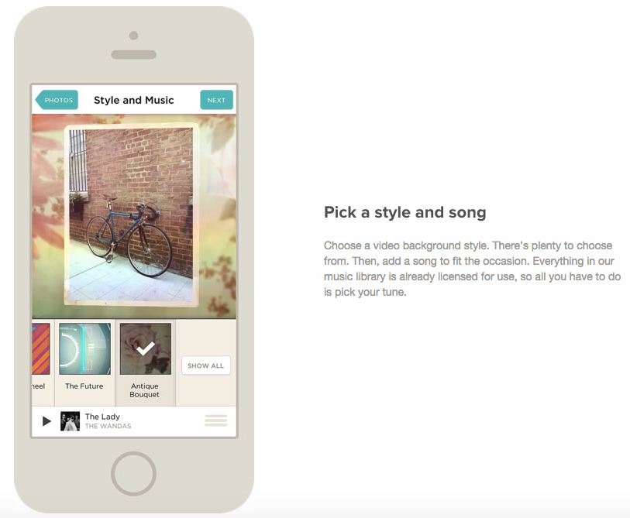

Slide 15
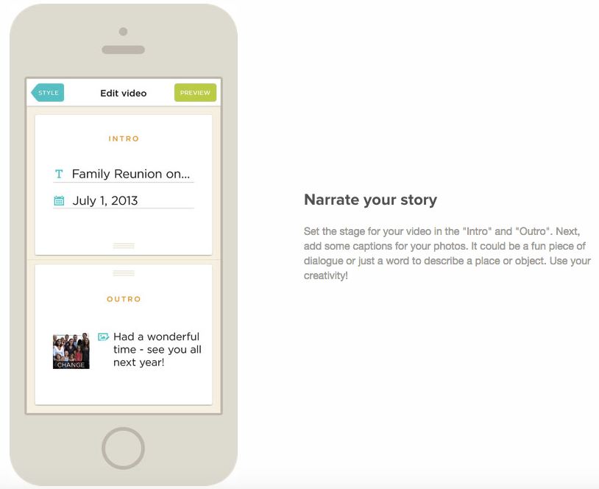

Slide 16
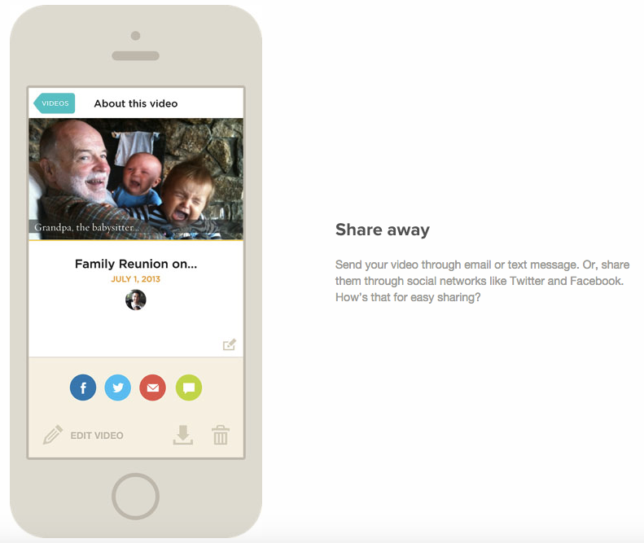

Slide 17
http://www.showingsuite.com/instagram-real-estate-marketing-tool/

Slide 18
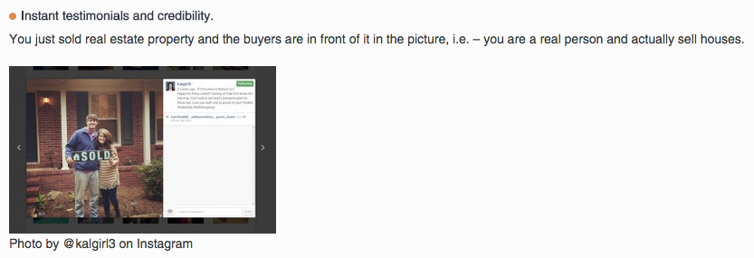
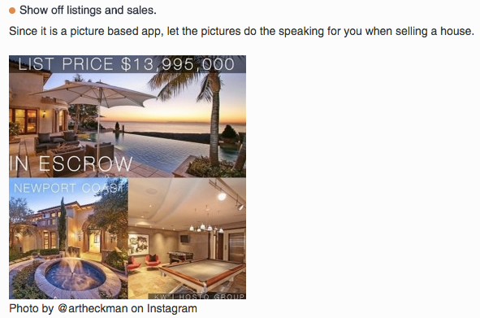

Slide 19
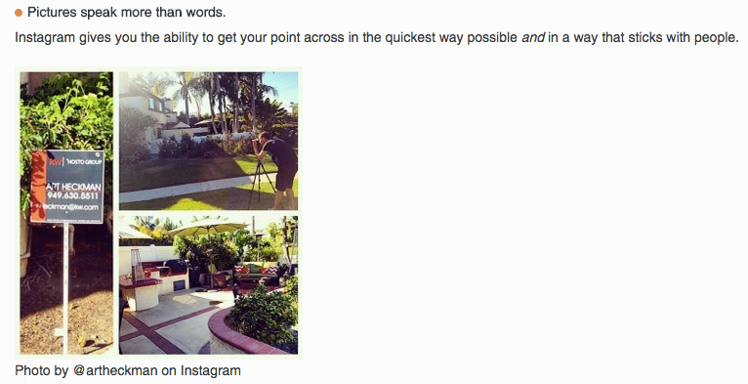

Slide 20
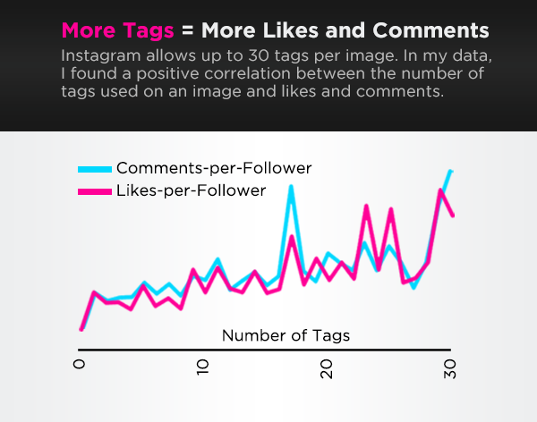
8 Little Known Facts About Instagram
Pictures, Filters, and Hashtags
Notes:
There’s a direct, positive relationship between hashtags and Instagram engagement, likes and comments.
The more hashtags a photo has, the more visible it is, the more visible a photo is, the more likely somebody else will like and talk about it, and frankly, that’s why you’re on Instagram in the first place. Just be sure to limit the number of hashtags to 30; Instagram stops the party there.

Slide 21
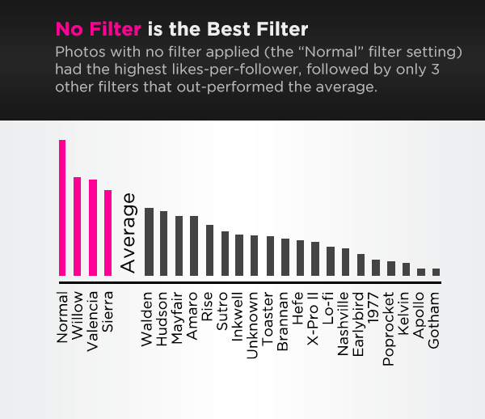

Slide 22
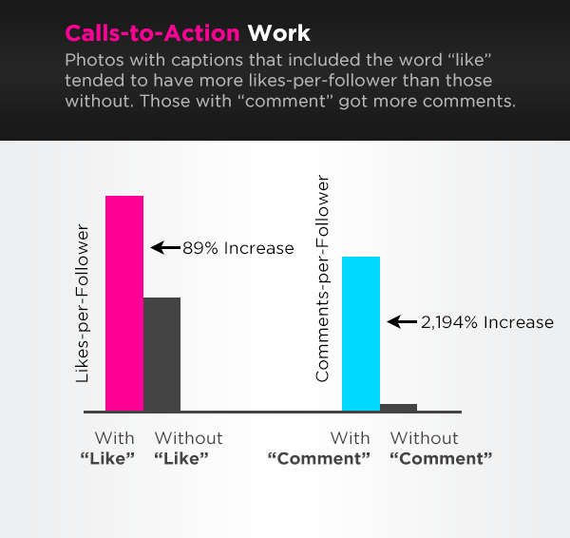

Slide 24
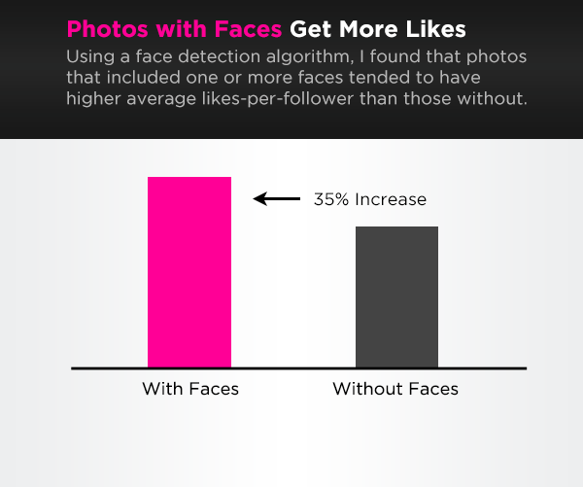

Slide 25
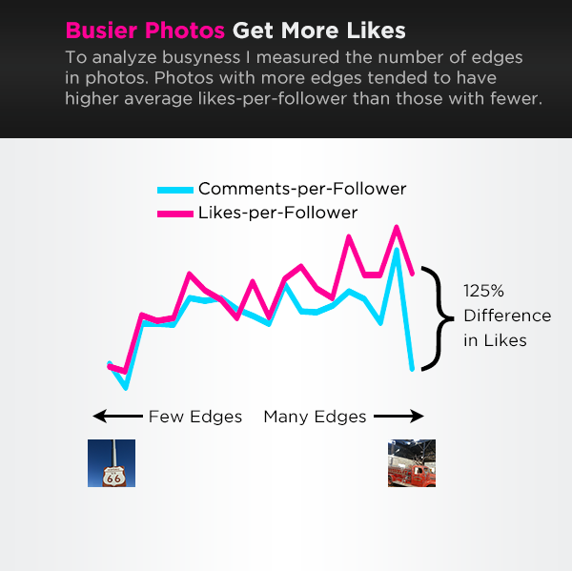

Slide 26
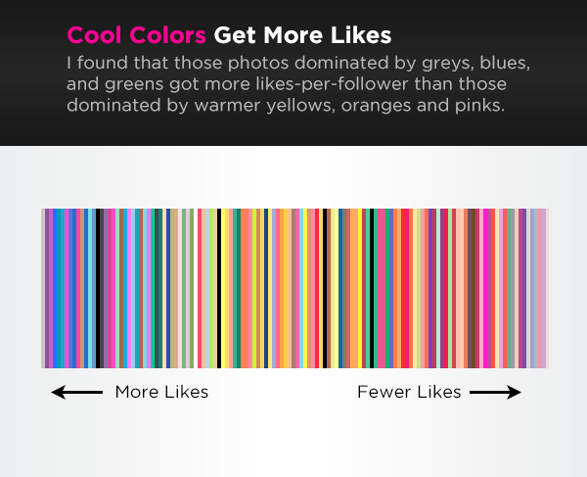

Slide 27
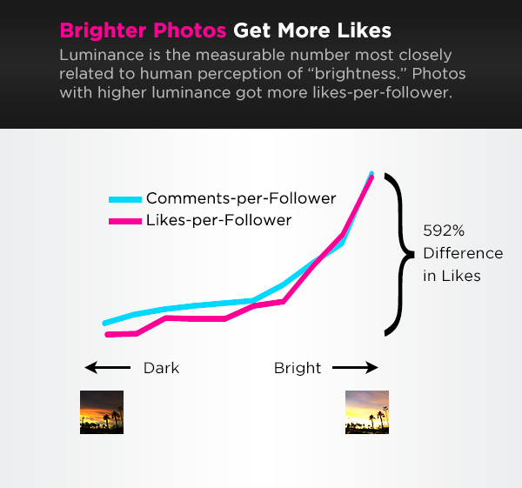

Slide 29
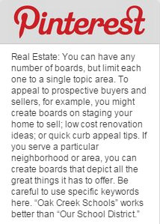
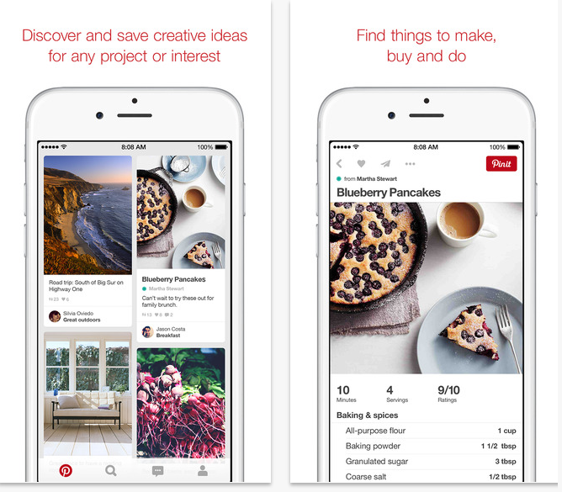
http://www.inman.com/next/25-killer-pinterest-real-estate-board-suggestions-to-target-buyers-and-sellers/
A real estate agent’s images are an essential tool to their business as is their marketing. One digital communication trend that is currently on the rise integrates branding opportunities and visuals to gain maximum exposure.
http://www.realtor.org/field-guides/field-guide-to-pinterest-for-realtors
http://www.inman.com/next/25-killer-pinterest-real-estate-board-suggestions-to-target-buyers-and-sellers/

Slide 30
Boards to attract buyers
https://www.pinterest.com/agentmastermind/
Home Decorating and Inspiration. Put together a board with a collection of rooms designed by famous designers.
My Dream Home. Almost everyone on Pinterest has a “Dream Home” board, and your job is to find pictures that your followers will want to add to theirs. Think massive walk-in closets, stunning built-in pools, and homes with curb appeal to leave anyone drooling.
Best Kid Room Ideas. A simple concept to find and an even easier one to gain you some repins.
Outdoor Living. Photos of lush waterfalls, stellar decks, and anything that would make a potential buyer jealous.
Style-themed boards. Make one with contemporary decor, another with traditional, and another with country living.

Slide 31
Boards to attract sellers
Capitalizing on Small Spaces. Ideas for people to make the most of their space, like multipurpose furniture ideas, and tips and tricks to using color.
DIY Weekend or Home Improvement Projects. Like adding a built-in bookshelf to the office or tips for repainting a bedroom.
Organizing Inspiration. Pinterest fans love creative organization ideas, so why not make a board about it?
Repurposing Ideas. Another popular theme on Pinterest: People love to make new things from old things and then brag about it.
Tips for Staging. Pin images that show the ideal way to stage a home for sale.
Community Boards. Most real estate agents have a territory they cover that includes at least a few cities or towns. Promote everything about the real estate communities you cover. Start first by having city or town pages on your website that have interesting and unique photos that people will want to pin. One of the many areas I cover is Milford, Mass. Take a look at my Milford Realtors guide as an example of what I am referring to. As you can see on this community page, there is a ton of useful content along with photos that can be pinned. Now take this concept and create a board for each of the towns you provide real estate services for and highlight all the best landmarks including schools, parks, restaurants, lakes and others that would be interesting to visitors. Remember, you want to get the point across that you are the local real estate market expert!

Slide 32
Boards to target certain areas
Things to Do in ____. Pin pictures with links to all of the fun community events going on in the areas you have homes for sale. Make seasonal boards so your followers can find the perfect thing to do year-round.
The Best Places to Eat in _____. Another Pinterest fave: food. Just because you are in the housing industry doesn’t mean you can’t take advantage of it. Post mouth-watering images of some delectable treats from around the town.
Popular Neighborhoods. Show overview photos, as well as specific homes, of the most desired neighborhoods in the city.
Outdoor Fun. Focus on parks, lakes and other places locals can go to enjoy nature in their own backyard.
The Best Places for a Wedding in _____. What would Pinterest be without wedding planning? Many people turn to Pinterest to choose every detail of their wedding, including the location, so you may as well get a piece of this very expensive pie.

Slide 33
Boards about you
What Makes Me Laugh. This is where you can post anything you think is funny, like those memes going around or just a funny picture you found on the Internet. Something hilarious has a high repin percentage.
My Favorite Recipes. Another chance to get on the food bandwagon that is Pinterest.
Get to Know Me. Pin anything that you like or enjoy, like your hobbies, your style and anything else that will help your followers relate to you on a personal level. This is also a great place to link back to your blog or website’s About Me section.
My Dream Vacations. Where do you want to go on vacation? Chances are someone else wants to go there, too. Find a stunning picture of this destination and it will probably have a high repin count.
My Inspiration. You surely have a favorite quote or something that motivates you. There are a lot of inspirational images out there about getting in shape, beating the odds, never giving up, etc.

Slide 34
Business boards
Homes for Sale. Of course, you need to have a few boards dedicated strictly to your business. You can either have one board with all of the homes you have for sale, or you can make several boards and sort the homes by price point, neighborhood or anything else you see fit. Remember, it’s all about the images, so invest some time in getting some professional photographer-worthy photos of the homes.
Homes Sold. Use this as your online resume to show off the homes that are no longer on the market, thanks to you.
Happy Clients. Have your past clients write a testimonial and post it on your website along with a picture. Pin this picture to Pinterest and you have a new board full of direct links to your website.
Top Real Estate Articles — this is one of my favorites! Have a board that is dedicated to all of your best blog content along with other fantastic real estate-related articles you come across both on Pinterest along with other places online. This should be a showcase of the best of the best. You want to make sure this board has both excellent content and really great graphics!
**Bonus Pinterest real estate board suggestion – Use group real estate boards to drive exponential traffic back to your sites. If there is one thing that group Pinterest boards can do, it’s dramatically increase your visibility and reach. Most group boards have a fairly decent amount of members and an even greater number of followers. A group board can really ratchet up your social media presence!

Slide 35
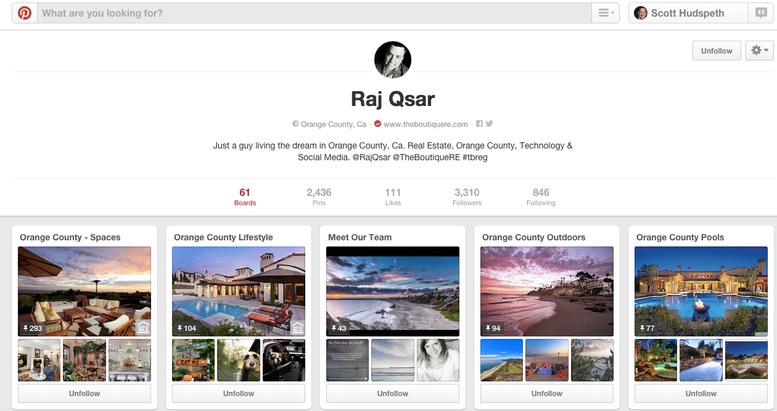
https://www.pinterest.com/rajqsar/

Slide 36
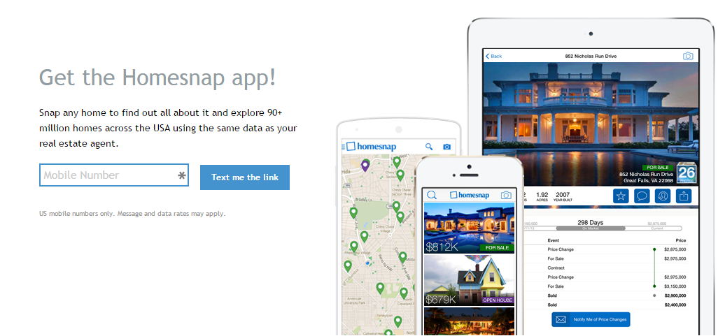
http://www.homesnap.com/
http://www.homesnap.com/mls/

Slide 37
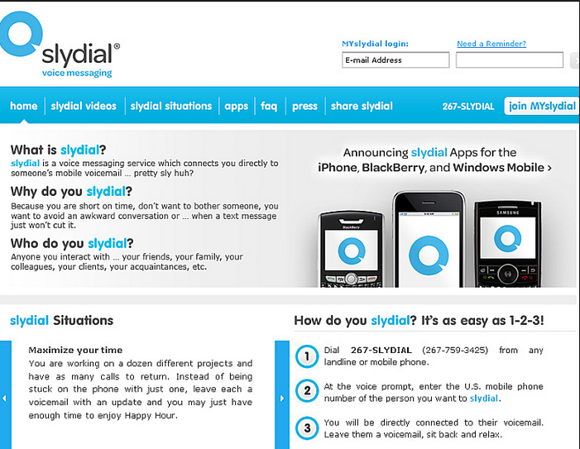
http://www.slydial.com/

Slide 38
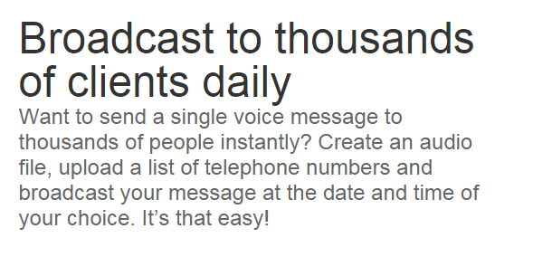
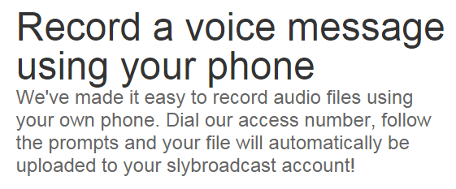
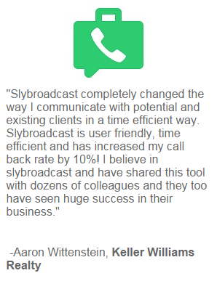

Slide 40
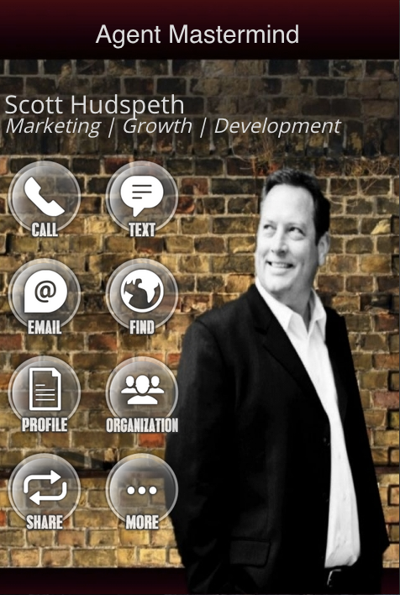

Slide 41
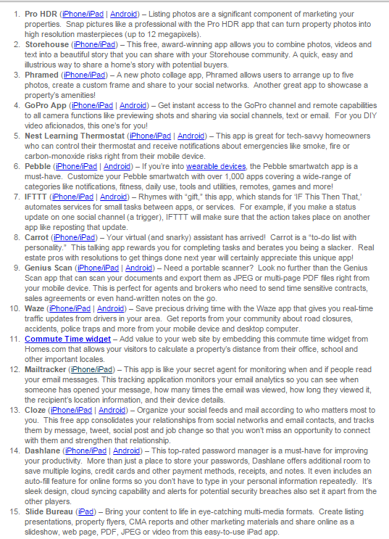
http://rismedia.com/2014-11-13/top-15-real-estate-apps-to-blaze-a-trail-in-2015/

