Slide 1
GMAIL / Email AND YOUR BUSINESS!
It’s not enough to be busy, so are the ants. The question is, what are we busy about? -Henry David Thoreau

Slide 3
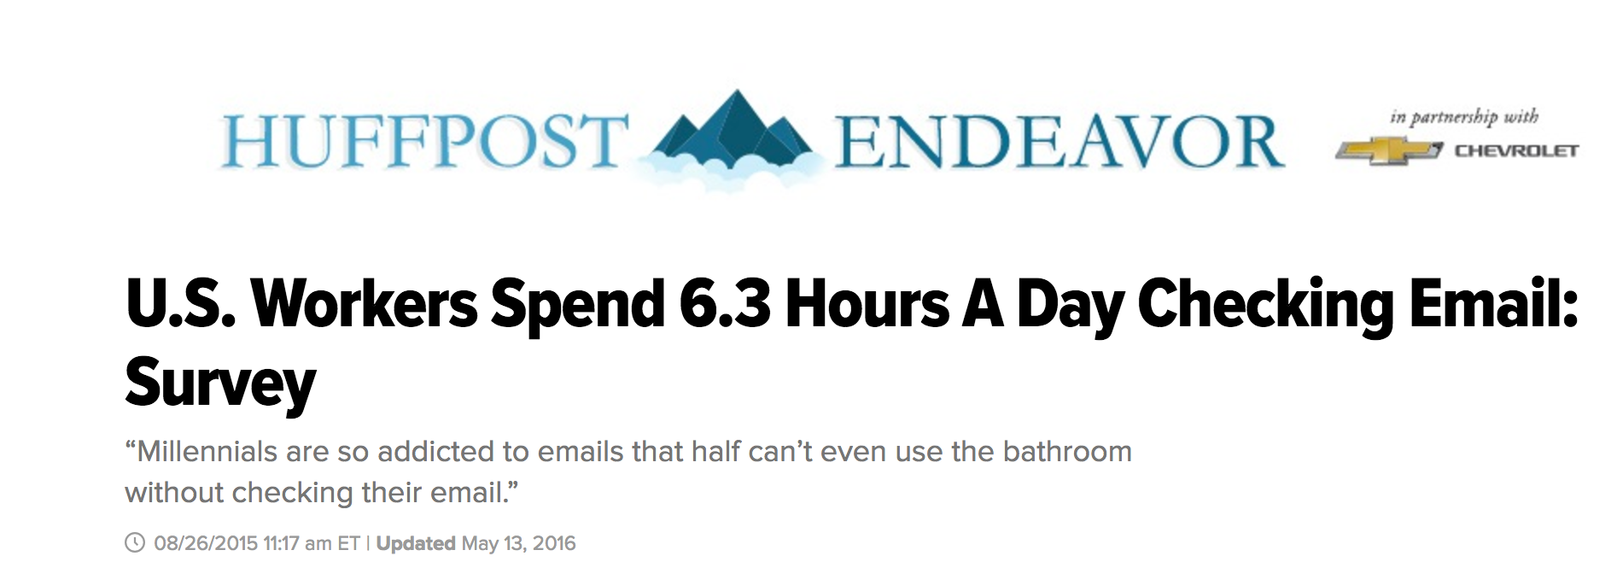

Slide 4
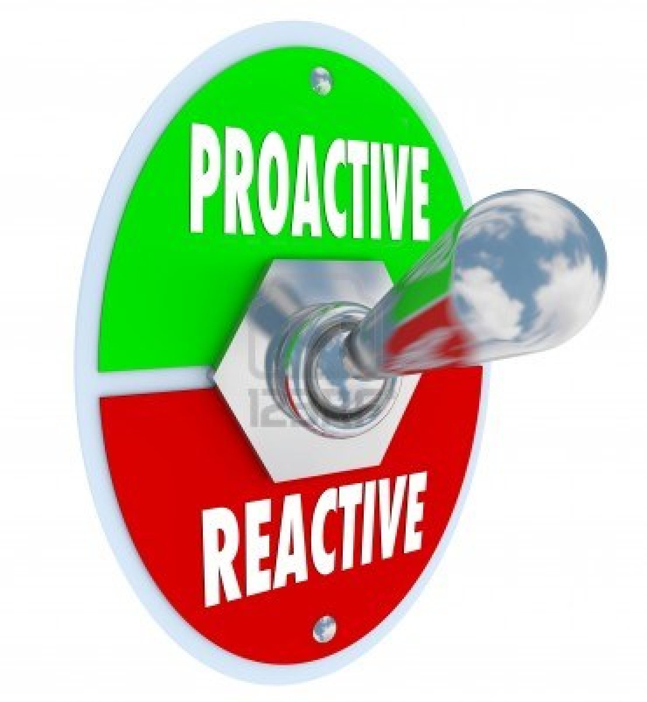
Reactive
The word “reactive” implies that you don’t have the initiative. You let the events set the agenda. You’re tossed and turned, so to speak, by the tides of life. Each new wave catches you by surprise. Huffing and puffing, you scramble to react to it in order to just stay afloat.

Slide 5
The Hardest Part
Staying Out Of Your Inbox
You Have To Work Off A Schedule, No Exceptions!
9-11am: Do MMA “Money Making Activity Work”
(Can be stuff from email of yesterday)
11-11:30 am: process emails (Pick a time and stick to it)
11:30pm-1:00 Break/Lunch
1:00 – 1:30 Social Media
1:30 – 3:00pm: MMA/Return phone calls
3:00 - 3:30pm: Email
3:30 Go Home/MMA
MMA = Money Making Activity

Slide 7
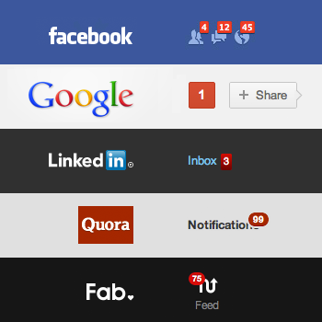
Challenge For You
Turn Off All Your Notifications!

Slide 8
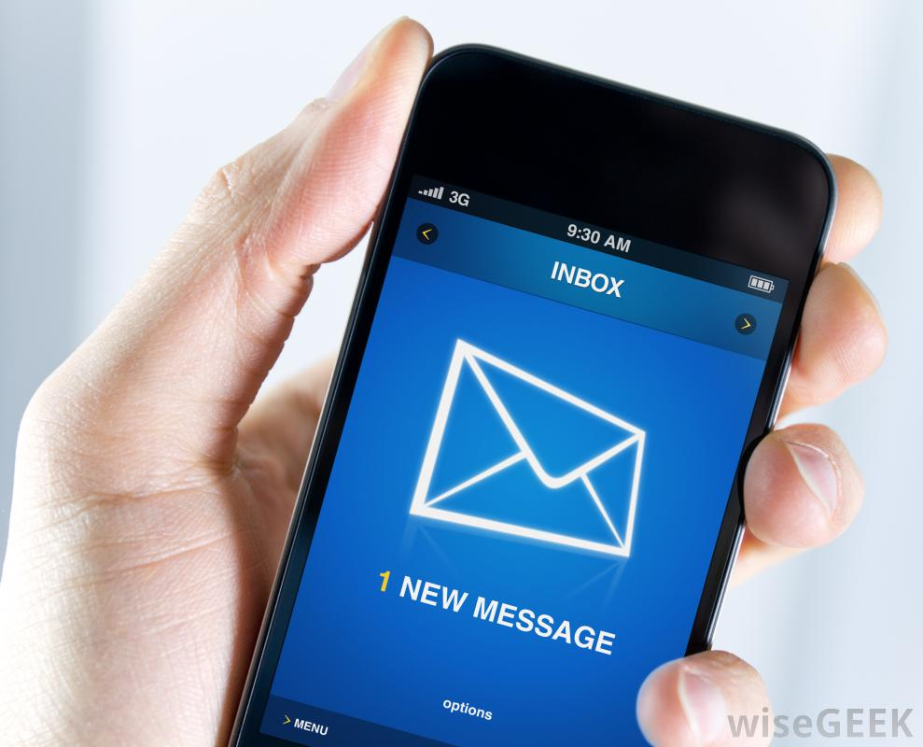

Slide 9
Why Gmail?
Automatically puts everyone you email in your contacts
Share your Gmail login so someone else can manage it
Calendar is in the clouds that others can manage
Can share calendar with anyone and everyone
Appointment notices sent to others for on time appointments
Tasks list is in the clouds
Filters so you can delegate 99% of your inbox
Filters to remove the garbage/spam/delegate
Documents are in the clouds
Have all your emails come to one email
Send from any email you wish
Tons of storage
Can archive old emails, not delete (Get them out of view)
Use Gmail for farming/marketing autumnwoods@gmail.com
Same search function as Google
Multiple emails
Canned response for quick response, less time in email inbox.
And so much more.
Lets Get Started!!!!

Slide 10
The Only Labels You Need
Reply
Waiting
All Mail

Slide 11
All –Reply - Waiting

Slide 12
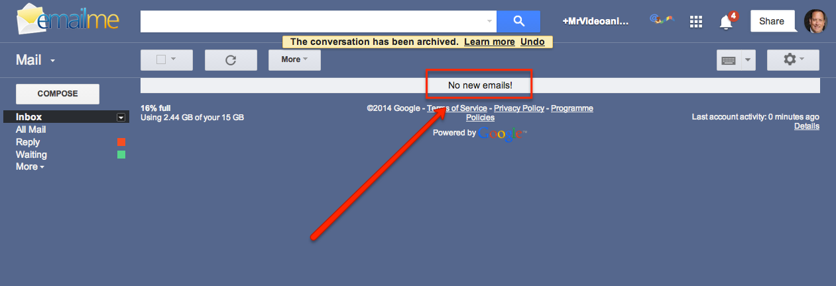
GboxZero
And Only Spend At Most 30 Minutes A Day In Your Inbox

Slide 13
Rule #1 / So Important
Can’t Check Email Until 11:00 AM

Slide 14
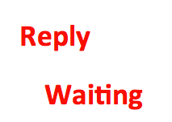
Lets Set Up Your Reply and Waiting Labels

Slide 15
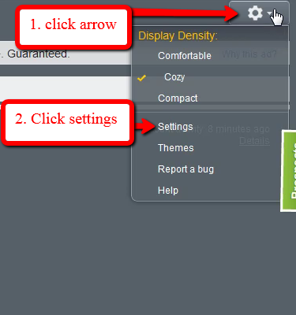

Slide 16
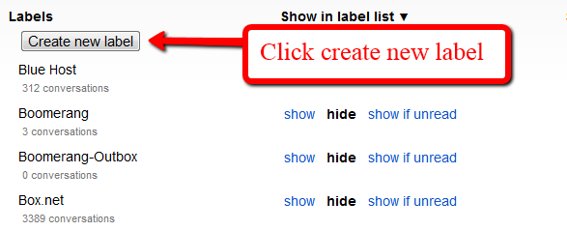
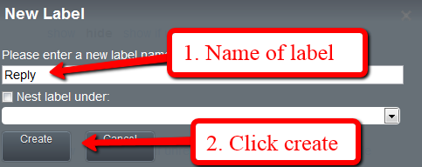

Slide 17
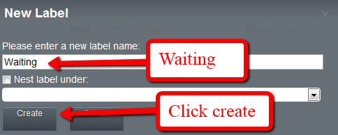
Same For “Waiting” Label

Slide 18
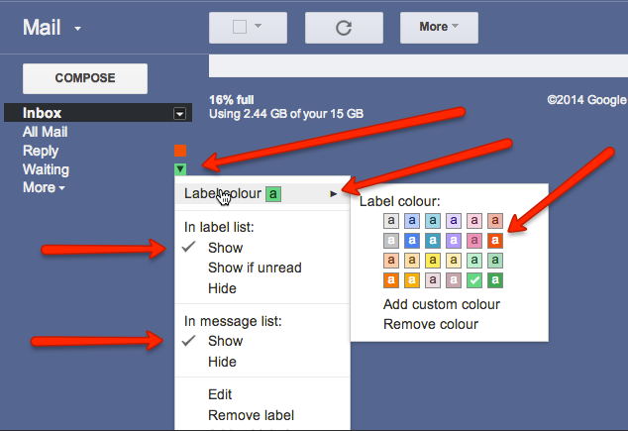
To Get Label To Show And Change Color

Slide 19
Reply label:
Someone is requesting you to do something (with or without deadline). Examples include submitting reports, verifying something, and taking on any task.
Someone is asking you to respond to something but it requires more deep thoughts from you to respond. Examples include people asking for your opinion or asking about your availability for an event, showing, weekly report.
After you’ve replied to emails in the this folder, you then move them to the archive folder. Within Gmail it’s easy, you remove the Reply label by clicking on the X next to the label name.

Slide 20
Waiting label:
Typical emails that come in the Waiting folder:
Tracking codes for UPS or Fedex packages coming your way.
Examples include shipping tracking numbers from online shopping.
You delegated a task and are waiting for a response / result.
Examples include emails from virtual assistants, seller or buyer response, employees, and anyone you are waiting to hear from.
Confirmation from someone.
Examples include asking another person if he/she received something from you (like an email, attachment, sales agreement, home inspection)
Anything you want to have at your fingertips ☺

Slide 21
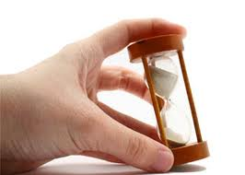
The Two-minute Rule
If it can be done
in less than two
minutes DO It Now!
2

Slide 22
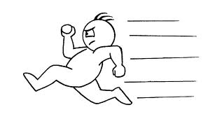
The value in this rule is that you go through your inbox really fast, and initially process only what is necessary. If someone needs a quick response, you’ve taken care of that. If an email needs more attention, you can work on that later and prioritize which email gets the most attention (after your inbox is processed and at Gboxzero).
Set A Filter For All The Spam

Slide 23
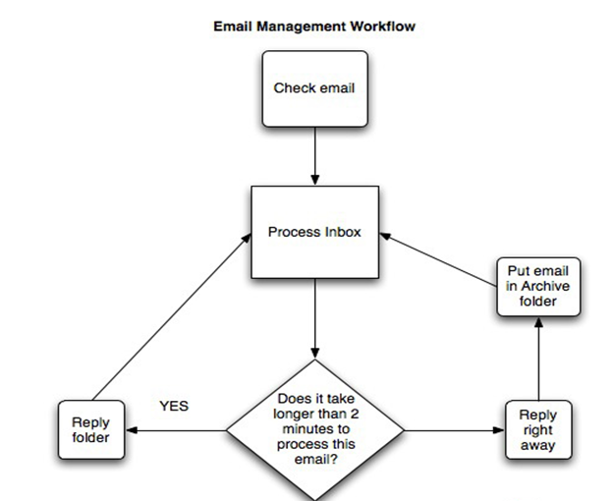

Slide 24
Huge Time Saver
Gmail Search

Slide 25
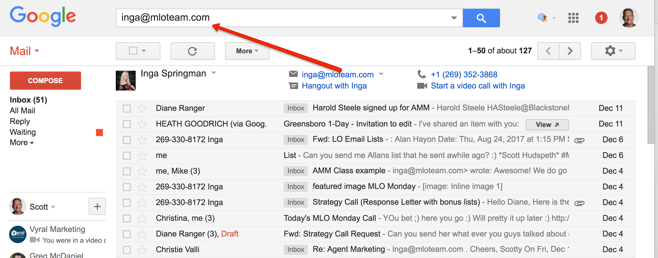
Gmail has the same search algorithms as Google does

Slide 26
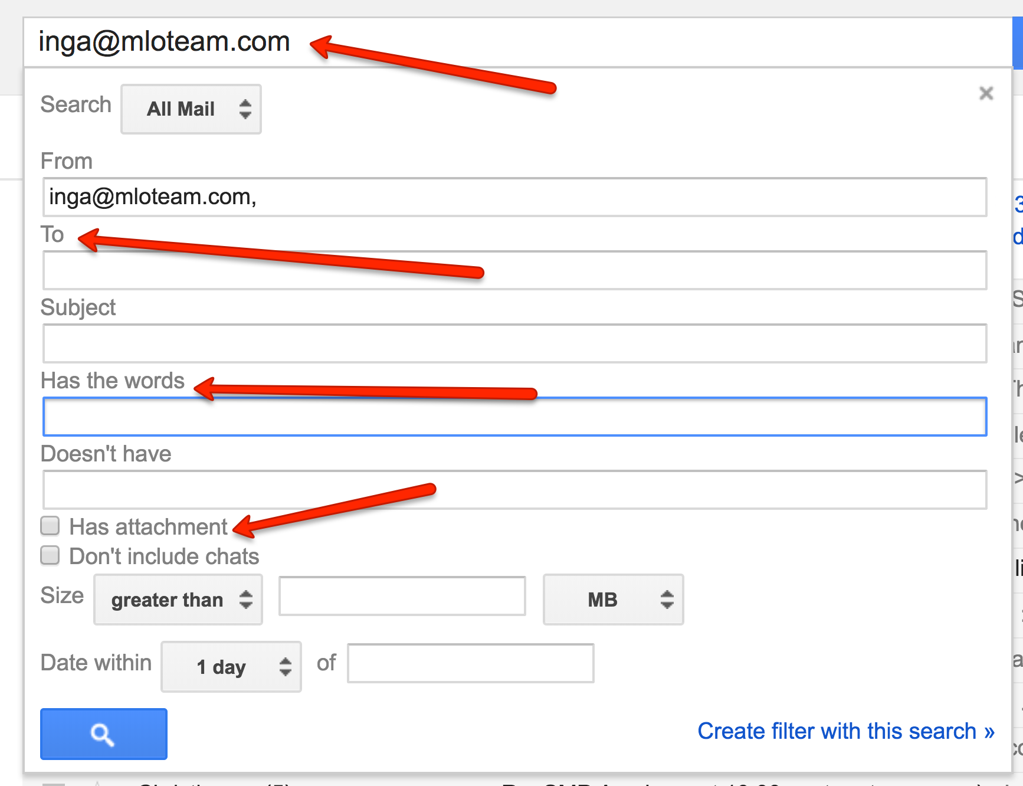
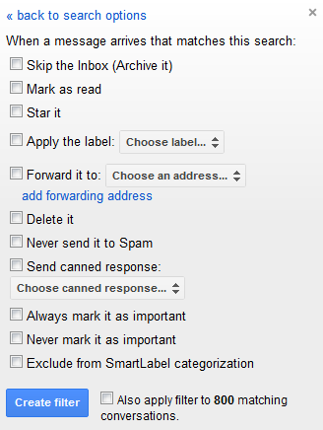
Search Capabilities Filter Settings available

Slide 27
Gmail Filters, Delegation!!!!!
Gmail's filters allow you to manage the flow of incoming messages. Using filters, you can automatically label, archive, delete, star, or forward your mail, even keep it out of Spam -- all based on a combination of keywords, sender, recipients, and more.

Slide 28
To Filter A Message Or Spam

Slide 29
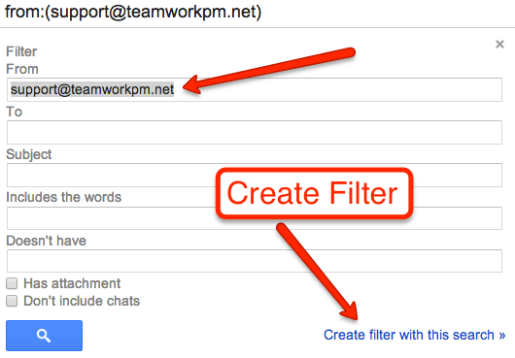

Slide 30
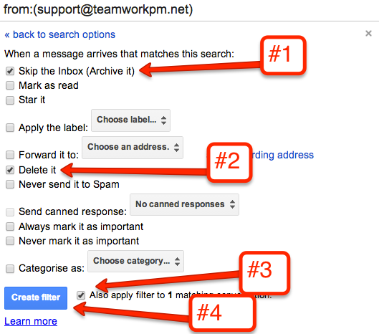

Slide 31
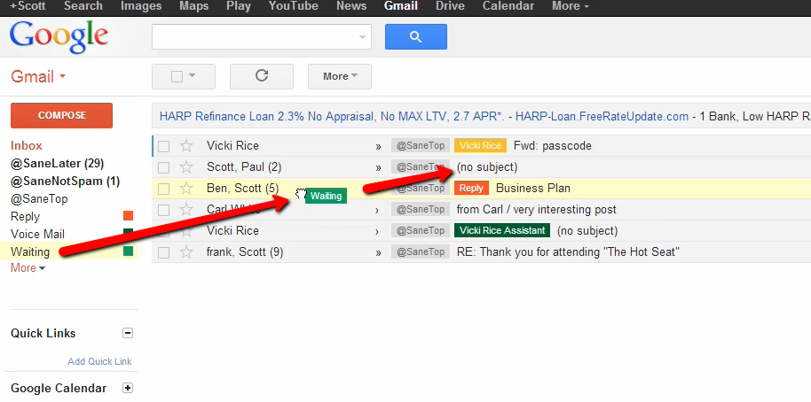
You Can Also Slide The label

Slide 32
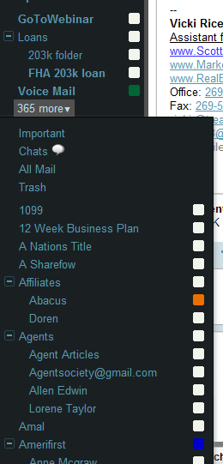
Side Labels
If You Would Like More

Slide 33
Multiple Email Addresses Within One Account
scottybud23@gmail.com
s.c.o.ttybud23@gmail.com
scottybud23@googlemail.com
scottybud23+whateveryouwant@gmail.com

Slide 35
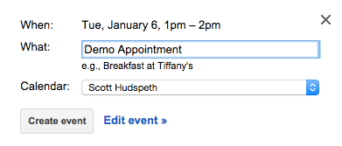
Google Calendar

Slide 36
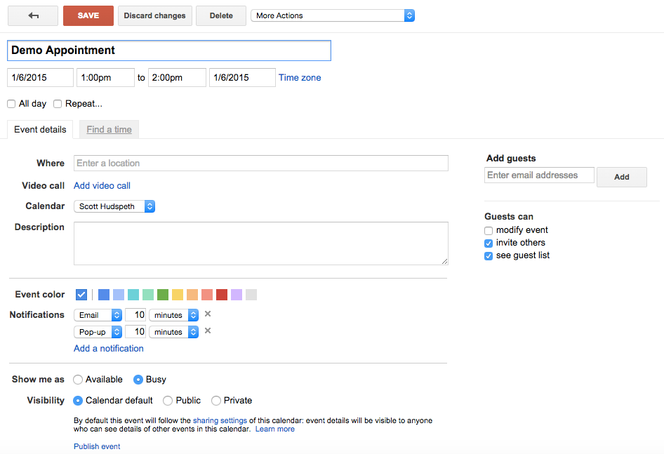

Slide 37
A Couple Gmail Cool Tricks And Apps

Slide 38
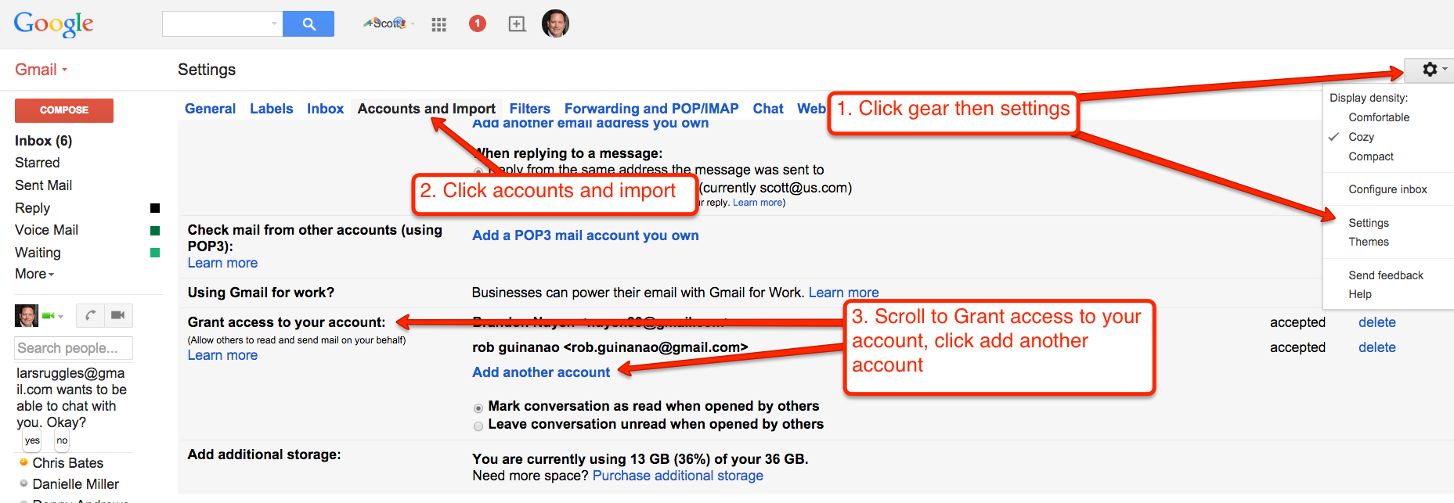
Share Your Account With Assistant

Slide 39
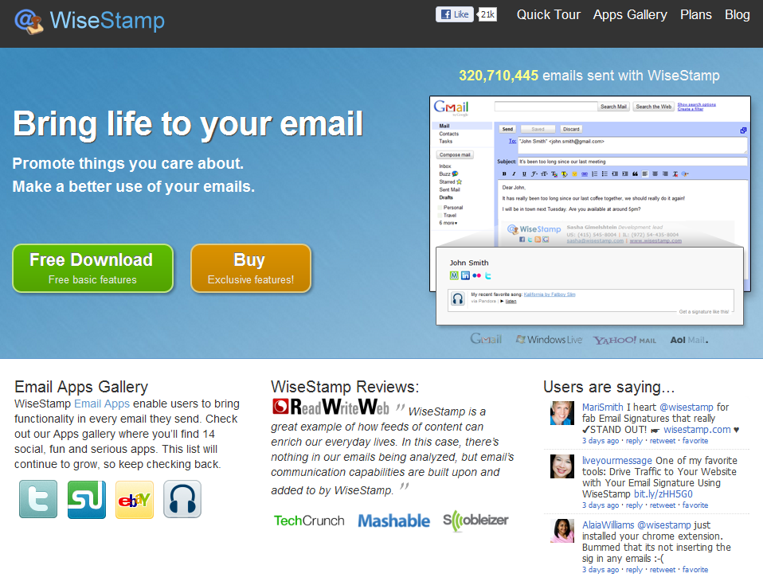

Slide 40
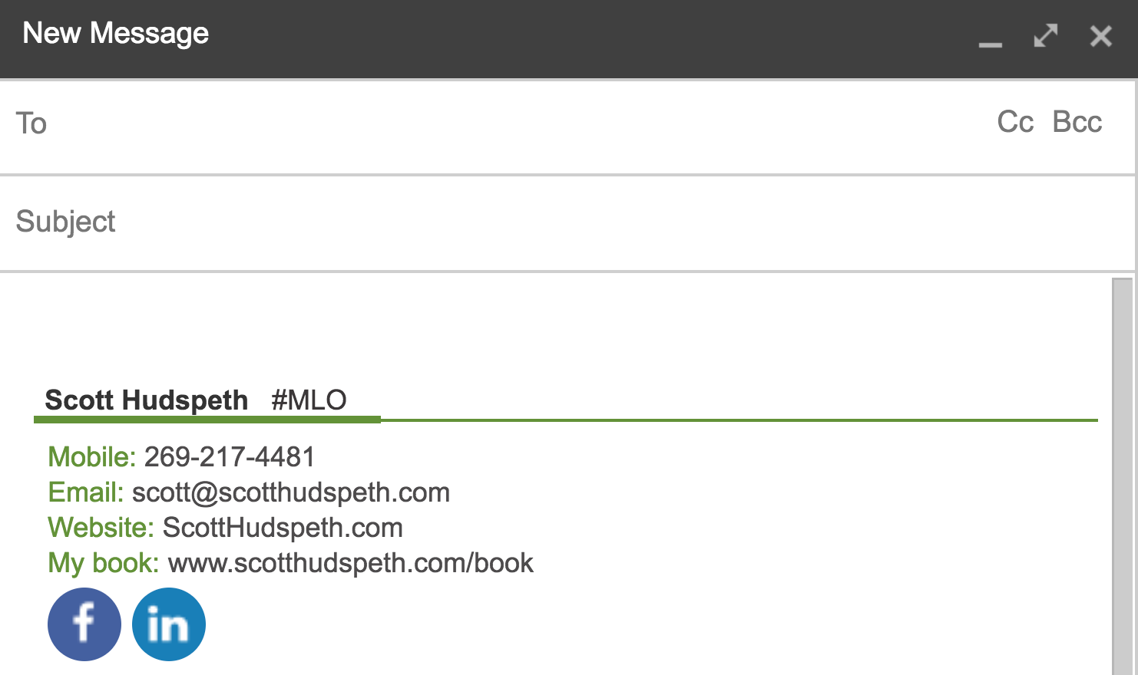
One Example

Slide 41
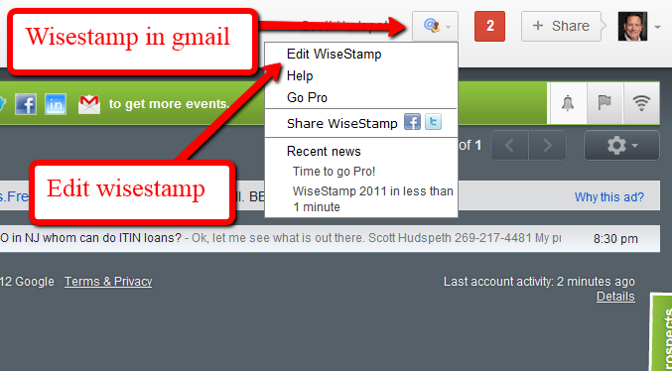
Edit WiseStamp.com After You Download

Slide 42
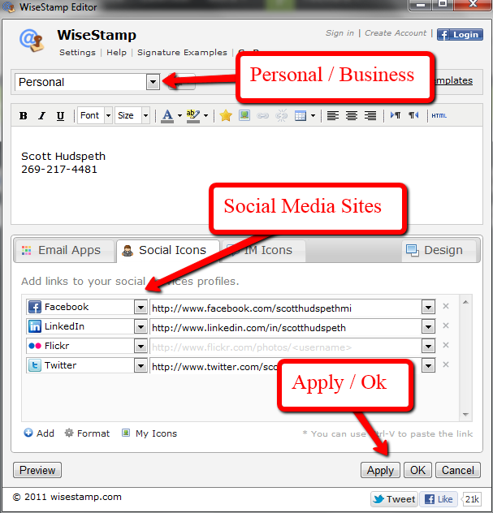

Slide 43
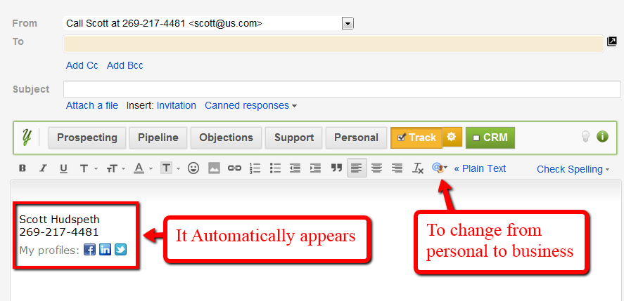

Slide 44
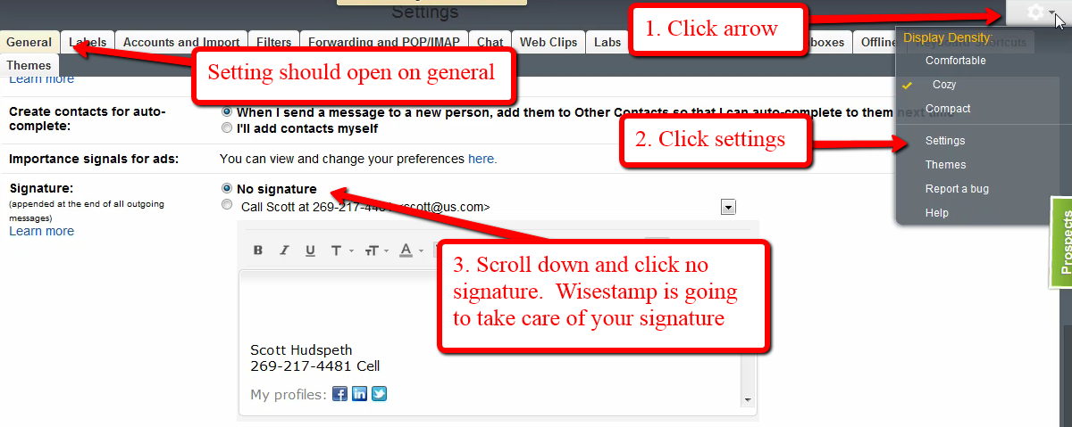

Slide 46
Send an email later
With Boomerang, you can write an email now and schedule it to be sent automatically at the perfect time. Just write the message as you normally would, then click the Send Later button. Use our handy calendar picker or our text box that understands language like "next Monday" to tell Boomerang when to send your message. We'll take it from there.
The best follow up reminders
Want a cleaner inbox, but don't want to lose track of important messages? Use Boomerang to take messages out of your inbox until you actually need them. Just click the Boomerang button when you have an email open, and choose when you need it again. Boomerang will archive the message. At the time you chose, we'll bring it back to your inbox, marked unread, starred, or even at the top of your message list.

Slide 47
Remind you if you don't hear back
There are times you need to make sure you follow up within a specific time frame after sending a message. You can select to only be reminded if nobody replies, or regardless. This way you won't let messages slip through the crack and will never forget to follow up with people.
Read receipts in Gmail to:
See how often readers are clicking links you send out
Make sure clients have received and viewed invoices
Find out when people are opening your emails

Slide 48
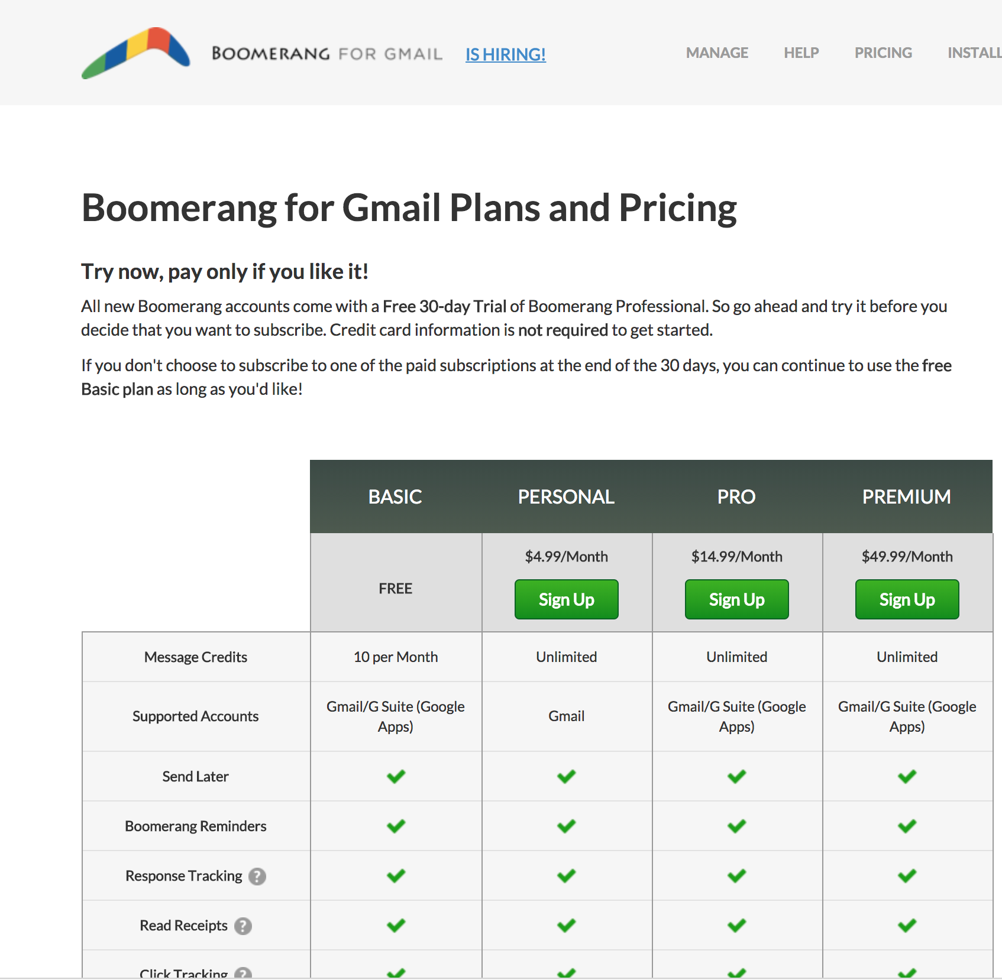

Slide 49
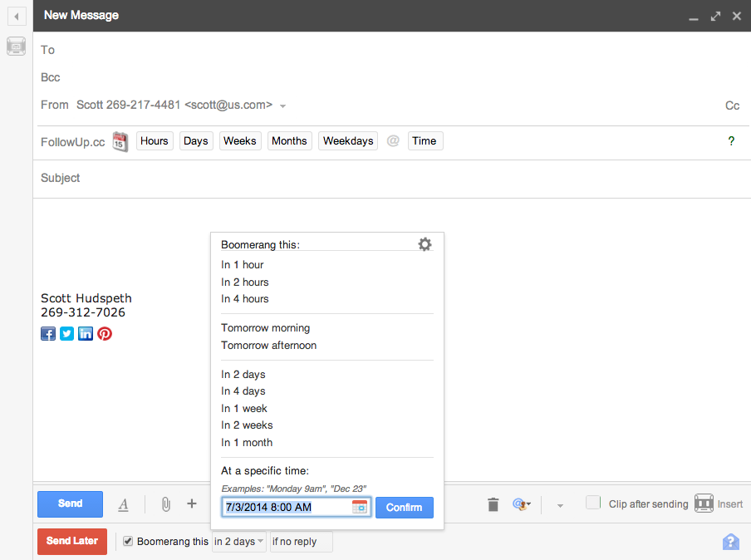

Slide 50
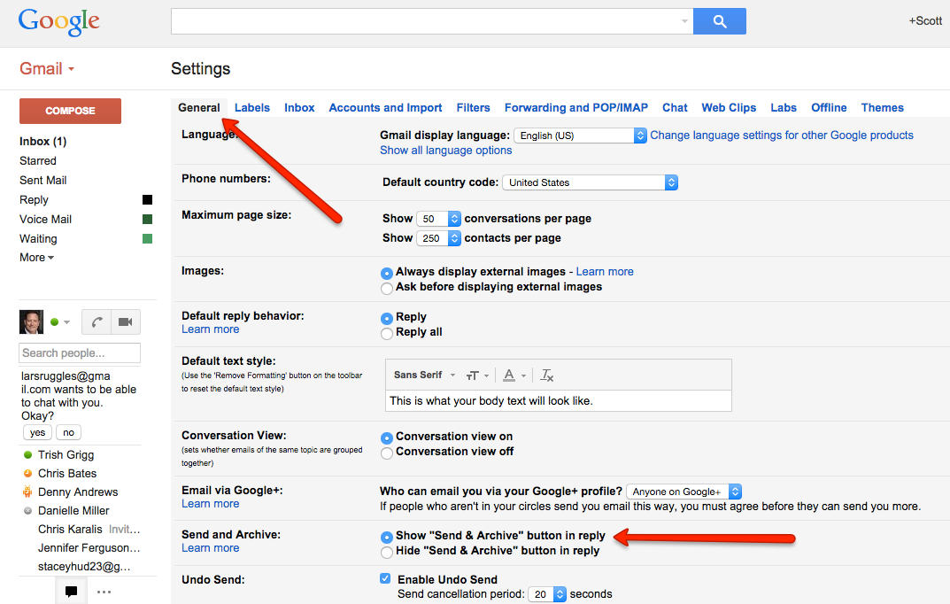
“Send & Archive”, Make Sure This Is On

Slide 51
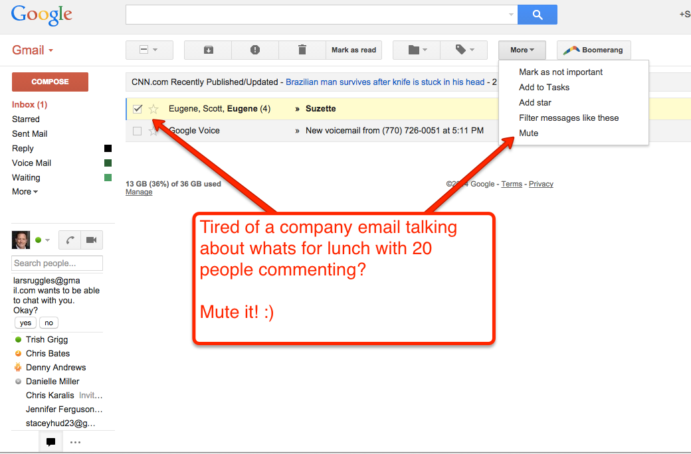
Tired Of An Email Chain

Slide 52
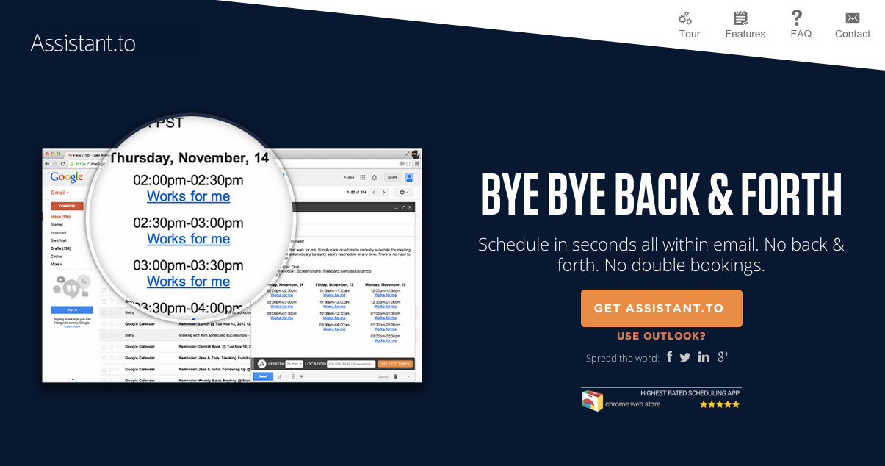
Love “Assistant.to”

Slide 53
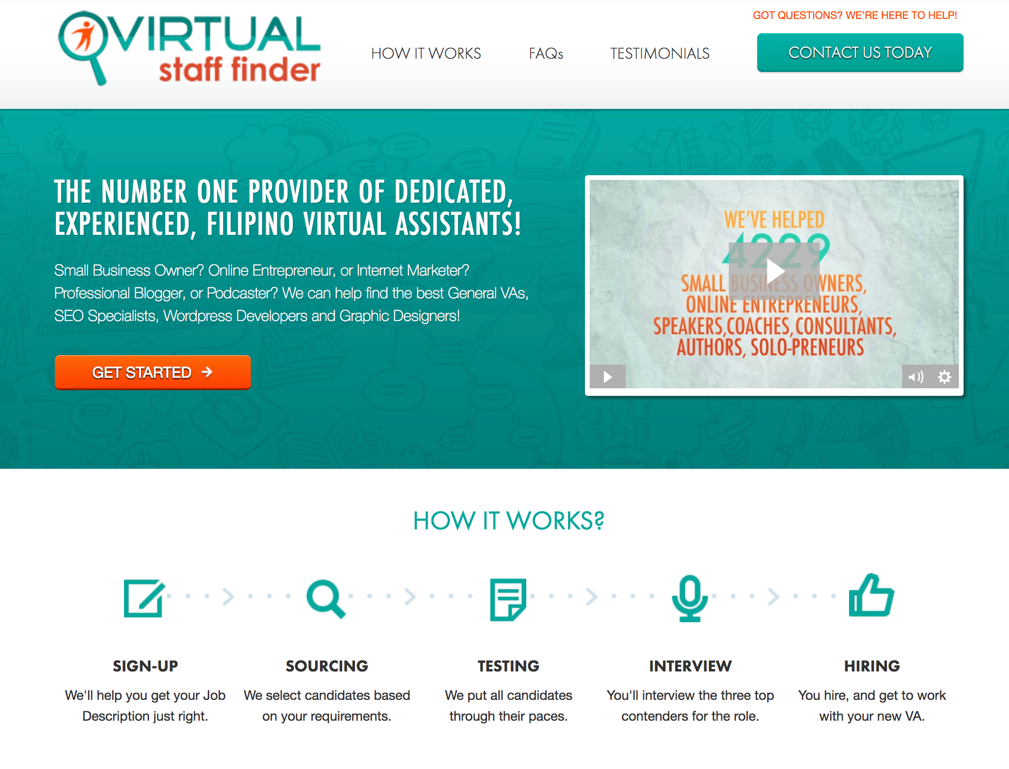

Slide 54
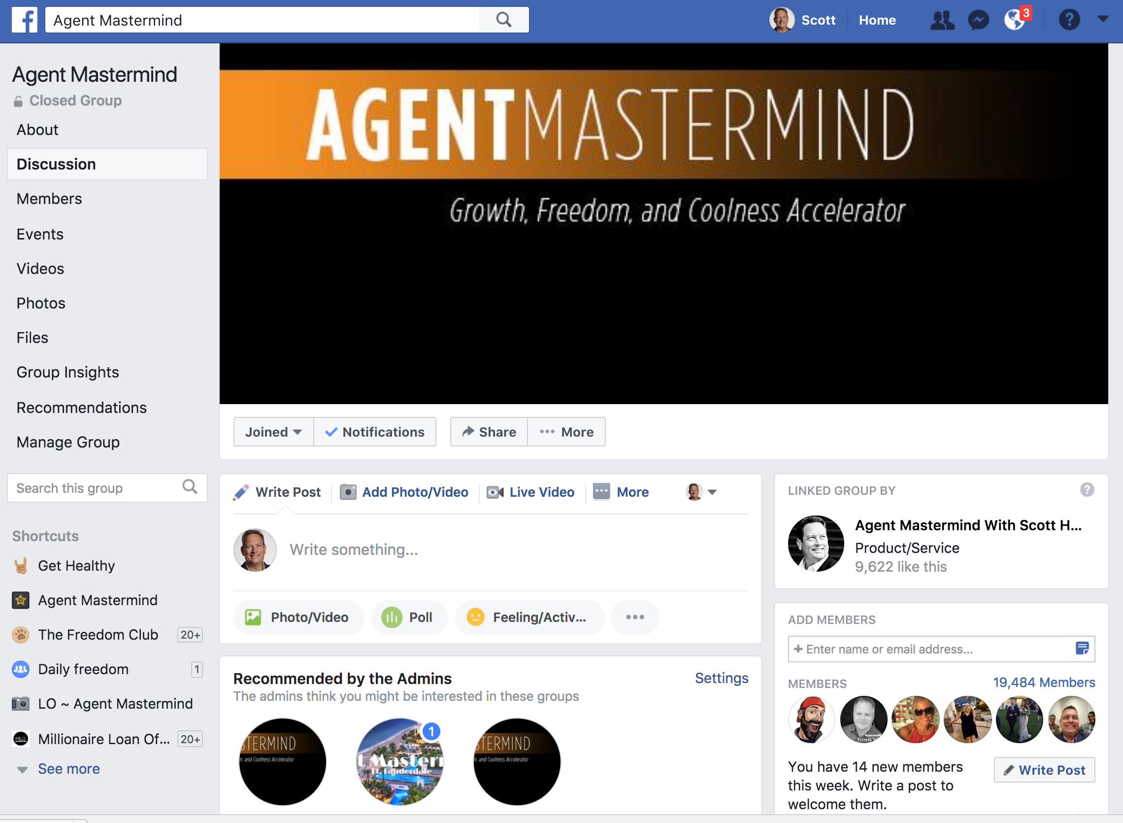
Join Our Private Facebook Group
www.facebook.com/groups/agentmastermind

