Slide 1
WOW

Slide 2
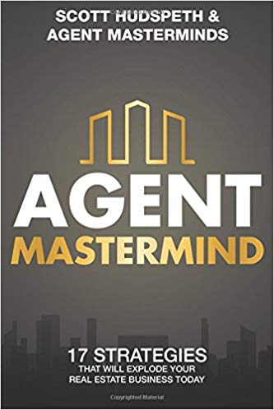
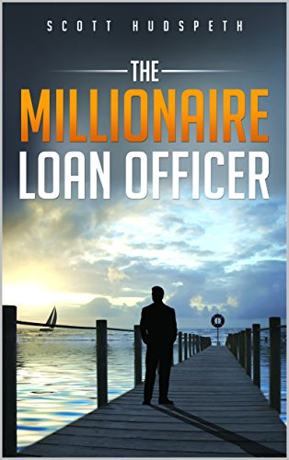
Christine Thank You So Much

Slide 3
My Amazing Family

Slide 4
WOW EXPERIENCE!
How many of you feel, in your heart of hearts, that you are delivering a WOW experience to your clients?

Slide 5
WOW
How many of you feel, like you are the Michael Jordan of your business?

Slide 6
How Do You Know?
So how do you know if You are delivering a WOW experience?

Slide 7
Are You Taking It For Granted
You may think you are delivering a WOW experience, but your clients are getting an OK experience, do you think there is a difference?
YES!

Slide 9
The Last 10
How many of the last 10 transactions do you feel you have earned the right to receive a referral from?
All Of Them Right?

Slide 10
How Many Referrals Did You Actually Receive?
What I hear 99% of the time
“0 or Maybe 1”

Slide 11
The Next 25 Minutes!
How to know and track if you are creating a WOW experience with your clients
How to average 3-4 referrals for every 10 closed transactions (Not Leads)
The C.A.R.E model to “Level Out The Seesaw”
Referrals or leads?
100% FREE to implement
How you can have referrals coming in as soon as tomorrow using moments of Gratitude

Slide 12
**C.A.R.E.**
“Creating A Referral Experience”

Slide 13
When People Come To Me!

Slide 14
Vivian Chen in 5 days!

Slide 15
10X
What would happened to your business if you 10X the number of referrals coming in?

Slide 16
What is the definition of a successful transaction?

Slide 17
Most Say
Closing on time
No one gets mad
Get full commission
Don’t get shopped
Don’t get fired
Get paid

Slide 18
New Definition Starting Today!
The true definition of a successful transaction
To have earned the right to ask and receive a referral BEFORE closing.

Slide 19
Monica Breckenridge
Recipient of Inc.5000 Award 2018 with only 12% Women Owned business's
Top 4 Real Estate Agent Nationwide in 2017 - Wall Street Journal
Currently writing the book, "Think Pink and Grow Rich: Building Your Own Empire Through Branding and Marketing"

Slide 20
What Makes You Referable?
Go

Slide 21
What We Hear!
Designation
Year of experience
Company
Attire
Honesty
Availability
Hardworking

Slide 22
How To Start This Tomorrow
I am changing your job title as of right now! ☺
Consultant
Project Manager
Master Communicator!

Slide 23
Make It About Them!
Makes the client feel important, appreciated and always #1
Remove the I from the equation
Sorry to say people don’t care about you, they care about what?
My daughter and her apartment story!
People don’t care what you say or what you do, they only care about how you make them feel!
Group Photo!

Slide 24
Using your new job titles to WIN over your clients and receive more referrals instantly
Do this and your business will never be the same!

Slide 25
How To Average 3-4 Referrals For Every 10 Transactions
Consultant / 1%
Project Manager / 1%
Master Communicator / 1%

Slide 26
Let me share with you how my team and I work!

Slide 27
Consultant / 1%
Problem - Automation, go through the motions
Mr. Roboto
Clients – Goals, Dreams, Desires, Wants and Needs
Script – One of the things I want to be very clear on before we do anything are your goals, dreams, desires, wants and needs

Slide 28
Project Manager / 1%
Wedding Coordinator / Building a home
Script - No less than 30 people will touch your file, as many as 100 things can go wrong, my team and I will be here through the whole process to make sure you have an amazing experience as your project manager
A lot of companies go through the motions being they have done it 1000 times, we look at it like a wedding, its specific and special to you and your family and needs to be treated as such. No one person is the same so why should your mortgage or mortgage experience be?

Slide 29
Master Communicator 1%
Moving Company Friday night at 5:00 pm
You will have fears and expectations and those might change as we move closer to the closing.
I want to be here to communicate with you how you want to be communicated with. The biggest fear of all is not closing on time, or even worse getting to the closing table and having something wrong.
That won’t happen on my watch if I always know and am aware of your fears and expectations.

Slide 30
My Goal (Client)

Slide 32
Listen for Moments of Gratitude And Then Ask for The Referral!

Slide 33
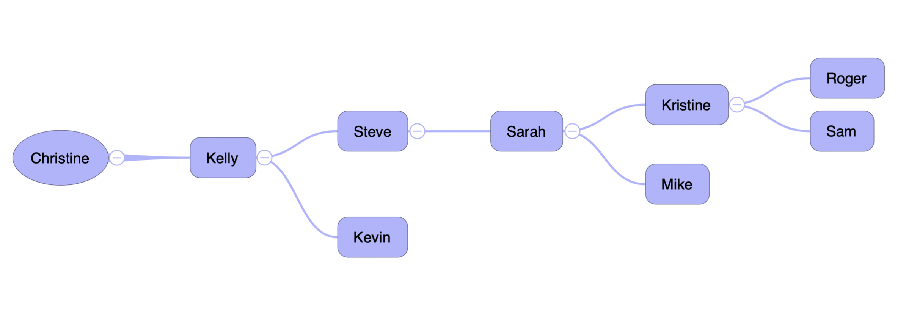
Want Even More Referrals?
Go Back, Please Go Back

Slide 34
I Wish I Had More Time Christine Thank You So Much!
Scott Hudspeth
www.TalkWithScotty.com
scott@scotthudspeth.com
www.facebook.com/scotthudspethmi
Or just Google Scott Hudspeth ☺

