Slide 1
Presentation With Scott Hudspeth
Matt CavanaUGH
A systems approach to Working less and Keeping More

Slide 2
Today’s Purpose
To Provide as much value as I possibly can… I want you to be inspired and be able to take away a few key things that you can immediately do to grow your business.
I want you to be able to make massive improvements in your business that don’t require you to spend any money!

Slide 3
Matt Cavanaugh
Teacher for 2 years
Wife was scared to death of me leaving
3 ½ Years in Corporate Sales
Left Corporate Job March 2015

Slide 4
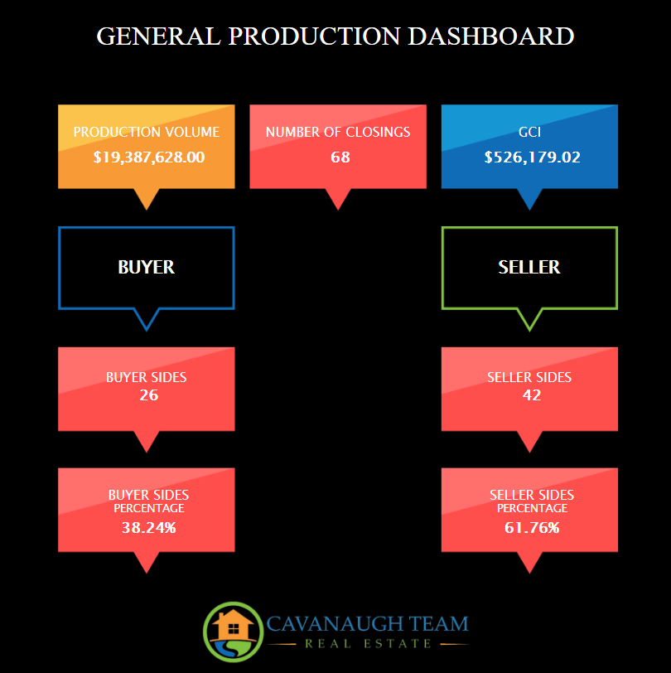
Matt Cavanaugh
Teacher for 2 years
Wife was scared to death of me leaving
3 ½ Years in Corporate Sales
Left Corporate Job March 2015
2015 RE Numbers
26 Sides
8.17M Volume
$220,000 GCI

Slide 5
2016 Goal
Build A Team
Install Systems
By End of 2016 - have A business that doesn’t require me in production

Slide 6
Team Structure
Matt Cavanaugh – CEO/Team Lead
Director Of Operations
Listing Agent
ISA
Buyers Agent/Showing Assistant
Agent/ Spanish Speaker
2 Admin VA’s (Overseas)
2 Programmers
1 – Part time Graphic Designer

Slide 7
Why Are Systems SOO IMPORTANT
Ask yourself this question

Slide 8
Systems Approach
I am going to cover the process that we go through in order to create our training, systems and processes and how it saves us tremendous amounts of time.

Slide 9
How to Build Systems
Make a list of everything you do in a day…
For example
Input A listing
Send out Flyers
Make Prospecting Calls
Chat with Sphere on Facebook
Record Everything You Do!
ScreenCast O Matic

Slide 10
How to Organize Systems
https://docs.google.com/document/d/1cR-xQBKgrTmpZLdrAftpE7v2PSBG-LOFk6Njz4Gg3FM/edit

Slide 11
How to use Those Systems to Create Massive Leverage in Your Business
Checklists
Training Manuals
Value Propositions
Marketing Material For Future Clients

Slide 12
Time/Money Continuum
Most Real Estate Agents/Loan Originators start their businesses with lots of time and NO money…
As they become successful agents begin to start using money to buy back their time….

Slide 13
Vote Today for Your Future
The choice you make on who you vote for in today’s election will make an insignificant difference in your lives COMPARED to the decision you make today on what you will do with the information that we covered.
NOTHING will impact your future more than your decision to map out your life and live it to the full.

Slide 14
Ways to Reach Out
Coaching and information about Upcoming Software Products and Launches:
Email: coaching@teamcavanaugh.com
Cell: 209 202 4678

