Slide 1
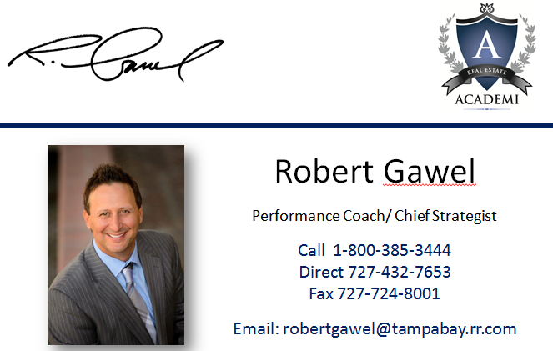
10 Reasons Real Estate Agents Fail & 6 Basic Skills for Success

Slide 2
Today’s Workshop
Introduction
Top 10 reason’s why most real estate agents fail
6 basic skills for real estate success
How to get to the next level
What we do

Slide 3
Introduction

Slide 4
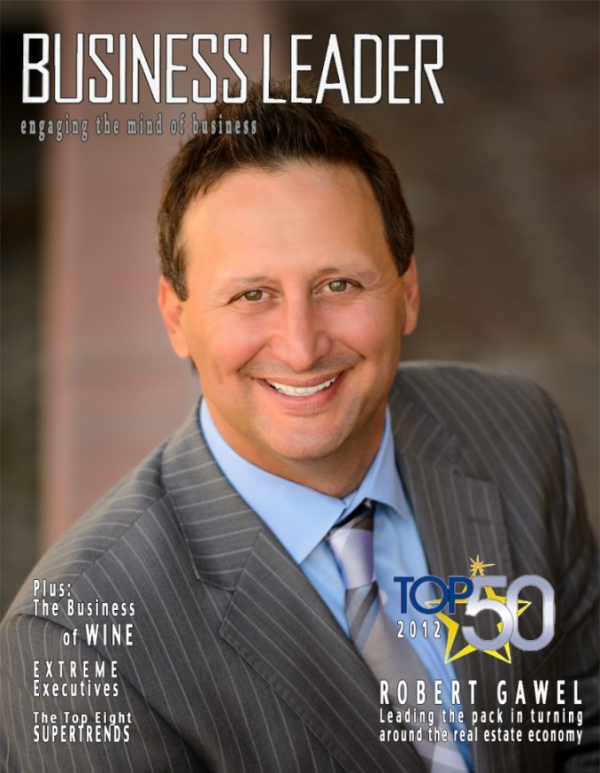
Real Estate Experience
Licensed October 19th, 1998
Broker License in since 2002
Training & Mentoring 12 years now
Sold/ closed over 1,200 homes / $250M

Slide 5
Video Marketing & BP Claims

Slide 6
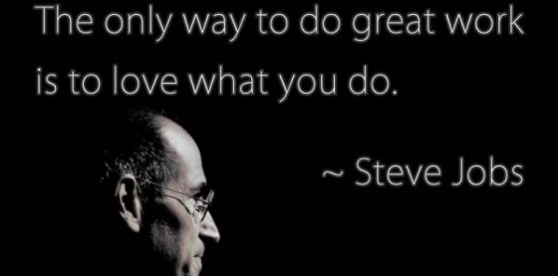
The Interview

Slide 7
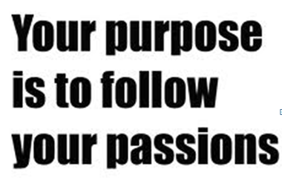
My Passion
Do what you love
Do great work
Paid well

Slide 8
What Does This Mean?

Slide 9
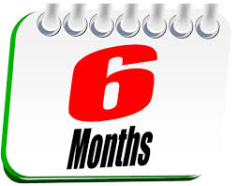
10 Reasons
I quit…I might be dead!
I just got my license!
After a decade… My top 10 reasons most agents fail

Slide 10
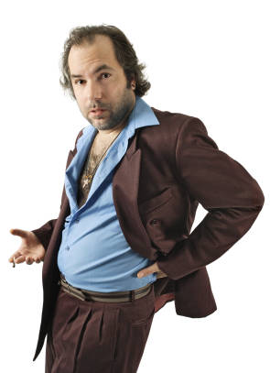
#1 Unrealistic Expectations
I became a Realtor because…
I like looking at houses
My Realtor was lousy
I love to watch HGTV
Easy money
…Why do I sell Real Estate?

Slide 11
#2 No Plan
No direction, systems or structure…NO PLAN!
Do you have a weekly activity plan?
What systems are in place?
Working in your business?
Working on your business?

Slide 12
John Maxwell Quote
“You’ll never change your life until you change something you do daily.
The secret of your success is found
in your daily routine”
John C. Maxwell

Slide 13
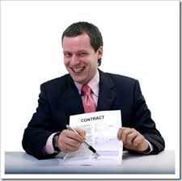
#3 Don’t Run Like a Biz
“I run a business”
“ I sell houses”

Slide 14
Question?
What business are you in?

Slide 15
#4 No Investment
What do you invest?
How many hours?
Are those quality hours?
How much money?
Do you have a website?
Do you have a leads system?

Slide 16
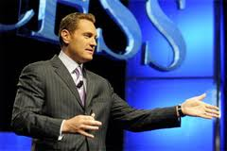
Interview
Negotiate a contracts
Go on Listing Appointments
Prospecting

Slide 17
#5 No Re-Investment
When you make it…
…how will you spend it?

Slide 18
#6 Lack of Commitment
Are you interested or committed?
The difference between INTEREST & COMMITMENT.
When you’re interested in doing something, you do it only when it’s convenient.
When you’re committed to something, you accept no excuses, only results!
Kenneth Blanchard

Slide 19
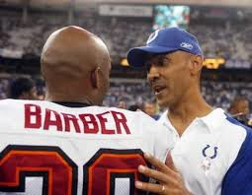
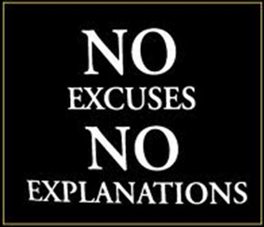
#7 The 2 E’s

Slide 20
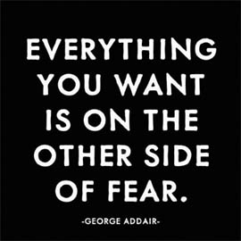
#8 Fear of ????
What if I get hung up on
What if the invite me over
What if they say NO
What if they say yes
What if I fail
What if I look stupid

Slide 21
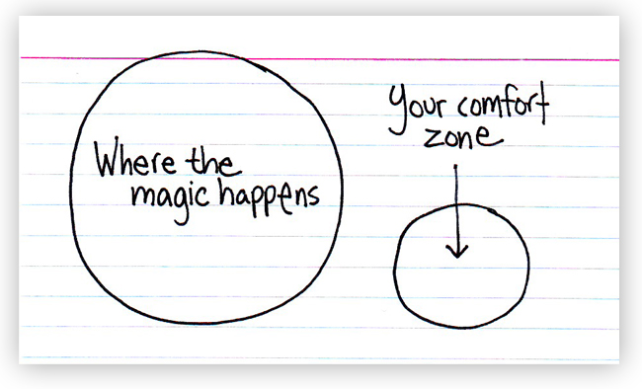
Step out of Comfort Zone

Slide 22
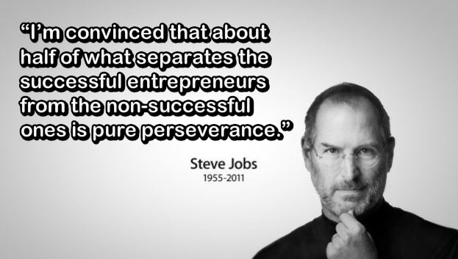
#9 No Perseverance

Slide 23
#10 Run out of Money
Every 30 days we are faced with…
Mortgage/ Rent
Electric Bill
Cable/ Phone/ Internet
Auto/Insurance
Gas, Food
Kids

Slide 24
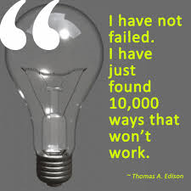
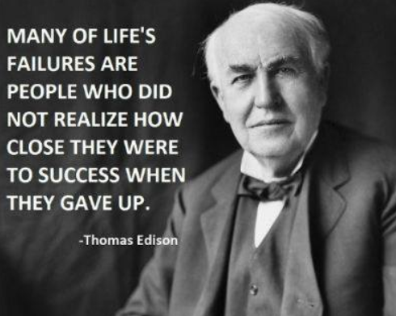
Don’t be a Quitter

Slide 25
6 Core Skills
“Don’t try to sell a house…build a business”
Lead Generation
Database Management
Prospecting
Presentation
Follow up
Handling Objections

Slide 26
Why is Lead Generation #1?
Leads is the Gas that drives the car!

Slide 27
Lead Generation Issues
Don’t know how to generate leads
Don’t have a clear lead strategy
Do what they see other agents doing
Waste money
Don’t want to spend the money

Slide 28
Lead generation
You call them or they call you
How many leads do you generate in a week?
Leads (ROI)
Do you have a budget to generate leads?
What’s working…what’s not?

Slide 29
Database Management
Do you have a database
How many contacts do you have?
Can your database perform email campaigns?
How often do you contact your database?
What do you send to your database?

Slide 30
Prospecting
Time block 4 to 6 hours for prospecting
Do you have enough quality leads?
Do the work and track your results
Build in systems
Stay committed to it
Don’t take things personally
Everybody fails

Slide 31
Presentations Skills
Is your listing presentation automated?
Do you practice it?
How many appointments per week?
Do you show up prepared?
Is your presentation Verbal, Visual & Interactive

Slide 32
Handling Objections
Understand the situation
Ask the right questions
Dig deep
Search to find a problem
Offer a better solution
Write down the objections you cannot handle

Slide 33
Follow up
How often should I follow up? (Dr. Seuss)
What do I say when I follow up?
Can I follow up by emails?
Follow up with everybody even the ones you loose!
Track your failures
MY Follow up System is: Send, Call, See

Slide 34
A Recent Study
44% of salespeople quit after the 1st time they hear NO
22% of salespeople quit after the 2nd time they hear NO
14% of salespeople quit after the 3rd time they hear NO
12% of salespeople quit after the 4th time they hear NO
92% of salespeople quit - 1st and 4th time they hear NO
60% of sales close after prospect says NO at least 4 times
8% of salespeople are left when the prospect is ready to say YES

Slide 35
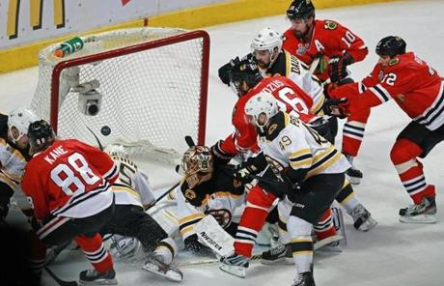
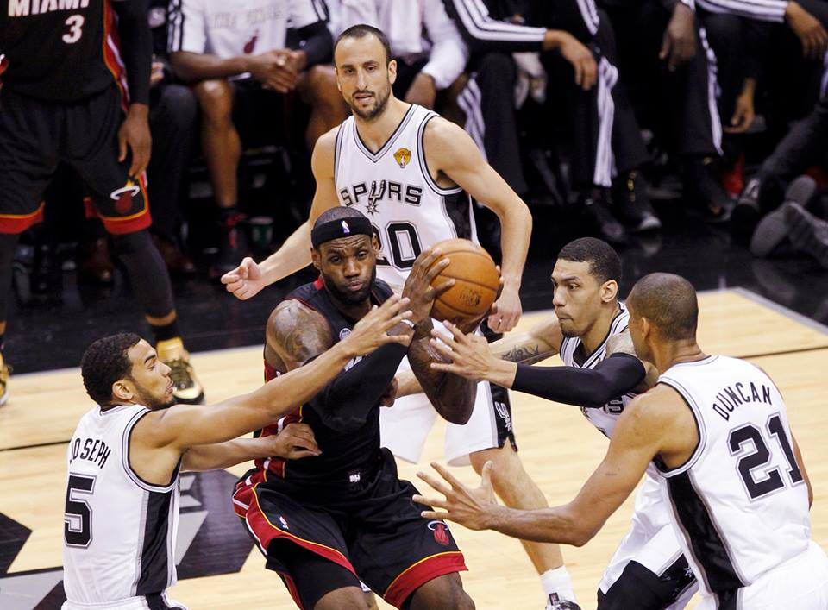
Rebounding Wins Championships
Game 2 - 2013 Stanley Cup
Game 4 - 2013 NBA Finals
Because the first shot rarely goes in!

Slide 36
Realtor Report Card
Rate: A, B, C, D, F for the following:
Lead Generation A B C D F
Database A B C D F
Prospecting A B C D F
Presentation Skills A B C D F
Closing Skills A B C D F
Follow Up System A B C D F

Slide 37
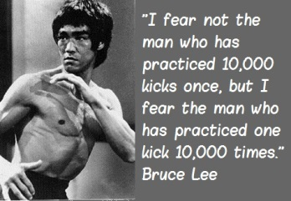
How Do I Succeed

Slide 38
Plan Going Forward
I will master the basics

Slide 39
FREE GIFT
Real Estate Academi is offering
FREE Workshops every Monday in February (11am to 12pm)
1- 30 Minute 1-on-1 strategy session
4 Favorite FSBO Scripts…WORK!
Email: INFO@REALESTATEACADEMI.COM
Call: 1-800-385-3444 (General Mailbox)

Slide 40
Think about this
What if you hired a coach
Trained like this every week
1-on-1 strategy sessions
Could it result in just 1 more sale per year
1- $79K Sale to $199K could pay for your personal coach all year!

Slide 41
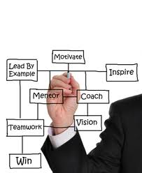
What WE DO?
Hold over 40 live training events online
Focus on mastering the 6 basic skills
Life balance and accountability
Private 1-on-1 coaching
Video marketing training
Professional editing services
24/7 Access to training library

Slide 42
Questions?

Slide 43
Contact Info
Robert Gawel
Performance Coach & Chief Strategist
1-800-385-3444
info@realestateacademi.com

