Slide 1

Reaching Your Database
We are in the “Marketing to our Database” business, NOT the “Real Estate Business”

Slide 2
Stats from the NAR:
74% of people said they would use the same agent again.
In reality, Only 24% actually did.
WHY???
If there’s no follow-up, people forget about you.
©The Marketing Animals 2023
.

Slide 3


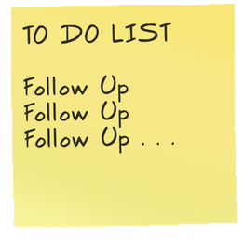
Marketing To Your Database
Call 4 Times/Year –
Email Automatically 1/Week
Snail Mail 1/Month
Text 1-2/Year

Slide 4
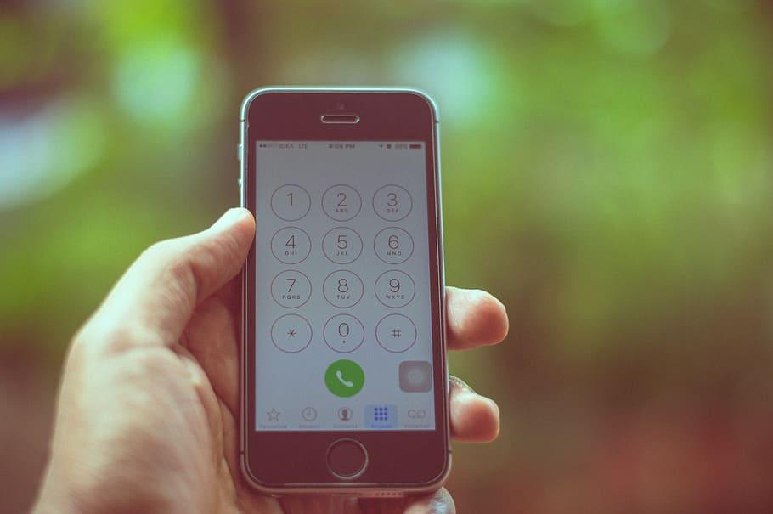
Calling Your Database of Past Clients
Four Times Per Year with Script
Live Calls from You
Phoneburnerfreedom.com
Freedom Caller (Assistant)
Call 2 letters of the alphabet per week, then lather, rinse, repeat!
©The Marketing Animals 2023
.

Slide 5
Call 4 Times/Year
“Hey this is <insert name> from <insert company>. I helped you with buy/sell your home. I just wanted to give you a quick call and say thanks for letting me help you. If you ever have any real estate questions, or would like a report on home prices in your neighborhood please give me a call. By the way, I was just looking at some home values in your area and I think you will be pleased with what I have to show you. The best number to reach me at is <insert phone number>. Hope all is well, and look forward to catching up soon. And if you have any friends or family members that could use some honest help, I hope I can count on you to tell them about me. Thanks so much and we’ll talk soon. Bye.”
(Voicemail Script 70% of the Time)

Slide 6
Call 4 Times/Year
“Hey this is <insert name> from <insert company>. I helped you buy/sell your home. I just wanted to give you a quick call and say thanks for letting me help you. How are you guys doing? <pause for answer and give an appropriate response>
Well I know you are really busy so I don’t want to keep you too long. Is there anything you need help with? <pause for answer and give an appropriate response>
Before I let you go, do you have any friends or family members that are looking to buy or sell a home? <pause for answer (usually the answer is no)>. Can I ask you a huge favor? <pause for yes>
Can I count on you to give me a call when you do? <pause for yes>
Thank you so much. Have an amazing rest of your day. Bye.”
(Live Answer)

Slide 7
Other Subjects:
Client Appreciation Month
Free CMA
Event you are hosting
Happy Holidays
©The Marketing Animals 2023
.

Slide 8

What About People That You Haven’t Spoken To In A Few Years?
People think about you a whole lot less than you think they do. Just call them!!
(If the person who sold you your last car hadn’t spoken to you in four years and then called and said “How’s that car treating you, would you be mad?)
Your clients are probably not
sitting around depressed waiting
for the phone to ring.

Slide 9
If you have more than 300 people in your database:
Use PhoneburnerFreedom.com
Imagine what your business would look like if you made an additional 300 calls a month, and it all took about an 1 hour a week!!!!
©The Marketing Animals 2023
.

Slide 10
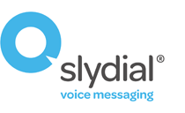

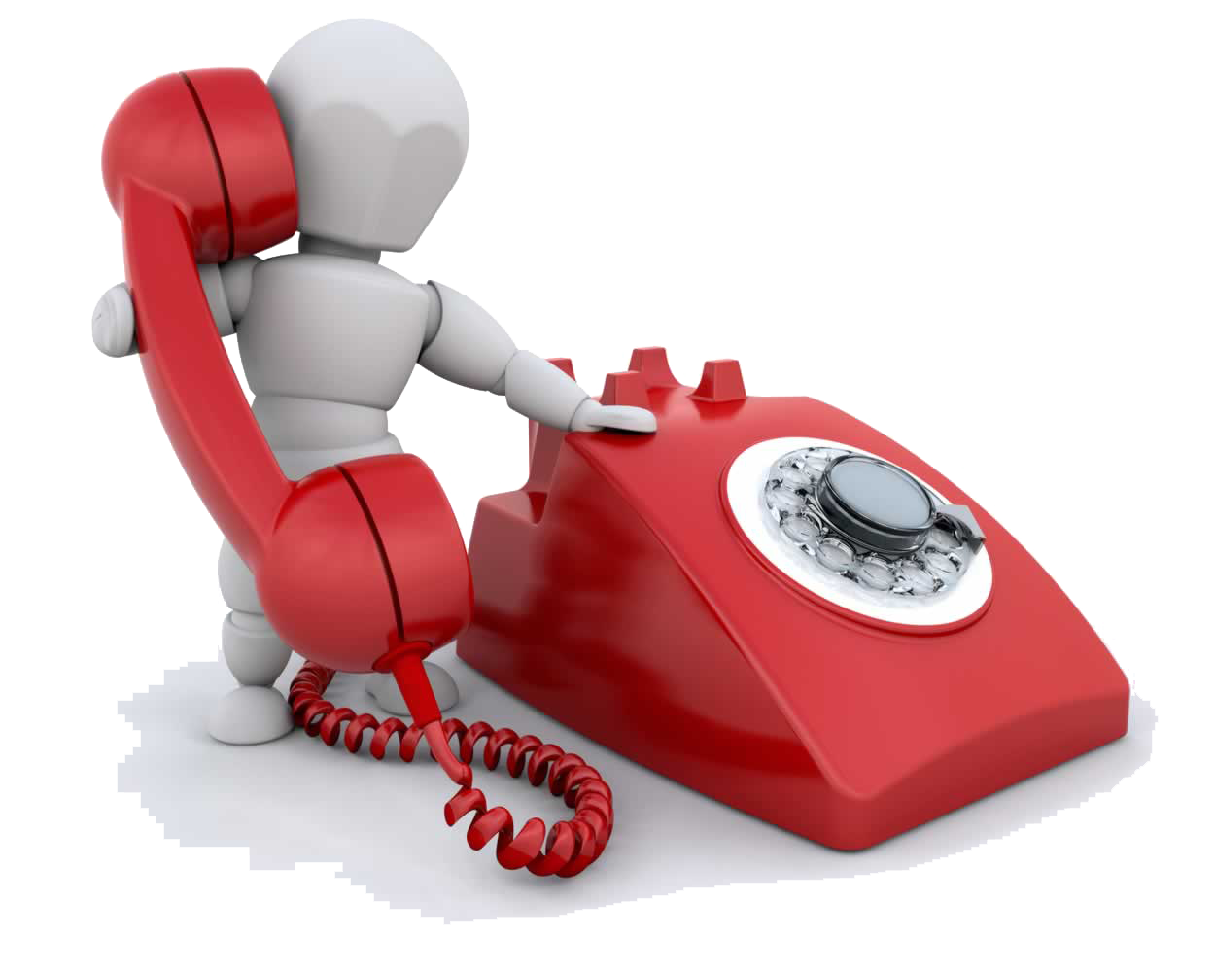

Don’t Have Time to Talk?
Just leave a message! (It skips their inbox and goes right to voicemail!). Use sparingly.
Use SlyDial (one at a time) Or SlyBroadcast (many)
Database

Slide 11
Snail Mail Once a Month
I like you
Superman letter (you saved the day)
Recipe Card
Gardening Tip
I’m a real person, just like you (family newsletter)
Holiday Cards

Slide 12

I Like You
Joe Girard — #1 car sales for 12 years in a row
“D’ya know that I sent out over 13,000 cards every month? And every one of them said, “I like you… Happy Fourth of July,” or “I like you… Happy Thanksgiving.” There’s nothin’ else on the card. Nothin’ but my name. I’m just telling ‘em that I like ‘em.”
©The Marketing Animals 2023
.

Slide 13


Slide 14


Slide 15
Can’t write 300 notes?
Hand write with blue gel ink 4 times in each quadrant of 8 ½ x11 paper
Print on color copier
Print on pale cardstock
Hire someone to address the envelopes
©The Marketing Animals 2023
.

Slide 16
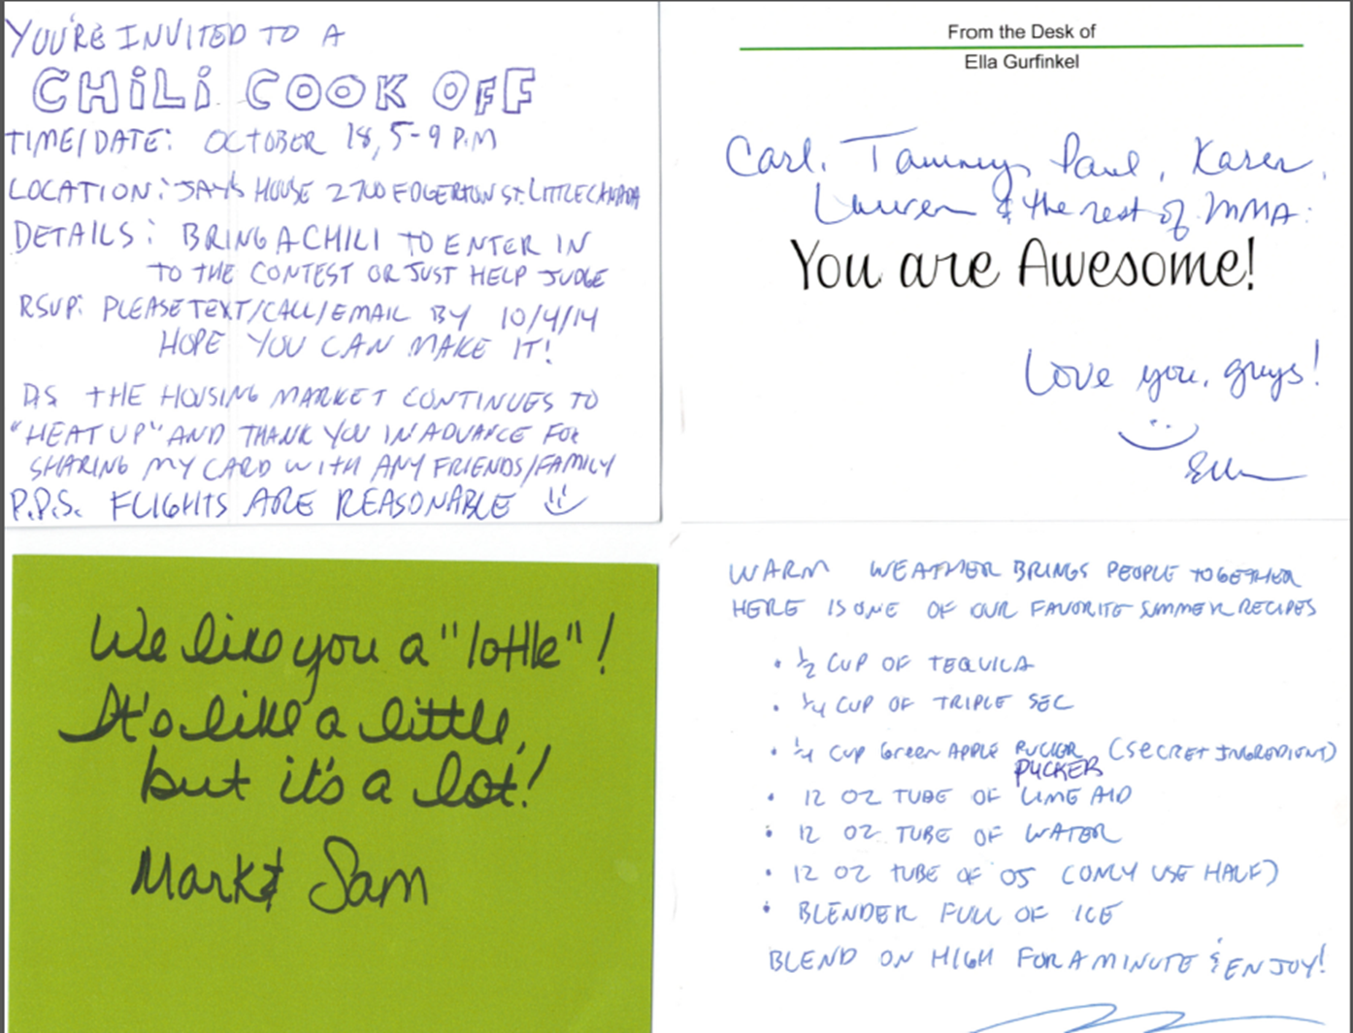
Examples

Slide 17

Email Your Database Once Per Week
Don’t send Real Estate info ALL the time (it’s boring)
Video Marketing -What’s happening in Your Area or a tip
Use your Smartphone
No editing
Short call to action at the very end
(Here’s what I got, here’s how it helps, here’s what I want you to do next)

Slide 18


Text them
Birthday
Holidays
Anniversary of their closing
New home that came on the market in their neighborhood
“Thinking of you.”

Slide 19
Social Media
Custom Audience – Tips, houses in area, motivational, videos
Direct Message – Congrats, sympathy, birthday, etc.

Slide 20
REACHING YOUR DATABASE RECAP:
Call 3 Times a year
Snail Mail Once a month
Email Automatically once a week
Text Message 1 to 2 times per year
Social Media often 2-7 times per week
©The Marketing Animals 2023
.

Slide 21
Results
1 closing for every 100 people in your database

