Slide 1
The Subtle Art of being Referable
The mindset of getting more while doing less

Slide 2
People Matter!! As we become more like the jetsons, the businesses that act like the flintstones will win!

Slide 3
3 questions to ask ourselves daily
How do you define a successful closing?
Would you prefer to work with a lead or a referral?
Why are you referable?
Closes on time,
Get paid
Buyer/Seller are happy
Don’t reduce my commission
Home Sells for List Price
a referral before closing!
Everyone says: A referral
Trust, relationship, value, ease of connecting, respect, honesty
Leads you have to pay for…..Referrals are
FREE
Designations, honesty, hardworking, available 24/7, been in the business for XXX time, broker affiliation, market knowledge, Returns calls, responds to voicemails, great service.
Instead: Aren’t we all
Consultants
Negotiators
Managers of fears & expectations

Slide 4
20/60/20 Rule
The Ingredients of a “JUST ASKing” Approach
Setting the stage up front
The Power of the “THANK YOU”
How many times a day do we hear “Thank you” or any kind of appreciation from our clients?
Setting the stage + Being an awesome Agent + Please don’t keep me a secret =
60% increase in referrals

Slide 5
So what is it, our goals or thiers?
We need to create an experience that orchestrates moments to ask for new business during the process.
We must bring value to our conversations

Slide 6
How you elevate yourself
Step 1. Building Rapport – Who said what about you?
Step 2. Have a specific presentation about how you work and why it’s a benefit to them
Step 3. Make sure you know your Value Proposition – Traingle of Trust
Step 4. Create balance in the relationship – Be a Consultant not a sales person
Step 5. Manage and set Expectations
Step 6. The commitment to work together

Slide 7
#1 question to always ask
What did “Jack and Jill”, have to say about me that prompted you call me?

Slide 8
3 things you get paid to do
Be a consultant
Be a negotiator
Be a manager of fears and expectations

Slide 9
Leveraging your current relationships
The Source
TRIANGLE OF TRUST
You
The cleint

Slide 10
Give them permission to reject you
The Beauty of the Take-away
Want vs. need based conversation
It’s ok if you or I don’t think we are a good fit for eachother

Slide 11
The Buyer/Borrower: 1. Submits incorrect information to the lender. 2. Has recent late payments on credit report. 3. Found out about additional debt after loan application. 4. Borrower loses job. 5. Co-borrower loses job. 6. Income verification lower than what was stated on loan application. 7. Overtime income not allowed by underwriter for qualifying. 8. Applicant makes large purchase on credit before closing. 9. Illness, injury, divorce or other financial setback during the process. 10. Lacks motivation. 11. Gift donor changes mind. 12. Cannot locate divorce decree. 13. Cannot locate petition or discharge of bankruptcy. 14. Cannot locate tax returns. 15. Cannot locate bank statements. 16. Difficulty in obtaining verification of rent. 17. Interest rate increases and borrower no longer qualifies. 18. Loan program changes with higher rates, points and fees. 19. Child support not disclosed on application. 20. Borrower is a foreign national. 21. Bankruptcy within the last 2 years. 22. Mortgage payment is double the previous housing payment. 23. Borrower/co-borrower does not have steady 2-year employment history. 24. Borrower brings in handwritten pay stubs. 25. Borrower switches to job requiring probation period just before closing. 26. Borrower switches to job from salary to 100% commission income. 27. Borrower/co-borrower/seller dies. 28. Family members or friends do not like the home buyer chooses. 29. Buyer feels the house is misrepresented. 30. Veterans DD214 form not available. 31. Buyer has spent money needed for down payment and closing costs and comes up short at closing. 32. Buyer does not properly "paper trail" additional money that comes from gifts, loans, etc. 33. Does not bring cashier’s check to title company for closing costs and down payment.
The Seller: 34. Loses motivation to sell (job transfer does not go through, reconciles marriage, etc.) 35. Cannot find a suitable replacement property. 36. Will not allow appraiser inside home. 37. Will not allow inspectors inside home in a timely manner. 38. Removes property from the premises the buyer believed was included. 39. Is unable to clear up liens against their property – short on cash to close. 40. Did not own 100% of property as previously disclosed. 41. Thought getting partners signatures were "no problem," but they were. 42. Leaves town without giving anyone Power of Attorney. 43. Delays the projected move-out date. 44. Did not complete the repairs agreed to in contract. 45. Seller’s home goes into foreclosure during the process. 46. Misrepresents information about home & neighborhood to the buyer.
47. Does not disclose all hidden or unknown defects and they are subsequently discovered. 48. Builder miscalculates completion date of new home. 49. Builder has too many cost overruns. 50. Final inspection on new home does not pass. 51. Seller does not appear for closing and won’t sign papers.
The Realtor(s): 52. Have no client control over buyers or sellers. 53. Delays access to property for inspection and appraisals. 54. Unfamiliar with their client’s financial position – do they have enough equity to sell, etc. 55. Does not get completed paperwork to the lender in time. 56. Inexperienced in this type of property transaction. 57. Takes unexpected time off during transaction and can’t be reached. 58. Jerks around other parties to the transaction – has huge ego. 59. Does not do sufficient homework on their clients or the property and wastes everyone’s time.
The Property: 60. County will not approve septic system or well. 61. Termite report reveals substantial damage and seller is not willing to fix or repair. 62. Home was misrepresented as to size and condition. 63. Home is destroyed prior to closing. 64. Home not structurally sound. 65. Home is uninsurable for homeowners insurance. 66. Property incorrectly zoned. 67. Portion of home sits on neighbors property. 68. Unique home and comparable properties for appraisal difficult to find.
The Title Company: 69. Fails to notify lender/agents of unsigned or unreturned documents. 70. Fails to obtain information from beneficiaries, lien holders, insurance companies, or lenders in a timely manner. 71. Lets principals leave town without getting all necessary signatures. 72. Loses or incorrectly prepares paperwork. 73. Does not pass on valuable information quickly enough. 74. Does not coordinate well, so that many items can be done simultaneously. 75. Does not bend the rules on small problems. 76. Does not find liens or any title problems until the last minute.
The Appraiser: 77. Is not local and misunderstands the market. 78. Is too busy to complete the appraisal on schedule. 79. No comparable sales are available. 80. Makes important mistakes on appraisal and brings in value too low. 81. Lender requires a second or "review" appraisal.
Inspectors: 82. Pest inspector too busy to schedule inspection when needed. 83. Inspector too picky about condition of property, hoping to create work for themselves. 84. Home inspector not available when needed. 85. Inspection reports alarm buyer and sale is cancelled

Slide 12
Agreement to work together
Giver/Taker/Matcher
If I do what I say, I need you…
Earn the right to ask

Slide 13
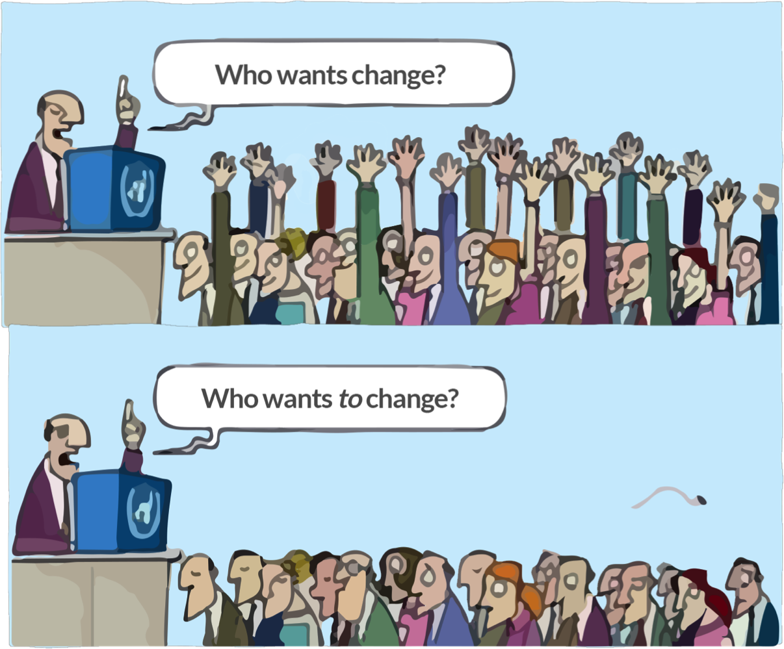
driven by: Gratitude
How many times a day do we hear, “Thank you”?
The typical response politely shuts the door to more opportuntity.
The why we ask, the when to ask, the how to ask.

