Slide 1
“APPY HOUR: The BEST APPS for REALTORS”

Slide 2
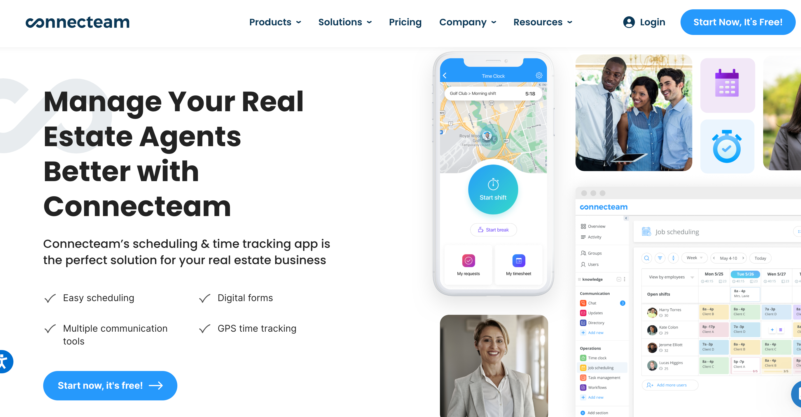
Connecteam – enhance communications, such as form-filling, signature-gathering, employee time tracking and schedule making

Slide 3
Dotloop is a cloud-based real estate transaction management software designed for brokers, teams, agents and service providers. It has transaction management, workflow tools, audit trails, document management, compliance management, task templates and reporting. You can edit, store, share and e-sign real estate documents.
It integrates with Boomtown, Inside Real Estate, LionDesk, RealGeeks, Zurple, SweepBright, SnapNHD, Google Drive, Preclose and others.

Slide 4
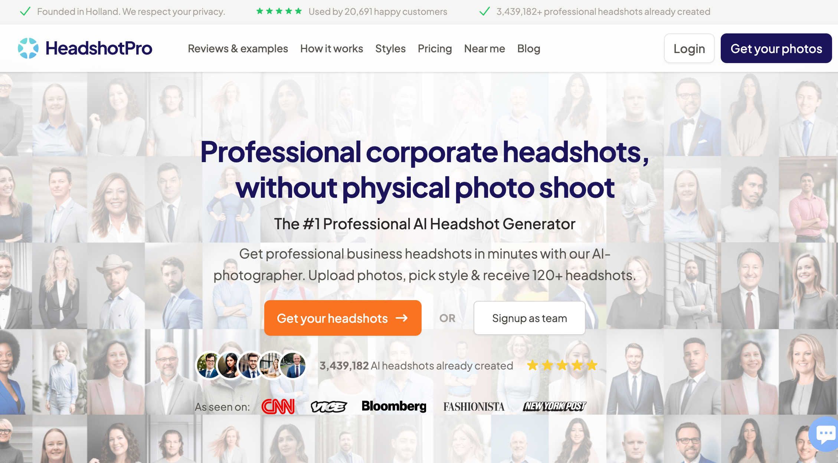
HeadShotPro.com

Slide 5
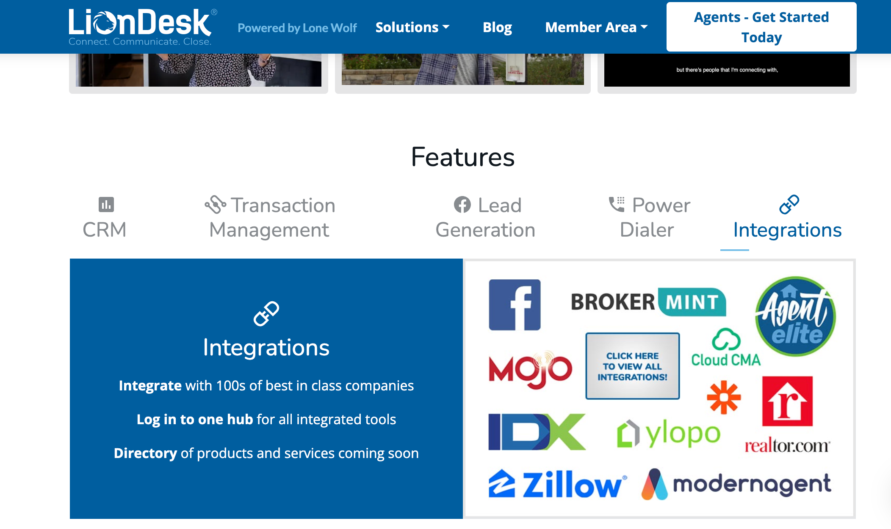
LionDesk - CRM Auto Drip Campaigns, Bulk Text Messages, Video Communication, Task Reminders, AI Lead Assist, Multiple Pipeline Transaction Management and much, much, more Includes built-in Facebook marketing along with integrated AI to automate your speed-to-lead response.

Slide 6
FreshChat - Give prospects an instant response, answering their questions with a programmed real estate bot.

Slide 7
REACH – You can send personalized messages to large groups of people via text. You can create groups and message templates. You can do all of this to save time and allow your entire database to receive text messages that are authentic and sincere.

Slide 8
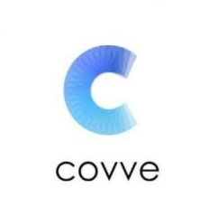
COVVE EXPORT- is an app that allows you to export your entire phone contacts into an excel spreadsheet in a minute. You can export all your contact info including all contact fields and notes into one spreadsheet. With one click, the spreadsheet will be sent to you via email.

Slide 9
LabCoat Agents Marketing Center - quickly creates gorgeous social media posts on the fly. It also offers a one-stop shop to create or edit tons of other marketing templates like business cards, flyers, door hangers, and more

Slide 10
Canva – Content Creator - Design your own flyers, book covers, logos, videos, marketing pieces etc.

Slide 11
Magic Plan - Get on-the-spot floor plans by scanning a room with your mobile device, and then upload that floor plan to create cost estimates, 3D tours, and more

Slide 12
CurbHero - The go-to app for agents who regularly run open houses. Customizable with a QR code sign-in feature. Curb Hero offers custom branding for bigger brokerages, text and email follow-up tools, lead verification, single-property websites, and CRM integrations

Slide 13
Monday.com – Pipeline management, project management and a light CRM. This kind of does it all!

Slide 14
Homekeepr/MooveGuru
Clients
Estimates for home repairs
Notifications of homes being sold in neighborhood
Moving services
Utilities
Service professionals
Home values
Agents
AI and Social media monitoring for life events with notifications of potential moves
Database management

Slide 15
ChatGPT
Copywriting; AI can help you with listing descriptions, write professional emails, review requests, blogging, and buyer and seller guides.
Time efficiency: AI can answer your questions, Expand reach and scalability. Help you write video scripts and keyword search.
Using AI to complement your personalized touch and expertise. You can leverage AI as an additional resource to enhance your service and provide better support to your clients.
FREE – Computer, mobile versions available.

Slide 16
CamScanner – Use your cell phone to scan just about anything…contracts, receipts or documents!

Slide 17
EVERNOTE
Evernote is an all-in-one organizational system that can be accessed on your desktop or used as an app. It's your place to "remember everything and tackle any project with your notes, tasks, and schedule - all in one place."
Think of it as a hybrid of the notes on your phone, project management app or to-do list app, calendar, Google Drive or Dropbox, and even CRM. Anything that you want to organize in your business, Evernote can help you do this.

Slide 18
RAPPORTIVE
Rapportive is a free Gmail extension that pulls in tons of information about your contacts right into your inbox. When someone e-mails you, you’ll be able to see their photo, location, their job, their latest postings on LinkedIn, Twitter and Facebook and any recent communication you’ve had with that person. You’ll also be able to connect with them instantly on social media.

Slide 19
BOMBBOMB
BombBomb is a complete email marketing platform. With their video email marketing software for real estate agents, you can easily make, send out, and track all the results of both traditional emails and video emails.
You’ll know exactly who’s opening emails, clicking links, watching videos, viewing documents, and much more. Send one-to-one, one-to-many, or one-to-all.

Slide 20
DROPBOX
Dropbox is a super-simple app that lets you store files on the go. It’s so common among agents these days that most have it on their phones.
The free version limits you to only 2GB storage and access on three devices, but paid plans offer advanced security features, offline file access, and the ability to request signatures, for example.

Slide 21
1PASSWORD
Generate, store and autofill all your passwords and logins. Every type of account you can think of is supported with the ability to create any custom ones you’d like.
You can also use 1Password to generate strong passwords when you can’t think of one.

Slide 22
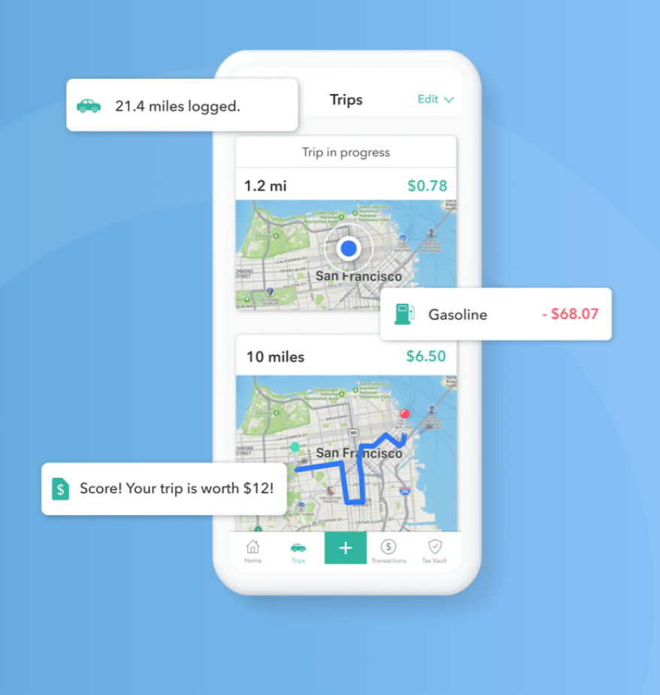
EVERLANCE
A versatile app that not only tracks your mileage but also helps you keep track of all your other business expenses.
Features include:
Automatic Tracking
Mileage Classification
Expense Tracking
Data Reports
Save for Taxes

Slide 23
The End
Questions? Contact the Loan Officer who invited you.

Slide 24
Now - Let’s Hear From YOU!
Any feedback on the apps I shared – The Good, The Bad and The Ugly. ☺
What are some of your favorite apps??? (and why)

