Slide 1
PhoneBurner & Scripts For Real Estate Agents
How To Get More Referrals & Closings By Secret Phone Technique
And we all know that the money is made by making phone calls.

Slide 2
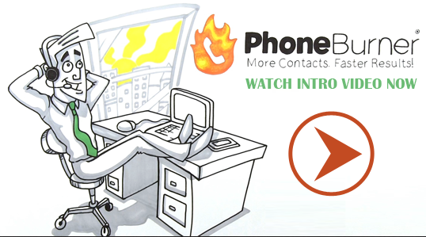
How to Burn Up the Phones
and Make More Meaningful Calls

Slide 3
We are in the “Marketing To Our Database” business, not the “Real Estate Business”

Slide 4
Marketing To Your Database
Call 3 Times / Year
Email Automatically 1 / Week
Snail Mail 1 / Month

Slide 5
Email Your Database Once Per Week
Don’t send Real Estate info ALL the time (it’s boring)
Video Marketing (the social lubricant) What’s happening in Tampa Bay Smartphone YouTube No editing Short call to action at the very end

Slide 6
Snail Mail Monthly Mailer
I like you
Superman letter
I like you
I’m a real person, just like you
I like you
Superman letter
I like you
I’m a real person, just like you
I like you
Superman letter
I like you
I’m a real person, just like you

Slide 7
Housekeeping….
There are no attorneys here…..
…. we shot them all….

Slide 8
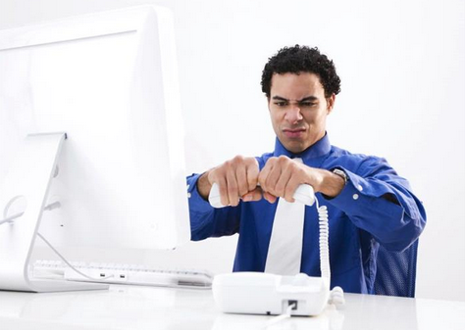
Did you know that as much as 70% of the time you spend on the phone is wasted time?

Slide 9
Would You Like to…
Stop wasting phone time?
Answering machines, busy signals and disconnected numbers steal away your most valuable commodity – time
Have increased contact rates?
PhoneBurner can triple your dials, triple the number of voicemails left and quadruple the number live answers reached.
Be more productive?
PhoneBurner auto dials your contacts, leaves voicemail messages, sends follow-up emails and makes notes for you.
Feel refreshed and focused?
PhoneBurner can handle the menial, monotonous tasks so you can focus on making connections with your prospects that answer live!

Slide 10
Overview Of How It Works

Slide 11
100% Cloud Based
Nothing to install on your computer.
Use the computer and phone you already own.
Dial from any location.

Slide 12
How it Works
Load your leads.
You can import a list of Contacts you already have.
The system includes a built-in Contact Manager that allows you to sort and search through your Contacts in useful and efficient ways.

Slide 13
How it Works
Record your voicemail message.
Record a voicemail message that PhoneBurner® will leave for you when reaching an answering machine.
You can record several different messages and choose the one you want when beginning a session.

Slide 14
Call 3 Times / Year (Voice Mail Script 70% of the time)
“Hey this is <insert name> from <insert company>. I helped you with buying / selling your home in the past. I just wanted to give you a quick thanks for letting me help out. If you ever have any real estate or mortgage questions, or would like to report on home prices in your neighborhood please give me a buzz. By the way, I was just looking at some home values in your area and I think you will be pleased with what I have to show you. The best number to reach me at is <insert phone number>. Hope all is well, and hope to talk to you soon. Oh, also, if you have any friends or family members that could use some honest help, just give me a call about that too, I would be honored to help out. I’ll talk to you when you call back. Bye.”

Slide 15
Freedom Caller (calling your database for you)

Slide 16
Call 3 Times / Year (Live Answer If Calls Made By Your Assistant)
“Hey this is <insert callers name>. <insert agent’s name & company> wanted me to give you a call. She helped you with buying / selling your home in the past, and she just wanted me to give you a quick thanks for letting her help out. How are you guys doing? <pause for answer and give an appropriate response> If you ever have any real estate or mortgage questions, <insert agent’s name> wanted me to tell you to please give her a buzz. If you will grab a pen, I’ll give you her number. <give time for them to get a pen> The best number to reach her at is <insert phone number>. Hope all is well, and hope to talk to you soon. Oh, also, <insert agent’s name> wanted me to ask if you have any friends or family members that are looking to buy, sell, or refinance a home and could use some honest help? <pause for answer>. Can we count on you to give <agent’s name> a call when you do? She would be honored to help out. She’ll talk to you when you call back. Bye.”

Slide 17
What About People That You Haven’t Spoken To In A Few Years……
People think about you a whole lot less than you think they do. Just call them!!

Slide 18
Scripts for Calling FSBOs (If Voicemail)
“Hi .. I saw you have a home for sale & I had a couple of questions... please call me at .....”

Slide 19
Scripts for Calling FSBOs (If live)
“….tell me about your house... that sounds great.. I'd love to see it... when can I come by?'

Slide 20
How it Works
Choose all the contacts you want to call.
Pick as few as 1 - or as many as 500 - contacts from your built-in Contact Manager.
If you only want to call people from a certain area code or zip code PhoneBurner® lets you do that.

Slide 21
How it Works
Start your auto-dial session.
It's as simple as picking up your phone, dialing into PhoneBurner®, and clicking a button.
You're ready to start calling Contacts at a rate of about one per minute!

Slide 22
You’re Probably Wondering…
When my contact answers, will there be a pause before they hear me speak?
No! With this state-of-the-art dialing technology, there is no pause after your Contact answers before you begin speaking like on those antiquated dialers. Your Contact will never know you are utilizing a dialing application to contact them.
What do I need to use PhoneBurner?
A computer (PC or Mac)
Internet Connection (DSL/Cable or faster)
Credit Card (for billing)
Phone (Regular landline, cell phone or VOIP)

Slide 23
You’re Probably Wondering…
Are there long distance charges?
Only for dialing into PhoneBurner. There are no long distance charges for calls made to clients.
Where can you use PhoneBurner?
Anywhere! If you can get online and on the phone at the same time, you can use it anywhere in the world.
Does PhoneBurner send emails?
Yes, it sends one follow up email per call, per contact. It is NOT an autoresponder system.
Can the email be customized?
Yes. You have a message library where you're allowed to enter as many custom emails as you want.

Slide 24
Script For Email When A Voice Mail Has Been Posted
“Subject: Just left you a message Email Body: Just a quick heads up. I just called and hit your voicemail so I left you a message. I’ll talk to you when you call back. Talk soon! <your name>

Slide 25
Using phone burner you can average about 1 minute per person in your database.
So a 300 person database = 300 minutes or 5 hours.
In 5 hours you can do what you haven’t done in 5 years…… call your entire database and get more deals!!

Slide 26
Imagine what your business would look like if you made an additional 300 calls a month, and it all took a total of about 5 hours or about 1 hour and 15 minutes a week!!!!

Slide 27
How Much Does it Cost?
Free 7 day trial
7.5 Hour Package
7.5 hours of usage each month.
Automatic rollover of minutes included.
$67.50 a month
Can purchase extra hours without having to upgrade account
Unlimited package
Unlimited usage
Allows for you to not worry about going over on time.
$149 a month
Can be downgraded at any time.

Slide 28
How to Sign Up
If you’re ready to be more productive and make more meaningful calls, then sign up at
www.PhoneBurner.com for your free 7 day trial!
Put in “freedom” for discount code

