Slide 1
Video Marketing On Steroids

Slide 2
Why Video?
Instant credibility
Instant celebrity Status
No competition- your competition still isn’t using it effectively (less than 20%)
People want to work with people they know, like and trust
It’s FUN
People don’t read as much anymore..
People get to hear your passion and excitement

Slide 3
Real Estate video marketing statistics:
Real estate listings that include at least one video get 400% more inquiries.
51% of home buyers use YouTube as their number one source of home research.
Century 21 increased their home sales rate by 20% after running a video campaign on social media platforms like Facebook, YouTube, and Flickr.
About 80% of active listing agents use drone photography and videography to market their listings.
44% of people are more likely to purchase something after watching a video about it.
Listings that leverage drone photography sell, on average, 68% faster than those without it.
Only 10% of recent home sellers reported that their agents effectively used video to market their property.
78% of real estate professionals surveyed by The Close say that video is important to standing out on social media.
Three out of four marketers say video has a stronger ROI than photos.
Facebook is the most popular (75%) social channel for marketers to post videos, followed by YouTube (70%), and Instagram (58%).

Slide 4
Mindset
Don’t always talk business, you want them to remember you!
Give them something to laugh at and smile
Do not over think this
Who cares what others think?
Be creative, crazy and funny; be yourself!
Use your pets, family and clients in your videos

Slide 5
Must Have in All Videos
Interest and Desire
Bonding and Trust
Free Samples
Call To Action

Slide 6
The 5 W’s

Slide 7
Who (Who Should I send a Video To?)
Customers- Past, Present, and Future
Sphere of Influence 200+
Industry partners - Divorce Lawyers, Insurance Agents, CPA, Financial Planners, Builders etc.
Community Business- Landscape, pool, electric, plumbing, restaurants, cleaners

Slide 8
What (What do I do/say)?
Be Yourself- Don’t try to be someone you’re not
Be comfortable but not shabby- what do you wear to a listing appointment?
Have a CLEAR call to action:
-Here's what I have
-Here's How it will benefit you
-Here’s what you need to do next…

Slide 9
Real Estate Video Content Ideas
Client Testimonials
Home Buying Tips
Home Selling Tips
Your Bio
Neighborhood Tours
Community Events
Interview Local Businesses
Show Me How
Open House Live
Tip of the Week
Motivational

Slide 10
Where (Where do I record)?
Your Office (behind the scene videos work great!)
Your Home, Yard and Garden
On Location- Restaurant, beach, etc
Where in the world am I? (Local Landmark)
A Park
Title company
While on vacation

Slide 11
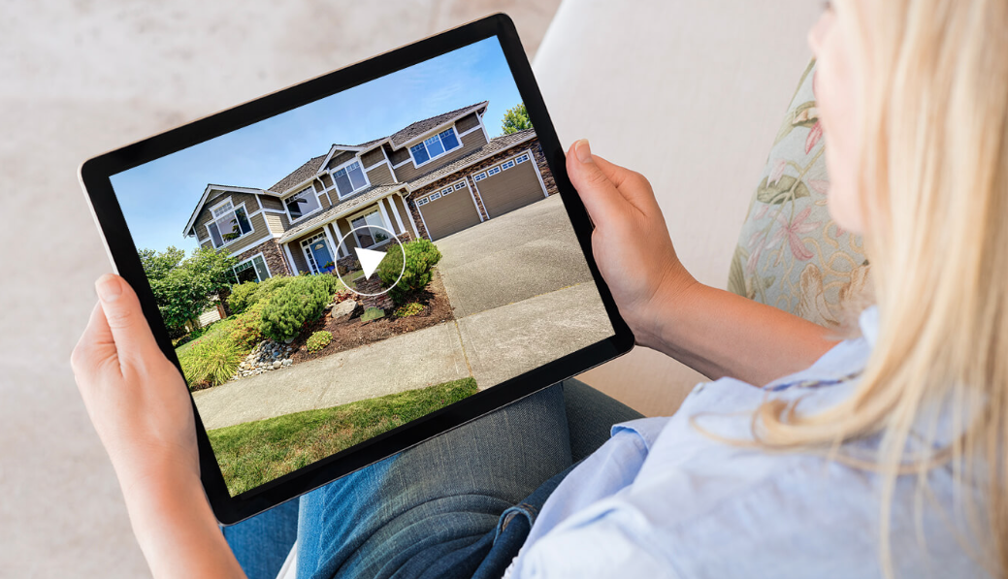
When (When do I post them)?
Saturday is the best Email day, but you can send a video any day.

Slide 12
Why (Why AM I Doing This)?
Forms a bond with your audience
Helps people know who you are
Makes you a real person
Makes you a celebrity like the local weatherman
Gives you another avenue for communication

Slide 13
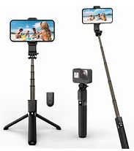
Equipment/Software Needed
Your Cell Phone
Selfie Stick (or a gimble)
Bluetooth Mic
Youtube
Facebook Live
BombBomb for weekly video email
Dubb.com is awesome for video emails

Slide 14
Tips
Don’t worry about perfection
Make sure the sound is good (no wind noise)
Use a teleprompter if needed
Have a script or bullet points (no winging it)
Make sure branding is consistent
Come up with your own tag line
Stay consistent
Put it in your calendar

Slide 15
Social Media
Facebook personal
Facebook page
Instagram
LinkedIn
TikTok
YouTube

Slide 16
Editing
Use Fiverr.com
Use a VA
Get a software like Descript
Don’t worry about it too much (You’ll get better)

Slide 17
Go into Your Past Client Database and Send 10 Personalized Video Selfies a Day

Slide 18
To Do:
Send 10 Video Selfies to Database
Write out content for next 4 weeks
Schedule in Calendar
Shoot videos
Send
Get busy with all the referrals you will get ☺

