Slide 1
8 Pinterest Ideas For Real Estate Agents
Pinterest will do three main things for real estate agents:
Increase website traffic
Help with search engine optimization (SEO)
Deliver a great branding experience for your buyers and sellers.

Slide 2
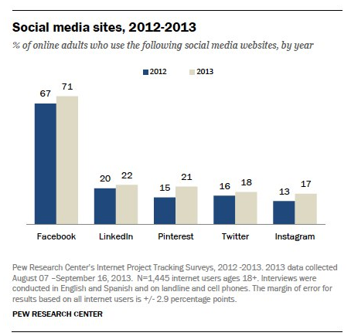

Slide 3
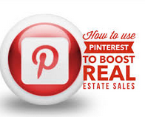
Pinterest is running 3rd / 4th depending on if you use YouTube or not.
The vast majority of the Pinterest population are female. 87 % of users are women, compared to just 13 % who are men.
Trust is one of the big strengths behind Pinterest. When asked about which social media sites they trust, the response was:
• 81 % trusted Pinterest • 73 % trusted Twitter • 67 % trusted Facebook
People really do like to spend some time on Pinterest, and usually a lot more than other social media sites. The average Twitter visit lasts 21 minutes, LinkedIn users stay for 17 minutes, and Google+ users for just 3 minutes. Where as Pinterest members spend a massive 89 minutes per visit on average browsing the site.
Notes:
http://freeagent.adwerx.com/blog/2013/6/19/real-estate-seo-essentials-part-1-keyword-research

Slide 4
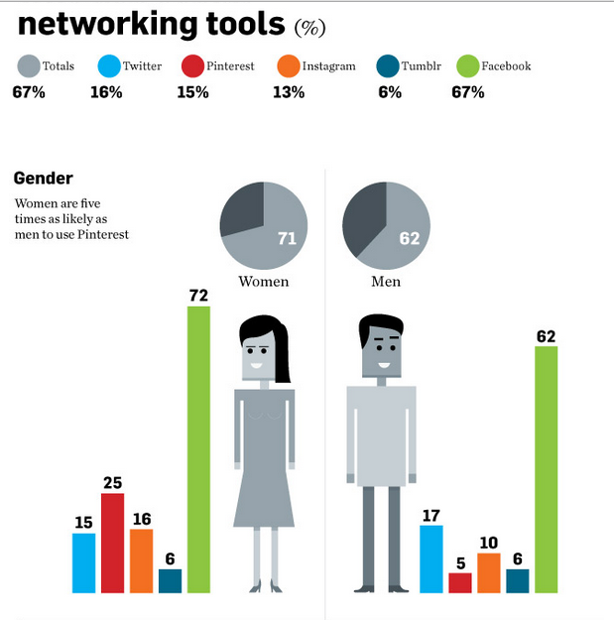
Random Pinterest Fact:

Slide 5
Pinterest Vocabulary
Pins Photo, Graphic or Video linked and shared. Taken from internet or uploaded by the user
Pin board Taking your above pin and organizing it in themes. Pinterest gets you started and you can change or add
Pin It Bookmark Code added to browser which allows pinning from any website
Re-pins Adding others pinners pins to your pin boards (sharing). Kind of like a Re-tweet. Basically sharing someone else’s pin
SEO Search Engine Optimization – Pinterest is at the top of Google searches. Images with links can be repined 100’s or 1000’s of time creating a lot of backlinks

Slide 6
Pinterest Vocabulary
Followers People who are following your pins and pin-boards
Following Following other people who have similar interests, who are friends, or who share common goals
Share When you are finished pinning, you can share what you just pinned on Facebook or Twitter
Likes The same as a Facebook like button. Showing that you like something. It does not post as a pin
Comment Like Facebook you can comment on a pin.

Slide 7
If You’re not Ready To Use Pinterest
You can reserve your brand name
Connect to your website or blog
Watch what others are doing on Pinterest

Slide 8
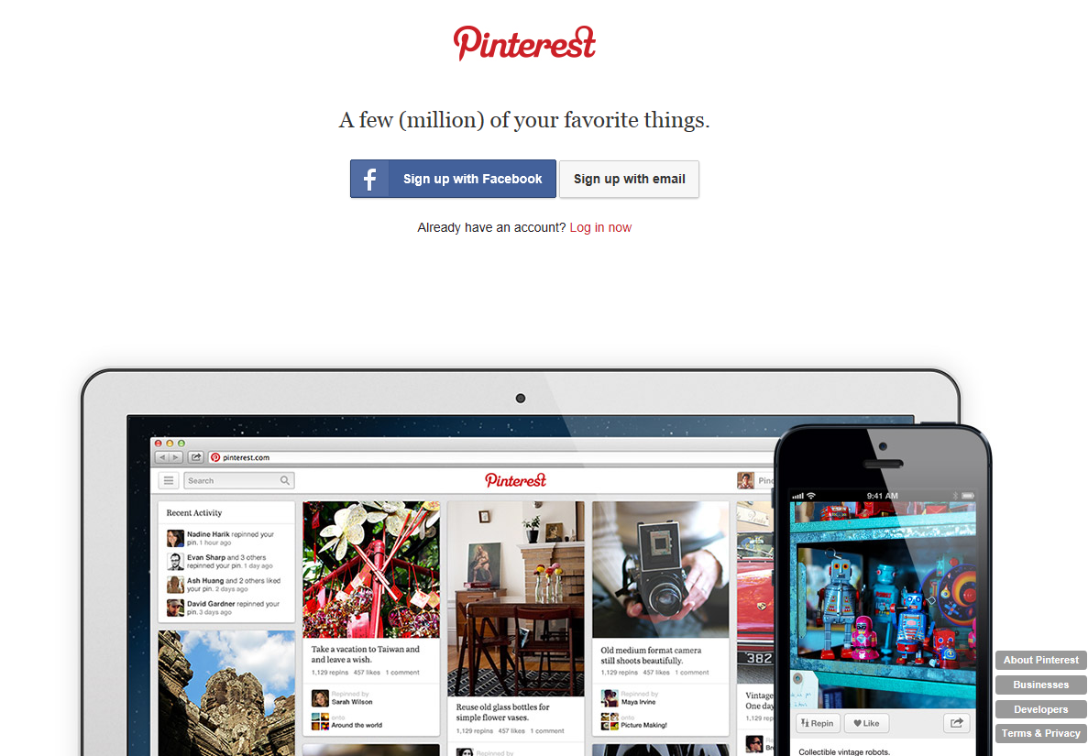

Slide 9
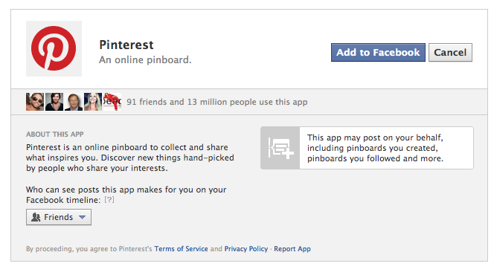
Setting Up Pinterest Account
When you use Facebook to create an account, it does make you add the Pinterest app to your Facebook. This can be turned off once the account is created

Slide 10
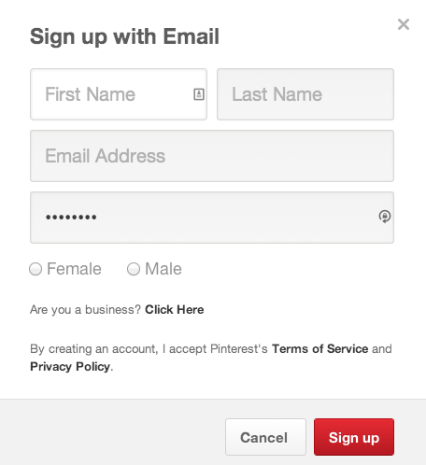
Setting Up Pinterest Account
Create your log in and password

Slide 11
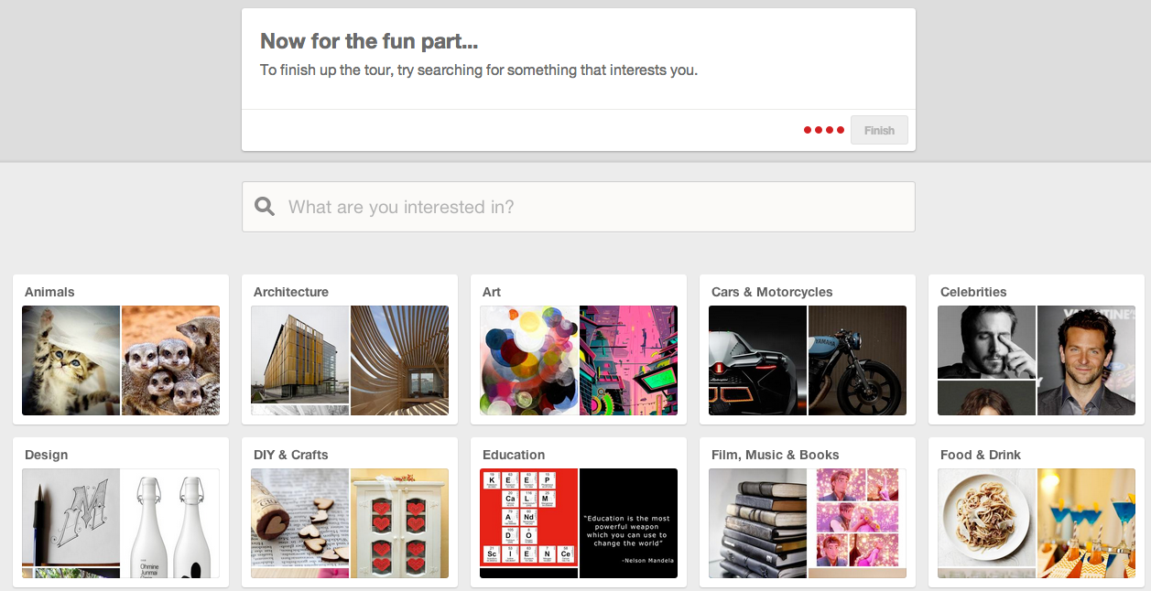
When you create your log in and password, you are asked to pick “Topics” or “Interests”. Click what would best represent your business.

Slide 12
Confirm Email

Slide 13
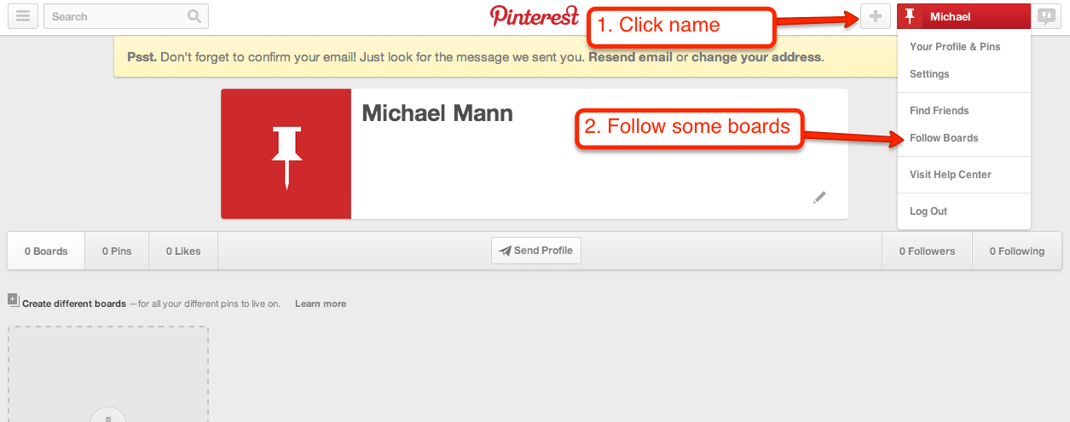
Follow 5 Boards

Slide 14
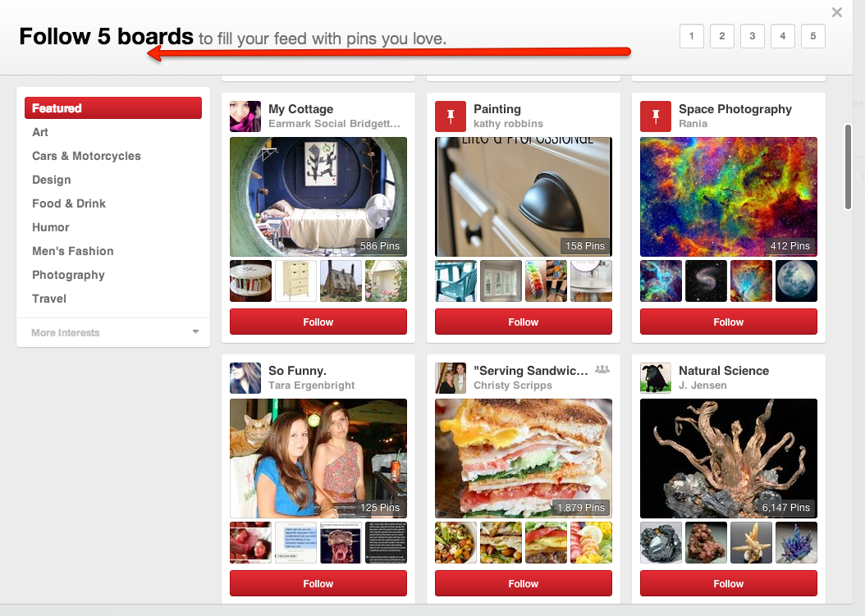
Choose Your Favorite

Slide 15
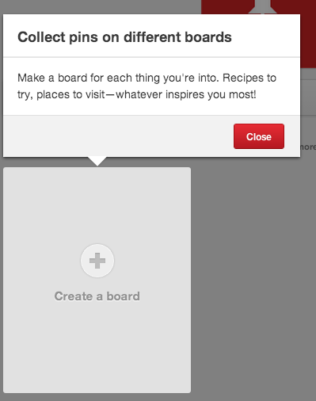
Create your first board

Slide 16
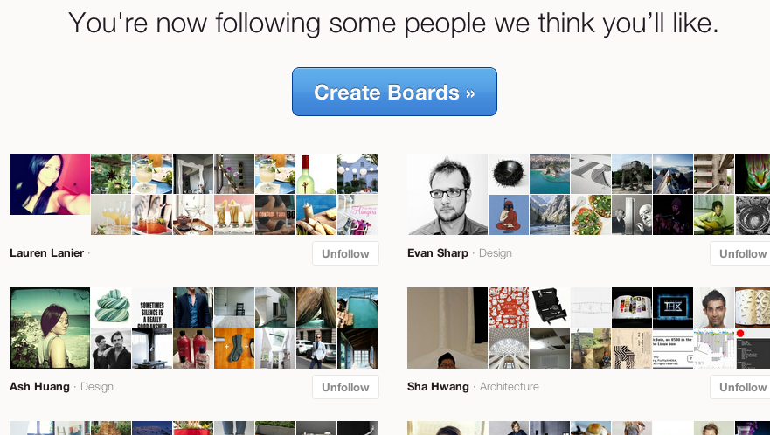
Pinterest will add followers for you that you may be interested in based on the topics you selected.

Slide 17
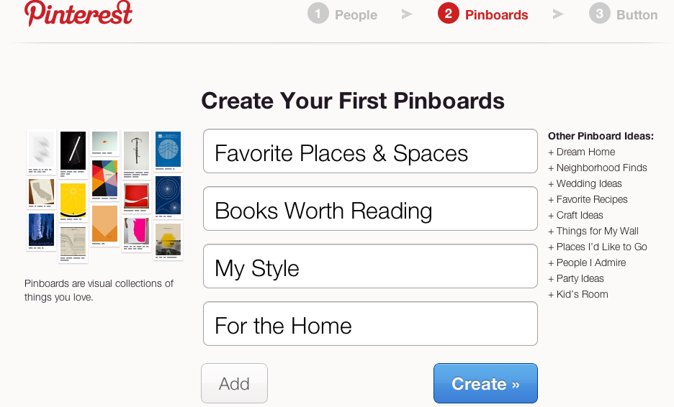
Now you can create your boards for you to pin to. Think of your boards as categories. Boards are used to separate different categories of content or interests

Slide 18
Mindset Of Pinterest / Social Media
Listen, Connect, Engage and Interact
Without expectation of anything in return
Go Deep with your current and past clients
Put it on your calendar 10-15 minutes twice a day
90% about them, like, follow, share and comment
Keep it simple
7.5% about you
2.5% about your business if any

Slide 19
8 Ideas When Using

Slide 20
#1. Introduce your team
Use head shots and go above and beyond. Under the pin description, share each agent's story and experience. Make it personal, keyword-heavy and link it back to your About Us page or to their LinkedIn or Twitter accounts.
Notes:
http://www.pinterest.com/rajqsar/meet-our-team/

Slide 21
Random Pinterest Fact:
Many real estate pinners use the site not just to share listings but to show the benefits of local neighborhoods, delve into real estate statistics (generally shared through charts and graphs), or explain the basics of real estate.
Using text over photos is a great way to create very shareable images. For your own photos you can use a watermark so that pinned photos retain your info. The description is another area where you can include information.
Having pins that focus on the real estate process. You can also involve home sellers in the process, asking them to pin their favorite things about the neighborhood.

Slide 22
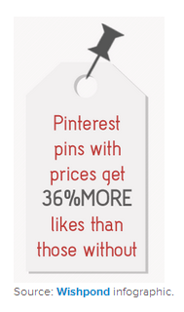
#2 Showcase your listings
Don't just upload the photos. Make sure you have all metadata behind it so that your pins can be easily found online and linked back to your website.
Add pricing by adding the dollar sign followed by a number in the description box.
Pinterest will automatically add a price tag to your pin.
Use hashtags, an effective way to be discovered.
Use general hashtags such as #RealEstate, #Home, #HomesForSale — but also use geo-specific hashtags such as #Durham, #NorthCarolina, #Brooklyn.

Slide 23
Random Pinterest Fact:
Pinterest is powerful because it drives more traffic to websites and blogs than Twitter, LinkedIn, Google+, or YouTube (study by Simply Measured). With 25 million users, the potential for exposure is huge for real estate agents as well as home buyers on Pinterest.
Notes:
http://freeagent.adwerx.com/blog/2013/7/10-pinterest-ideas-for-real-estate-agents

Slide 24
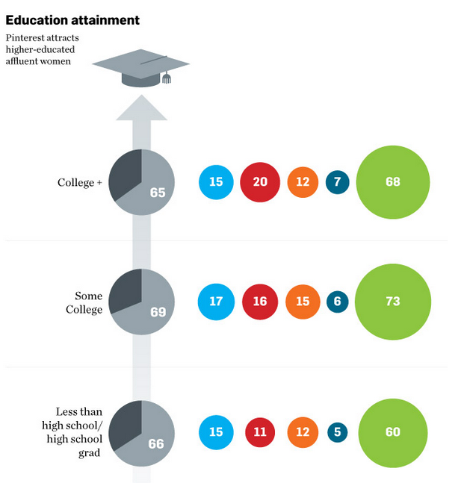
Random Pinterest Fact:

Slide 25
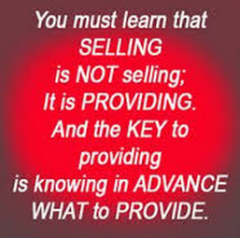
#3: Lifestyle Content
This is where Pinterest's strength really lies. Pinners enjoy spending time on lifestyle content such as arts and crafts, style and fashion, food recipes, humor, and of course, home ideas.
The number one category on Pinterest is "Home" and the #1 most popular board name is "For The Home." That means there are plenty of opportunities for you to gain engagement by pinning fun lifestyle photos related to homes.
Examples: Dream Homes, Home Decor (as you get savvy, you can create a board for each individual space in the house like kitchen, bathroom, kid's bedroom and garden), Seasonal Boards (i.e., home staging for summer, fall, winter and spring).

Slide 26
Random Pinterest Fact:
A recent Pew Study has shown that women are five times as likely as men to use Pinterest and that most of those women are highly educated and affluent. And according to National Association of Realtors (NAR), single women are buying houses at twice the rate of single men, making them the second largest home buying demographic after married couples

Slide 27
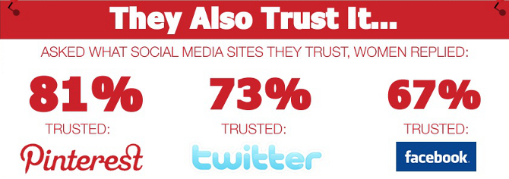

Slide 28
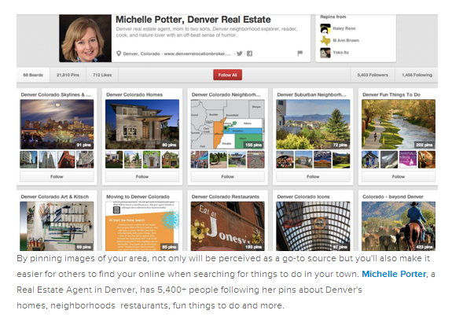
#4: Go Local
This is a great way for you to show off your knowledge in the local community — not to mention that, with the right keywords, it will help your website rank higher in the search engines. Here you can pin about great places to eat in your town, schools, nightlife, beauty spas, community parks your prospective buyers can take their kids and dogs. You can be the go-to source of what's good and cool in the area. What better way is there to improve your personal branding?
Notes:
http://www.pinterest.com/denverrealty/

Slide 29
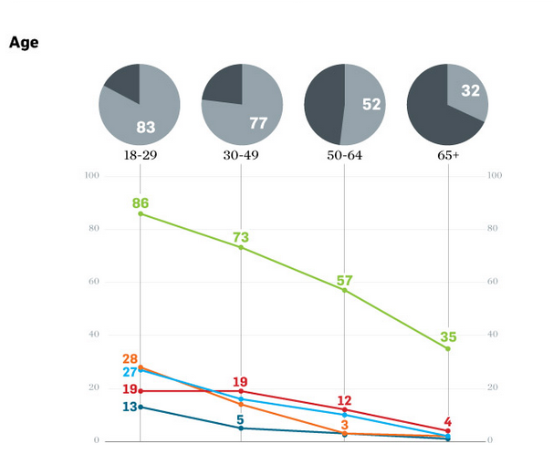
Random Pinterest Fact:

Slide 30
#5: Real Estate Advice
In addition to being a local source, you can also use Pinterest to prove you're knowledgeable in real estate.
You may already be giving advice in your blog or website so Pinterest is another great outlet to promote it. Also, repin posts from reputable sources in the industry such as NAR, Inman News, Lisa Archer from Geeky Girls, Housing Wire, and RIS Media.
Notes:
http://www.pinterest.com/search/boards/?q=real%20estate%20advice

Slide 31
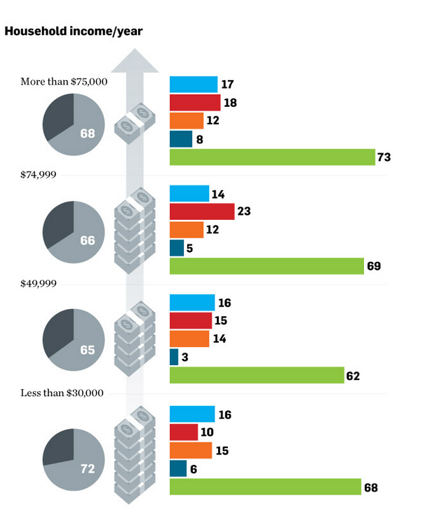
Random Pinterest Fact:

Slide 32
#6: Include Videos
Create a board specifically for videos.
Video marketing is a trend you have to understand and exploit in your real estate marketing plan. Adding a board for your videos will increase your rank for SEO but will also give a face to your brand. Ideas: pin customer testimonials, happy birthday wishes, listing video, tip of the week videos, client success stories, top 2014 paint colors, Buyers MOST wanted, Curb Appeal, anything you think your target market will be interested in.
The goal is to showcase your knowledge and expertise, be the resource they need
90% of all web visitors will be watching video in the near future, according to 2013 Consumer Electronics Show.
Notes:
http://www.pinterest.com/search/boards/?q=real%20estate%20videos

Slide 34
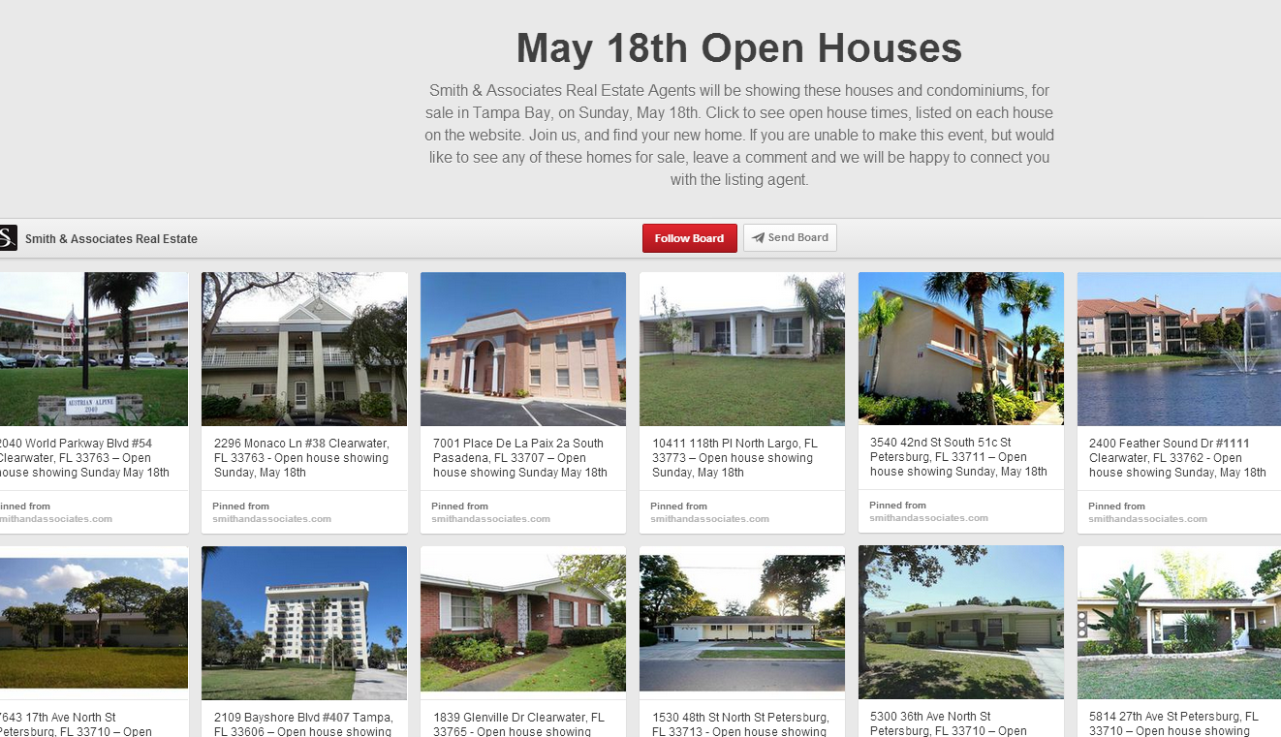
#7: Open House and Staging Ideas
Going back to lifestyle content, this is another great spot to share your ideas and personality with your clients or even a great way to store ideas for future listings. Examples of good pins: cookies and snacks recipes, home design ideas, floor plans, event decor, and open house invitation ideas.
Once you have a small "showpiece," you can move on to get followers. The key in using Pinterest for real estate marketing is to build recognition, be perceived as an expert and trustworthy professional in your field, and drive traffic to your website or blog, which will then be more likely bring you leads.
Notes:
http://www.pinterest.com/search/boards/?q=home%20staging, http://www.pinterest.com/search/boards/?q=Real%20estate%20open%20house

Slide 35
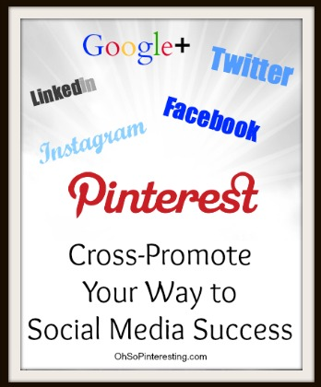
#8: Share the LOVE
No matter what site you are promoting, it’s always good practice to cross-promote your site.
What I do recommend is to cross-promote social networks and be active on the ones that are best suited to your business. Leverage the audience you’ve already built.
You might have a casual Facebook or Twitter follower who happens to be a Pinterest super user so why not invite them to follow your Pinterest account too?
While you can’t share pins directly to your business’s Facebook page, you can post a link to a pin or a repin on a business page.
Simply copy the URL and paste it into a new Facebook post. You could also include something that says “Did you know we’re on Pinterest too? For more about_______ follow our _________ Pinterest board”

Slide 36
Mindset Of Pinterest / Social Media
Listen, Connect, Engage and Interact
Without expectation of anything in return
Go Deep with your current and past clients
Put it on your calendar 10-15 minutes twice a day
90% about them, like, follow, share and comment
Keep it simple
7.5% about you
2.5% about your business if any

Slide 37
Let’s Find And Follow Your Friends On Facebook and Twitter

Slide 38
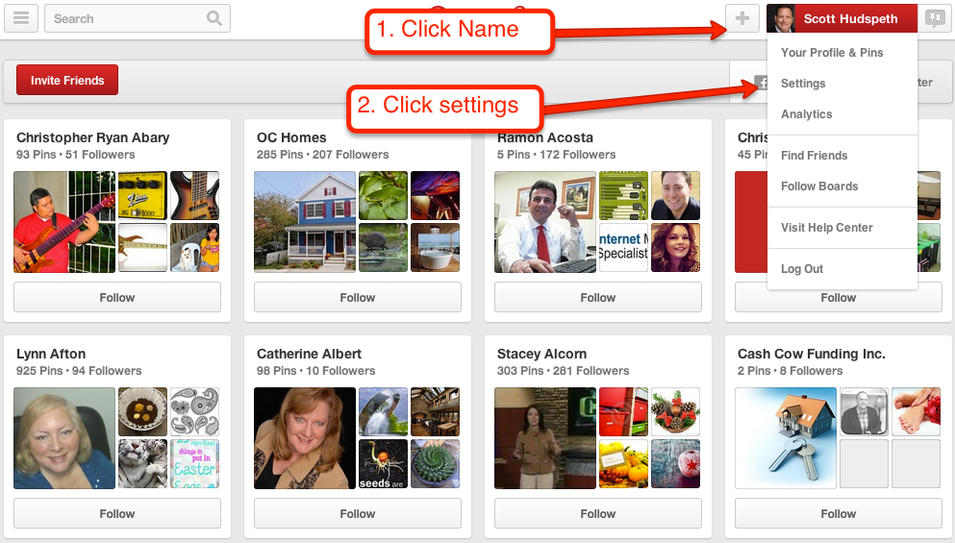
Connect Your Pinterest Account To Facebook And Twitter

Slide 39
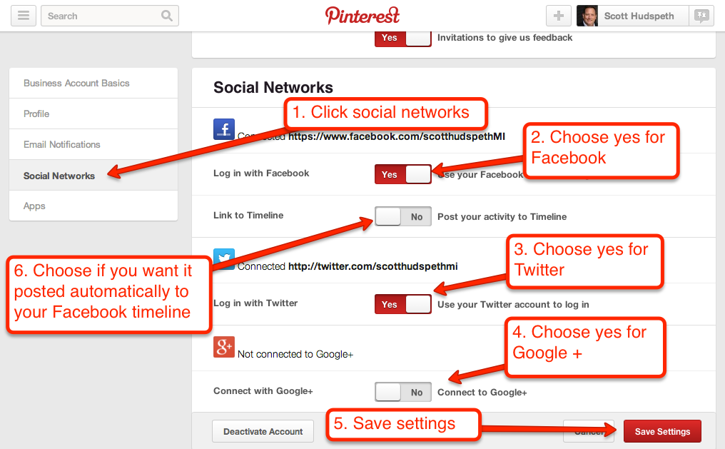
Turn On Facebook and Twitter

Slide 40
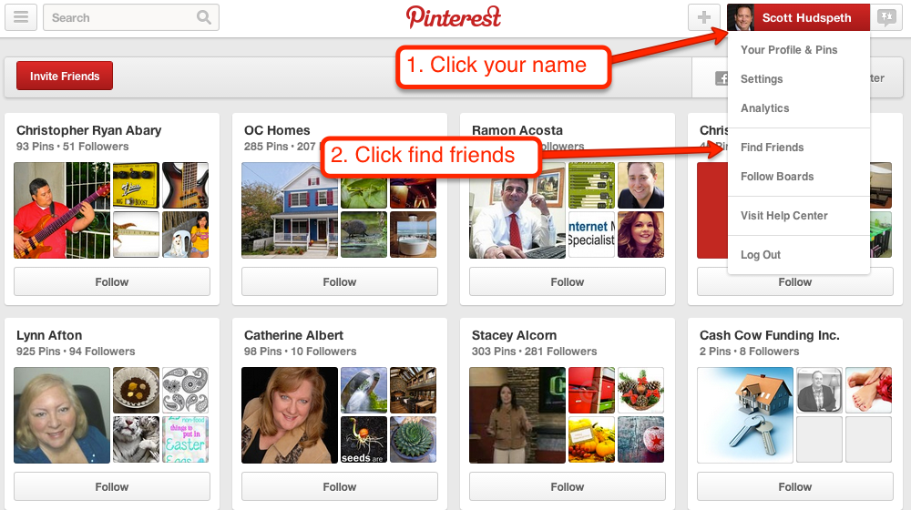
Find Your Friends On Facebook / Twitter

Slide 41
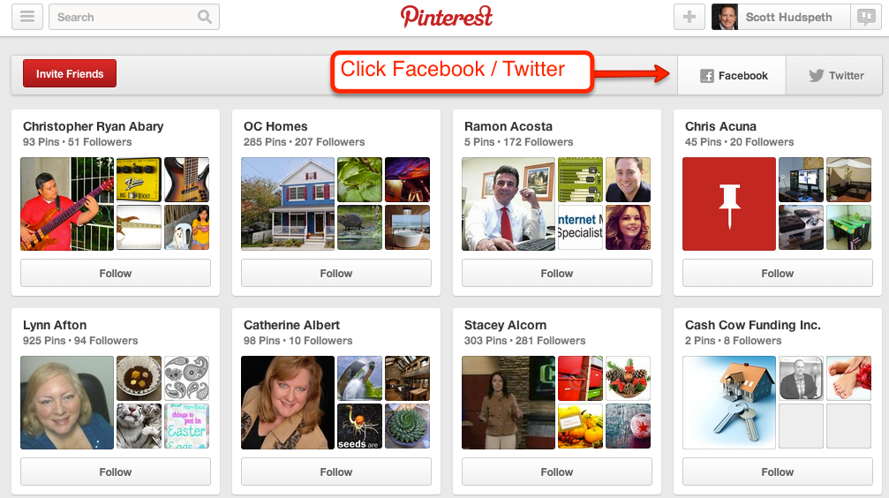
Click Facebook Or Twitter

Slide 42
www.pinstamatic.com

Slide 43
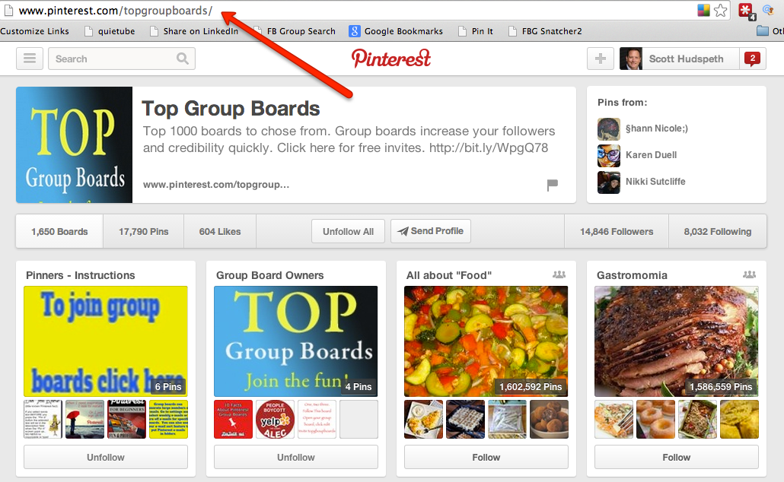
http://www.pinterest.com/topgroupboards/

Slide 44
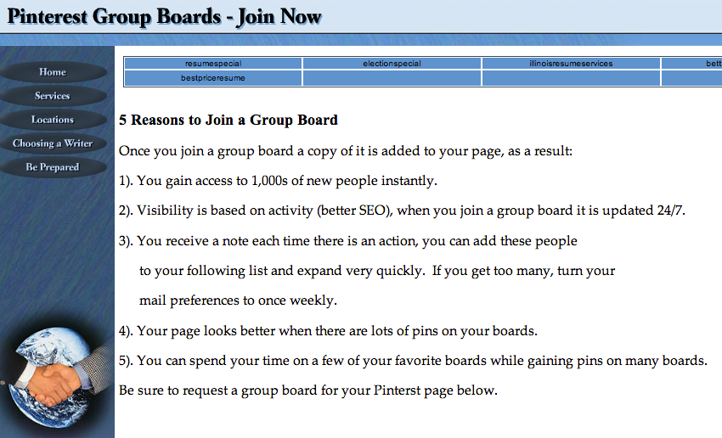
http://www.betterresumes.com/beprepared/pinterestgroups.html

