Slide 1
Understanding the Sales Process
Maximize your earnings!!

Slide 2
3 Parts to Any Business
The sales process (4 parts)
The Organization (3 parts – people (staff), places (location – physical or remote), things (software, equipment, processes)
Finances– How much you make VS how much you keep.
© The Marketing Animals 2023

Slide 3
4 Parts To A Successful “Sale”/Leads
Traffic/Leads – Who are you talking to and how do you generate leads? (Where does your business come from?)
Relationship – How do those leads feel about you? Are you able to build rapport quickly?
Call to Action - Are you asking for the business?
Follow up – Do you have a system for consistent follow-up?

Slide 4
Traffic - Leads
Internet leads – Trulia/Zillow, Homesnap, Redfin, Realtor.com, Google Local, Market Leader, Real Geeks, CINC
Online presence - Your own Website, Single property websites, Your Google Local, etc. Are you number 1? Are you easy to find?
FSBO’s and Expireds – TheRedX, MLS
Media – Radio, TV, newspapers, magazines, local throw aways
Open Houses
B2B partners – CPA, FP, Atty., Builder, Lenders, etc.
Leads Group – BNI, Chamber
Social Media – Facebook, LinkedIn, Instagram, Twitter, You Tube
Teaching classes – Local library, apartment complexes, etc. (First time homebuyer, etc.)
Direct Mail pieces
Canvassing/Farming a neighborhood
Floor Time
Your own past database (warmest source)

Slide 5
Relationship – How to build rapport
ENGAGE!!!
FROG – Family, Recreation, Occupation, Goals
Call every week (people who are looking)
Private Facebook messages
Text messages
Social Media posts
Video marketing
Notes and letters
Face to face meetings
Teach classes
Be consistent, persistent and curious

Slide 6
Call to Action - Ask For Business
What would it take for us to do business together? Is there anything that would prevent you from using me as your agent?
All actions should have goal (result) in mind. Ask for what you want. (have your team ask too!)
Call To Action Formula: 1. Here’s what I got 2. Here’s how it benefits you 3. Here’s what you need to do next

Slide 7
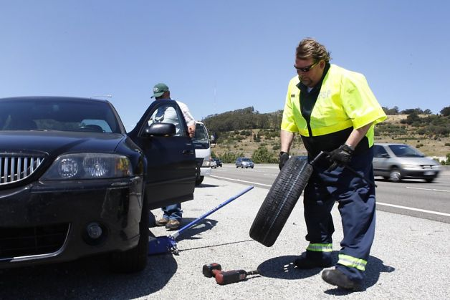

Slide 8
“Good” salespeople think that selling is a good thing.
“Poor” salespeople think that selling is a bad thing…..

Slide 9
Follow Up
Do you have a CRM to help with this? Must have a schedule (campaign)
Handwritten thank you notes
Facebook posts or DM’s
Weekly phone call to your leads
Call your past client database 4X per year
Weekly Email/Video marketing
Tips, stuff to do in the area, birthday, etc.
Monthly snail mail
Occasional text message
“Thanks a Latte” – Send a note to new clients with a $5 Starbucks Card. “Sit back, relax, have a cup of coffee on me. You’re in great hands.”

Slide 10
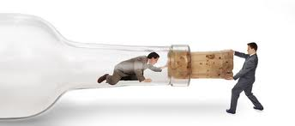
Where’s your bottleneck?
Every company has one and they change constantly. Where is yours?

Slide 11
Let’s Do A 2 Week Map Out
From Traffic – Call Past Database
What needs to be done? Database divided by 2 letters of alphabet and called on Weds.
Who needs to do it? My assistant
What, if any, are the obstacles? Wrong phone numbers, time
Will you commit in to do it?

Slide 12
Let’s Do A 2 Week Map Out
From Relationship – Note after meeting
What needs to be done? Note sent to buyer or seller after first meeting
Who needs to do it? me
What, if any, are the obstacles? Buy notecards and stamps. Pre-write notes
Will you commit to do it?

Slide 13
Let’s Do A 2 Week Map Out
From CTA
What needs to be done? Ask for commitment
Who needs to do it? me
What, if any, are the obstacles? Fear – do it anyways
Will you commit to do it?

Slide 14
Let’s Do A 2 Week Map Out
From Follow-up
What needs to be done? Need CRM, find, get, plan, implement
Who needs to do it? My assistant
What, if any, are the obstacles? Overwhelmed by choices, get content ready (use AI)
Will you commit to do it?

Slide 15
Conclusion
Constantly ask – Where is my bottleneck?
What would your business look like in 12 months if you did this process every 2 weeks?

