Slide 1
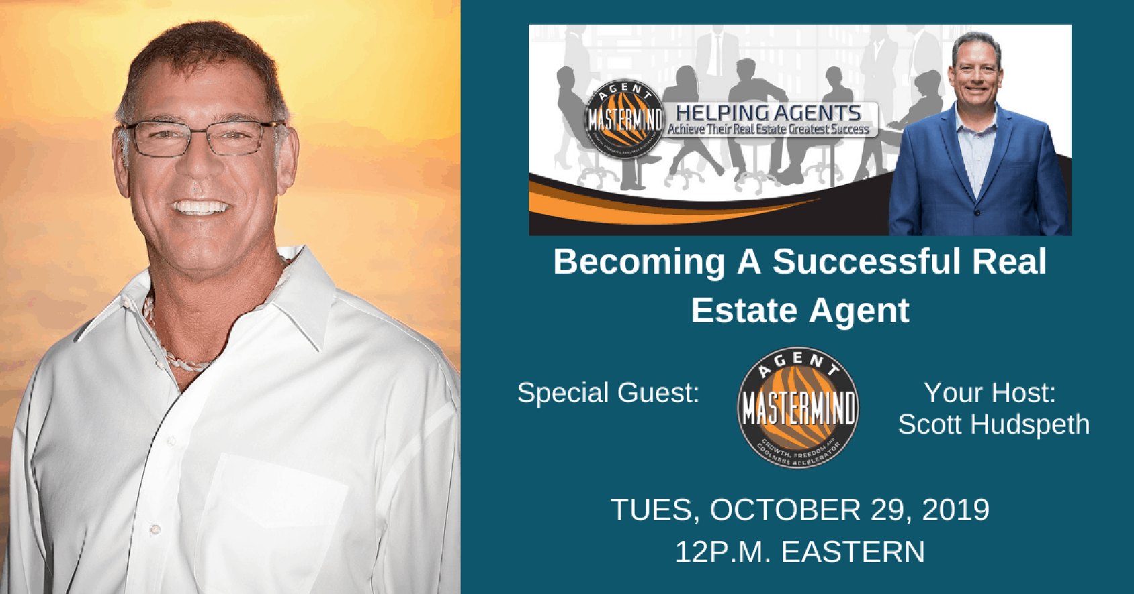
Marc Pelletz

Slide 3
Welcome Marc Pelletz
Marc has been involved in real estate for close to four decades, he has been through several real estate cycles and knows how to be successful no matter what the market is at that moment. Marc has been inspired and motivated by many real estate experts and masters of motivational philosophy over the years, which has helped transform all areas of his life. In the last 10 years, Marc has created and grown a real estate company, accumulating over 200 rental properties and flipping over 100 million dollars of real estate while earning himself millions. Marc consistently earns a seven-figure income while having more time for family, vacation, and self-improvement.

Slide 4
Questions For Marc
Tell us about yourself (Your Story so to speak) for starters.
For our beginners or short timers in the business, what advice would you have for them just starting out.
For someone who is struggling or stuck, what advice would you give them
You have been through several real estate cycles, what advice would you give our listeners to help them
make it through anything that might come at them?
Knowing what you know now, what would you have done differently in the real estate game

Slide 5
Questions
What time of marketing do you do or have you done that you feel worked best for you in Real estate business?
Expired listings
FSBO's
Open Houses
Dialing for dollars / To who?
Knocking doors
Buying leads
Any others
Fix and Flip, you are the master, what advice would you give to someone looking to get into the fix and flips
Knowing what you know now, what would you do different?

Slide 6
Questions
What does your your team look like or knowing what you know now, what does the perfect team look like?
Knowing what you know now, who would be your first hire and why?
Any final words you would like to leave with our listeners?

