Slide 1
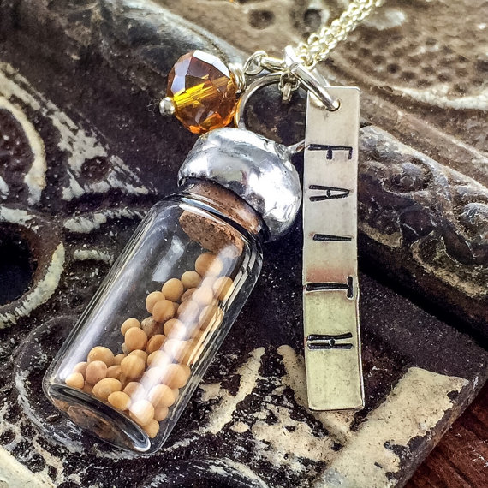
Mustard Seed Methods, LLC.
Expireds From “Stale to SOLD”
Notes:
Intro- Business for 16 years now, started out with KW for 6 years and then husband got his Broker license and we have been selling on our own ever since. We do an average of $12mil in volume each year consistently made up mostly of expireds and past clients. Recently, we have boosted our average sale price from $154k up to $232k through our proven “pre-habbing” techniques. We now sell 100% of our marketable listings at an average of 102% of asking price with our merchandising meetings and price prepping strategies.

Slide 2
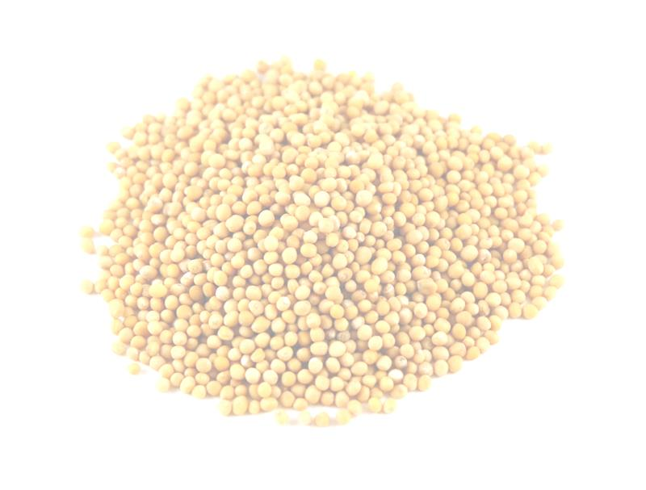
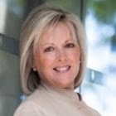
Melanie Ferguson
14 years in real estate
CRS since 2006
Co-writer for KW Listing Mastery
Participated in Special Listing Masterminds
Converts 4 out of every 10 expired calls
Average $12million volume every year
Other Businesses
Mustard Seed Methods, LLC.
Notes:
Stats credentials number of conversions

Slide 3
What is a mustard seed?
Although the mustard seed is one of the smallest seeds in agriculture, it is able to grow into a large tree, sometimes in even the most adverse conditions.
Mustard Seed Methods, LLC.
Notes:
For our purposes, the mustard seed represents our business. For this session it represents our Expireds Business.

Slide 4
People do business with people they “FEEL” like they know, like and trust.
Mustard Seed Methods, LLC.
Notes:
It’s true that people do business with people they ‘feel’ like they know, like and trust. Who always comes out feeling the best in a conversation? The one who talks the most!

Slide 5
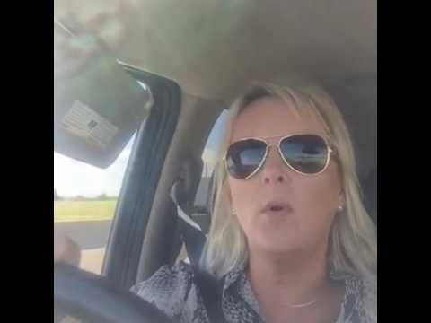
Silence is the Sunshine!
Mustard Seed Methods, LLC.
Notes:
Silence is the Sunshine… the best way to explain this is in a little video clip that I shared right after taking an expired listing. Here it is!

Slide 6
If you’ll let them, most prospects will talk themselves right into hiring you! --Melanie Ferguson
Mustard Seed Methods, LLC.
Notes:
I’ve found that if you’ll let them, most prospects will talk themselves right into hiring you...So how do we get to that point? Before every phone call, I say a quick “They’re Home, They’re Happy, and They’re Hiring Me!” to myself. HOME, HAPPY, HIRING
Agreement before Advice Always! They must say “yes” at least 4 times to ‘anything’ you say to be in agreement. This needs to happen before you offer any of your own input whether it be condition, price, etc. Never discuss commission over the phone. We have scripts for that.
When on the appointment, Never sit down at the table until they are in ‘agreement’ with you or you may very well be wasting your time.

Slide 7
EXPIRED PHONE SCRIPT
Hi there! I’m calling about the home for sale, is this the owner? (Yes#1)
(without skipping a beat) Great, I’m ________with _________, I noticed your home is no longer available online and wanted to find out if it had actually SOLD??? (leading) or if it is still available for offers? (Yes#2)
From the pictures, it looks like a great property…why do you feel it didn’t sell? (I completely understand..)
Hmm, Oh, I see…well…If it had SOLD… may I ask where were you planning to go?
Great, have you chosen another home already? (Yes #3) When would you have liked to be moved?
So then, how soon could you give possession of the home to a buyer? _____________________
Sounds like a great plan! (Whisper) Now what happens if this home is not sold by then, what will you do? how will you feel? So, would it actually be in your best interest to have the home sold in the next say 30-60-90 days? (Yes #4)
Close: Yes: Great, Hmm, then I’m glad I called…you see, we specialize in homes just like yours that should have SOLD but didn’t and it would only take me a few minutes to see enough of your home to tell my buyers about it, what time works best for you, ____ or____? I’m excited to meet you and see the home!
No: Bless them and move on!
Mustard Seed Methods, LLC.
Notes:
This script is 100% proven to get appointments! I get 4 out of every 10 expired appointments using this very script! This one is my free gift to you. Just go to the website at the end of this presentation to get your copy and get started!

Slide 8
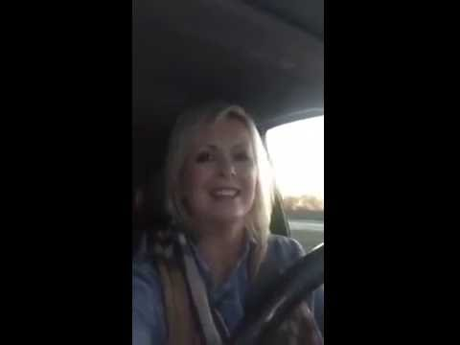
Expired Meeting Excitement!
Mustard Seed Methods, LLC.
Notes:
This is something I posted on my way to an expired listing appointment.

Slide 9
Leverage Yourself!
How Do I Find Expireds?
What about the DNC?
vulcan7.com/mustardseedmethods
Mustard Seed Methods, LLC.
Notes:
LEVERAGE! You know what to say, now who do you call? You can try to search your mls for expireds and then look up on white pages which is time intensive and often inaccurate info. Or you can subscribe to a service. There are several out there now to choose from, I have tried most all of them and prefer Vulcan7 because of their accuracy! I do not like spending time calling the wrong numbers and making no appointments. As far as the DNC is concerned, this is a personal choice. I’m of the personal opinion that if you need an excuse not to call, this would be yours….I call them all. Vulcan7 will let you know if they are on the DNC list. They are the only lead service that is set up to handle an ISA. Inside Sales Agent. Simply upload your Expired Script and monitor your progress all in one spot! They are a sponsorship only service and this link will get you signed up with one month for $49 and 3 past months of expireds for FREE!

Slide 10
“Expireds Challenge”
What do you do to differently to market the home? That is a great question that I want to address. (write it down) It may be easiest to give you a copy of our proven 89 point marketing plan for your review, if it looks good to you, will you be ready to hire me today?
Mustard Seed Methods, LLC.
Notes:
If you’d like a free copy of our 89pt marketing plan go to our fb page mustard seed methods...

Slide 11
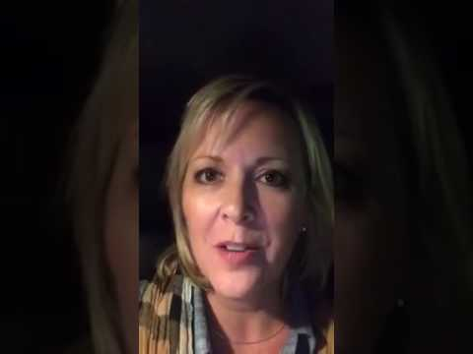
Nailed It!
Mustard Seed Methods, LLC.
Notes:
Took the listing!

Slide 12
Peace is found in the Plan
Daily activities as small as a mustard seed,
grow into Big Results!
Top 5 Expired Appointment Scripts along with Pricing Expireds to Sell
MustardSeedMethods.com
Mustard Seed Methods, LLC.
Notes:
Make a plan to add Expireds to your lead gen methods and watch it grow!

Slide 13
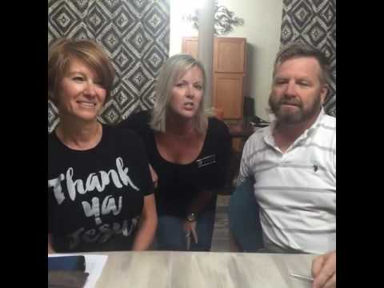
Don’t forget to add Facebook Video Testimonials!
Mustard Seed Methods, LLC.
Notes:
Don’t forget to tell the world through social media!

Slide 14
Referrals in the North Texas Area
Melanie Brett Ferguson
972-672-3341
FergusonRealtyGroup.com
Mustard Seed Methods, LLC.
Notes:
Here it is!

