Slide 1
ChatGPT and Your Real Estate Business

Slide 2
Open AI’s New ChatGPT

Slide 3
AGENDA
What is ChatGPT?
ChatGPT Interface
How to Use ChatGPT
Use Cases

Slide 4
What is ChatGPT?
ChatGPT is an artificial intelligence chatbot developed by OpenAI and was released in November 2022
It stands for Chat Bot+ Generative Pretrained Transformer
Generative = Generates Responses
Pretrained = It is Pretrained by Humans
Transformer = Transforms input to meaningful output

Slide 5
What is ChatGPT is NOT?
It is NOT Smart – It is a trained algorithm
It is NOT Creative – It does what you ask
It is NOT Always Right – Check your work
It is NOT Connected to the Internet – unless use plug-in (Bing)
It’s NOT fully current – Data from 2021-2022

Slide 6
What Can It Do?
Craft engaging property descriptions
Write informative blog posts, books or articles
Write persuasive sales pitches
Build seller and buyer campaigns
Create a social media calendar and content
SEO copy
Create Facebook Ads
Build class content
And so much more!

Slide 7
Fun Facts
100 Trillion parameters (data)
830 Plug-ins
10 million queries a day

Slide 8
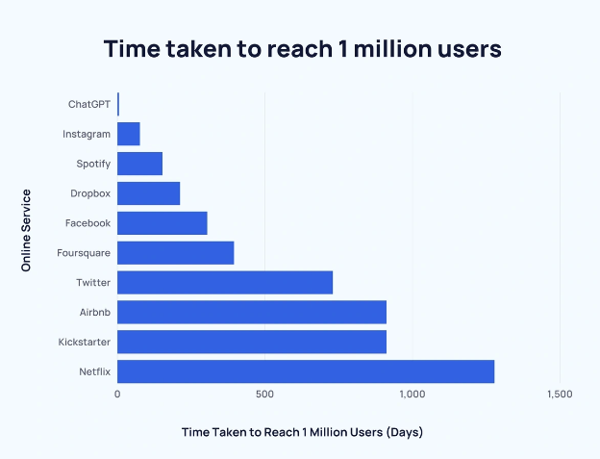

Slide 9
Time taken to reach 100 Million Users
Canva – 9 years
Facebook – 5 years
Instagram – 2.5 years
TicTok – 9 months
ChatGPT – 60 DAYS!

Slide 10
Three Ways You Can Use ChatGPT Right Now

Slide 11
1) Copywriting
Listing Descriptions
Email
Ad Copy
Writing Reviews
Website Copy
Blog Posts
Buyer/Seller Guides
Checklists
SEO
Write your Bio
Write a book

Slide 12
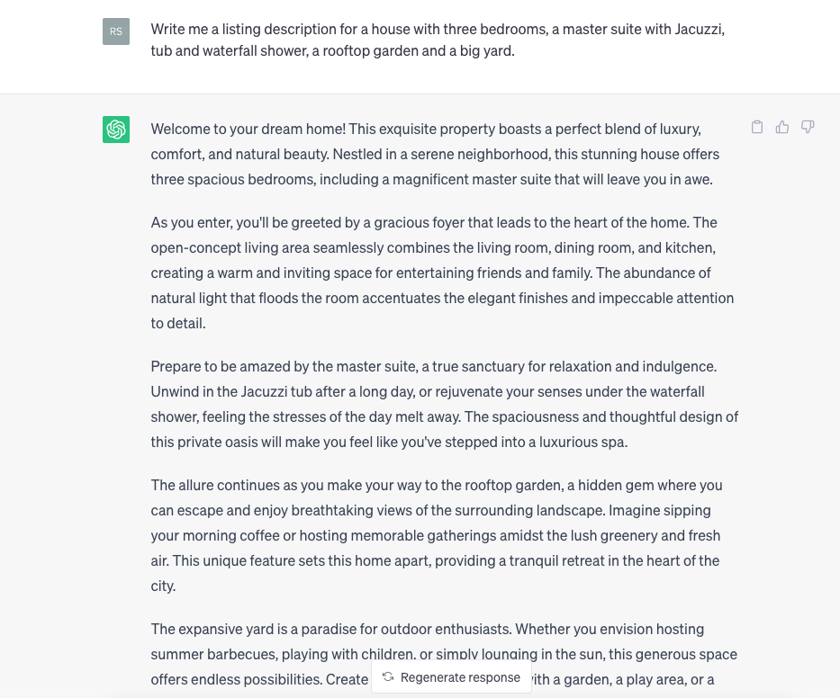

Slide 13
Open House Previews

Slide 14
Prompts
Prompt: In a casual but professional tone, write a brief letter introducing a neighborhood property with three bedrooms, master suite with a jacuzzi and a big yard with a three-car garage just 20 miles outside the city. I want to invite neighbors to an exclusive open house preview of the property on Saturday, July 29th from 2:00 to 4:00 pm. End with a call to action for more information.

Slide 15
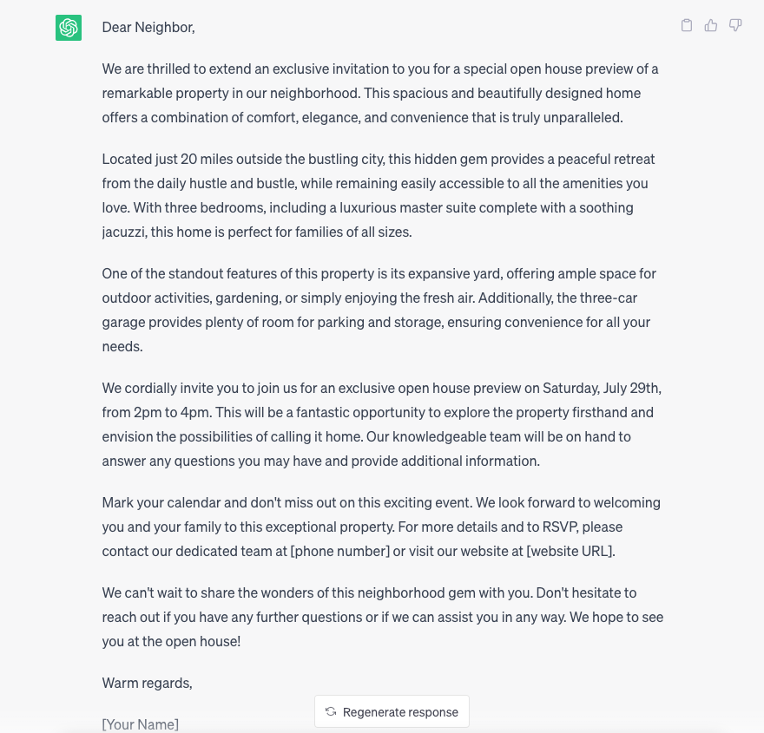

Slide 16
Facebook Ads

Slide 17
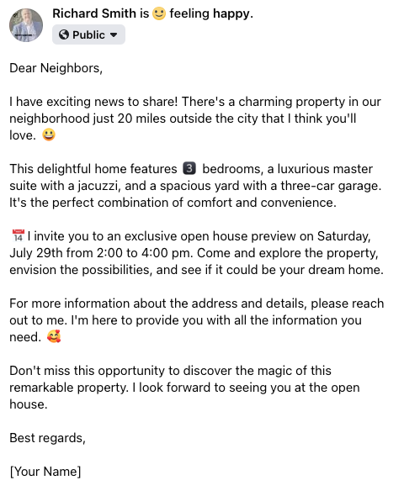

Slide 18
2) Social Posts
Video Scripts
Content Ideas
Instagram Reels
Keyword Search

Slide 19
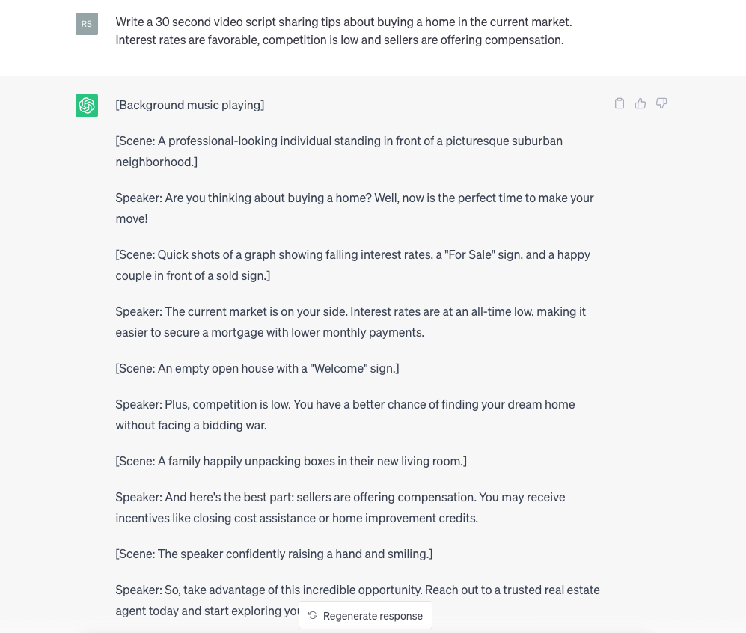

Slide 20
3) Messaging
Emails
Team Communication
Assistant Tasks
Listing Presentations
Video scripts

Slide 21
Email
Subject lines for prospective home buyers
Create an email to help buyers prepare for moving day
Sellers looking to relocate
Improve emails or get help revising to give them a different approach

Slide 22
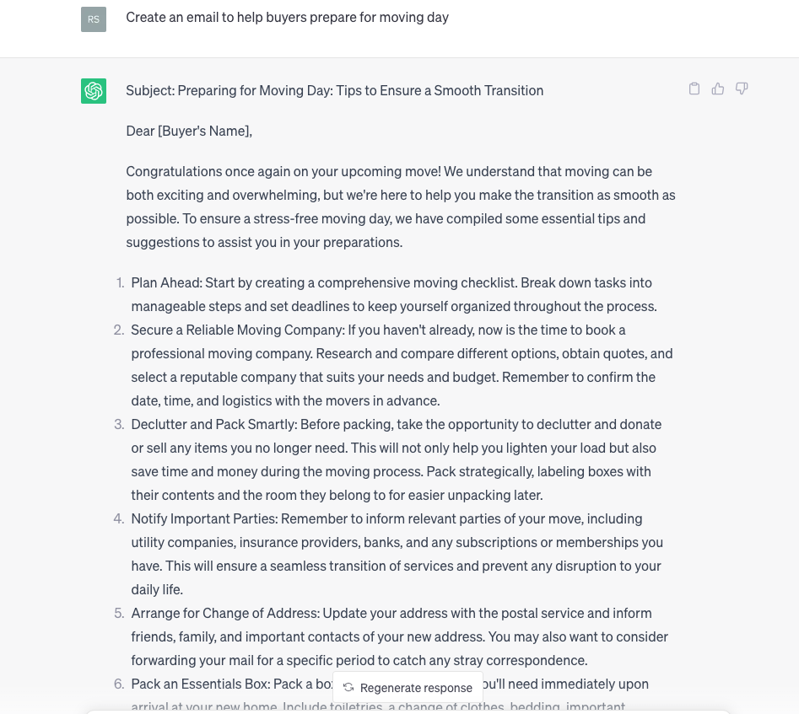
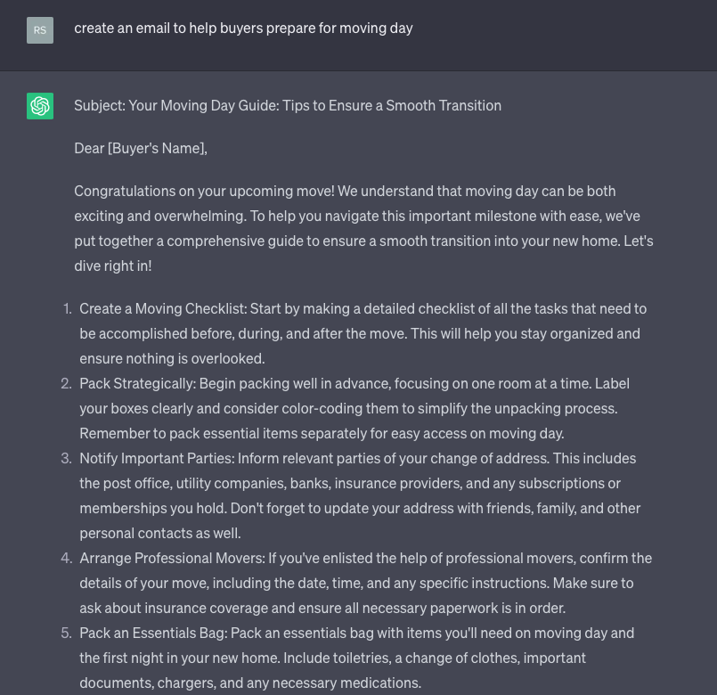

Slide 23
Listing Presentation

Slide 24
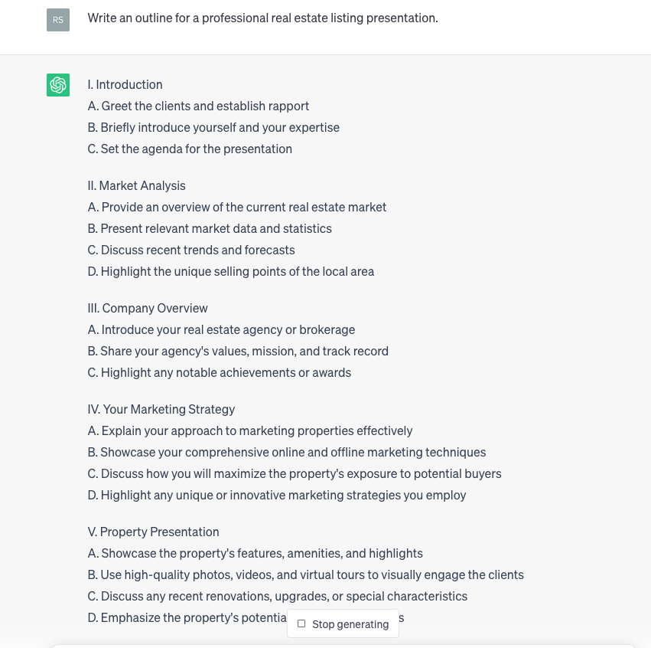

Slide 25
Openai.com

Slide 26
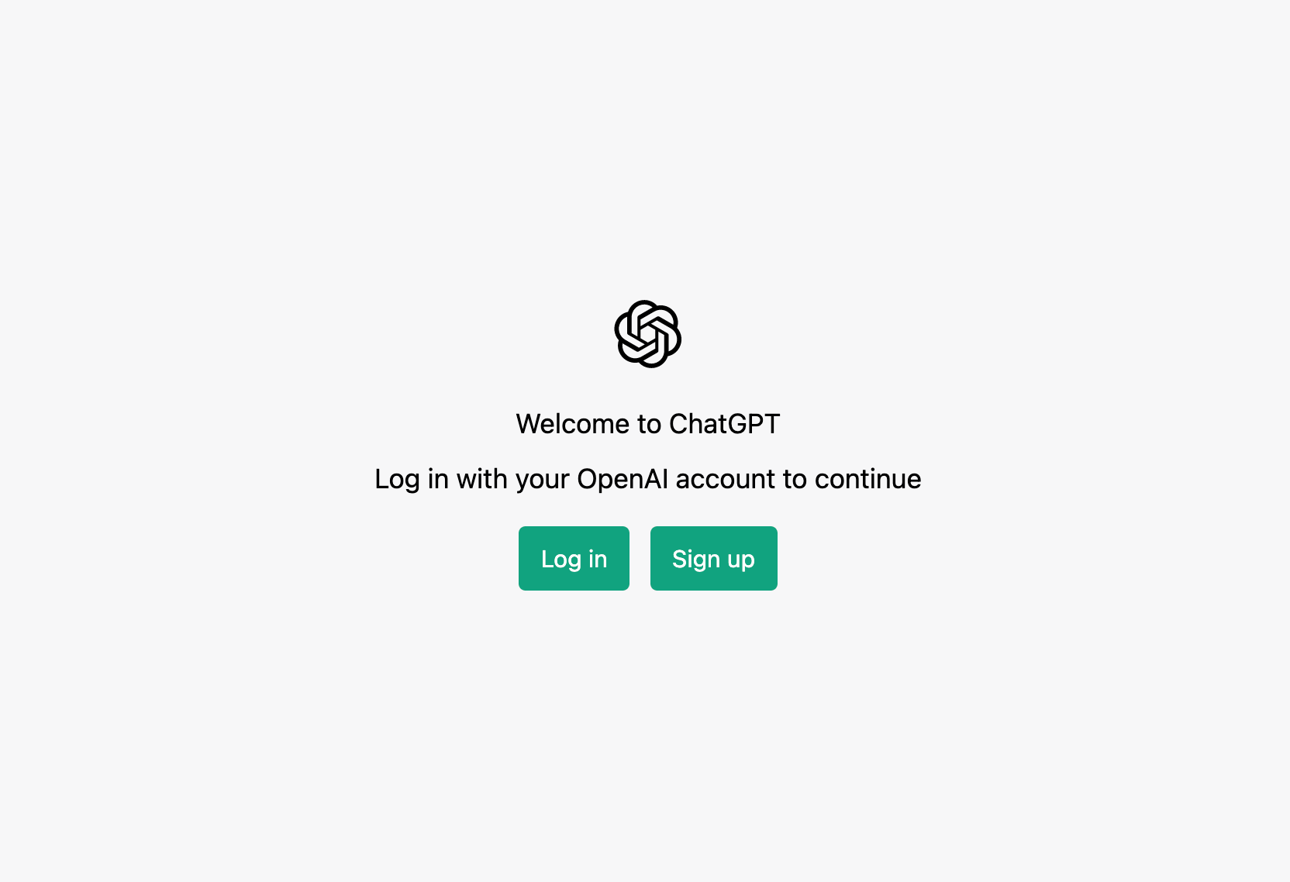
Openai.com

Slide 27
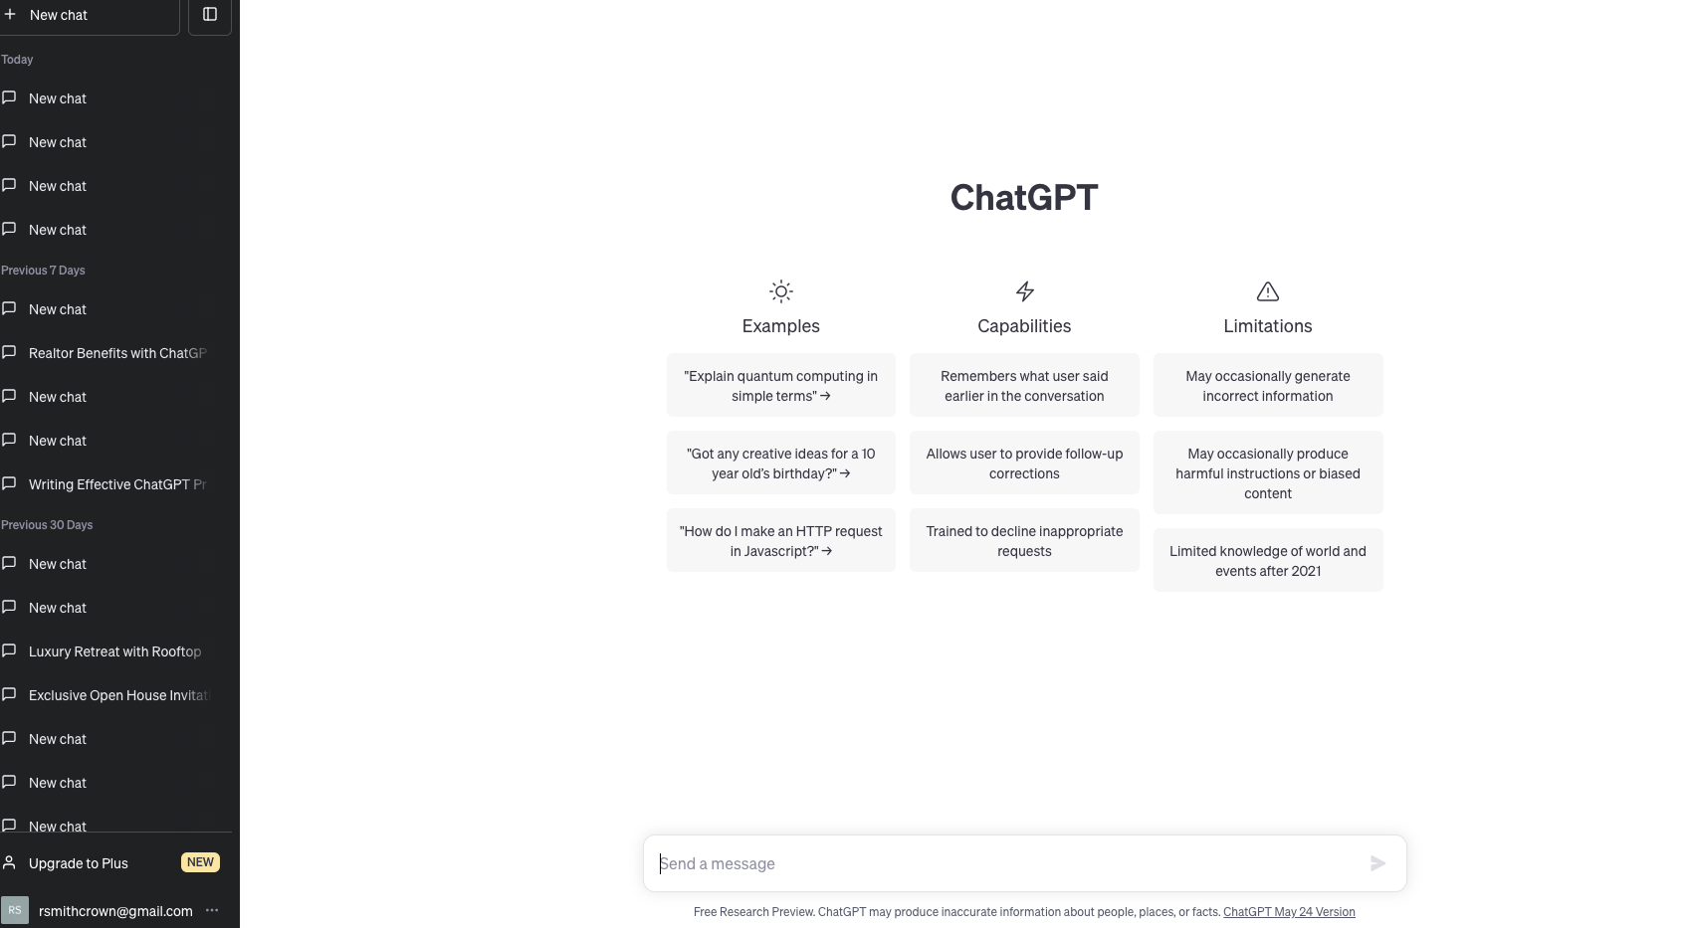

Slide 29
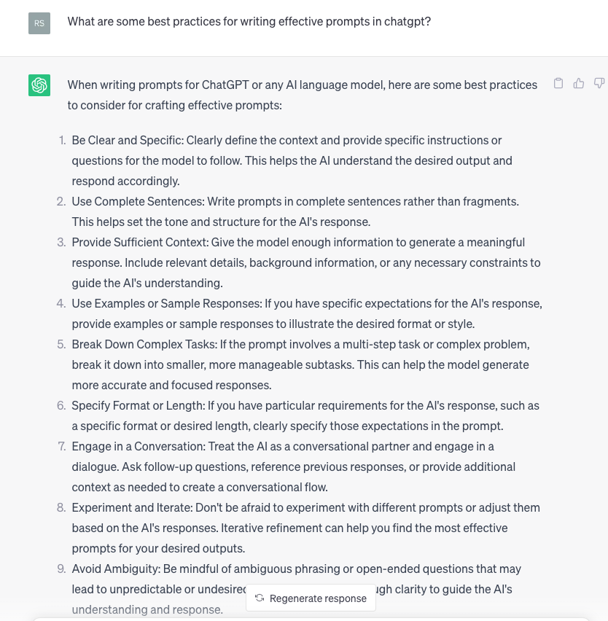

Slide 30
Pro Tip
Use the “act as” hack to specify that the ChatGPT should “act as” a tutor or language coach, providing clear direction and guidance.

Slide 31
ChatGPT Tips: CREATE
CREDIT: TERRANCE

Slide 32
Notes:
Two apps that can help you with writing emails and content

Slide 34
Will AI replace real estate agents and lenders?!!
“Analytical and thinking tasks are increasingly being performed by AI, and, thus, human workers must place increased emphasis on the empathetic and emotional dimensions of their work."

Slide 35
Remember
The two most important things are your prompts and what you do with them.
You need to audit the content and add your own voice. The output won’t always be perfect.
Just get started. Practice, test and repeat. You will improve.

