Slide 1
How to Use Digital Business Cards to Build Referral Network

Slide 2
What is Savvy Card
FOR INDIVIDUALS
SavvyCard is the free business referral system where everybody works for you.
You create your free SavvyCard in minutes with our easy to use Card Builder, customize it as little or as much as you’d like and share it with everyone you know so they can pass you referrals.
Each SavvyCard includes:
Share button so people can refer you by text, email and QR code
Call, Text and Email buttons so people can easily contact you
Find button so people can get turn by turn directions to your place of business
Personal Profile and Organization buttons so people can learn about what you do
My Sites and Social buttons to link to your existing websites and social accounts
SavvyCards aren’t meant to replace your existing business cards, but they are an awesome complement to them. Like peanut butter and chocolate. Or bacon and... more bacon.
For times when you can’t give out a paper business card, use SavvyCard instead.

Slide 3
What is Savvy Card
Business Referrals
You can’t give everyone you know a stack of your business cards (and they probably wouldn’t carry them around everywhere even if you did!). Email or text your SavvyCard to your friends, family, employees and clients so that they can use it to refer you to the people they know.
The SavvyCard system tracks all referral activity, so you can easily know when someone is referring you and thank or reward them for their efforts. Every time you are referred through the SavvyCard system, you’ll get an email notification, so that you can immediately follow up and close that business.
Remote Introductions
More than ever, business is happening remotely—through email, phone and over the web. There’s no substitute for meeting potential clients in person, but for those times when that’s not possible, SavvyCard is the next best thing to a firm handshake and a smile.
Text your SavvyCard to people you meet over the phone
Email your SavvyCard to people you are introduced to on the web
Link to it from your email signature
Share it to through social media like Twitter and Facebook
Send it to people you are meeting in person for the first time so they know what you look like (we’ve all done that dance at Starbucks or Panera Bread right?)

Slide 4
What is Savvy Card
Never be without a card
There are times when you just don’t have a business card handy, and invariably that’s when you meet the perfect client. Instead of scribbling your contact details on a napkin, whip out your cell phone and text them your SavvyCard. When you get back to the office you can pull their name and contact information from your SavvyCard Referral Log and easily reconnect with them.
Highly interactive "mini websites" through which you can market yourself in ways not previously possible with regular business cards.
Even indexed by search engines and can be found through online searches, particularly local ones.
Work on any web-enabled device. Laptop, iPad, Android, Samsung Galaxy, everywhere
Fully Customizable. Add Backgrounds, images, websites, and more
Make it a lot easier to market yourself and network.
You can update them at any time and those changes will propagate to everyone who has your card - in real time.

Slide 5
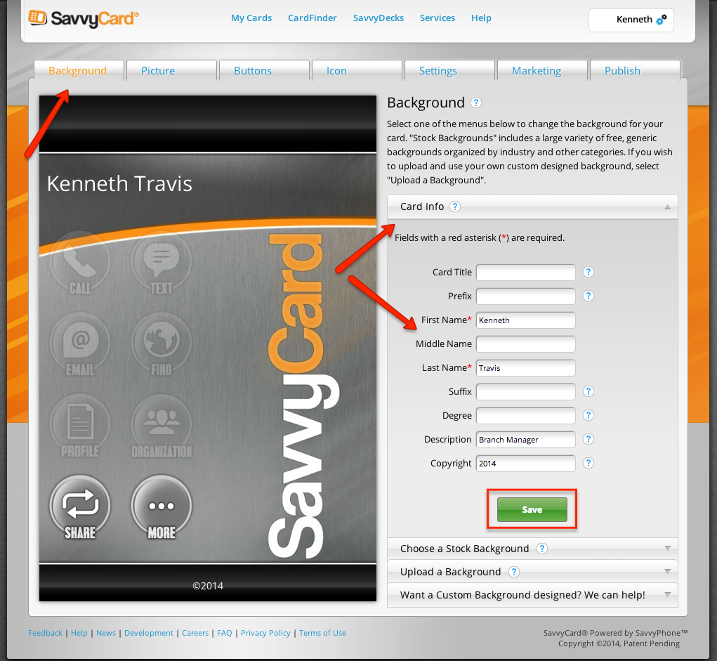
Step By Step - Background
Click the Background tab
Then Card info tab on the right
Fill in Card info as needed
Click “Save”

Slide 6
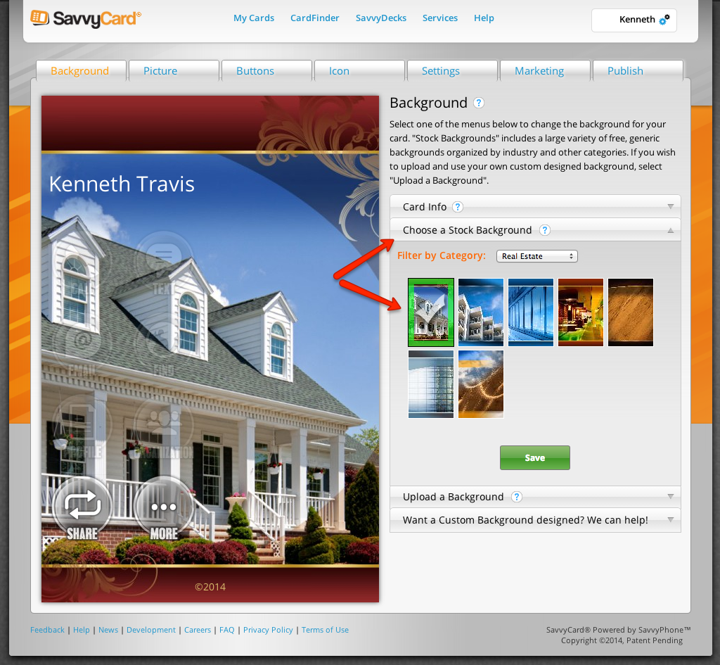
Step By Step - Background
Click “Choose a Stock Background” or “Upload a Background”
Then choose one that you prefer
Fill in Card info as needed
4. Click “Save”

Slide 7
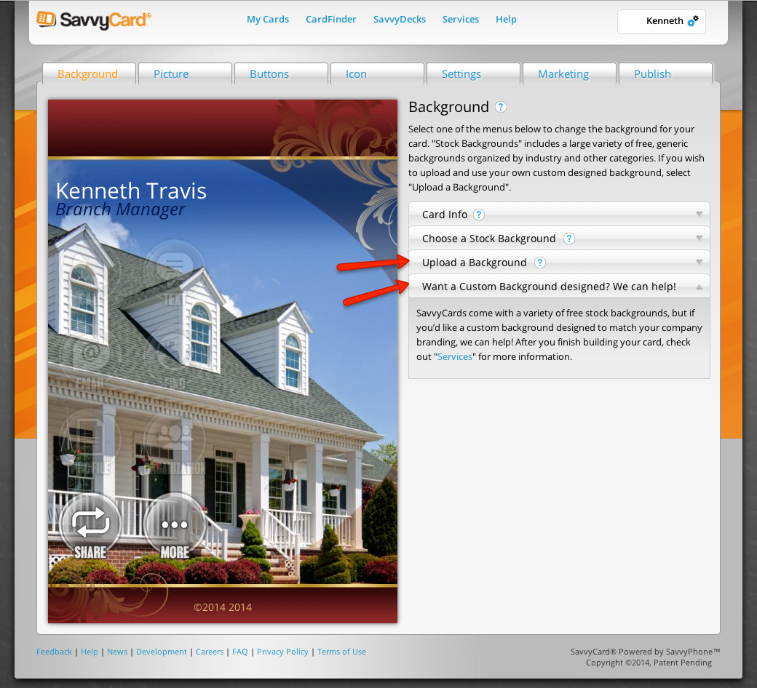
Step By Step - Background
You can upload a background using the guidelines and templates provided
You can also have a custom background designed for a small fee

Slide 8
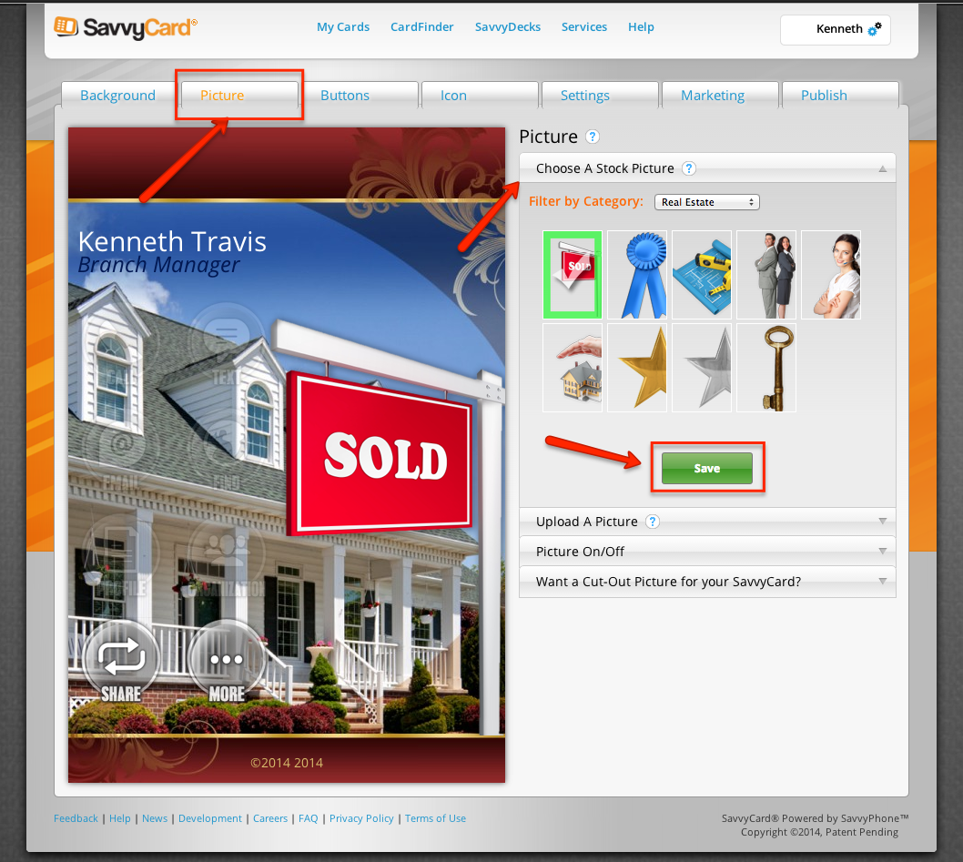
Step By Step - Pictures
Click the “Picture” Tab on top
Then “Choose A Stock Picture” or “Upload a Picture”
After your selection click “Save”
Picture is automatically saved and turned to “on”

Slide 9
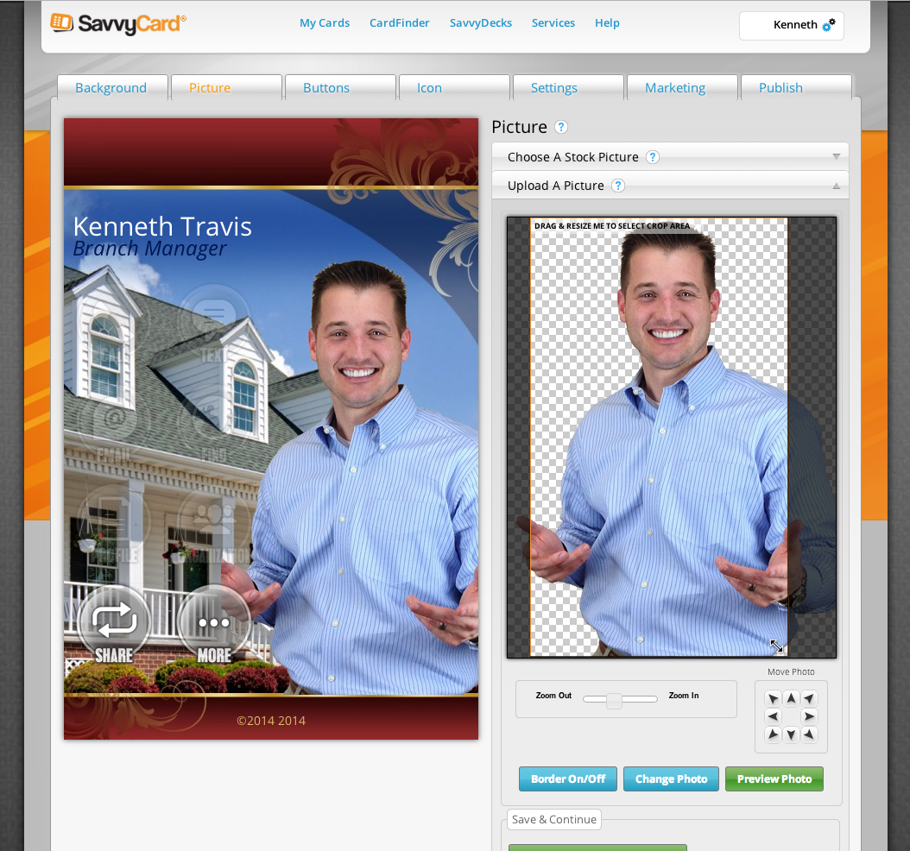
Step By Step - Pictures
Click the “Upload a Picture”
Then choose file
Drag and resize as needed
Click “Apply Photo Changes & Finish”
Service for cut and retouch of photos to have similar effect as shown for a small fee.

Slide 10
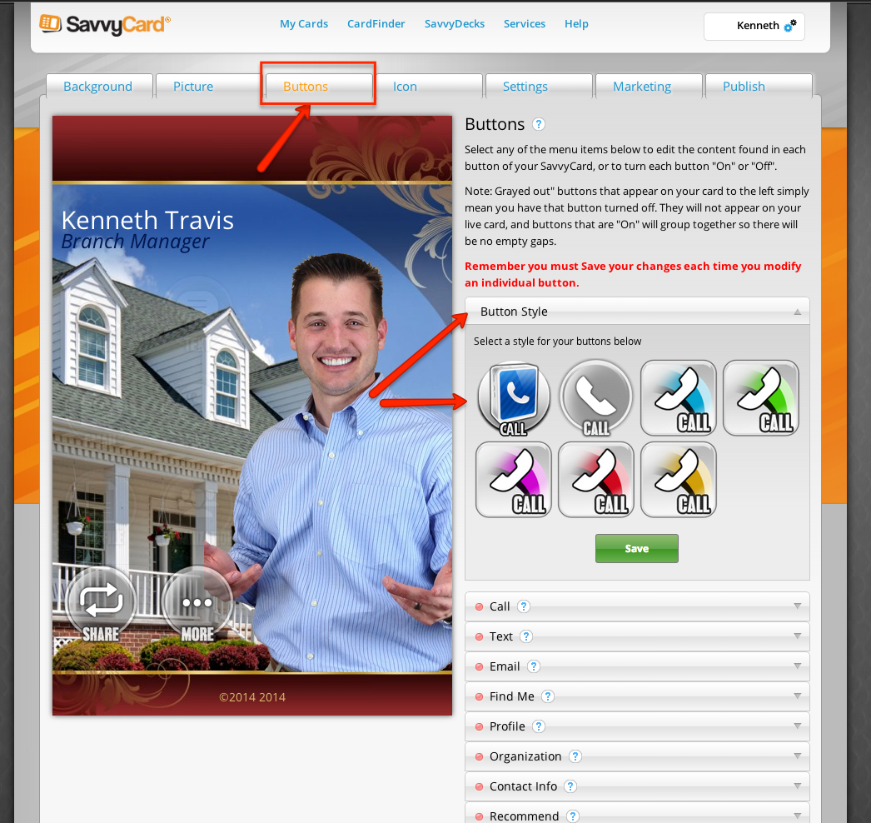
Step By Step - Buttons
Click the Buttons Tab
Then choose a button style
Click “SAVE”
Remember you must save your changes each time you modify an individual button

Slide 11
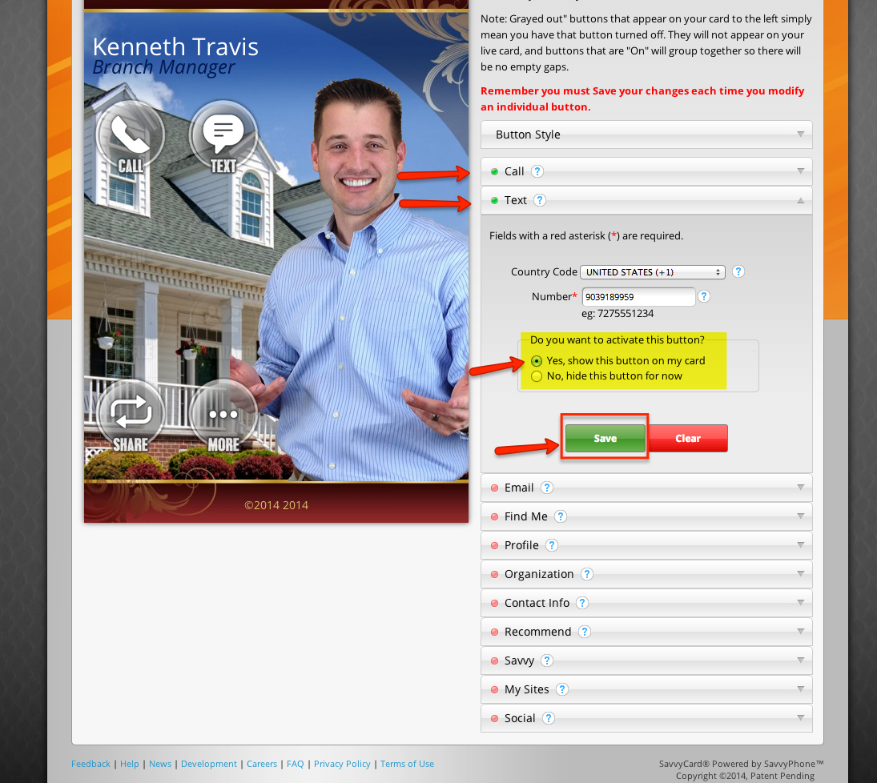
Step By Step - Buttons
Click each button that you would like to have added as needed
Then click “Yes, show this button on my card”
Click “SAVE”
Remember you must save your changes each time you modify an individual button

Slide 12
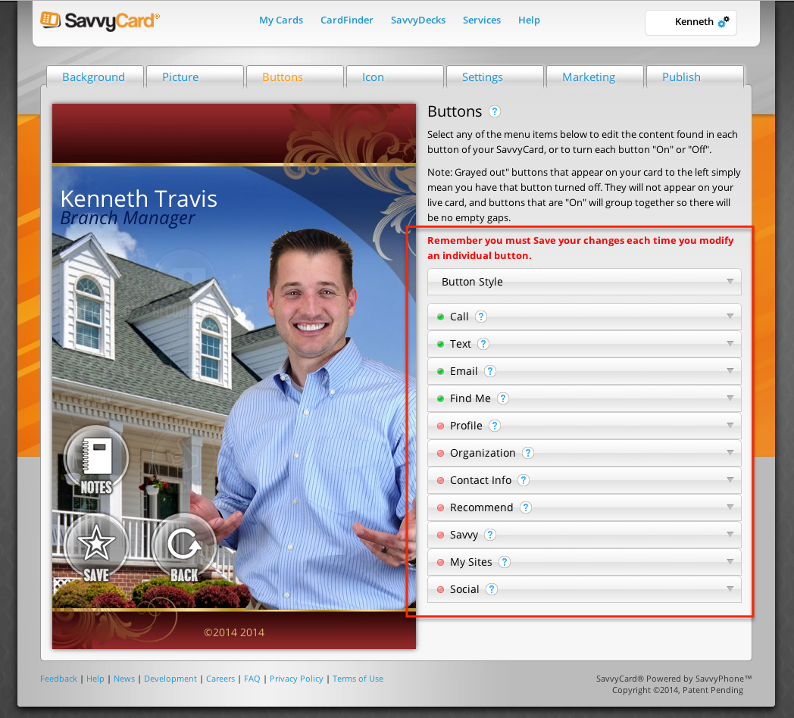
Step By Step - Buttons
Add as much information to each button as you can.
The More information & education you can share with potential client is better.
Examples of information & Education

Slide 13
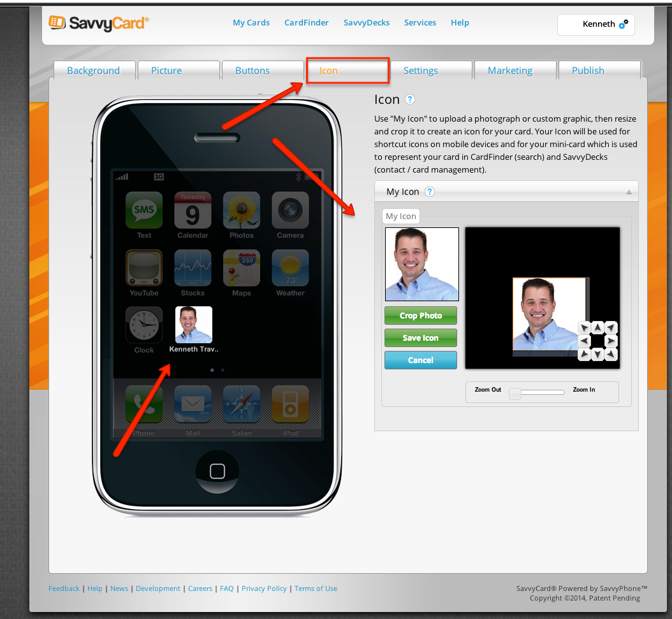
Step By Step - Icon
Click on the Icon tab
The Icon is picture that will show on the clients smartphone. It is best to have something that represents you and that people will recognize.

Slide 14
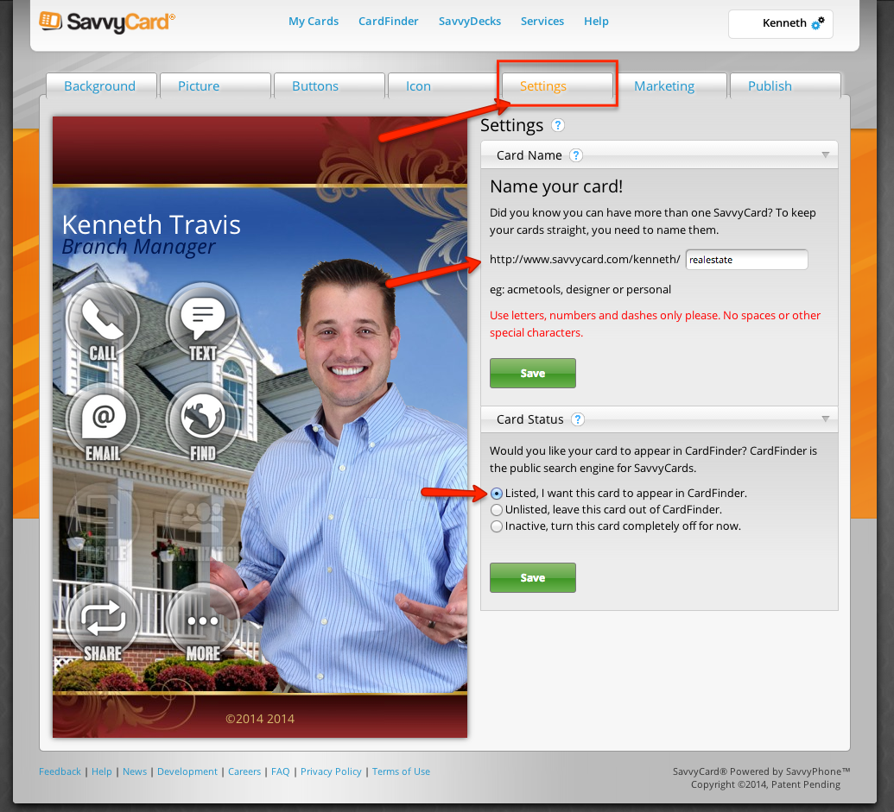
Step By Step - Settings
Click on the Settings tab
Name your card something that represents you and your business
Click Save
Check the “Listed” button. You want your card to appear in card finder where others can search for you
Click Save

Slide 15
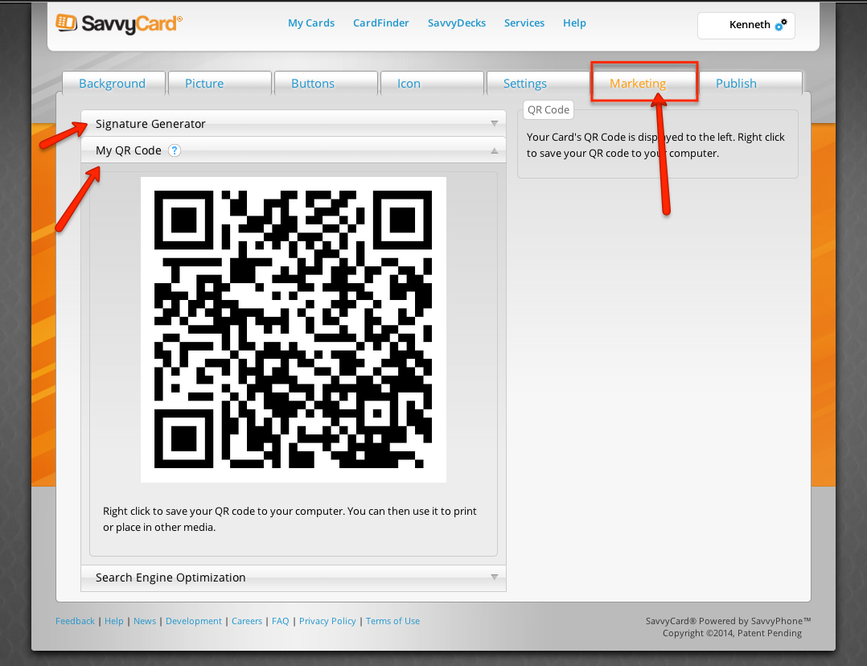
Step By Step - Marketing
Click on the Marketing tab
You can generate a signature to use on email signature line
You can use the QR code on business cards and print marketing.

Slide 16
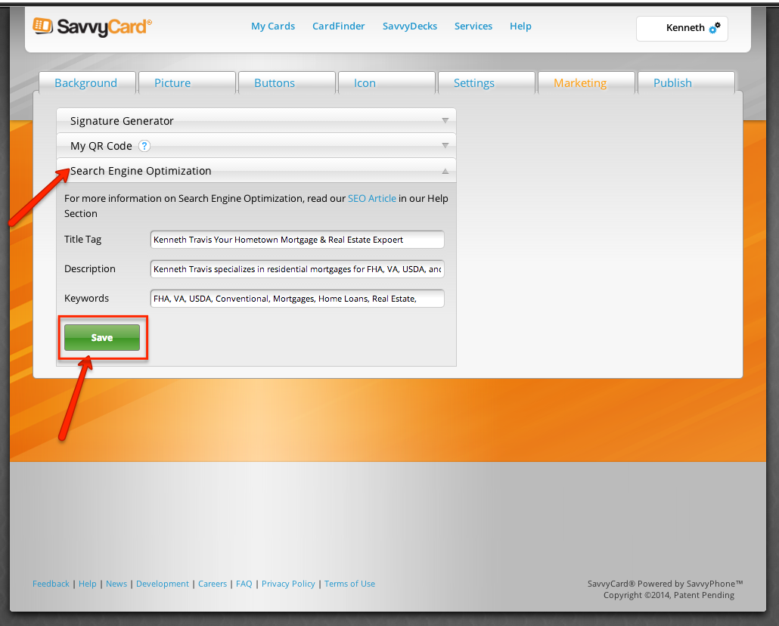
Step By Step - Marketing
Click on Search Engine Optimization
Fill in Title Tag, Description, and Keywords that you want to represent you. These terms will be indexed by search engines and help with overall SEO
Click SAVE

Slide 17
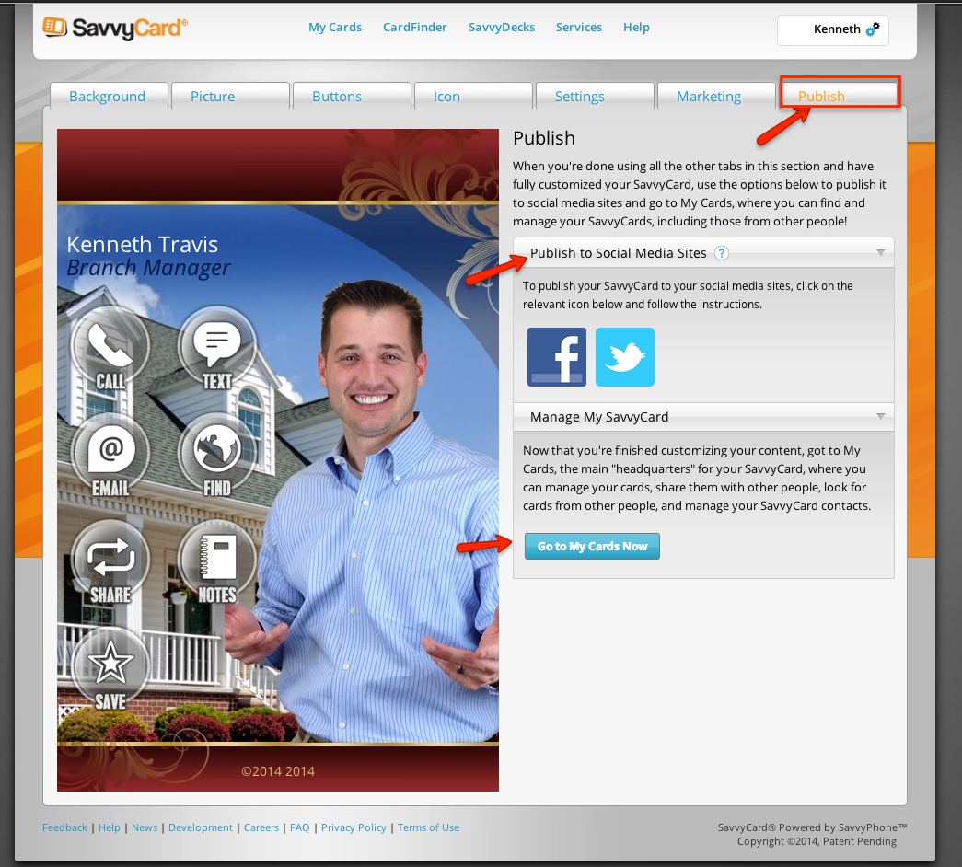
Step By Step - Publish
Click on Publish Tab
Publish to share to social media site
Click Go to my cards now

Slide 18
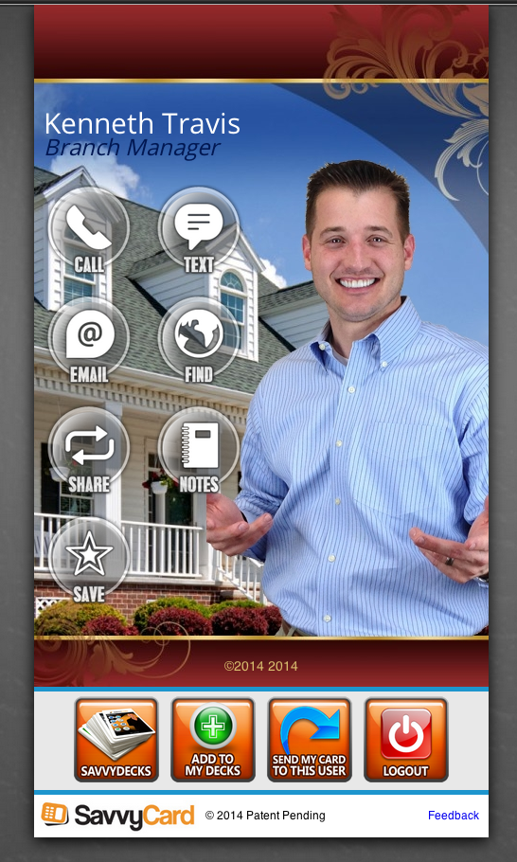
Step By Step - Final

Slide 19
Discussion
Use SavvyCards to Market Your Business
Following are some ideas for how to use SavvyCards to enhance marketing programs for your business.
- Branding
- Sharing
- QR Codes
- Email Signature
- Web Links
- Green Marketing

