Slide 1
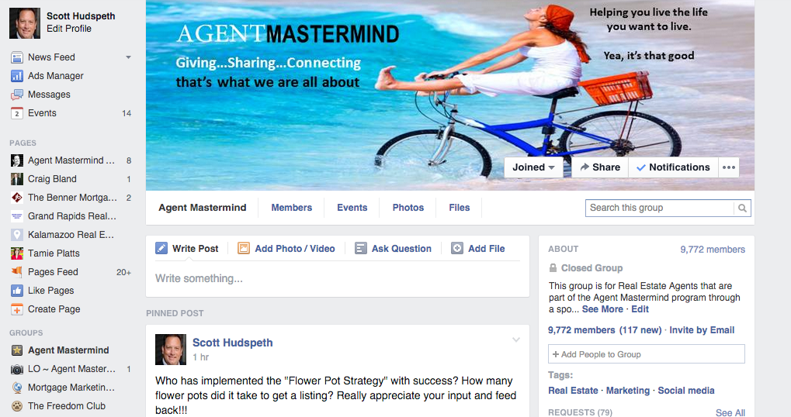
Welcome To Agent Mastermind
www.agentmastermind.com/groups/agentmastermind

Slide 2
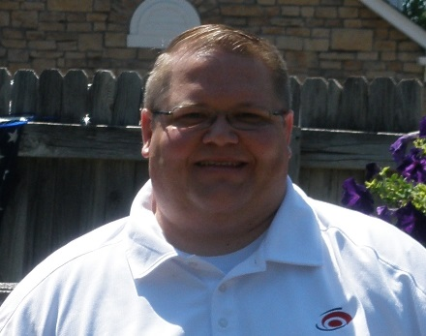
Lead Generation & Prospecting Expireds and FSBOs
Aaron Redfearn, Loan Officer

Slide 3
About Aaron Redfearn
Senior Loan Officer at Supreme Lending in Denver
Over 13 years of mortgage experience
Based on 2013 survey results, 100% of our Realtor partners recommend us to their peers, 99% of our consumers
Use today’s technology to help Agents win every Listing Presentation and sell their Listings faster
Using Results In Advance marketing, I help Agents double their business
Married to my wife, Karla, for 11 years
Have 2 sons, ages 7 & 8, the oldest wants to play professional football someday

Slide 4
Game Plan Today
Essentials Of Selling-Daily Success Plan
Examine Cold Calling vs. In Person Visit
Law of Reciprocity
Results In Advance Marketing
Discuss lead generation
12 prospecting tips
4 scripts that work
5 Top seller objections
10 things you should do

Slide 5
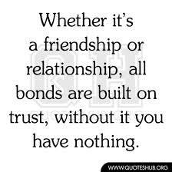
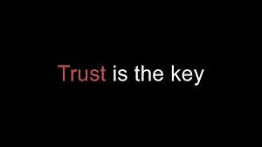
Essentials Of Selling
Selling Essentials
People do business with people that they Bond With and Trust
Find opportunities to eyeball your Leads, to shake their hand and introduce you as a person…and not as a postcard or voice message

Slide 6
Essentials Of Selling
Key To Your Success- Have A Daily Success Plan
3 “In Person” Visits per day (3E,2E+1F,1E+2PC)
12-18 “Success Calls” per day
This is known as “Money Making Activity”
Do this and watch your business grow
Use your Loan Officer as an Accountability Coach
Today’s strategy will give you Both

Slide 7
Essentials Of Selling
Ask Yourself…What Is My Competition Doing With Expireds?
Sending out a postcard?
Calling and leaving a voice message?
Ask yourself… Do I want to be another postcard or just another voice message?

Slide 8
Essentials Of Selling
Have You Ever Wondered How To Be A Green Fish In A Goldfish Bowl?
Do you want a “Unique Selling Proposition”?
Results in Advance is your “green fish”

Slide 9
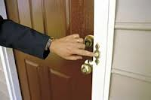
Essentials Of Selling
So Should I Cold Call My Leads or Make In Person Visits?
Let’s Take A Look At Both Techniques?

Slide 10
Cold Calling Vs. Visit
Cold Calling
Time block 4 to 6 hours a week to prospect
Call 60 to 90 leads a week
Don’t take incoming calls when prospecting
Don’t sell anything over the phone
50% to 60% of Expireds/ FSBOS don’t answer the phone
If you call 60 prospects a week- 24 to 30 will answer
24 to 30 Live conversations- goal is at least 5 appointments
Only reason your calling is to get a face-to-face
Agree with what they say and get an appointment
Any selling will be done in person
After prospecting session put notes into database

Slide 11
Cold Calling Vs. Visit
Personal Visit
Use Results In Advance marketing
Prepare your marketing pieces the day before your visit
Ring the doorbell with a 50/50 chance they are home (give or leave)
Set appointment after they review your marketing materials
Higher rate of conversion

Slide 12
Cold Calling Vs. Visit
Once you see both techniques, chose the one best suited for your personality

Slide 13
Law Of Reciprocity
Reciprocity in social psychology refers to responding to a positive action with another positive action, rewarding kind actions
If you provide Marketing, Marketing, Marketing materials in advance of your meetings with Sellers, you begin to build trust and bond with the Seller.
You may receive a positive action back from the Seller

Slide 14
Results In Advance Marketing
First, ask why the Expired’s home did not sell and they did not renew their Listing agreement?
In the eyes of the Seller it was not enough marketing of their home to bring a suitable buyer to purchase their home
Your focus is on marketing, marketing and marketing their home
In fact, any flyer, brochure or website should make NO mention of price…focus on marketing

Slide 15
Results In Advance Marketing
What if you prepared the following in advance:
Create a property website
Create a “flipbook presentation”
Create property business cards
Create a brochure
Create text message numbers to allow the property website to download to a cell phone
Create an ePost card that the Seller can share with family, friends and business associates
Create a HITS report
Create a Facebook Listing Page to get up to 40,000 eyeballs
And what if this took you only 20 minutes to prepare!

Slide 16
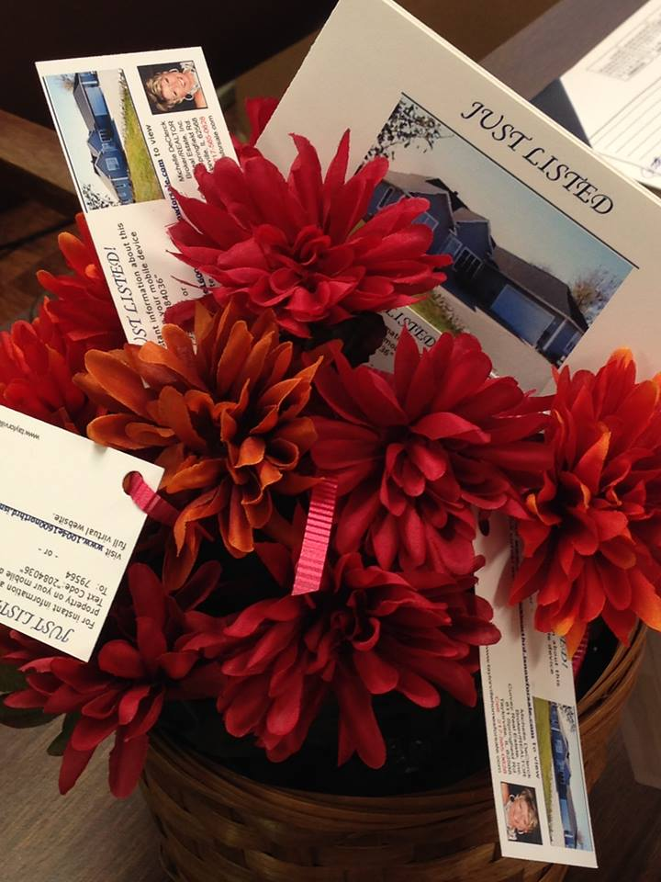
Results In Advance Marketing
What if your Presentation looked like this:

Slide 17
Let’s start with
6 Core Skills
Lead Generation
Database Management
Prospecting
Presentation
Handle Objections/ Solve Problems
Follow up

Slide 18
Why is Leads #1?
Leads are the Gas that drives the car!

Slide 19
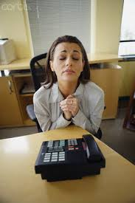
Don’t wait for the phone
Go on the offense!

Slide 20
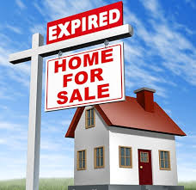
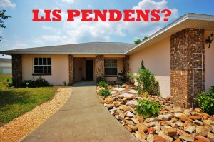
Buy quality leads
Spend $40 to $115 per month

Slide 21
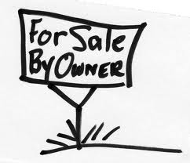
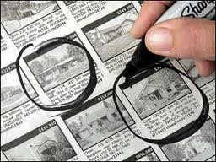
Why do I need to buy leads?

Slide 22
How long does it take?
If you are researching your own leads you’re wasting time!
Spend your time doing highly productive activities

Slide 23
A Recommendation
FSBO, Expired & Lis Pendens Leads

Slide 24
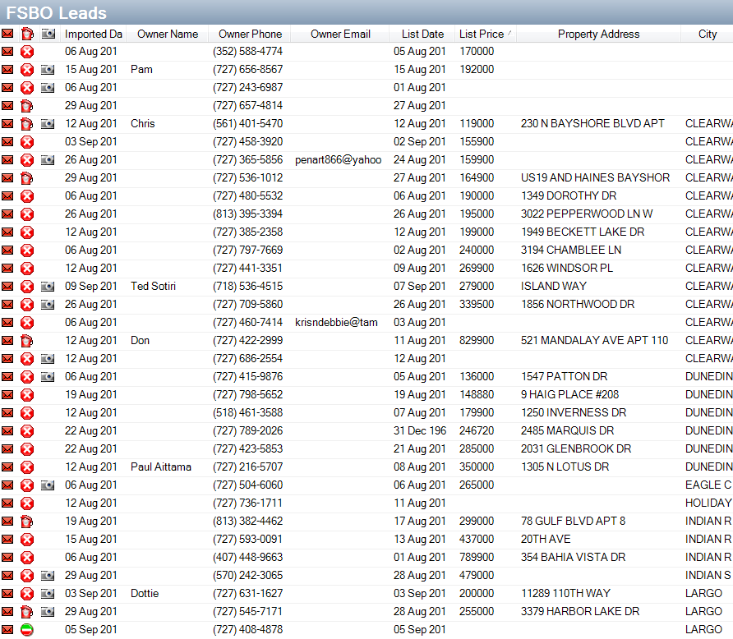
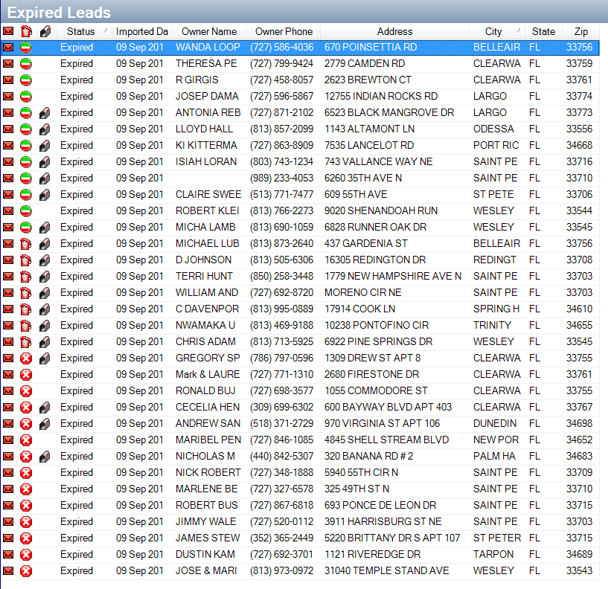
One Week REDX Example
110 FSBO Leads in One Month
33 Expired Listings in 4 days

Slide 25
Do the Math
REDX is on pace for approximately 200 leads this month
That’s 2,400 leads per year
The FSBO & Expired membership $89 / $112 (Lis Pendens)
Basically I’m trading $1,068.00 a year for over 2,000 leads
1- $200K listing sold will bring in a $6K commission
Over 50% of FSBO will list in 4 to 6 weeks
In 4 to 6 weeks your leads are ripe
Within 30 to 60 days working my program you’re very busy
How can you get those listings?

Slide 26
What’s Next?
6 Core Skills
Lead Generation
Database Management
Prospecting
Presentation
Handle Objections/ Solve Problems
Follow up

Slide 27
12 Prospecting Tips
Time block 4 to 6 hours a week to prospect
Call 60 to 90 leads a week
Don’t take incoming calls when prospecting
Don’t sell anything over the phone
50% to 60% of FSBOS don’t answer the phone
If you call 60 prospects a week- 24 to 30 will answer
24 to 30 Live conversations- goal is at least 5 appointments
Only reason your calling is to get a face-to-face
Agree with what they say and get an appointment
Any selling will be done in person
After prospecting session put notes into database

Slide 28
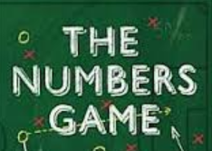
Number 12
Don’t take it personally!

Slide 29
Don’t Give Up After The First Call
1st call
No
interest
2nd call
Asking
Questions
3rd call
Booked
Appointment

Slide 30
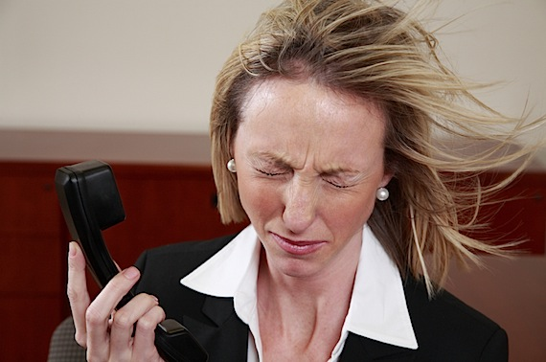
Mean vs. Nice
2 types of people you talk to when prospecting
I’ll take my chances!

Slide 31
4 FSBO Scripts- #1
(Yes, we are cooperating- script)
Hello may I please speak to the owner of the home for sale at _______________________?
(FSBO says: This is him)
I understand that you’re selling “For Sale by Owner” and I’m not trying to interfere with that, I was just wondering are you cooperating with real estate agents?
(FSBO says: Yes, we are… bring me a buyer and I will pay you a 3% commission)
Ok, that sounds great! Do you mind telling me a little bit about your home?
(FSBO says: I have 3 bedrooms, 2 baths, an in-ground pool, hardwood floors, etc…)
That sounds really nice… Is there a time I could come by and take a look at the property?
(Book the appointment)

Slide 32
4 FSBO Scripts- #2
(No, we are not cooperating script- We’re trying to save money!)
Hello may I please speak to the owner of the home for sale at _______________________?
(FSBO says: This is him)
I understand that you’re selling “For Sale by Owner” and I’m not trying to interfere with that,
I was just wondering are you cooperating with real estate agents?
(FSBO says: No, we are selling it ourselves we don’t really need an agent)
Are you selling it yourself because you don’t like Realtors or are you just trying to save money?
(FSBO says: We have nothing against Realtors, were just trying to save money?)
I appreciate your honesty…Do you mind telling me a little bit about your home?
(FSBO says: I’ll tell you about my home but I’m not going to list with you!)
Oh, that’s OK! Perhaps if I know more about your home, I would have it top of my mind if I meet a Buyer best suited for your home.
(FSBO says: I have 3 bedrooms, 2 baths, an in-ground pool, hardwood floors, etc…)
That sounds really nice… Is there a time I could come by and take a look at the property?
(Book the appointment)

Slide 33
4 FSBO Scripts- #3
(No, we are not cooperating script- We don’t like Realtors!)
Hello may I please speak to the owner of the home for sale at _______________________?
(FSBO says: This is him)
I understand that you’re selling “For Sale by Owner” and I’m not trying to interfere with that,
I was just wondering are you cooperating with real estate agents?
(FSBO says: No, we are selling it ourselves we don’t really need an agent)
Are you selling it yourself because you don’t like Realtors or are you just trying to save money?
(FSBO says: I don’t like Realtors!)
I appreciate your honesty, but if you don’t like Realtors I bet it’s because you’ve had a bad experience?
(FSBO says: Yes, I had several bad experiences and I can do this myself)
Ok, I understand but have you ever had a bad experience eating out in a restaurant? I know I have…but that doesn’t stop me from eating out…all I do is go to a different restaurant… Do you mind telling me a little bit about your home?
That sounds really nice… Is there a time I could come by and take a look at the property?
(Book the appointment)

Slide 34
4 FSBO Scripts- #4
(What does cooperating mean? script)
Hello may I please speak to the owner of the home for sale at _______________________?
(FSBO says: This is him)
I understand that you’re selling “For Sale by Owner” and I’m not trying to interfere with that,
I was just wondering are you cooperating with real estate agents?
(FSBO says: What does cooperating mean?)
It means, if I could help you produce a contract on your home would you be willing to work
with me as long as you get what you want?
(FSBO: Well I guess so, but I’m not going to list my home with you!)
That’s fine… Do you mind telling me a little bit about your home?
(FSBO says: I have 3 bedrooms, 2 baths, an in-ground pool, hardwood floors, etc…)
That sounds really nice… Is there a time I could come by and take a look at the property?
(Book the appointment)

Slide 35
5 Top Seller Objections
What commission do you charge?
Bring me a buyer and I’m willing to pay you a 3% commission!
I’m not listing with a Realtor!
Do you have a buyer for my home?
I have a friend in the business!

Slide 36
Notre Dame Study
44% of salespeople quit after the 1st time they hear NO
22% of salespeople quit after the 2nd time they hear NO
14% of salespeople quit after the 3rd time they hear NO
12% of salespeople quit after the 4th time they hear NO
92% of salespeople quit - 1st and 4th time they hear NO
60% of sales close after prospect says NO at least 4 times
8% of salespeople are left when the prospect is ready to say YES

Slide 37
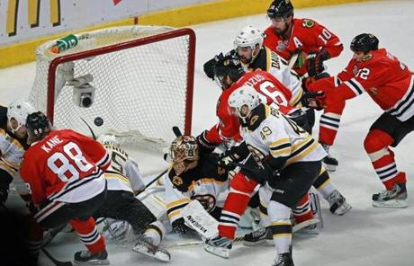
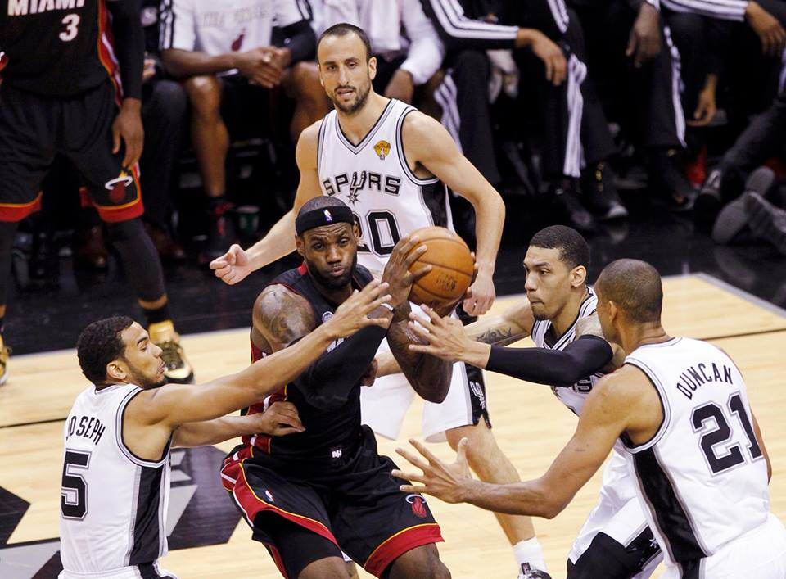
Rebounding Wins Championships
Game 2 - 2013 Stanley Cup
Game 4 - 2013 NBA Finals
Because the first shot rarely goes in!

Slide 38
10 Things to Do When Cold Calling!
Start with a FSBO & Expired package…$89 a month
Download leads a couple of times per week
Time block 4 to 6 hours of calling time per week
Call 15 people per hour
3 to 5 minutes per phone call
Call 60 to 90 people a week
Log results into database
Set up a minimum of 5 appointments a week
Follow up with Everybody!

Slide 39
Most Importantly
10. When previewing the house…
Focus on Conversations not Conversions!

Slide 40
Finally
Conversations turn into Conversions!

Slide 41
10 Things to Do When Visiting In Person!
Start with a FSBO & Expired package…$89 a month
Download leads a couple of times per week
Time block 8 to 12 hours of time per week (about 2 hours a day, of which an hour is spent preparing your materials for the next day)
Visit 3 people per day; sell nothing at the door
1 to 3 minutes if they are home; if not, leave the flower pot
Call 15 people a week
Log results into database
Call back and set a minimum of 5 appointments a week
Follow up with Everybody!

Slide 42
Most Importantly
10. Focus on wanting to interview for the job of marketing their home should they decide to relist their home…
Focus on Marketing, Marketing, Marketing their home

Slide 43
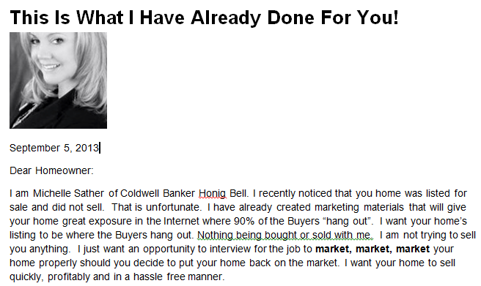
Let’s Prepare For An Expired
1.0 Create your Cover Letter that states “This Is What I Have Already Done For You”

Slide 44
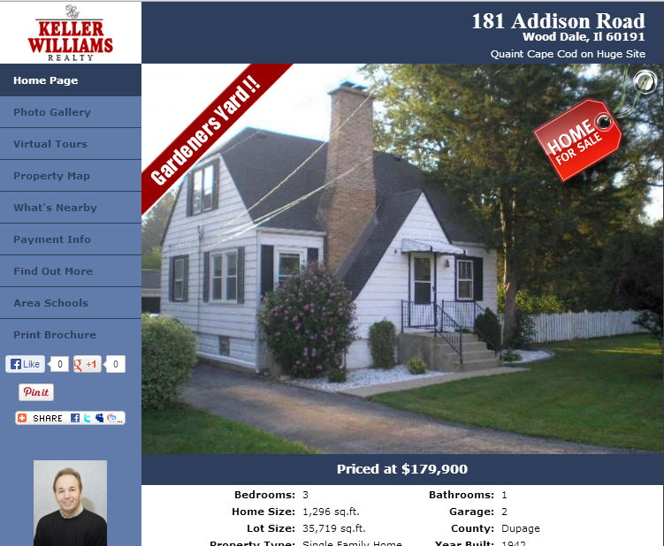
Let’s Prepare For An Expired
2.0 Using the pictures from the MLS, create a Property Website, and copy the URL into the Cover Letter

Slide 45
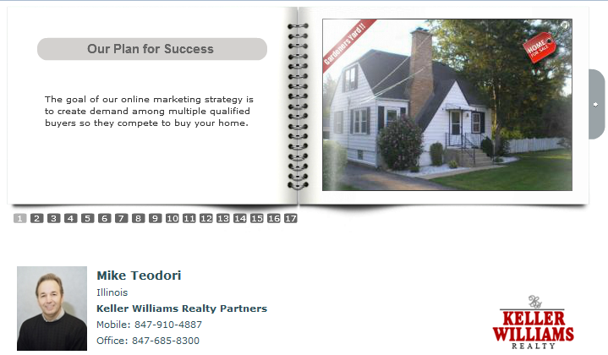
Let’s Prepare For An Expired
3.0 If your system provides you with a Flipshow Presentation…paste the URL into your Cover Letter

Slide 46
Let’s Prepare For An Expired
4.0 Create Property Business Cards using an Avery label maker template.

Slide 47
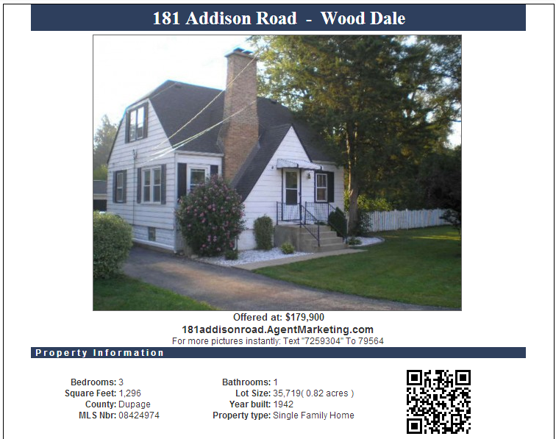
Let’s Prepare For An Expired
5.0 Create or print a Brochure, roll it colored side out and place a colored rubber band on it.
Put in your flower pot

Slide 48
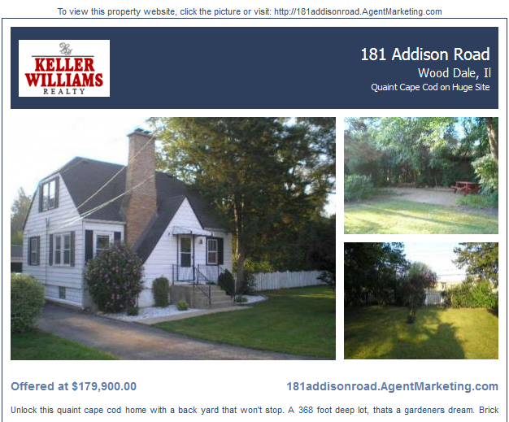
Let’s Prepare For An Expired
6.0 Create an ePost card so you can forward it to the Seller.

Slide 49
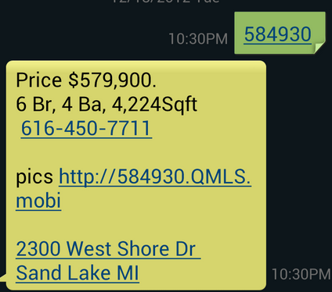
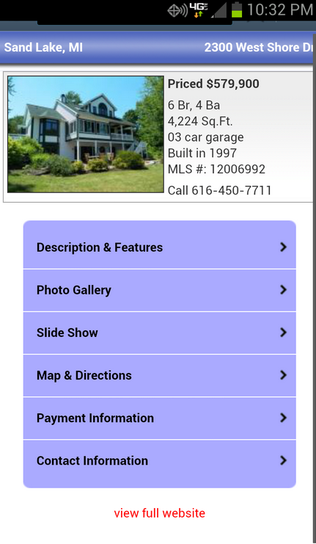
Let’s Prepare For An Expired
7.0 Text “7259304” to “79564” to view the mobile version of the property website. Put it in your Cover Letter

Slide 50
Let’s Prepare For An Expired
8.0 Sprinkle the Property Business Cards, insert the rolled up Brochure and trifold your Cover Letter and be prepared for…WOW!!

Slide 51
Let’s Prepare For An Expired
Who is the Expired going to call if they are SERIOUS about Listing their home?
The Agent that sent them a Postcard?
The Agent that left them a voice message?
Or, the Agent that left them a flower arrangement with already created Marketing, Marketing, Marketing materials for them.
Nothing being bought or sold
Just wanted to interview for the job of marketing your home

Slide 52
Questions
Aaron Redfearn
Supreme Lending
(720)-862-5392
aaron.redfearn@supremelending.com

Slide 53
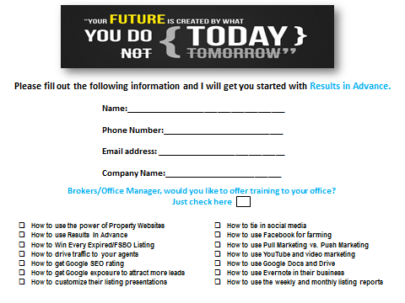
Questions

Slide 54
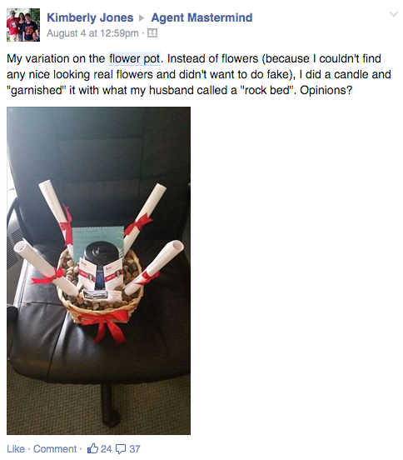

Slide 55
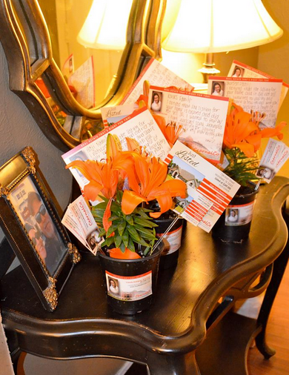

Slide 57
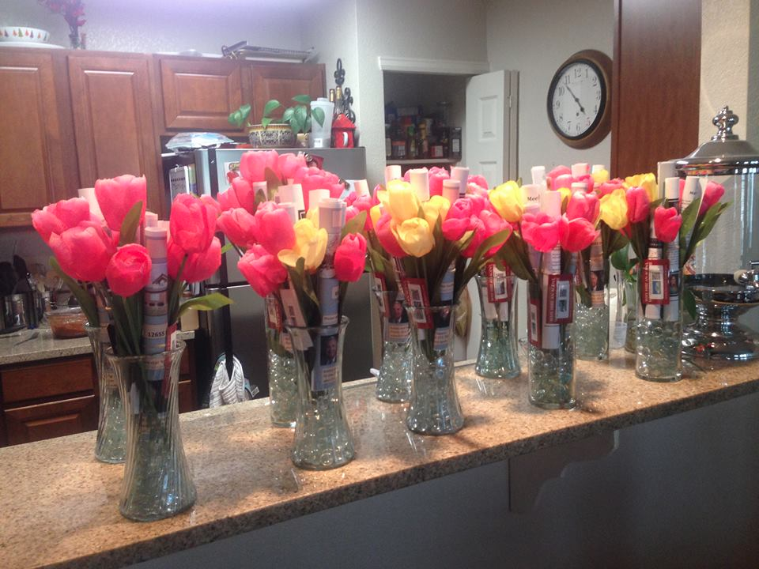

Slide 58
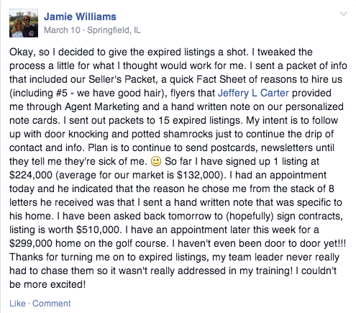

Slide 59
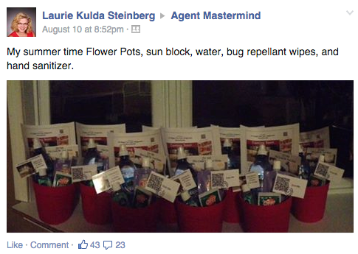

Slide 60
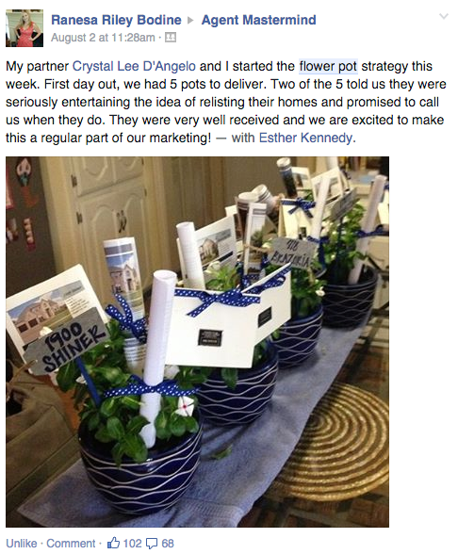

Slide 61
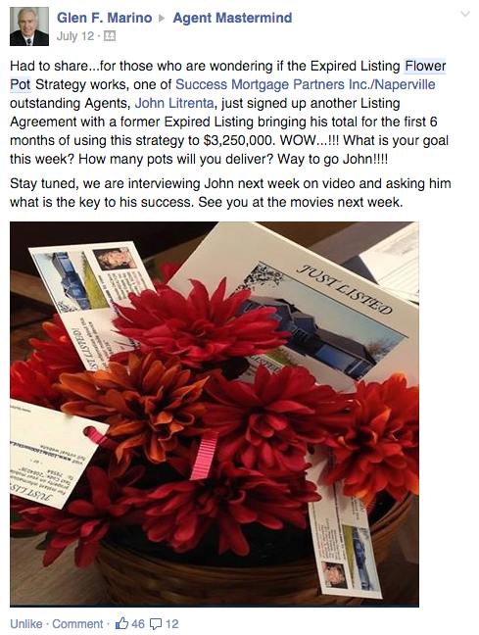

Slide 62
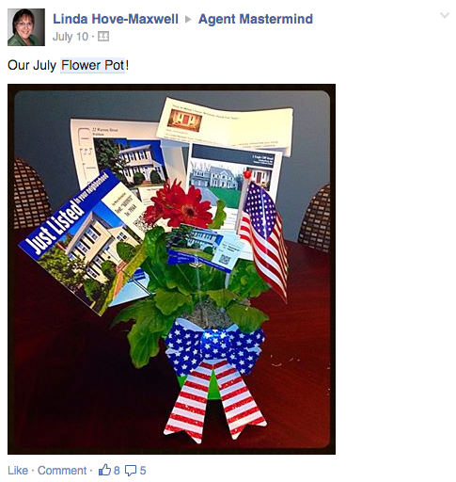

Slide 63
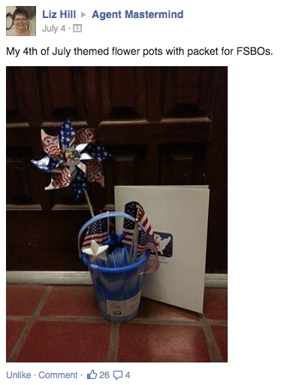

Slide 64
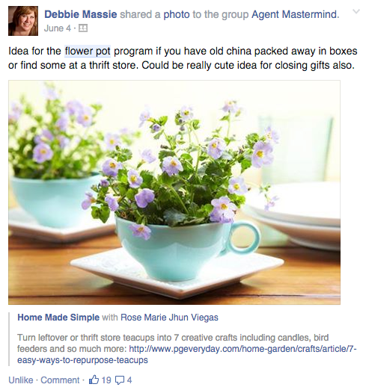

Slide 65
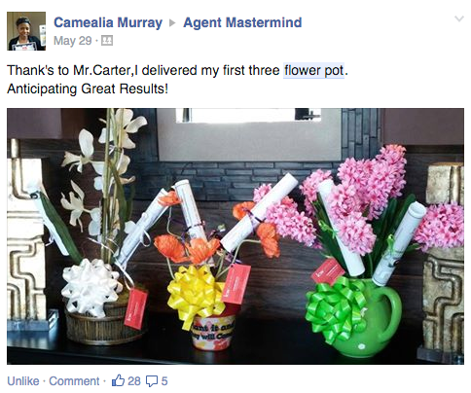

Slide 66
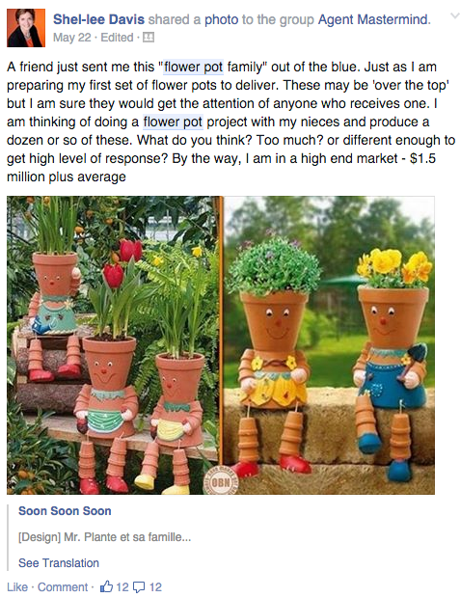

Slide 67
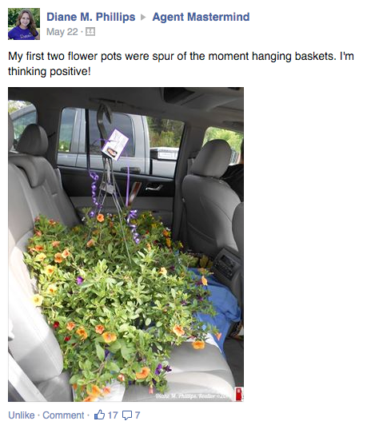

Slide 68
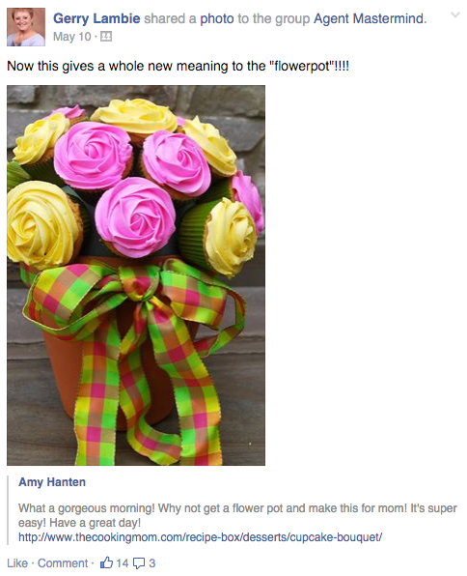

Slide 70
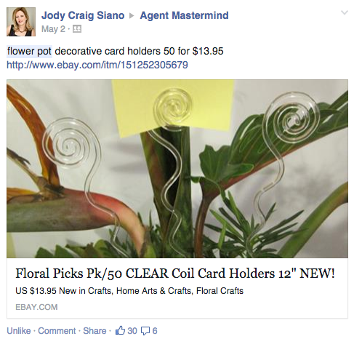

Slide 71
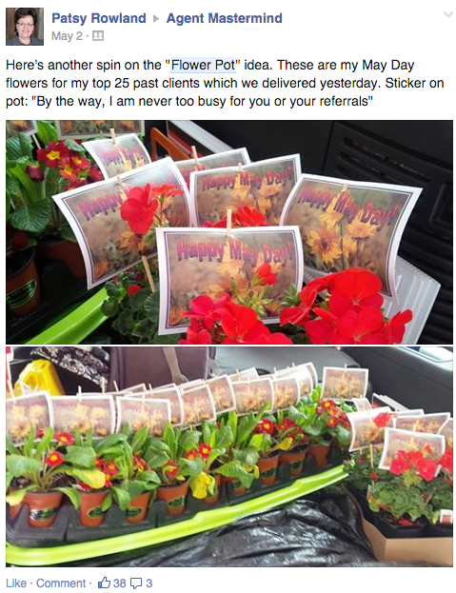

Slide 72
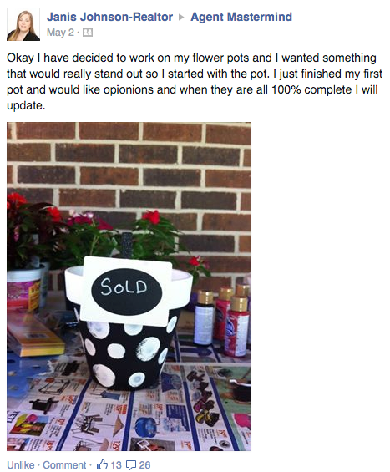

Slide 73
