Slide 1
I Need Help!! Why you need to hire an assistant now (and how to hire one)
Giving…Sharing…Connecting

Slide 2
Joining Us On Our Private Facebook Group At www.Facebook.com/groups/AgentMastermind
6,083 Top Guns As of 11:30 today ☺

Slide 3
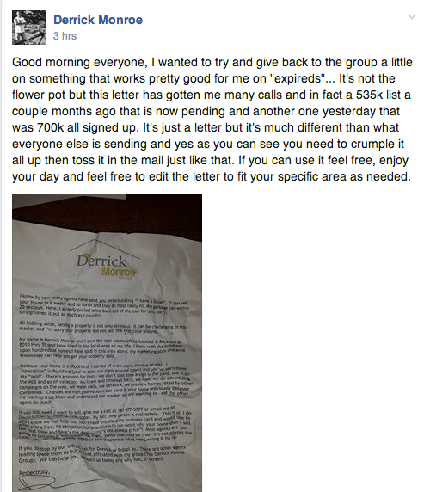

Slide 4
How can we use the 80/20 principle to be more effective?
Which 20% of your activities are resulting in 80% of your desired outcomes and happiness?
Which 20% of your sources are causing 80% of your problems and unhappiness?
What Do You Like Doing????

Slide 5
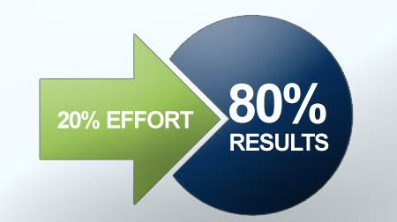

Slide 6
What’s our lesson?
Are we doing something that we hate doing?
Are we doing work that a clerk or an assistant could be doing?
Are we “inventing” tasks so that we can trick ourselves into thinking that we are being productive?

Slide 8
Putting It Into Action:
Write down a list of items that you do everyday
Check emails Make lunch Return calls Talk to clients in process Put out fires Check Status of files Open Houses Calling leads Show Homes Do monthly mailers
Go to office depot Video Marketing Bookkeeping / payroll Plan Day Agent Mastermind Classes Home Inspections
Pest Inspecitions
Go to closings Calling / meeting new clients referral partners

Slide 9
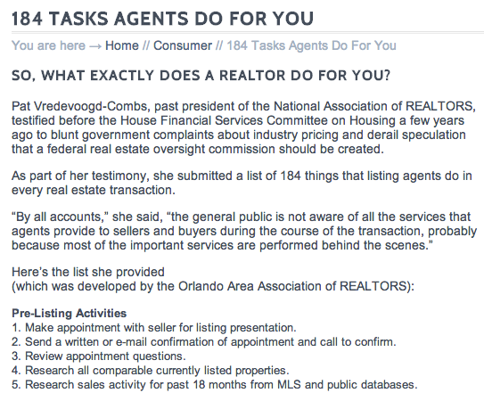
184 Things! http://ohiorealtors.org/consumers/184-tasks-agents-do-for-you/

Slide 10
Pick The One
Pick the one thing that you will be doing 8 hours per day, 5 days per week, for the next 2 weeks, that if you don’t do this one thing, in 90 days you are out of business…

Slide 11
Typically, the big $$$ is made:
Consulting with clients and building relationships!
Strategic NOT Tactical

Slide 12
When Should You Get An Assistant?
At a certain “Closings per month”?
When I’m too busy?
Notes:
Some say at a certain units per month, I say you should get an assistant as soon as you want to start cranking out some serious business.
You will never become a superstar without one, when do you want to be a superstar?
Remember you want to be productive, not busy

Slide 13
What Is Your Number
Income last year / 2080 hours = hourly wage
100,000 / 2080 hours = $48.08 an hour
Would you pay someone $48.08 an hour to do what you are doing on a daily basis?

Slide 14
$48

Slide 15
I Can’t Afford One Now
Notes:
You can’t afford one, because you don’t have one.
Hire one for 4 hours once a week. Use that 4 hours to be on the phone and crank out some income, then use that money to buy more assistant time.
If you don’t have an assistant, you are the assistant.
The time you spend doing the $8 an hour stuff, guess what, you are making $8, not $180 an hour. Make up your mind, are you an $8 person, or a $180 an hour person. You are going to be one, the good news is, you get to chose which one you are.
Feel the fear and do it anyway.
Assistants are not a luxury item, they are a necessity item. Electricity used to be a luxury item, not anymore. Same with assistants.

Slide 16
Good Assistants Are Free / They Bring Me The Money
Notes:
Good assistants are free. They bring you in money.
They bring in more than they cost, so in reality, they pay you to work for you.
The contribute more than they take out

Slide 17
What If You Spent Your Time
Farming your database
Use Phoneburner.com to call your database 3-4 times a year
Use the flower pot strategy to get more listings, keep the listings you have and market to expired listings, FSBO’s
Run Facebook custom audience ads to your current and past database on a month basis so they remember who you are and what you do for a living
Turn your Facebook likes and shares into commission checks like Shaun shared with us last week

Slide 18
What does your assistant do
Post property on Facebook
E-marketing
Brochures
MLS Management
Website/Facebook Updates
Mailers
Sale Flyers
Home/Room Photography
Editing of Images
Newsletters
Email blasts
Seller/buyers packets
Client thank you gift/card
Scheduling/Clendar
Everything that I don’t want to…
Tactical Items
Notes:
See, if you are doing all these things, you feel busy and you go home at the end of the day thinking you were busy all day, but you were not productive.

Slide 19
What Do You Do?
Open houses
Plan your Marketing (not necessarily implement it)
Call Your Leads
Market to expireds / Presentations
Mastermind With Other Like Minded People
Strategic planning every 2 weeks
Only The Things That You Want To Do
STRATEGIZE!!!

Slide 20
“My Clients / Referral Partners Need To Talk To Me About All Things”
But I’m a CONTROL FREAK!!!
Do you talk to your doctor about billing?

Slide 21
The Script That Works
Dr. Butler story….
“Carl wanted me to call you to tell you….” (never do they say “I”, always “Carl wanted you to know….”)
Chrissy is my partner, she specializes in this and will help you with the home sales process.
I upsell my team to the people we work with, my team upsells me.

Slide 22
Where To Find Assistants
Title companies
Real estate offices
Restaurants
Craigslist
Smiling faces at cash registers
Tell all your friends you are looking for someone
Notes:
There are enough of these people that are unemployed.

Slide 23
Do I Share My Assistant With Another Agent?
Notes:
This should be only be a short term solution, if you have to do it at all. Hard to serve to masters

Slide 24
How Much Do I Pay Them?
Good quality people for less money than you think
Start Them Off On A 60 Day Trial
Notes:
Read slide

Slide 25
Reasons to Hire a Virtual Assistant
Can complete a lot of tasks for low cost
Free your time up to be making $$$ and building relationships
Help you focus on your 80/20
Helps you delegate tasks that you don’t want to be working on or shouldn’t be doing yourself
The range of skills you can find in a VA is limitless

Slide 26
VA Effectiveness
Virtual Asst: Can’t physically “tap” assistant on the shoulder that you need them to do something right now.
With Jing, Join.me, Skype and/or GoToMeeting, you can communicate and “look” over each other’s shoulders
Virtual assistant doesn’t interrupt you by walking in your office
Hard to monitor virtual assistant “staying on task” (There are websites you can use, but the real measure is RESULTS!!!)

Slide 27
In-house Effectiveness…
Can run errands for you (Office Depot, Post Office, Lunch, etc…)
Makes you crawl out of bed and get dressed for the day.
Helps keep you focused by being your coach or “boss”
Easier to “catch the vision” when they overhear the day to day operations.

Slide 28
Expenses….Virtual wins
No extra phone line
No extra computer
No “desk” space
Doesn’t distract you from your 80/20
No payroll taxes
No water / snacks
No office supplies
No software
No printer ink
No office “hanky panky” (which can be very expensive)

Slide 29
The Types Of Assistants For Agents (Virtual vs In-house for each of these)
Executive assistant. Checks your voicemail, orders your lunch, checks your email, schedules your doctor appointments, puts gas in your car, manages your calendar, runs your errands (In-house)
Implementation Assistant: Facebook postings, calling your past database, calling prospective referral partners, video marketing (editing, blog creation, etc...), AgentMastermind.com management, etc. No mortgage experience necessary (in-house OR virtual)
Loan coordinator: liaison between processor and you. You ORIGINATE loans, but don’t baby sit the loan process. You don’t chase docs, conditions or put out fires and such. (In-house)
Mini Me: licensed, takes apps, really does all the LO jobs, great at meeting referral partners / making new relationships, basically does everything you do, but not a “rainmaker.” (In-house)

Slide 30
Sources of Virtual Assistants
www.fiverr.com
$5 per “Gig”
www.odesk.com
Pay per job or per hour - $5 - $100 per hour
www.Onlinejobs.ph
$1.25 - $3 per hour
http://www.oncallvas.com/
$15 an hour
www.realsupportinc.com
http://list2closeassistant.com

Slide 31
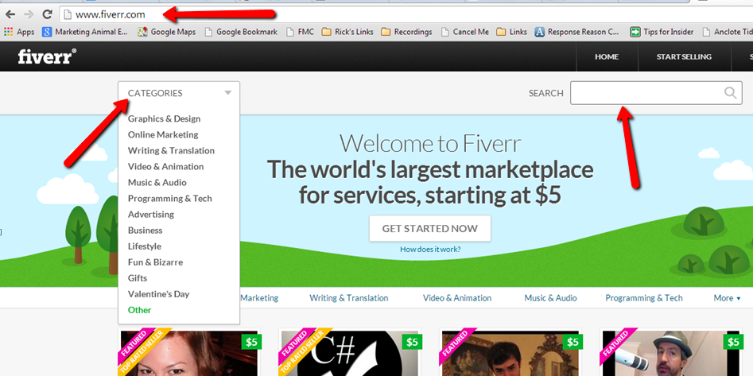
Fiverr.com

Slide 32
Fiverr.com
Free to join
$5 for any gig (more for extras)
You can have ANYTHING done on Fiverr
Writing, Facebook, Websites, Content, Logos, Video Editing
More of a one time gig but you could hire someone over and over

Slide 33
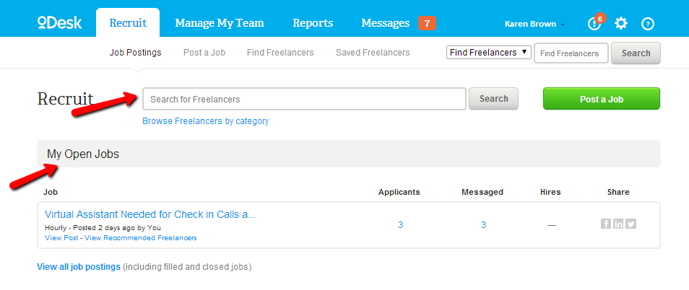
Odesk.com

Slide 34
Odesk.com
Free to sign up
Pay ranges from $3-$100 per hour
Wide range of services
Have to have CC on file to post a job
Payment is done through Odesk
Tracking of hours is done through Odesk
Great for projects or ongoing

Slide 35
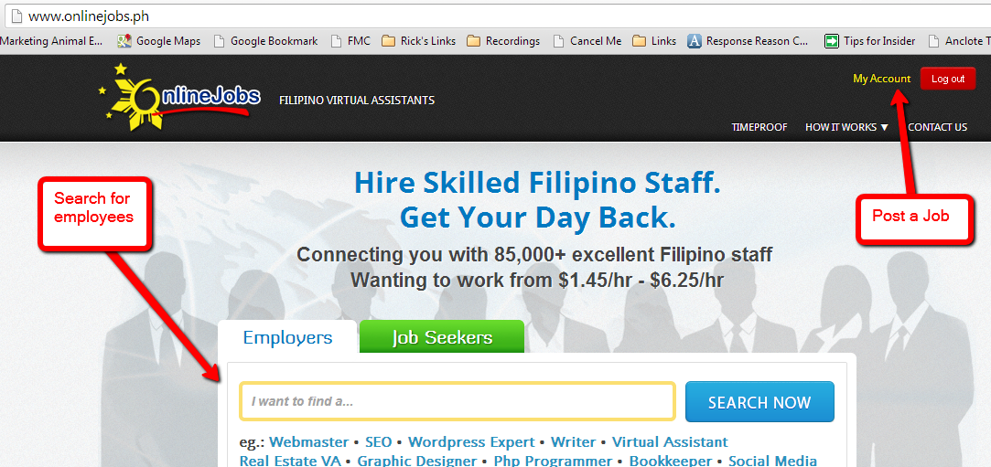
OnlineJobs.ph

Slide 36
OnlineJobs.ph
Paid account for job postings
Only Philippine workers
$2 to $3 an hour
Can find someone for any job
Post a job or find workers yourself

Slide 37
Sample Posting
IMPORTANT – Please send a sample voice recording answering the three questions listed at the end.
Real Estate Agent Assistant to Top Producer
A top (your city) Real Estate Agent for a successful (your city) Realty company is looking for a go-getter assistant......someone who’s a self starter, and efficient multi –tasker, great with people.....and who wants to be close to the front line......without being on it.
Perhaps you’re a real estate agent who doesn’t want to be a real estate agent. Or you’re someone who has worked in real estate or real estate- related business, such as a mortgage or title company as an assistant or transaction coordinator.
​You’ll really be doing 5 jobs in one. The office manager, the website and e-mail manager, the transaction coordinator, and the client service manager. And in helping the agent grow their business, you’ll share the rewards
​Chances are, you’re an organization whiz. You like to set up systems that make an office run more efficiently.

Slide 38
Follow Up Email
If they don’t send a recording, use a canned response to follow up. Simply reply with –
Thank you for your interest. To move to the next round of interviews, please send a sample voice recording answering the following three questions –
Describe your past experience as a virtual assistant.
Why do you feel you are a good candidate for this position?
What are some of your hobbies or things you enjoy doing when you are not working?
We will review the submissions and contact you via email and Skype if you are selected for the next round of interviews.

Slide 39
Screening Candidates
As submissions come through, listen to the recording. If they did not send a voice recording, send the canned response.
If you have one you like, email them back to set up a time to chat via Skype.
Add them on Skype and interview them via messenging and phone call.
Good candidates are getting scooped up quickly so important to contact them immediately.

Slide 40
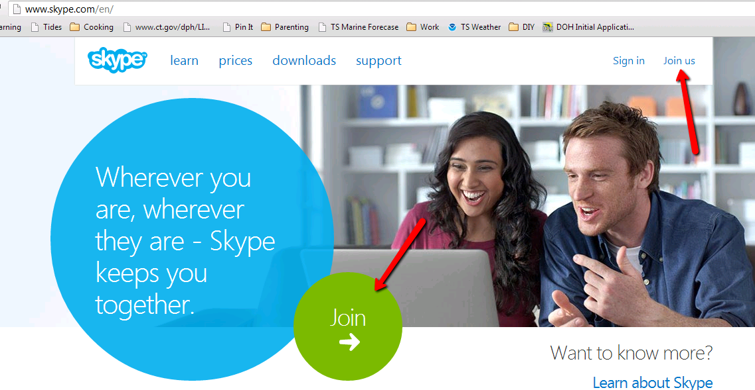
How to Interview and Communicate with VAs

Slide 41
Hiring a VA
When you find someone you like, offer them the position through Skype.
Recommended starting wage of $2.50-15:00 US an hour.
Recommend you have them start on a Monday
Pay bi-weekly on every other Friday
Focus on one item in the beginning to learn
Set up listings for Flower Pot Strategy
Video Marketing
Phone Calling, etc.

Slide 42
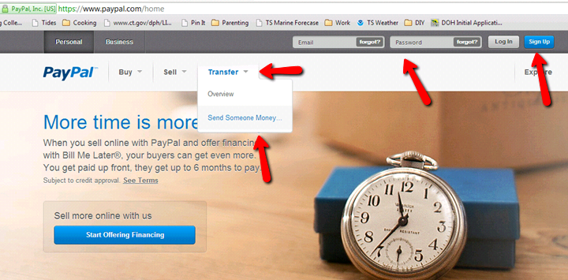
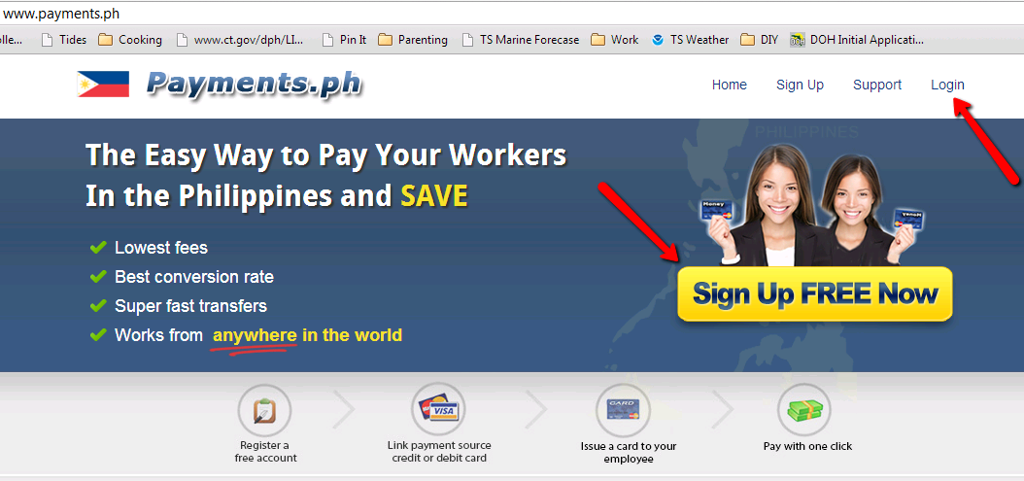
Paying your VA

Slide 43
Sources for In-House Assistants
www.Craigslist.com
$25 per posting
www.Monster.com
$295 for 60 Days
www.linkedin.com
$195 for 30 day posting (bulk discounts available)
www.indeed.com
Pay Per Click on your Job Ad $0.25 to $1.50
Write Small Checks To Cash Big Checks

Slide 44
Process for In House
Create anonymous Gmail address
toprealestatecompany@gmail.com
Set up Google Voice number for that account
Leave custom voicemail greeting
Create job site account using that email
Post job with required steps for applying
Set up canned responses for applicants
ONLY set up face to face interviews with people who follow the process

Slide 45
Sample In House Ad
A top producing Real Estate Agent in Tampa is looking for a go-getter assistant...someone who is a self-starter, an efficient multi-tasker, great with people, has a positive attitude and loves working. You are great at follow-up. You pay attention to detail and stay on top of tasks with ease. Chances are you're an organizational whiz. You like to set up systems that make an office run more efficiently. You will be responsible for gathering client information, making regular phone calls to clients and referral partners, setting up appointments and Realtor events and entering information into our database to prepare mortgage clients. Attention to detail is key and mortgage experience is an added bonus. You love to make phone calls and keep in touch with clients and referral partners. You know your way around the internet and can figure out new ways to use it to keep in touch with clients. Great at building rapport and gathering information when needed.

Slide 46
Sample In House Ad Continued…
You have at least 2 years professional office/assistant experience with some phone skills involved. We need someone that is comfortable making follow up calls and talking over the phone.
Only apply if you want to be part of a fast-growing team who really cares about their clients. This position will start as part-time but has room to grow to full-time for the right candidate. The ideal hours to be filled are 9am to 1pm Monday through Friday with some flexibility.
If you're interested in joining our team, please email your resume and cover letter to: youremail@gmail.com and then call (555) 555-1212 and answer the following three questions - 1. How would your friends and family describe your personality? 2. Describe some of the phone calls you have made in a previous position. 3. Why are you a good fit for our mortgage company? Only those candidates that submit the necessary information AND call to leave a message will be considered for this position. Thank you and good luck!

Slide 47
Interview Questions
You can download a great list of job interview questions at
http://budurl.com/gettoknowme

Slide 48
When it’s time to say goodbye…
The moment you start questioning whether the employee is going to work for you, it is time to move on.

Slide 49
Steps To “Letting Somebody Go”
Never do it in front of other employees
Change your passwords
Don’t be a jerk (even if they are)
Never post anything about it on social media

Slide 50
Steps To “Letting Somebody Go”
If clients say “where is Bob?”….. You say “Bob took a different career path or Bob is no longer at this office, but Steve can help you with that….”
Never say why somebody is gone
Never say that you fired them
If somebody calls for a reference, just tell them that you have a policy not to discuss past employees performance with anybody…. And then DON’T!!

Slide 51
Always take the High Road
Your other employees are watching and see how you treat others
Your referral partners listen to see how you treat your employees
You never know when something will come back to bite you in the rear….☺
Plus you feel good when you do

Slide 52
Tasks your VA Can Complete
Linkedin
Build and manage your profile
Create and manage groups
Increase connections
Twitter
Create and manage account
Tweet for you
Video Marketing
Edit videos
Email/post videos for your database
Post to social media sites
Pinterest
Daily/Weekly posts
Video’s / Pics
New Listings
Sold listings
Testimonials / Pics
Animoto
Private videos for special guests
Happy Birthdays
Weddings
Special holidays

Slide 53
Tasks your VA Can Complete
Agents Unfair Advantage
Upload Properties
Build Property Plogs
Monitor Leads
Craigslist Postings
Facebook
Build fan pages
Monitor and post to fan pages
Help create following
Post on past and current clients fan pages
Create and manage groups
Website Management
Blog postings, building blogs, following blogs
Building and handling websites
Comments on websites
Email Management
Sort and filter emails
Handle emails with prospects
Follow My Clients
Live Chat
Monitor chat rooms
Handle all correspondence

Slide 54
How Do I Train My Virtual Assistant?
Lynda.com ($25 / month)
http://www.lynda.com/Business-training-tutorials/29-0.html
http://www.lynda.com/Video-training-tutorials/78-0.html

Slide 55
Where do you start?
Write down a list of all the things you do in a day and separate that into two lists
Your 80% and your 20%
Hire someone to start doing the things on the 80% list so you can focus on your 20%
Watch the change come over your business!

