Slide 1
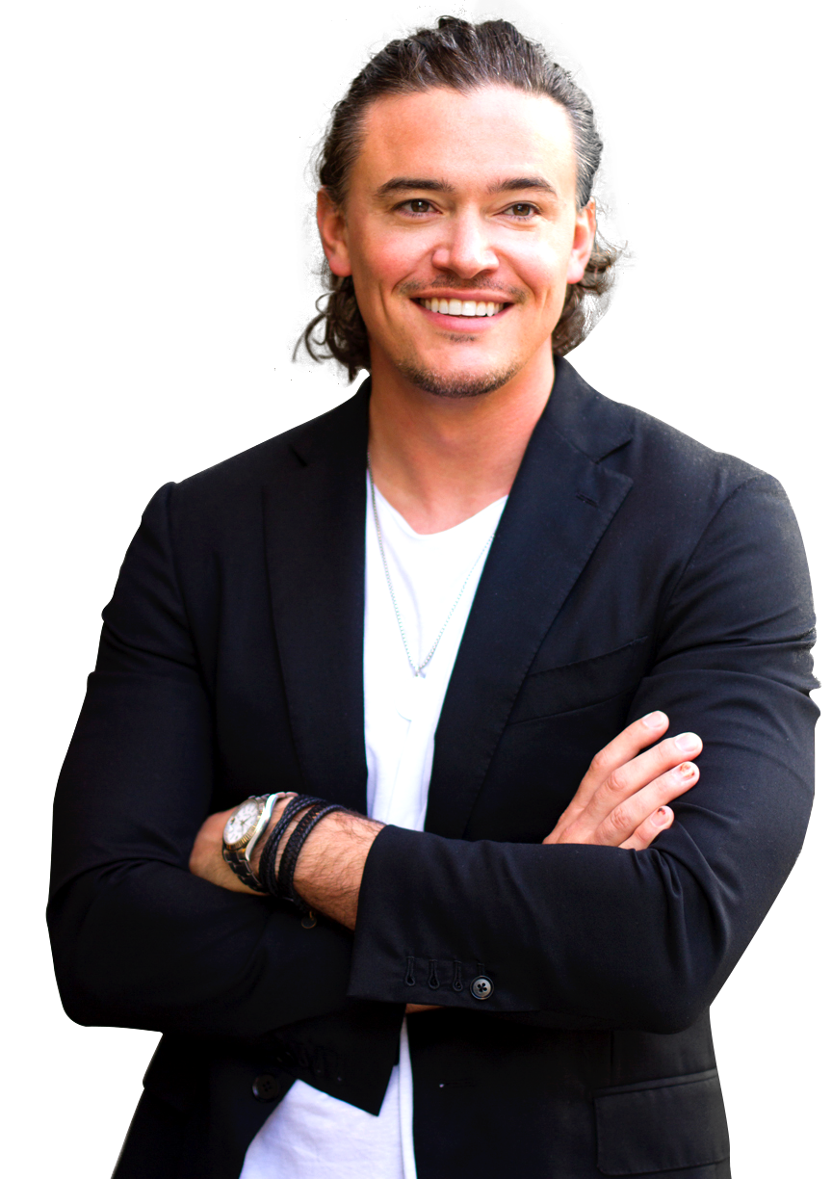
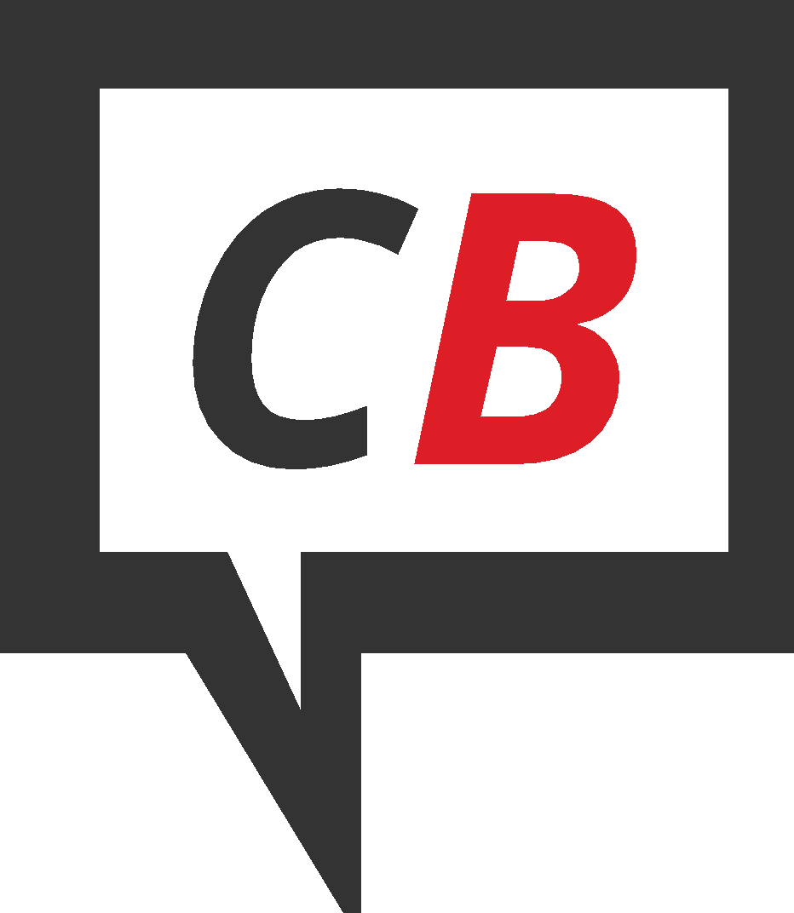
Build Your First
10,000 Fans!
SHAUN NILSSON
Co-Founder, CityBlast.com
1.888.712.7888
info@cityblast.com

Slide 2
1 of 5 global pageviews is on Facebook
1 of 4 global pageviews is on Social Media
1.888.712.7888
info@cityblast.com
Notes:
01/24/13
2

Slide 3
Audience Size is Key
Businesses that grow their presence on Facebook have on average 225% higher post engagement
1.888.712.7888
info@cityblast.com
Notes:
01/24/13
3

Slide 4
Audience Size is Key
Facebook fans are 291% more likely to act on an offer from a business they like compared to non-fans!
1.888.712.7888
info@cityblast.com
Notes:
01/24/13
4

Slide 5
But how does it work?
1.888.712.7888
info@cityblast.com
Notes:
01/24/13
5

Slide 6
The Easiest Way to Get Targeted Local Followers is to Advertize!
1.888.712.7888
info@cityblast.com
Notes:
01/24/13
6

Slide 7
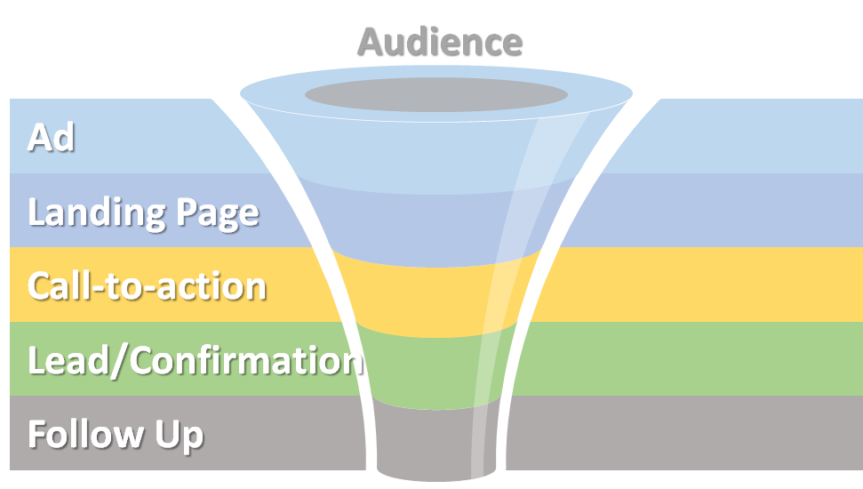
Funnels: The Key to Growth
1.888.712.7888
info@cityblast.com
Notes:
01/24/13
7

Slide 8
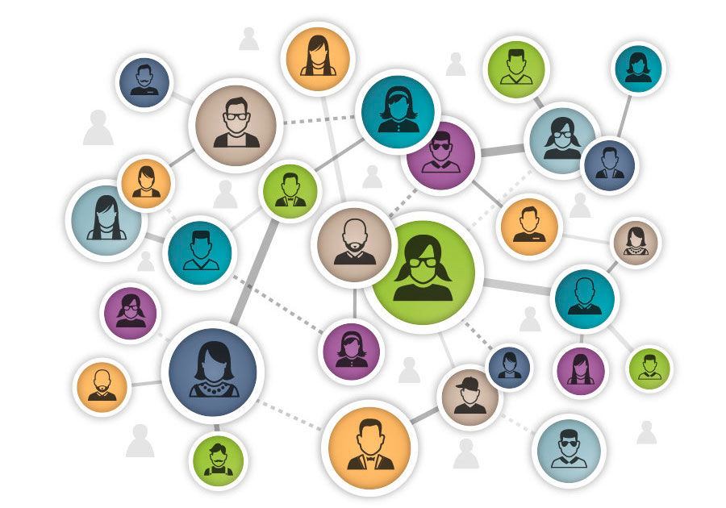
Step 1: Your Target Audience
Use Audience Insights
Create client personas
Custom audiences
Improve relevance score
1.888.712.7888
info@cityblast.com
Notes:
01/24/13
8

Slide 9
Step 2: Build your Creative
Appeal to emotions
Eye-catching images
Hook the viewer
Test, test, test
1.888.712.7888
info@cityblast.com
Notes:
01/24/13
9

Slide 10
Words Matter!
You/Your: brain is activated by “you” and “your.”
Free: the ultimate - guaranteed to catch the eye.
Now: Creates immediacy and urges into action.
New: shows you are offering something fresh.
1.888.712.7888
info@cityblast.com
Notes:
01/24/13
10

Slide 11
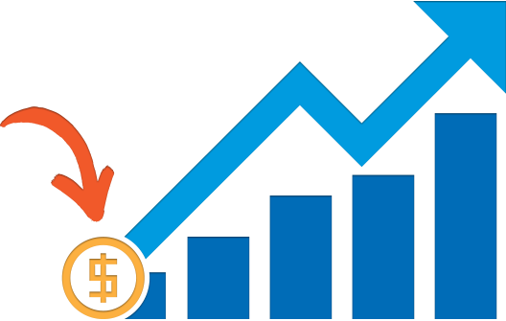
Step 3: Bid Strategy & Budget
Daily vs Lifetime
Test budget > Ad set
Target your result
Try lookalike strategy
1.888.712.7888
info@cityblast.com
Notes:
01/24/13
11

Slide 12
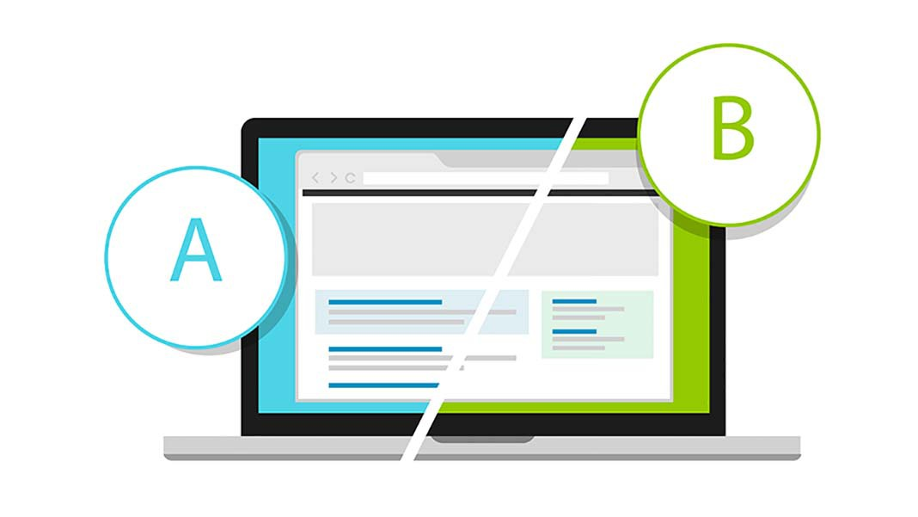
Step 4: Assume Nothing, Test Everything
“You don’t create successful ads, you build them.”
Audience
Creative
Placement
1.888.712.7888
info@cityblast.com
Notes:
01/24/13
12

Slide 13
Pay Attention To Metrics
Impressions
Frequency
Amount Spent
Click-through Rate (CTR)
Link Clicks
Cost per click
Followers
Cost per Follower
1.888.712.7888
info@cityblast.com
Notes:
01/24/13
13

Slide 14
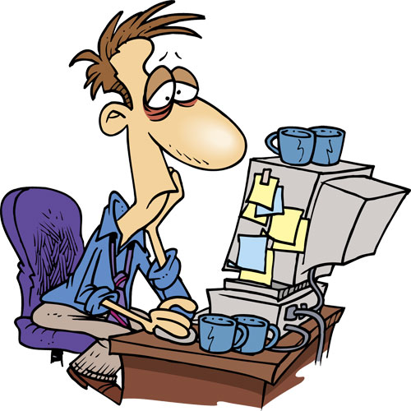
Warning! Avoid Ad Fatigue
Rotate your growth ads
Create unique sets for different audiences
Vary ad placement
1.888.712.7888
info@cityblast.com
Notes:
01/24/13
14

Slide 15
But it’s not perfect...
“A criticism of online advertising is the time and money lost while optimizing your funnel.”
Small businesses waste more than one-quarter of their online budget through lack of focus
1.888.712.7888
info@cityblast.com
Notes:
01/24/13
15

Slide 16
CityBlast Solves this Problem For The Real Estate Industry.
1.888.712.7888
info@cityblast.com
Notes:
01/24/13
16

Slide 17
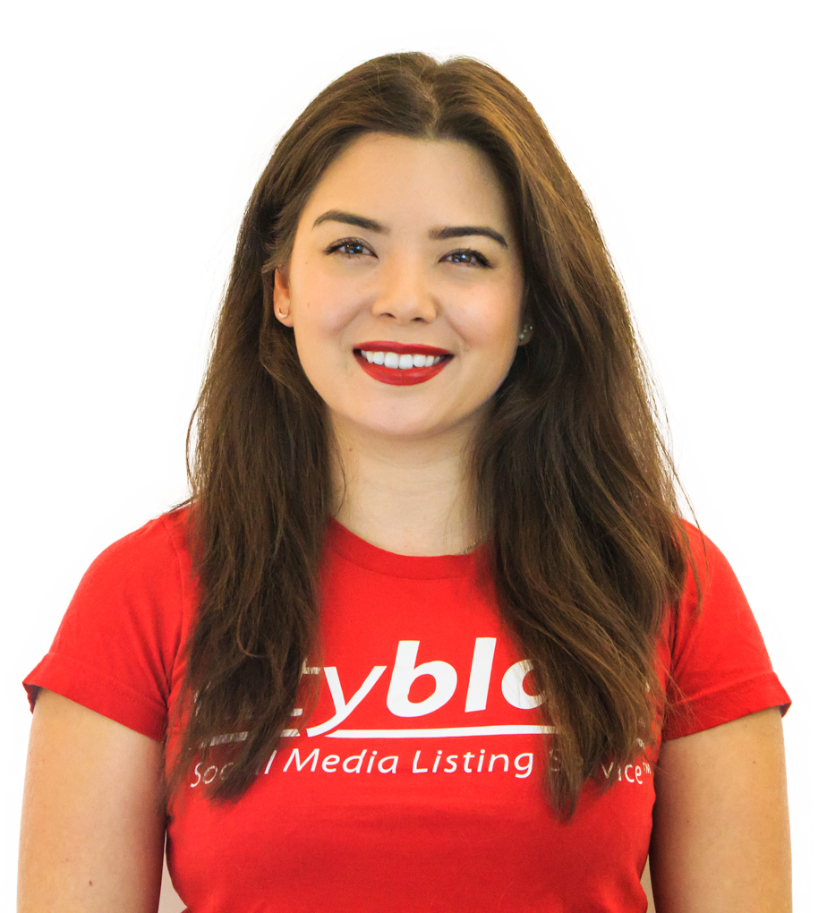
Take action for your business.
Sign up today!
www.cityblast.com/growth
Claim Your Rebate!
info@cityblast.com
1.888.712.7888
info@cityblast.com
Notes:
01/24/13
17

