Slide 1
Real estate agents
How To Stay On Top Of Your Game!

Slide 2
Who Am I?
Marketing and Mentoring trainer for Real Estate and Mortgage Industry
How to get consistency and accountability in business
How to create systems and processes so you can grow
How to hire the right team
How to get Freedom : Financial, Time, Stress and Relationship

Slide 3
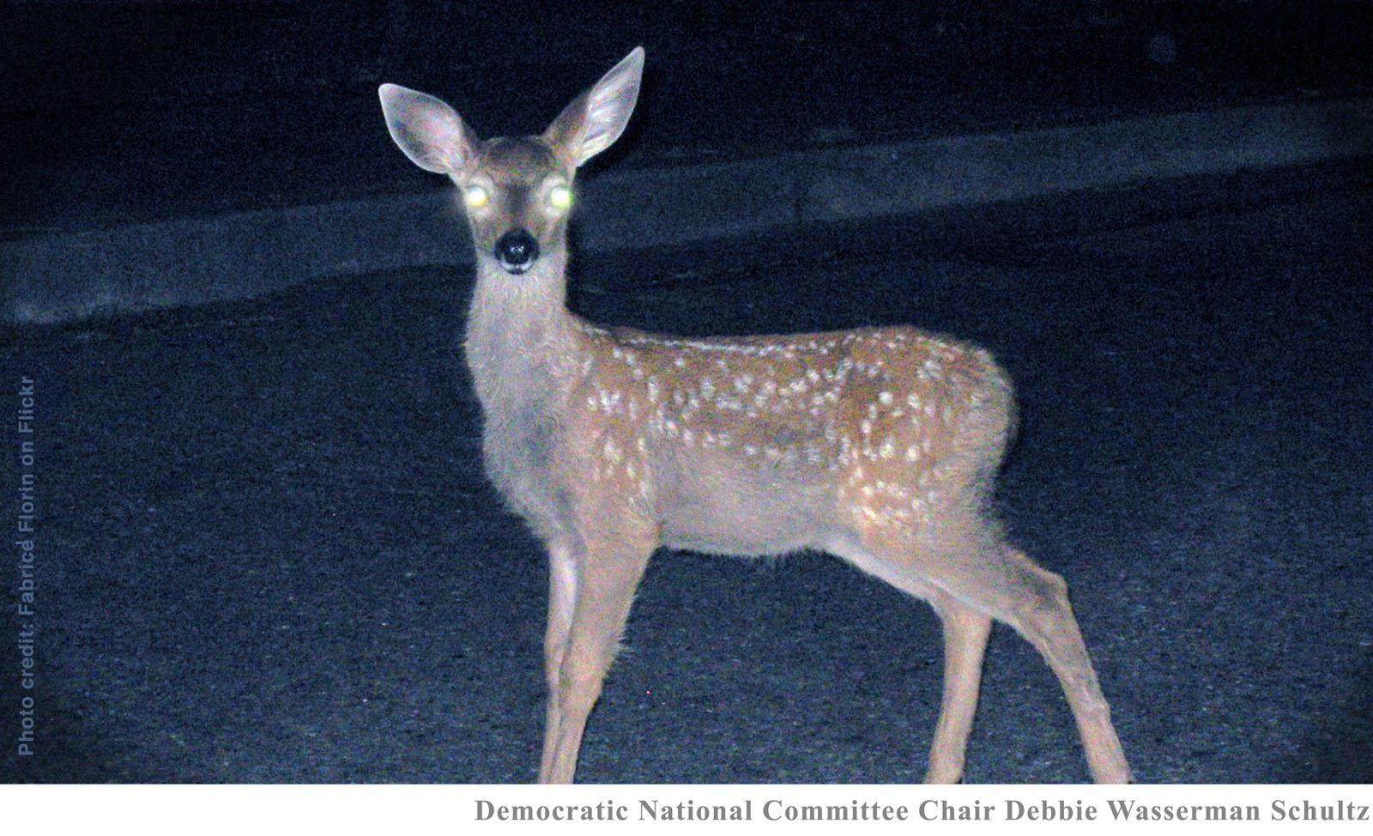
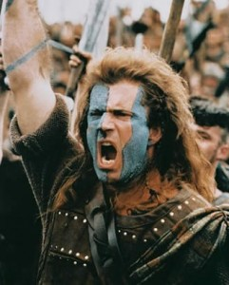
In crisis people:
This Photo by Unknown Author is licensed under CC BY-NC-ND
This Photo by Unknown Author is licensed under CC BY-SA-NC
This Photo by Unknown Author is licensed under CC BY-ND
Who are you? What can you control?

Slide 4
Don’t Just Survive, Thrive!
Part 1 : Daily Plan
Create a daily plan to set yourself up for success each and every day!
Everything in Business should be planned out!
How many people will you call each day?
How many handwritten notes will you send each day/week?
How many face to face meetings will you have each day?
When will you work on Social Media?

Slide 5
Don’t Just Survive, Thrive!
Part 1 : Daily Plan
5. How will you prospect?
6. How/When will you follow-up on leads?
When will you meet with your team?
When will you list/show houses? (even virtually)?

Slide 6
Don’t Just Survive, Thrive!
Part 2: Do You Market To Your Database?
NAR Stats
Are you sending mailers (Love Notes) on a regular basis?
Are you calling your whole database every 90-120 days?
Are your emails welcome guests or annoying pests - DELETE

Slide 7
Don’t Just Survive, Thrive!
Part 2: Do You Market To Your Database?
Are you wishing them Happy Birthday
On Facebook
Video text
Are you wishing a Happy Anniversary of the day they purchased their home?
On Facebook
Video Text
Are you marketing on Facebook?
Custom Audience
Private Message
Posts

Slide 8
Part 3: Technology
Are you using Technology in your business right now?
Don’t
Just
Survive,
Thrive!
Zoom (previous class)
For virtual meetings with clients
Showing properties to buyers/sellers
Sly Broadcast or PhoneBurnerFreedom.com/MojoSells.com
Use to make your phone calls easily from your list
Love phone burner – allows you to send personalized message and a follow-up email
BombBomb and Smart Prompt (teleprompter)
Allows you to send personalized/bulk video messages (via text and email)!

Slide 9
Part 3: Technology
Don’t
Just
Survive,
Thrive!
Periscope, Facetime, Zoom, What’sApp – live streaming
CamScanner – Scan documents to your phone
DocuSign – sign documents virtually
Document Storage – DotLoop, Box, Dropbox, Google Drive
Do you have a CRM?
Allows you to schedule emails to send out
Keeps addresses and phone numbers organized
Top Producer, Follow-up Boss, Brian Buffini, Big Purple Dot, Lion Desk
Zip Whip, Mighty Text, Reach, Text Magic
Allows you to send out blast texts

Slide 10
Part 4: How to keep your mind in shape?
Don’t
Just
Survive,
Thrive!
Are you committed to stay positive and being the light?
COMMIT to being the light. Don’t join in the panic! This could be the best thing that EVER happened to you.
It’s 2030 and my business is amazing all because I took action during a crisis in 2020. I’m so glad I …. It made me a better ….
Step up to the plate and lead. Help people! Solve problems. Necessity is the mother of invention. ☺ People will remember.
Live by your calendar – What can you control?
This actually saves you time
TIME BLOCK

Slide 11
Part 4: How to keep your mind in shape?
Don’t
Just
Survive,
Thrive!
Are you committed to stay positive and being the light?
Get up and show up!
Dress like it’s a normal work day! (doctor
Do your morning routine or create one!
Read something inspirational/motivational
Take a class you’ve been wanting to take
Require your staff to do this as well, create the mindset!
Re-evaluate your expenses – What do you really need?

Slide 12
Part 4: How to keep your mind in shape?
Don’t
Just
Survive,
Thrive!
Are you committed to stay positive and being the light?
This is a pipeline business and if you stop you will have to start again… So keep your pipeline full now!
You must …
Work well with others – Negotiate, collaborate, compromise
Make sure your team is well trained
Give grace – people are having a hard time
Treat each day as regular business (We are business owners and entrepreneurs – we have to be on our game!)

Slide 13
Don’t Just Survive, Thrive!
Accountability is key to following your plan.
Did you make your calls today?
Did you write your notes today?
Did you create a video today?
Did you post on Facebook today?
Accountability and someone to hold your feet to the fire is one of the biggest things to bring to your business!

