Slide 1
www.facebook.com/groups/agentmastermind

Slide 2
People do business with people that they know, like and trust! If They remember you and what you do for a living!

Slide 3
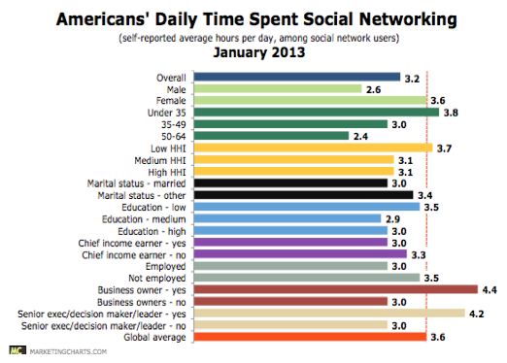

Slide 4
Statistics
Social Networking Eats Up 3+ Hours Per Day For The Average American User
18-34-year-olds report spending 3.8 hours a day
35-49-year-olds report spending 3 hours per day; and
50-64-year-olds report spending 2.4 hours per day.

Slide 5
Regular Facebook Ads Are Good But…….
They don’t know you, like you or trust you
The demographics only allow you so many options….
Specific area
Age groups
Company……
(If they have it in their profile)
But how do you know if you are being seen by the specific target you are looking for?

Slide 6
Introducing!!!!!
Custom Audience Facebook ads
Also known as Facebook ads that suck
Here’s what you will need:
1. Google Chrome
2. Facebook Fan Page
3. Database on a CSV file
4. Copy of this Power Point
Lets jump right in.

Slide 7
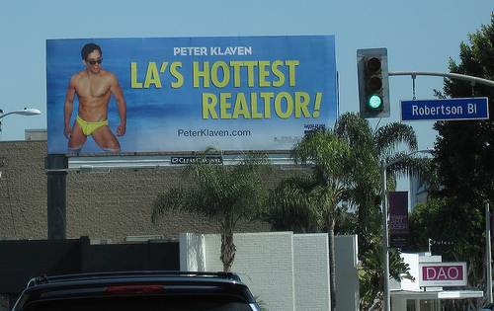
“Branding Advertising”

Slide 8
Usually Doesn’t Work
Don’t have deep pockets like Coke
Hard (if not impossible) to measure results
Can’t target a specific crowd

Slide 9
FaceBook Is Different
Ads follow the eyeballs
Laser Beam Focus
Can measure the results (trackable)
You can run custom audience Facebook ads to
Past clients
Current clients
B2B partners
CPA’s
Financial planners

Slide 10
You Don’t Want Clicks
You Don’t Want Clicks, You Want Eyeballs
You just want people to see you
You want people to remember you
You want your clients to refer their
Friends
Family
Co-workers to YOU

Slide 11
Example

Slide 12
Check This Out

Slide 13
Key Points
Use the same picture on your Facebook profile
Put your name as the headline (branding yourself)
You are in front of their eyeballs for 2-3 hours a day
Don’t be clever
Lousy call to action / but not stupid
Be very targeted (past clients and current clients)
“Friend” everyone you talk to

Slide 14
Why Do Custom Facebook Ads?
Makes you a celebrity (she/he is everywhere)
Cheap and automatic (set it and forget it)
***You are familiar when you send email on a weekly basis
***You are familiar when you call every 3-4 months
***You are top of mind when one of their friends, family or co-workers are talking about buying and selling a home

Slide 15
What If They Do Click?
Have a cool video opt in page with a strong call to action about your “why”
Have them land on your personal Facebook page
Have them land on a post that is a testimonial or past closing
When’s the last time you delivered your targeted message for 50 cents?

Slide 16
Lets Do This https://www.facebook.com/ads/manage

Slide 17
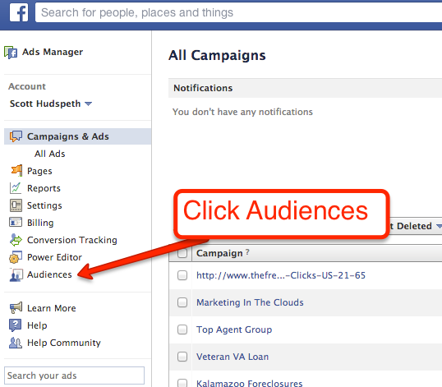
Step 2:

Slide 18
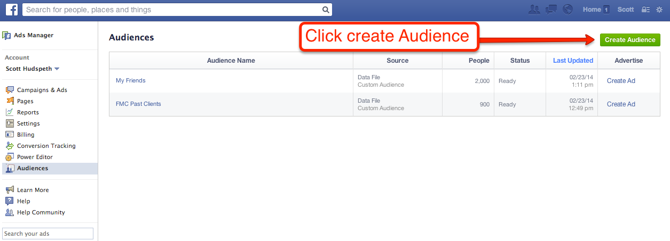
Click Create Audience

Slide 19
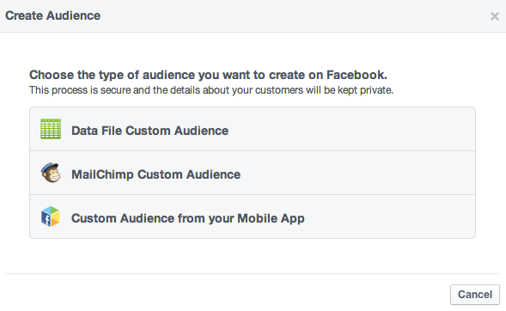
3 Choices

Slide 20
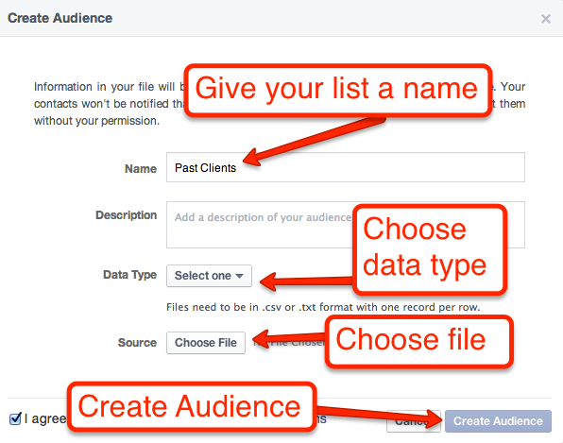

Slide 21
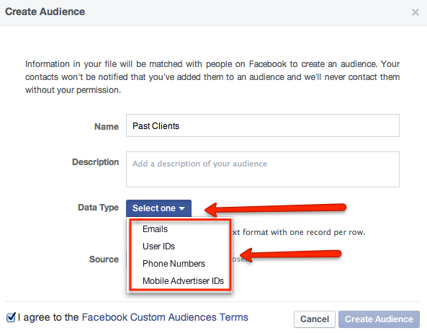

Slide 22
4 Different Ways To Upload A List
Emails
User Id’s
Phone Numbers
Mobile Advertisers IDs

Slide 23
Easiest
Emails
User ID’s
www.findmyfacebookid.com

Slide 24
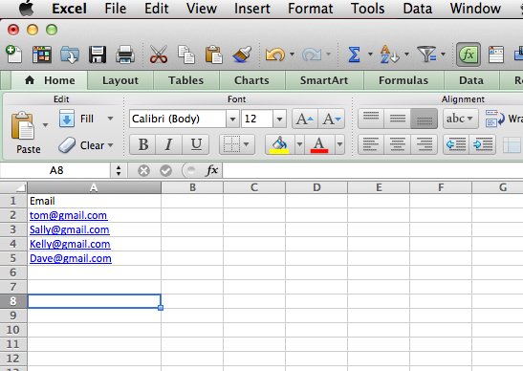
Use Excel To Build Your List

Slide 25
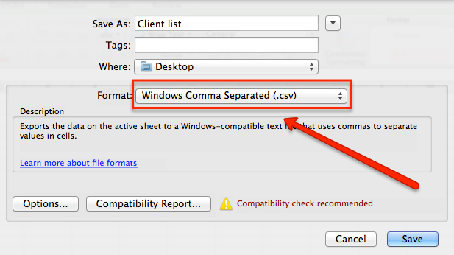
Save CSV Format

Slide 26
Your List
It will automatically remove the duplicates in your list.
The tool will only upload emails that match the email they used to signup for Facebook
You may see a different number uploaded than the list size.
It will take a couple minutes to a couple hours depending on the time of day.

Slide 27
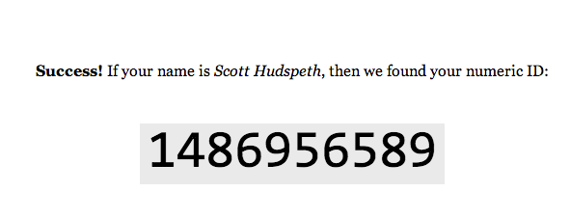
www.findmyfacebookid.com

Slide 28
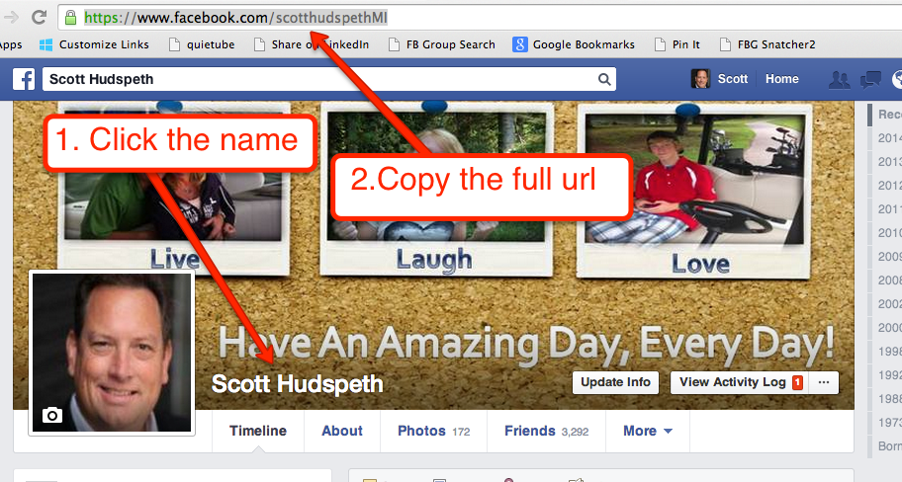

Slide 29
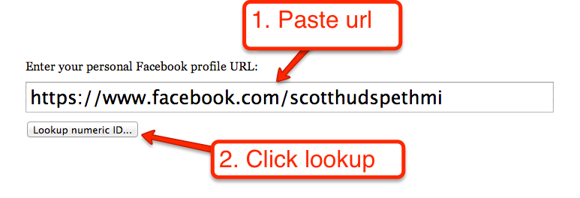
www.findmyfacebookid.com

Slide 30
Save The Same Way You Do The Emails

Slide 31
Lets Create An Ad

Slide 32
Step 2:

Slide 33
Click Create Ad

Slide 34
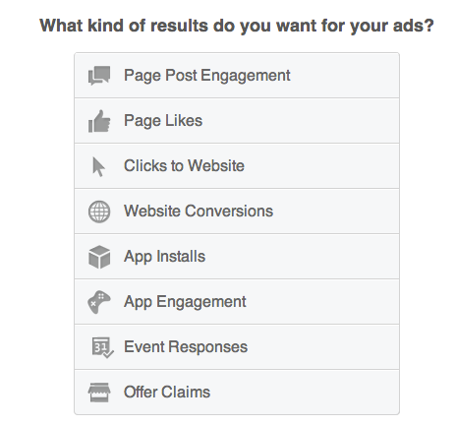
Many Options

Slide 35
Your Goal
Remind everyone, who you are and what you do for a living
This isn’t to get clicks or likes
Sure you might get likes or shares but this isn’t the goal.

Slide 36
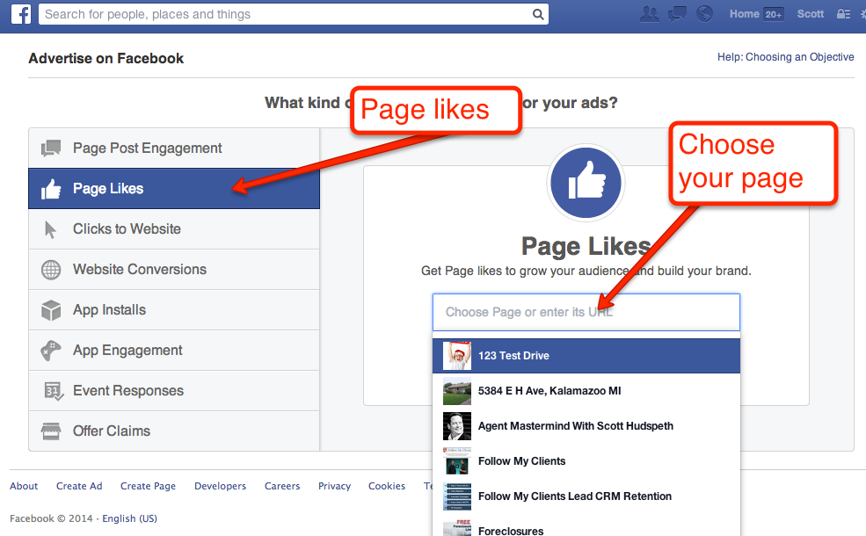
Pick Your Choice

Slide 37
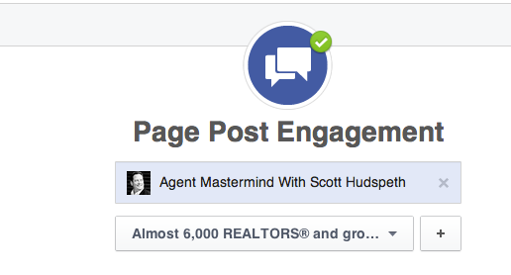
My Favorite Way And Usually The Cheapest

Slide 38
Choose Images If You Wish

Slide 40
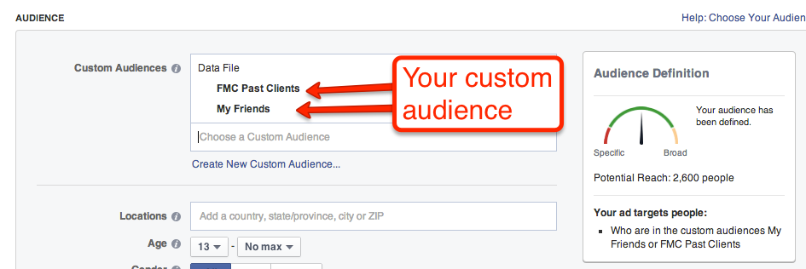
Choose Custom Audience

Slide 41
Pick Daily Amount

Slide 42
3 Choices For Pricing
Page likes
Clicks on your ad
Impressions on your ad

Slide 43
Step 9
Your ad is under review
Once approved it is active, targeting exactly who you want to target when you want to target them
So STOP………

Slide 44
Suggestions
Run the ad every other week
Add new clients to your list every other week
Sick part you need to know.
Add everyone you talk to
Run the ad using likes, clicks or impressions
Facebook is in the making money business, if your ad isn’t getting any clicks they will stop showing it

