Slide 1
The DSP
Your Daily Plan for Success
©The Marketing Animals 2023

Slide 2
What are we talking about today?
A Simple Step-by-Step Plan that Top Producers use to increase their business
How to get your BEST work done first thing in the morning
©The Marketing Animals 2023

Slide 3
Overview – Do this EVERY DAY
13 – proactive OUTBOUND “Hellos” to people who can send you business
3 – Face to Face “meetings that matter”
5 – Handwritten notes to people you’ve called or met
©The Marketing Animals 2023

Slide 4
YIKES! Who do I call???
Business partners you know – Builders, Title, Attorney, Photographer, Stager, Insurance rep, Handyman, Contractor Landscaper, etc.
Business partners you don’t know
Current Pipeline of clients under contract (We call this Just Ask)
Past Database of closed clients
PAL’s – Pre-Approved and Looking
Expired Listings
Leads Groups
Zillow (or similar) leads
Sphere of Influence
©The Marketing Animals 2023

Slide 5
Past Database - Monday
This is your past database of CLOSED clients
Call once a quarter
Note once a month or every other month
Text on their birthday, holidays and special occasions
Appreciation events – movies, bar-b-que, Santa, etc.
Social Media – Custom Audience
Email – This is LAST because it has a poor reach rate
©The Marketing Animals 2023

Slide 6
Partners you know - Tuesday
Call, text, email, video text, video email (bomb bomb), direct message on social media, handwritten note, in person meeting, testimonials, etc.
Communicate every couple of weeks!
Appreciation, thanking for referral, asking for business, how are you, let’s get together, asking for business, introduction to other partners, class invite, Holiday Idea exchange, asking for business (you get the picture)….
©The Marketing Animals 2023

Slide 7
Partners you DON’T know - Tuesday
Call 30 people for 12 weeks to ask for a “coffee”
Meet for coffee and FROG to see if you’re a good match.
Follow up for once a month asking for a referral
©The Marketing Animals 2023

Slide 8
Goal
Build a Focus 40 list of top referral partners who refer you AT LEAST one deal a quarter.
©The Marketing Animals 2023

Slide 9
Scripts for referral partners
Call and thank them for being a partner
“I Love your referrals”
Who else do you know
Can I give your name out? What would make a good referral for you?
Make your own “Angie’s List”
©The Marketing Animals 2023

Slide 10
Circle of Influence - Wednesday
Make a list of 200 people you know
Business owners, people from church, people from college, people from your kid’s school or soccer club, leads group members, etc.
Call quarterly and see what they are up to and if they need any help. Ask for the business!
©The Marketing Animals 2023

Slide 11
Just Ask - Thursday
This is your current “under contract” pipeline – Lot’s of people to call here.
Lender
Both Borrowers or the Both Sellers
Any other referring person
Title Rep
Insurance Rep
Anyone else you can think of…☺ (the money tree)
©The Marketing Animals 2023

Slide 12
PAL’s - Thursday
This is your seller or “buyer’s out looking” pipeline – Lot’s of people to call here, too.
The referral partner/person
Both Borrowers or Both sellers
Anyone else you can think of…☺ (the money tree)
Edify the Partner and keep them motivated to work with you
©The Marketing Animals 2023

Slide 13
Saturday or Sunday
Open houses
Show Houses
Listing Presentations
©The Marketing Animals 2023

Slide 14
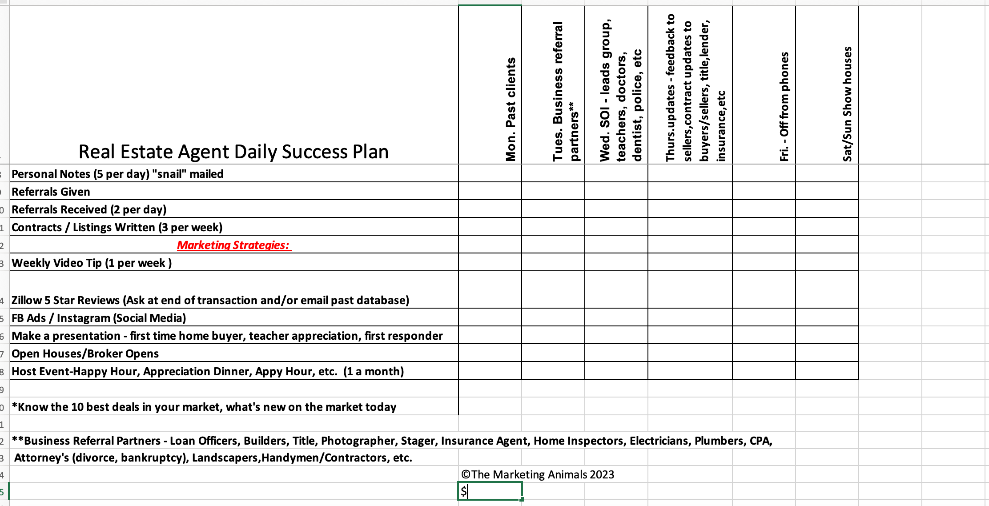
DSP Tracker

Slide 15
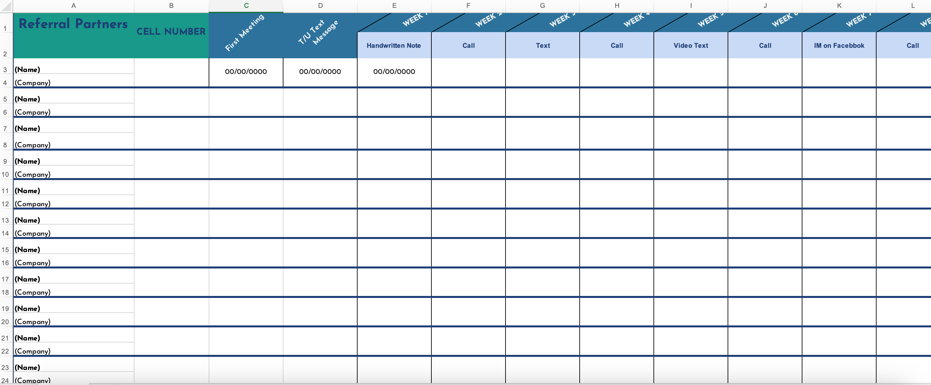
Tracking it all

Slide 16
Key Points
Go for the “NO” (Offers – No’s = $$$$$)
Someone can help with this – An assistant can call for you
Do it yourself until you find someone
Schedule it and COMMIT!
NUMBER ONE, NUMBER ONE, NUMBER ONE OPPORTUNITY TO GROW YOUR BUSINESS!
©The Marketing Animals 2023

