Slide 1
© and ™ 2007-present DivorceThisHouse.com All Rights Reserved.

Slide 2
© and ™ 2007-present DivorceThisHouse.com All Rights Reserved.

Slide 3
© and ™ 2007-present DivorceThisHouse.com All Rights Reserved.

Slide 4
© and ™ 2007-present DivorceThisHouse.com All Rights Reserved.

Slide 5
© and ™ 2007-present DivorceThisHouse.com All Rights Reserved.

Slide 6
© and ™ 2007-present DivorceThisHouse.com All Rights Reserved.

Slide 7
© and ™ 2007-present DivorceThisHouse.
com All Rights Reserved.

Slide 8
© and ™ 2007-present DivorceThisHouse.com All Rights Reserved.

Slide 9
© and ™ 2007-present DivorceThisHouse.
com All Rights Reserved.

Slide 10
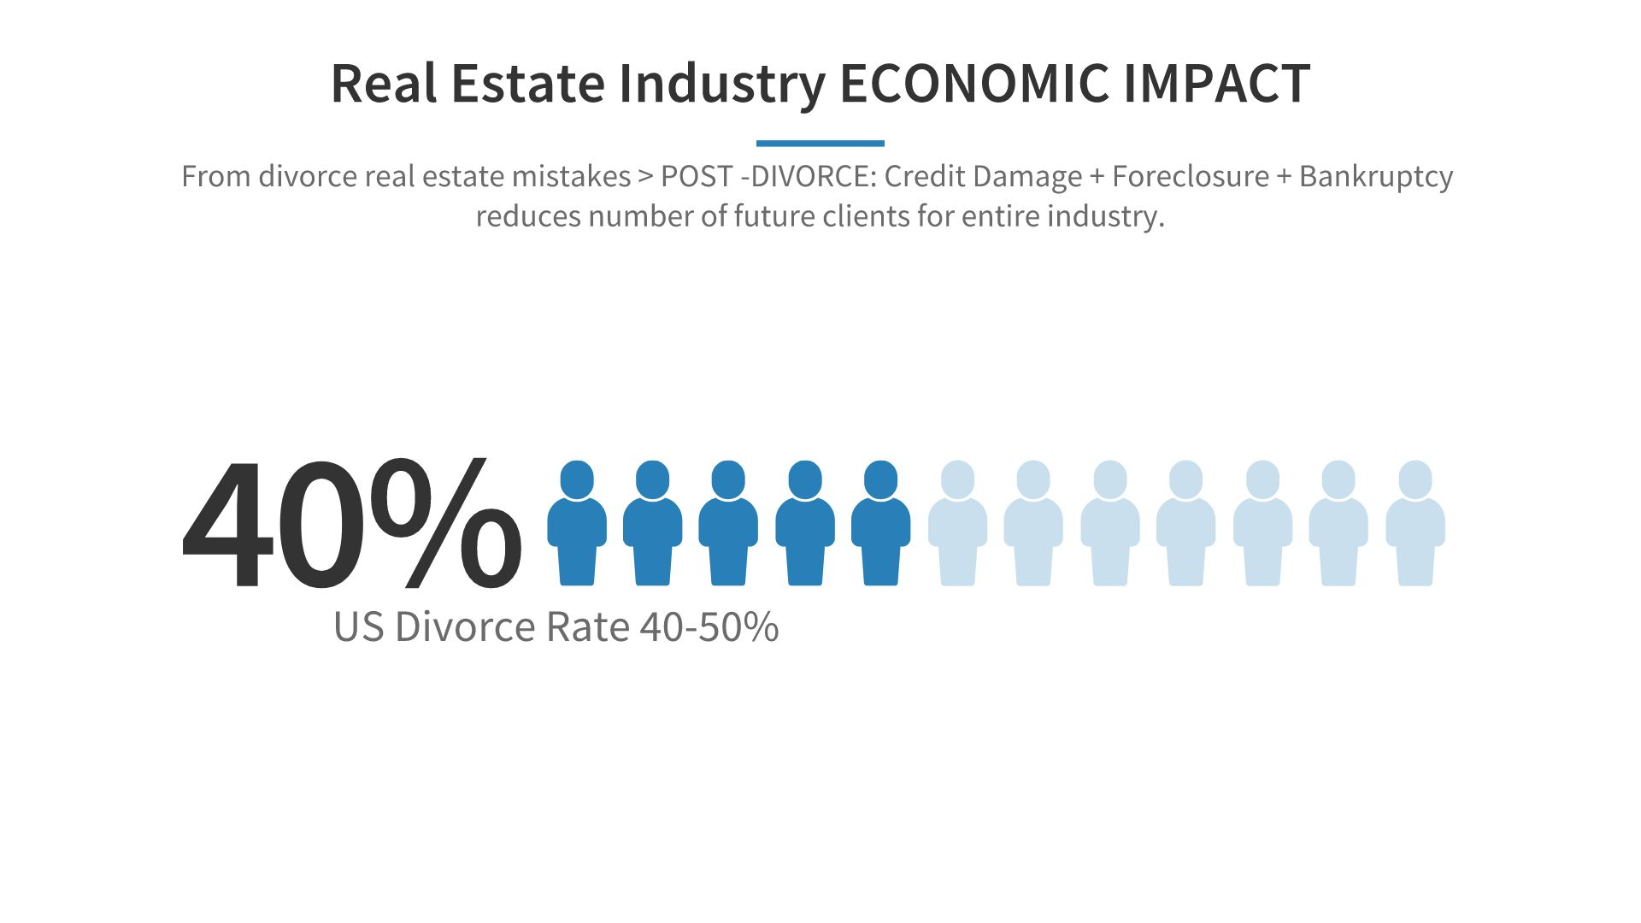
© and ™ 2007-present DivorceThisHouse.com All Rights Reserved.

Slide 11
© and ™ 2007-present DivorceThisHouse.com All Rights Reserved.

Slide 12
© and ™ 2007-present DivorceThisHouse.com All Rights Reserved.

Slide 13
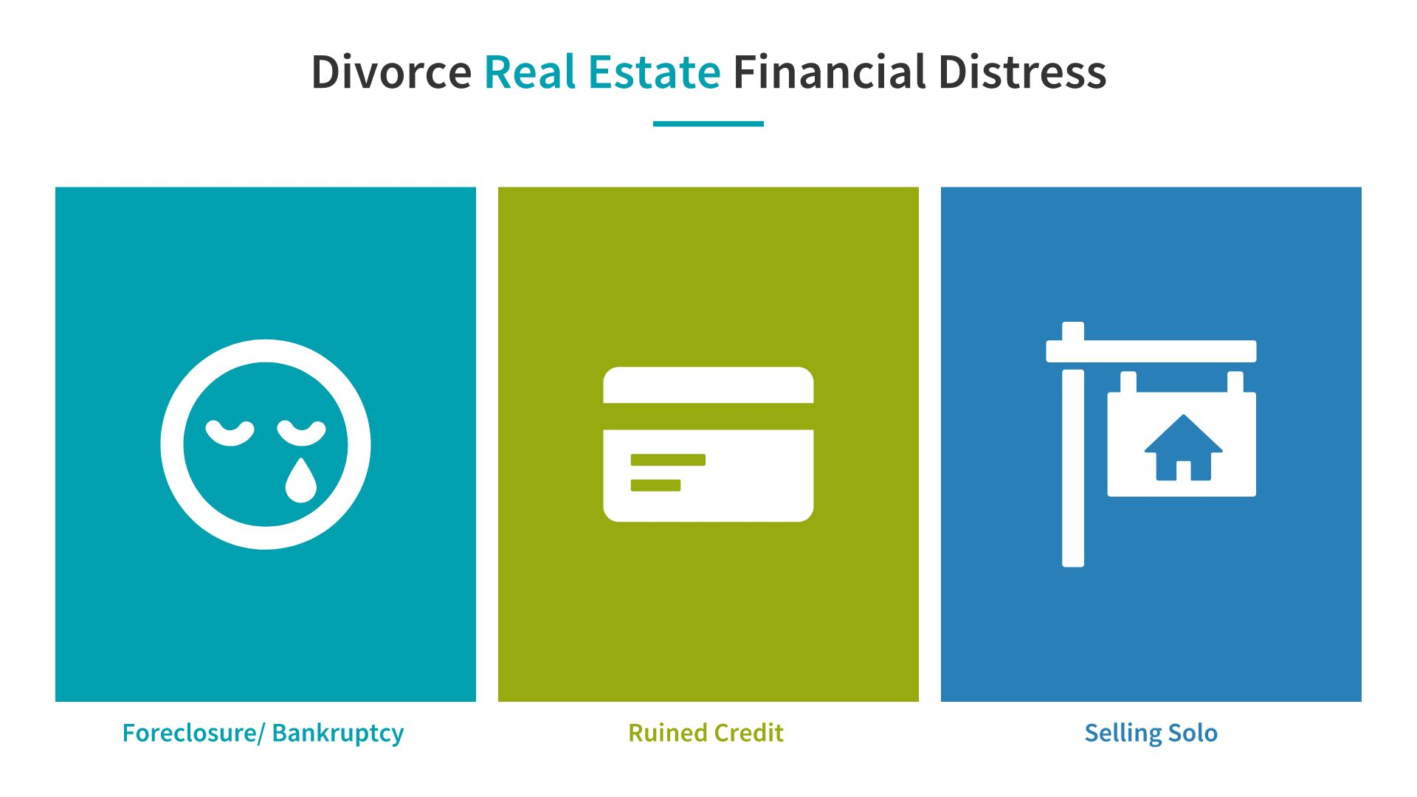
© and ™ 2007-present DivorceThisHouse.com All Rights Reserved.

Slide 14
© and ™ 2007-present DivorceThisHouse.com All Rights Reserved.

Slide 15
© and ™ 2007-present DivorceThisHouse.com All Rights Reserved.

Slide 16
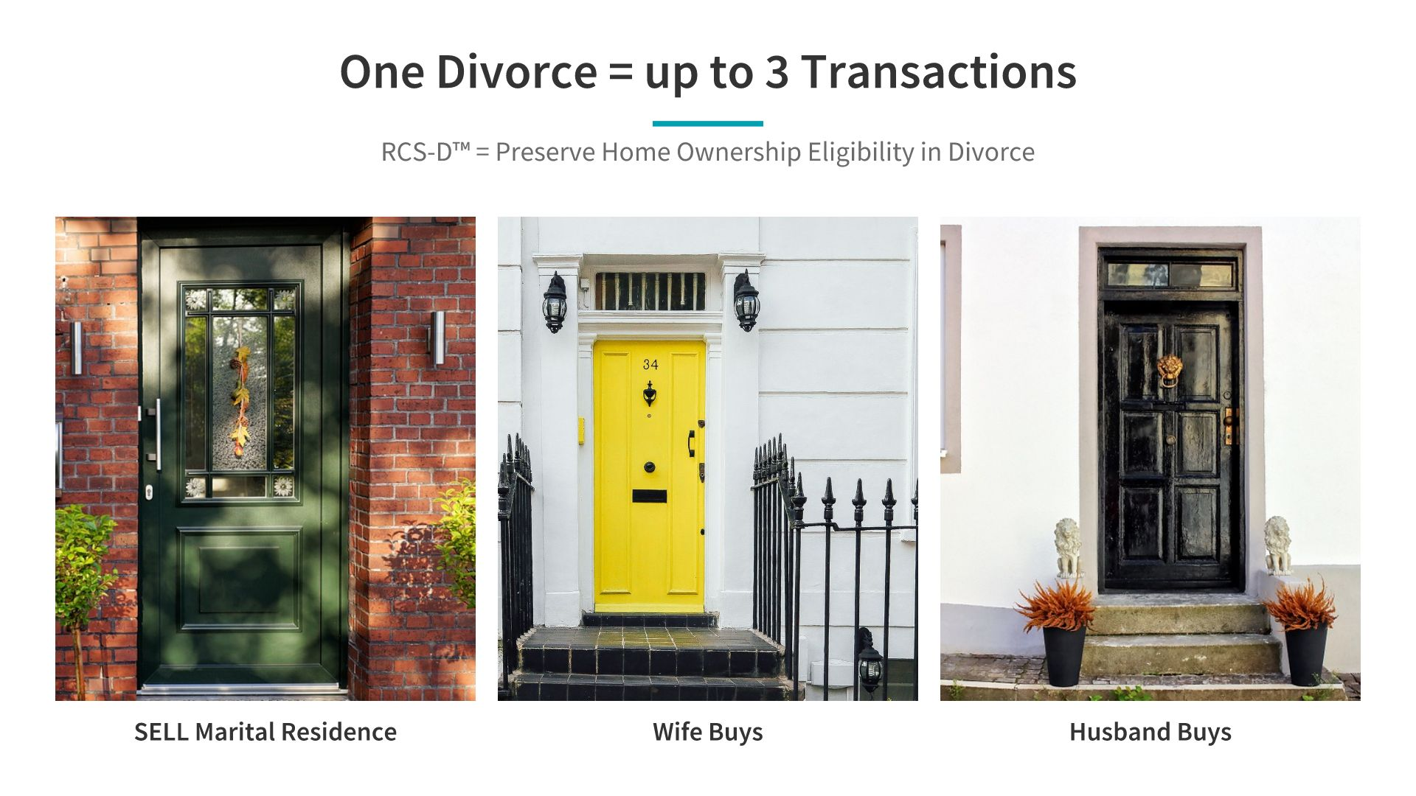
© and ™ 2007-present DivorceThisHouse.com All Rights Reserved.

Slide 17
© and ™ 2007-present DivorceThisHouse.com All Rights Reserved.

Slide 18
© and ™ 2007-present DivorceThisHouse.com All Rights Reserved.

Slide 19
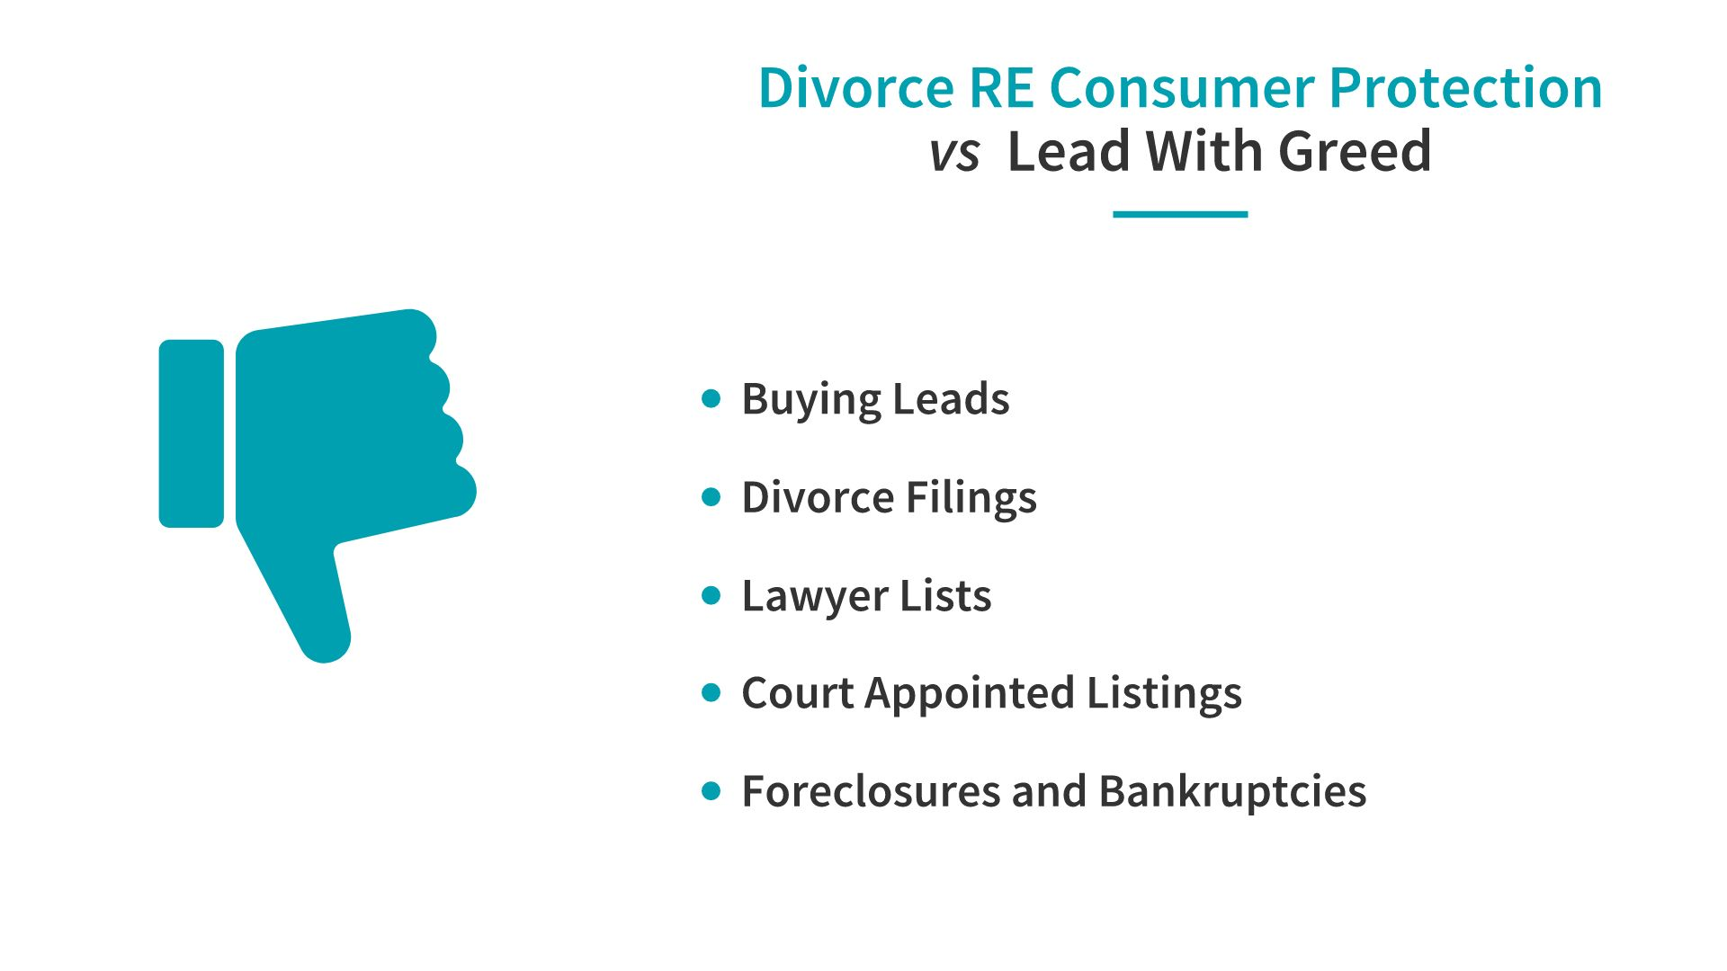
© and ™ 2007-present DivorceThisHouse.com All Rights Reserved.

Slide 20
© and ™ 2007-present DivorceThisHouse.
com All Rights Reserved.

Slide 21
© and ™ 2007-present DivorceThisHouse.com All Rights Reserved.

Slide 22
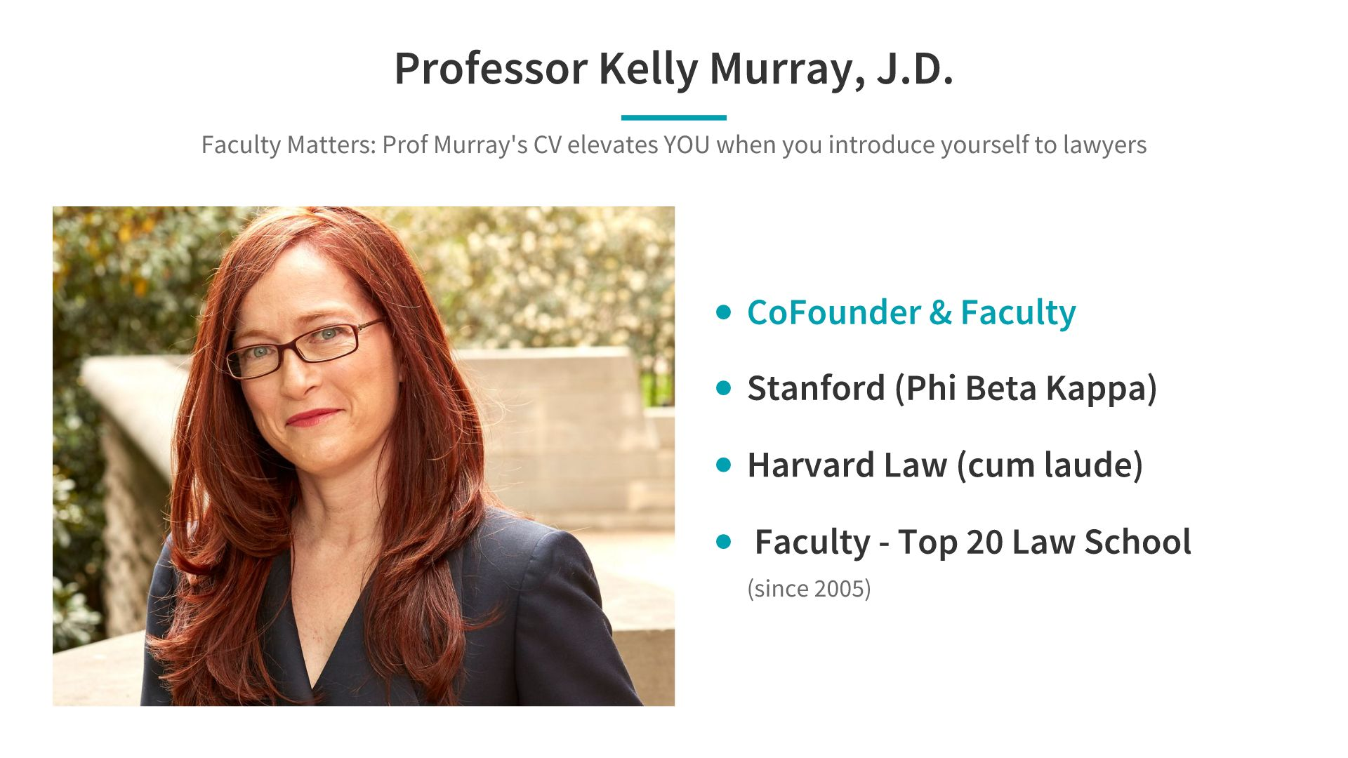
© and ™ 2007-present DivorceThisHouse.com All Rights Reserved.

Slide 23
© and ™ 2007-present DivorceThisHouse.com All Rights Reserved.

Slide 24
© and ™ 2007-present DivorceThisHouse.com All Rights Reserved.

Slide 25
© and ™ 2007-present DivorceThisHouse.com All Rights Reserved.

Slide 26
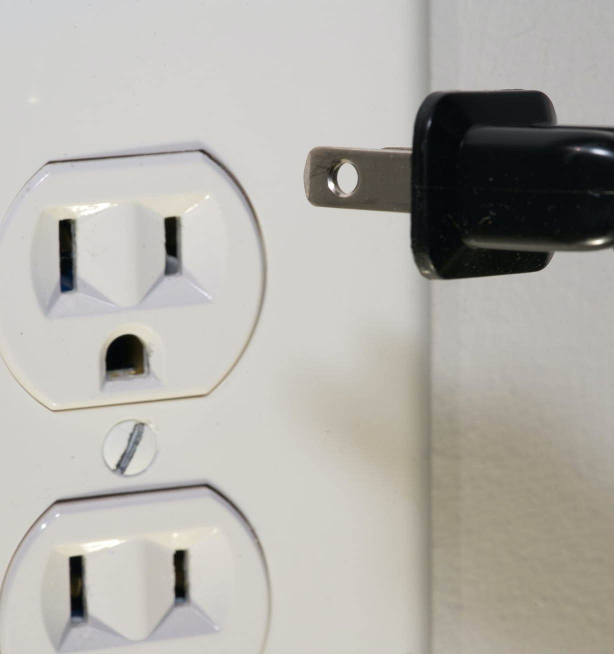
3 Pillars of Agent Mastermind
1
Meet more referral partners & clients
2
Create deeper stronger relationships
3
RCS-D Lender & Agent team work
© and ™ 2007-present DivorceThisHouse.com All Rights Reserved.
Notes:
3 Pillars of Agent Mastermind: We plug in with meeting more referral partners, developing deeper relationships and strengthening REALTOR/ Lender business relationships Translating into INCREASED CLIENT TRANSACTIONS/Satisfaction

Slide 27
© and ™ 2007-present DivorceThisHouse.com All Rights Reserved.

Slide 28
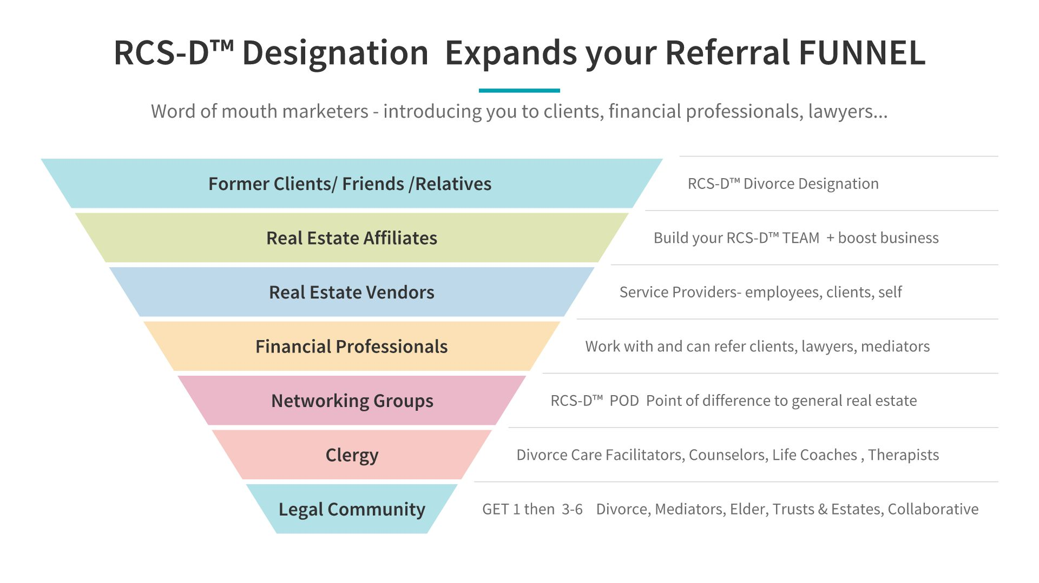
© and ™ 2007-present DivorceThisHouse.com All Rights Reserved.

Slide 29
© and ™ 2007-present DivorceThisHouse.com All Rights Reserved.

Slide 30
© and ™ 2007-present DivorceThisHouse.com All Rights Reserved.

Slide 31
© and ™ 2007-present DivorceThisHouse.com All Rights Reserved.

Slide 32
© and ™ 2007-present DivorceThisHouse.com All Rights Reserved.

Slide 33
© and ™ 2007-present DivorceThisHouse.com
All Rights Reserved.

Slide 34
© and ™ 2007-present DivorceThisHouse.com All Rights Reserved.

Slide 35
© and ™ 2007-present DivorceThisHouse.com All Rights Reserved.

Slide 36
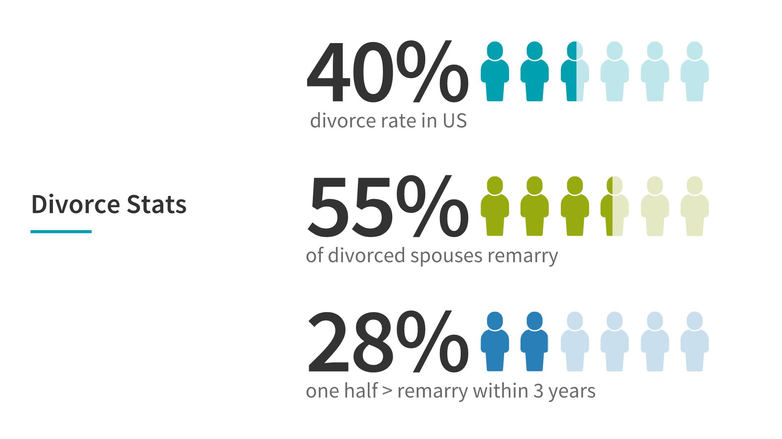
© and ™ 2007-present DivorceThisHouse.com
All Rights Reserved.

Slide 37
© and ™ 2007-present DivorceThisHouse.com All Rights Reserved.

Slide 38
© and ™ 2007-present DivorceThisHouse.com
All Rights Reserved.

Slide 39
© and ™ 2007-present DivorceThisHouse.com
All Rights Reserved.

Slide 40
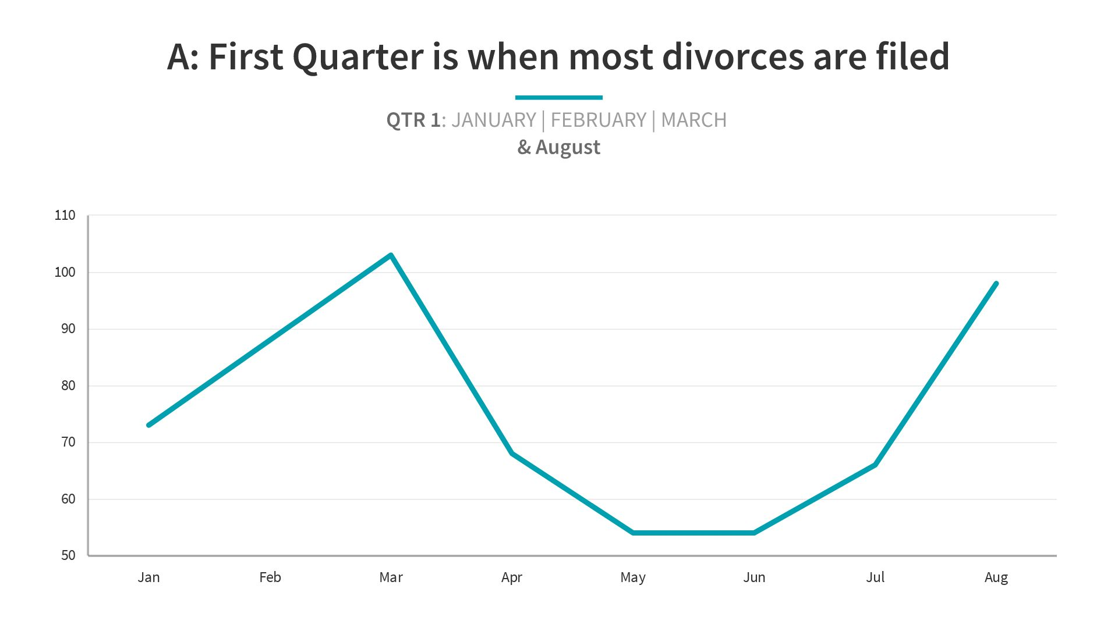
© and ™ 2007-present DivorceThisHouse.com All Rights Reserved.

Slide 42
© and ™ 2007-present DivorceThisHouse.com All Rights Reserved.

Slide 43
© and ™ 2007-present DivorceThisHouse.com All Rights Reserved.

Slide 44
© and ™ 2007-present DivorceThisHouse.com
All Rights Reserved.

Slide 45
© and ™ 2007-present DivorceThisHouse.com All Rights Reserved.

Slide 46
© and ™ 2007-present DivorceThisHouse.com All Rights Reserved.

Slide 47
© and ™ 2007-present DivorceThisHouse.com
All Rights Reserved.

Slide 48
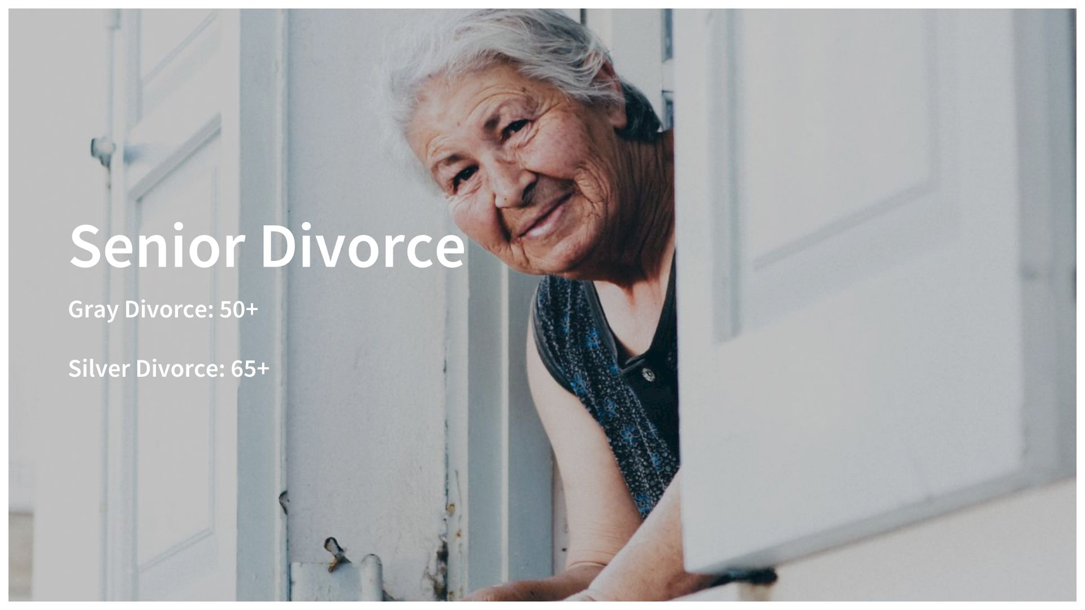
© and ™ 2007-present DivorceThisHouse.com
All Rights Reserved.

Slide 49
© and ™ 2007-present DivorceThisHouse.com All Rights Reserved.

Slide 50
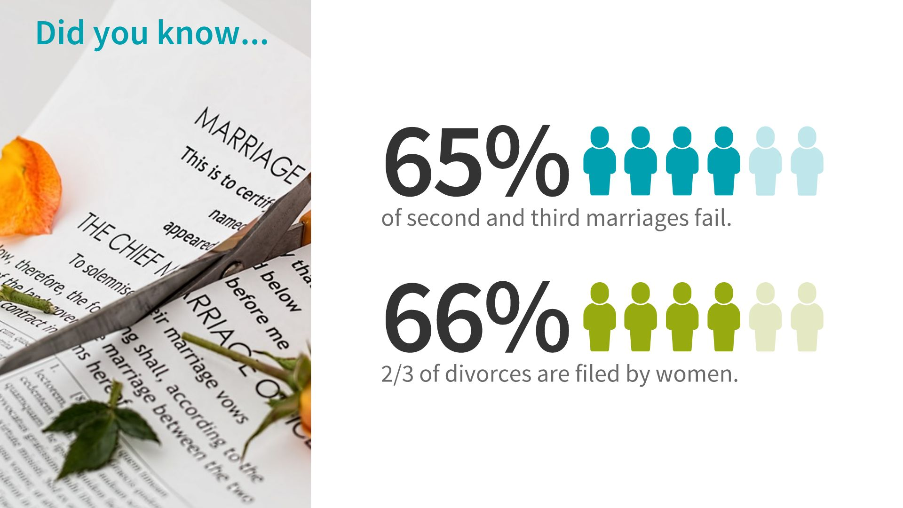
© and ™ 2007-present DivorceThisHouse.com All Rights Reserved.

Slide 51
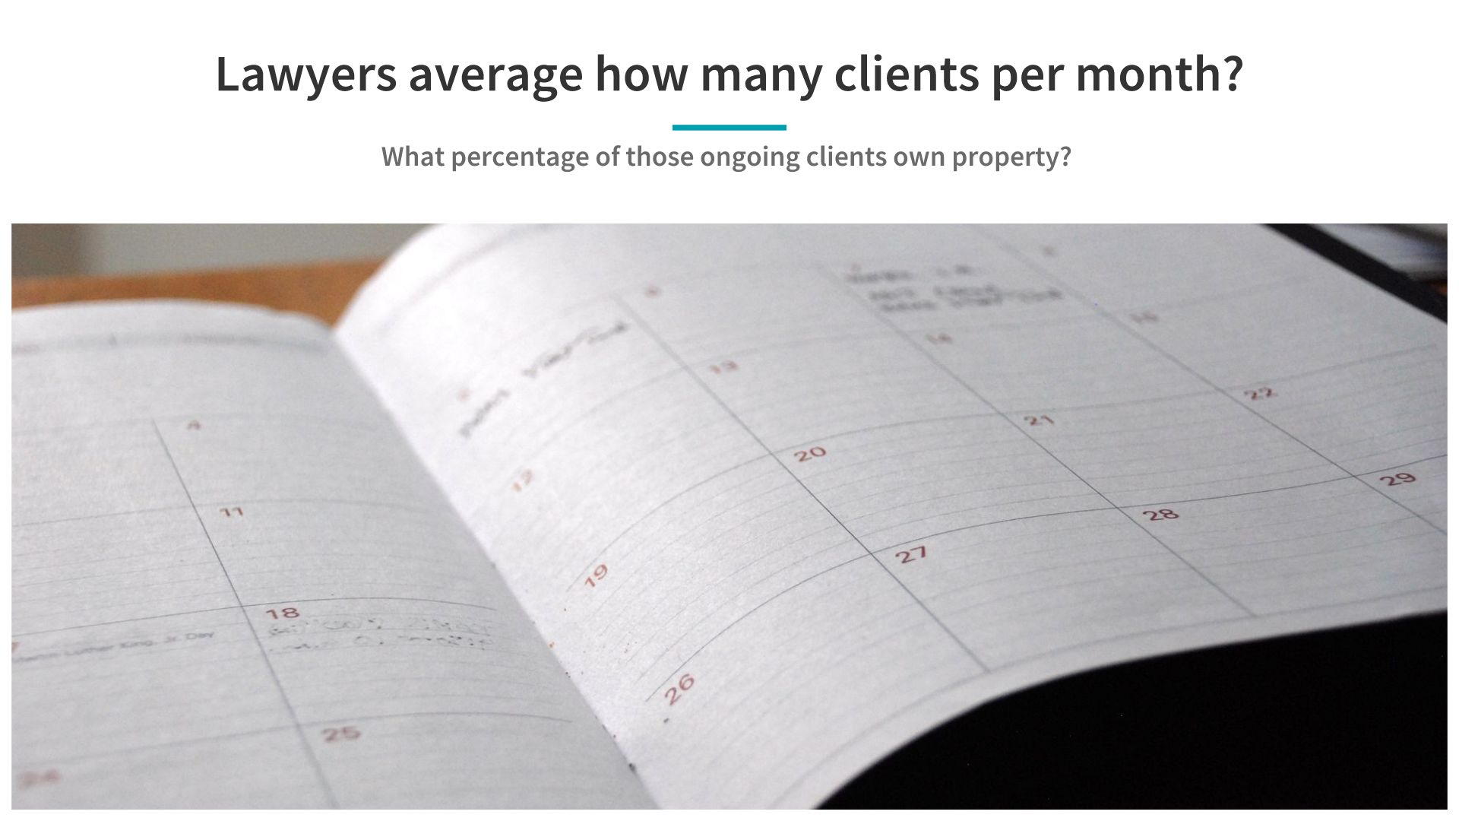
© and ™ 2007-present DivorceThisHouse.com All Rights Reserved.

Slide 52
© and ™ 2007-present DivorceThisHouse.com All Rights Reserved.

Slide 53
© and ™ 2007-present DivorceThisHouse.
com All Rights Reserved.

Slide 54
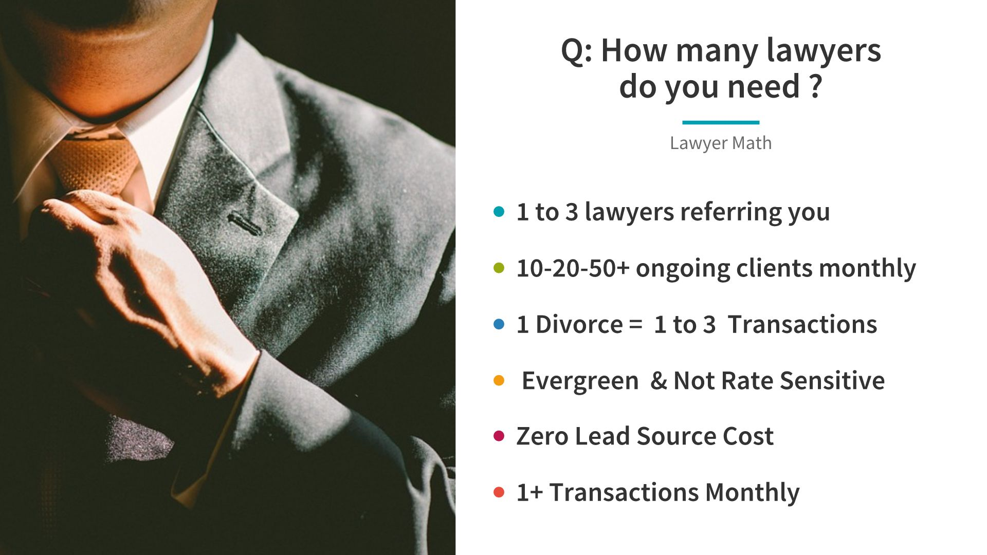
© and ™ 2007-present DivorceThisHouse.
com All Rights Reserved.

Slide 55
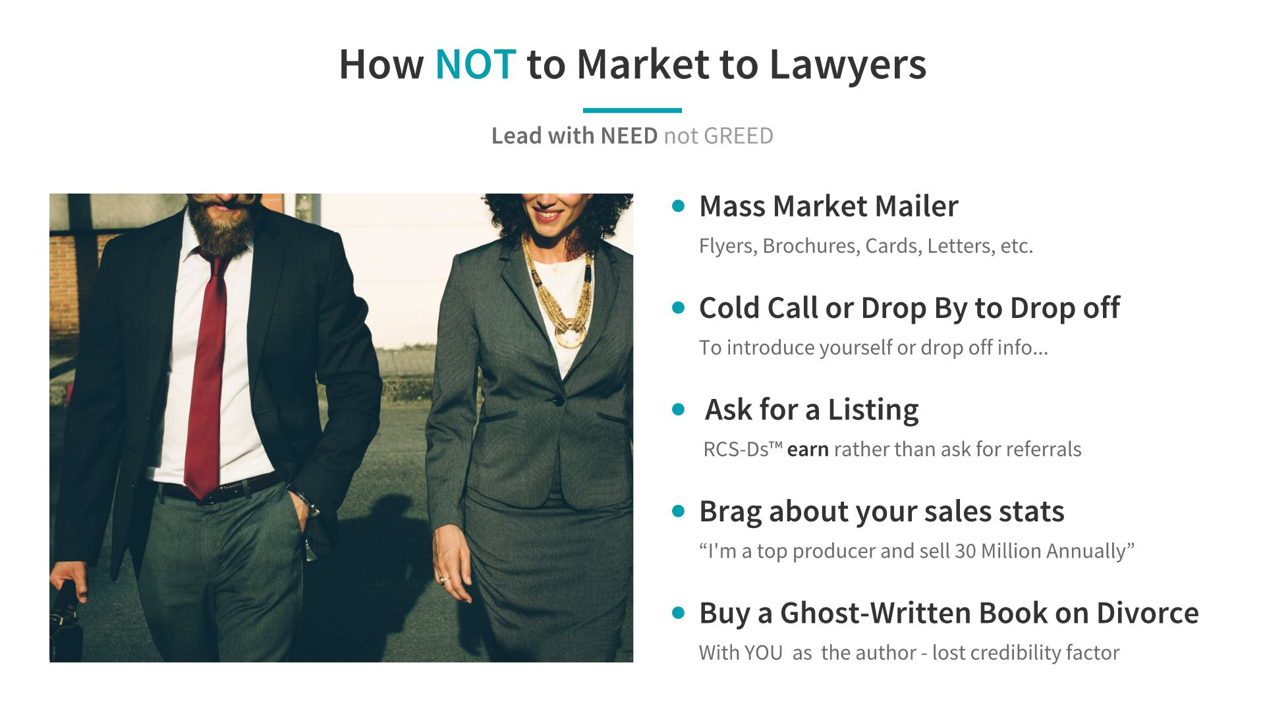
© and ™ 2007-present DivorceThisHouse.com All Rights Reserved.

Slide 56
© and ™ 2007-present DivorceThisHouse.com
All Rights Reserved.

Slide 57
© and ™ 2007-present DivorceThisHouse.com All Rights Reserved.

Slide 58
© and ™ 2007-present DivorceThisHouse.com All Rights Reserved.

Slide 59
AgentMastermind.DivorceThisHouse.com

Slide 60
© and ™ 2007-present DivorceThisHouse.
com All Rights Reserved.

