Slide 1
Making the Most of Your Time
The Fine Art of Time Blocking

Slide 2
What You Will Learn In 60 Minutes
How to STOP doing the things that aren’t going to get you more closings
How to START doing the things that ARE going to get you more closings
A specific structure for the first 4 hours each day.

Slide 3
Direct correlation between income and time spent in focus activities
Average Sales People
Top
Producers

Slide 4
How To Get Rich Selling Real Estate
Step 1
Identify other highly successful real estate agents
Find out what they are doing
Copy them
Ask for their help or opinion
Notes:
Identify highly successful people, then identify what they are doing, and then model them. But it’s not just copying them, it’s getting into their mind and seeing how they think, then model that, or adapt the way they think.

Slide 5
Step 2
Do your Freedom Statement – how much longer to work, how much to get out of debt in that time frame, how much monthly income you need, how much savings/investments you need to generate that income, how many houses you need to sell.
Know your specific numbers (x # leads, x # of listings, or x # of buyers, x # of referral partners, x # of meetings set)
Notes:
Know your outcome. Don’t just say you want to write more loans, say how many per month and begin to plan your day and activities accordingly. Talk about reverse engineering your numbers.

Slide 6
Step 3
Follow a proven plan (DSP-Daily Success Plan)
Know that your plan will work
Don’t go into it trying to “prove it” wrong
Go into it to prove it right.
Mindset is KEY! What’s yours right now?
Notes:
If you knew the plan would work, how dedicated would you be to follow that plan for you day, what would you not do if you knew it would work. So that’s secret #2 is, the most successful LOs believe what they are going to do is going to work. They don’t go trying to prove it wrong, they go in trying to prove it right. They don’t go into saying, this probably isn’t going to work, but what the hell.

Slide 7
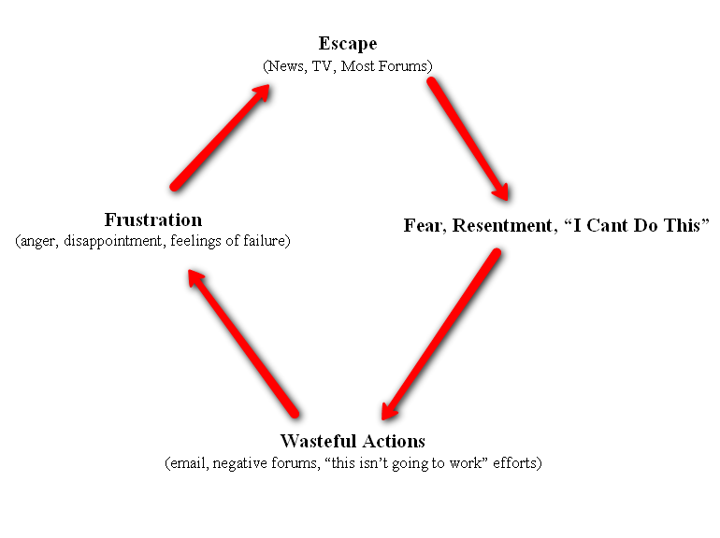
DESTRUCTIVE Downward Spiral

Slide 8
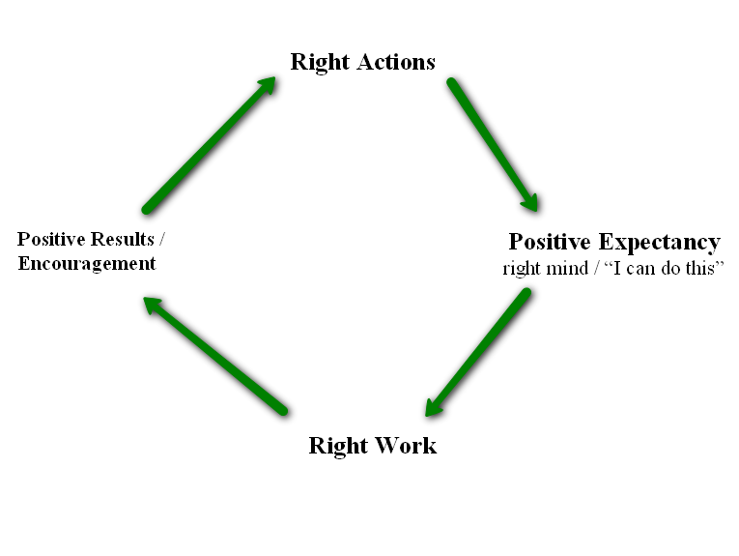
SOARING to Freedom

Slide 9
How To Have The “Right Mind”
Don’t compare yourself to others
Associate with like minded people
Ignore “Haters” (25% rule)
Build a success library of stories
Fill your head with good stuff
Self-talk – “There is an endless source of clients”

Slide 10
Step 4
Put in the work!
There is no silver bullet or magic bean.
Schedule everything!
Notes:
Work hard. It may look like we are screwing around, but we are working, we just love doing it. The key is, if you do #2 and 3 above, it’s fun work. Like I’m working now, it just doesn’t feel like work. I’m here with my best friends giving them directions to the party.

Slide 11
What do Top Producers think?
I only do focused work
I only surround myself with quality people
I work from a schedule
I know my numbers at all times
I set challenging goals
I mastermind with likeminded people
I am generous with my ideas – I share

Slide 12
Tell Me What To Do

Slide 13
Back to the 80/20
What 20% of your activities bring in 80% of your income?
Find out what it is and do a second set of your 20%!!!
Farm out the rest

Slide 14
Putting It Into Action:
Write down a list of items that you do everyday
What’s the one thing???

Slide 15
Check emails Return calls Talk to buyers/sellers already working with Put out fires Write/review contracts Show houses Call leads Listing presentations Do monthly mailers Run errands Video Marketing Bookkeeping/payroll Plan Day Teach Classes Talk to underwriter Continuing Educations Go to closings Call/meet new referral partners Market to past database Check Zillow Upload stuff to MLS Write Addendums Meet with inspectors or appraisers CMA’s

Slide 16
Pick The One
Pick the one thing that you will be doing 8 hours per day, 5 days per week, for the next 2 weeks, that if you don’t do this one thing, in 90 days you are out of business…

Slide 17
Typically, the big $$$ is made:
Consulting with clients and building relationships!
Strategic NOT Tactical

Slide 18
The Single Mother
Morning
6:00 get up and go work out, 7:00 wake up kids, 7:15 get dressed, 7:30 eat breakfast, 7:45 sign school work and get back pack together, 8:00 get in car for bus stop, 8:15 bus comes, 8:30 arrive at office
Work – What ever comes up
Evening
5:00 get home from work, 5:15 start dinner, 5:30 visit with kids, 6:00 eat dinner, 6:30 do dishes and pick up house, 7:00 start homework, 8:00 finish homework and watch TV or play games, 9:00 bedtime for kids

Slide 19
Direct correlation between income and time spent in focus activities
Average Sales Person
Top
Producer

Slide 20
Challenge Time
Do it this way from 8:30am to Noon
Do it your way Noon to 5pm

Slide 21
What goes on your schedule
1) Prospecting Time
2) One one one meetings with Referral Partners
3) Meetings with New Clients
4) Return Phone call time
5) Firefighting time
6) “Flex” time
7) Quitting Time!

Slide 22
Your New Schedule
Listen to positive things on your way to work or as soon as you get up. Exercise, eat well, read, etc. Start your day right!
8:30 – 8:50 Make sure you are ready for your 20% (#1 activity)
8:50-9:00 Read positive thoughts
9:00 – 11:00 Do your 20% 1) Pick up phone - Call leads, title companies, past clients, referral partners, Expireds, COI, etc. 2) Go on appointments – meet with referral partners and potential clients, 3) Teach Classes
11:00-12:00 Work Stuff – Return calls, check emails, respond to offers, etc.
Notes:
Creating conversations. Purpose of phone calls is to get belly to belly, then FROG ‘em. End of frog, “is it ok if my assistant (or me) calls you from time to time to see if you met somebody over the past week that I could help you with”

Slide 23
Part Two (If you feel adventurous)
1:00 – 2:00 Call leads back and set appointments
2:00 – 3:00 Build a bridge – Video marketing, Social Media, Build Presentations, Learn AI, etc.
3:00 on – Listing appointments, show houses, return calls, emails, etc.
6-6:30ish – Be done for the day. Your family needs you too!
Notes:
Creating conversations. Purpose of phone calls is to get belly to belly, then FROG ‘em. End of frog, “is it ok if my assistant (or me) calls you from time to time to see if you met somebody over the past week that I could help you with”

Slide 24
Calendar Rules
If it’s on the calendar you HAVE to do it! You can rearrange but not cancel
You must work 8 hours (if you’re full time and growing)
You must have 2 hours of $$$$ time
Start with more flex time and then slowly decrease
Tomorrow’s calendar is set before you go home today
You MUST have a quitting time

Slide 25
Who does the rest?
An Assistant!!!!
What does it cost?
The question is really is “What does it cost NOT to have an assistant???
Every assistant helps close another 2 transactions
2 x $6K (comm) = $12,000. Assistant only costs $3K
Costing you $9,000 a month NOT to have one

Slide 26
So Now You Know….
The question isn’t “Can You?”…
The question is “WILL YOU?”
Everybody is =
until someone makes a decision

Slide 27
We are not special people
We DO special things

