Slide 1
Tyler Steenken
Director of Strategic Partnerships

Slide 2
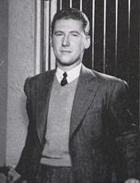
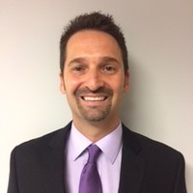
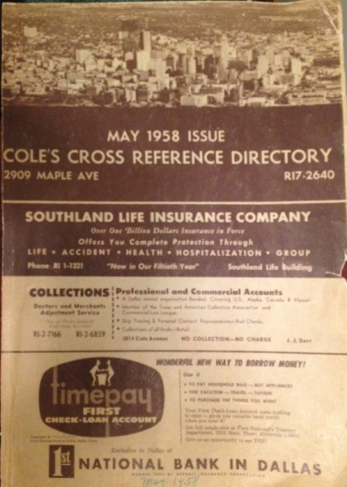
70 YEAR HISTORY
Also known as The Cole Directory
Published in 1947
“Blue Book”
Criss-Cross Directory
Invaluable information for industries in home services, real estate, insurance, collections, police dept., etc.
TODAY: Cole Realty Resource provides neighborhood contact information Online with 24/7 access to real-time cell phones and emails (+250 data attributes)

Slide 3
AGENTS SPEAKING ON STAGE WILL SAY…
Successful agents are not relying on buying “leads” that are also getting called by dozens of other agents
You need to be having MORE conversations about buying and selling real estate with people you do not know
Instead they are creating a sustainable business and are focusing on creating more RELATIONSHIPS!

Slide 4
WHO CAN I CONNECT WITH? Did you know that 70% of all sellers will ONLY interview one agent to list and sell their home (NAR)? What you doing to get in front of these homeowners so you are top of mind when they are ready to pull the trigger?
Reach out to neighbors:
How to contact them:
Apartment Renters
Trigger events such as recent activity (around a just listed, under transaction, just sold)
Mega open houses
Charity events
We have buyers looking in your neighborhood
Expireds
Pick up the phone and hand dial
Ringless voicemail ( such as Sly Broadcast)
Send emails
Upload the lists into FB marketing campaigns

Slide 5
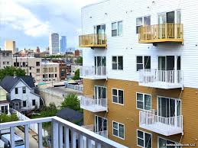
Apartment Renters: CONVERTING TO BUYERS!
Target specific buildings, apartment renters on a street or in an entire zip code
Spending $ on rent… why not buy?
Team up with a lender and hold a first time home buyer workshop (4 steps on how to buy your first home)
FREE coffee at the coffee shop or rent out space at the apartment building
Hold a community event & apartment renters to participate

Slide 6
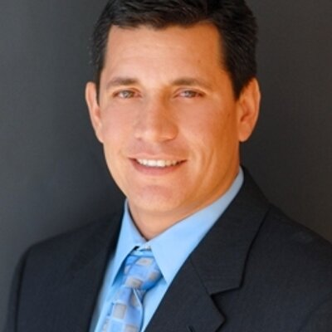
GREG HARRELSON: COMMUNITY DOMINATOR
Team up with a lender and OWN a neighborhood
#1 agent in Myrtle Beach, top 1% agent nationally
Always provide value
Find your FARM (6% + turnover rate)
Hold a community event & invite the neighbors (movie in the park, etc.)
Notify the entire neighborhood any time there is an activity
Monthly eNewsletter
Facebook Custom Audience
Think long term, be known as the Industry Expert, come from contribution

Slide 7
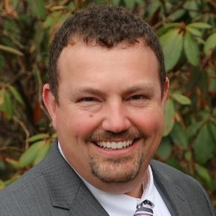
JOHN MOSCILLO: INVENTORY IS SHORT-LEVERAGE “I HAVE BUYERS"
30+ transactions last year, Bedford, NH
Had buyers who refused to move until they could live in their dream neighborhood
They lived on a well known busy street with lots of traffic
Dropped a voice mail to all of the homeowners in a specific subdivision his buyers wanted to live in
Sent a very specific email about his buyers and why they wanted to live in this neighborhood
Found a retired couple looking to downsize who responded back to him
His buyers bought their house (pocket listing) and he was able to list/ sell his buyers house
3 transactions and over 15K in GCI from this one tactic

Slide 8
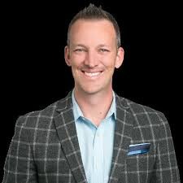
KYLE WHISSEL: CREATE BUZZ AROUND YOUR OPEN HOUSE
San Diego, CA
Listed as #79 in the country via Wallstreet Journal
Exclusive Open House for just the neighbors on the Friday before
Food Truck!
Call/ Email/ Door Knock to invite everyone to stop by
Open House signs everywhere
Make sure to get contact information from anyone who stops by
Ask lots of questions
If it helps you sell the house great. However, the ultimate goal is this helps create meaningful relationships with neighbors who may be wanting to sell soon

Slide 9
OVERVIEW:
Access includes contact names, addresses, landlines, cell phones, emails, etc.
Prospect IQ: 250 attributes such as income, credit range, length of residence, hobbies, and more!
Full access to scripts, training, and etc.
https://partner.coleinformation.com/agentmastermind

