Slide 1
How to Hire Your “A” Team (Using the DISC Profile to Help You)

Slide 2
Looking for Unicorns
This Photo by Unknown Author is licensed under CC BY-SA

Slide 3
Hiring a great employee to help you with your real estate business is one of the most challenging tasks when building your business

Slide 4
Which Employee Costs You Most?
Superior – 1%
Excellent – 4%
Good – 65%
Fair – 20%
Poor – 10%

Slide 5
GOOD IS THE ENEMY OF GREAT!

Slide 6
Hiring Someone Is Not A Typical Skill We Have Learned
The skill needed to hire is not taught In school
But this skill is invaluable in business!!
“Business is a team sport. The average small business owner loses because they do not have a team.” Robert Kiyosaki

Slide 7
Typical Hiring Mistakes and Costs
Mistakes
Hiring in haste just to fill the spot (no background check, no skill test, no working interview or reference check done)
Hiring family and/or friends that are not qualified (On the job training will cost you THOUSANDS – COI - cost of inaction.)
Quick to hire and slow to fire (I feel bad, I really like them, or they really need this job)
Not defining the position (know what problem you want to solve)
Fear of hiring the wrong person (I hired wrong before)
No one does it like me (I’m the ONLY one ☺)
No time taken to properly train a new employee (throwing them to the wolves without any training)
Costs
Advertising costs (depending where you advertise)
Training time

Slide 8
THE DISC TEST IS A POWERFUL HIRING TOOL TO FIND A GREAT ASSISTANT
Why? Because it helps you find the right person for the right position!!!

Slide 9
Using the DISC TEST to Hire
1. Its best if you take the test first.
2. Here is a website that you can take the
DISC TEST for FREE
www.DISCProfileLink.com
3. No profile – no hire

Slide 10
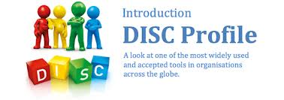
Why bother??? What’s the value???
Identify and appreciate our own behavior style
Identify and appreciate the behavior style of others
Identify motivating drivers
Identifies how the brain solves problems

Slide 11
What is a DISC Test?
DISC is a quadrant behavior model based
on the work of Dr. William Marston that
examines the behavior of individuals in
their environment or within a specific
situation.

Slide 12
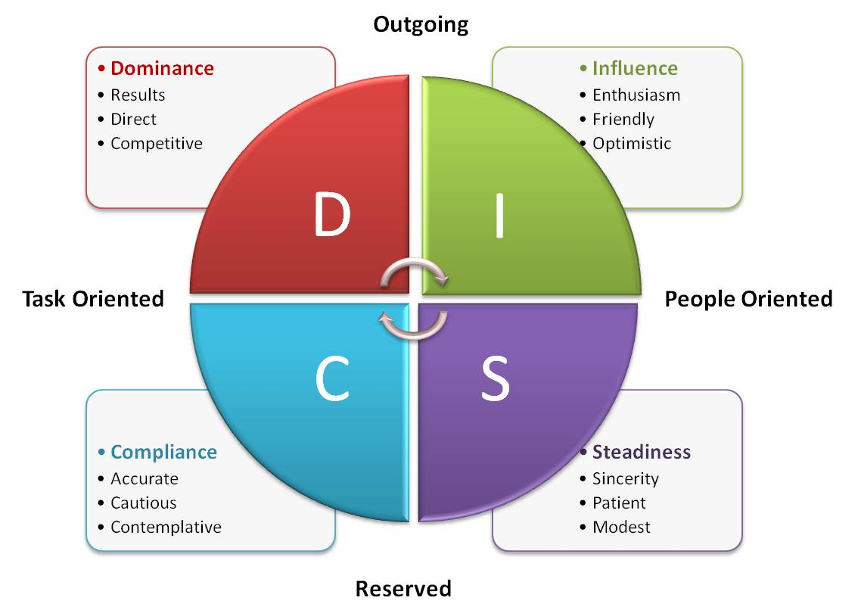

Slide 13
Disc Profile
Dominant (D) – Direct Darrell
Direct, outspoken, results-oriented, a leader, problem-solver
Best characterized by: Donald Trump, General Patton
Influencing (I) – Chatty Kathy
Friendly, outgoing, talkative, optimistic, the life of the party, people-oriented
Best characterized by: Oprah, Jimmy Fallon
Steady (S) – Steady Eddie
Team player, stable, consistent, maintains the status quo, peacemaker, family-oriented, patient
Best characterized by: Larry Page (Google), Barbara Bush, Mother Teresa
Compliant (C) – Perfect Polly
Logical, organized, data-driven, methodical, perfectionist, detail-oriented
Best characterized by: Steve Jobs, Bill Gates, Albert Einstein

Slide 14
Sales Person/Real Estate Agent

Slide 15
Assistant

Slide 16
Working with an assistant with a “D” Style:
They like to work independently
Very sufficient in getting the job done with minimal direction
They do not like to be micro-managed
They are very good at problem solving.
They can be bossy
May have their own “entrepreneurial” dreams

Slide 17
Working with an “I” Style:
Very Sociable as they are very friendly and approachable.
Good with working with customers
Great at being able to get things done because of the relationships that they create.
Successful Title Reps are a good examples of this personality style.
Very good at handling sales calls and setting up your initial appointments or going out in the field to help with promotional work.

Slide 18
Working with an “S” Style:
They are great with customers as well but more reserved.
These assistants are very loyal
They prefer consistency and stability.
They avoid confrontation and are good at following direction.

Slide 19
Working with a “C” Style
They are Perfectionists.
As a team member, they are the ones who know compliance, rules and regulations.
They are great at detail and will map out procedures step by step.
Their desks are very neat and organized.
They will help you get and stay organized as they prefer order.
They are great at creating systems.

Slide 20
Values
High – This comes easily and naturally with no energy or effort – Fuels us!
Low – Is a drain or takes effort. Not of value to us

Slide 21
What does it mean?
Notes:
The Aesthetic Dimension: The main motivation in this value is the drive to achieve balance, harmony and find form or beauty. Environmental concerns or “green” initiatives are also typically prized by this dimension.
The Economic Dimension: This dimension examines the motivation for security from economic gain, and to achieve practical returns. The preferred approach of this dimension is a professional one with a focus on bottom-line results.
The Individualistic Dimension: The Individualistic dimension deals with one's need to be seen as unique, independent, and to stand apart from the crowd. This is the drive to be socially independent and have opportunity for freedom of personal expression.
The Political Dimension: This drive is to be seen as a leader and to have influence and control over one's environment or success. Competitiveness is often associated with those scoring high in this motivation.
The Altruistic Dimension: This drive is an expression of the need or drive to benefit others in a humanitarian sense. There is a genuine sincerity in this dimension to help others, give of one's time, resources and energy, in aid of others.
The Regulatory Dimension: The Regulatory drive indicates one's drive to establish order, routine and structure. This motivation is to promote rules and policies, a traditional approach and security through standards and protocols.
The Theoretical Dimension: The drive to understand, gain knowledge, or discover the “truth”. This motivation can often be to gain knowledge for knowledge sake. Rational thinking, reasoning and problem solving are important to this dimension.

Slide 22
Aesthetic (A great stager!!)
High Drive/Passion For:
Artistic Expression, Harmony, Form over function
Mutual respect, Balance, Creativity
Beauty, Peace, Connection
Low
OK with inconsistency
Not concerned with Harmony
Prefers Function over Form

Slide 23
Economic (A Salesperson)
High Drive/Passion For:
Practical returns, monetary gains
Efficiency, Results, ROI
Utility, Production, Capitalism
Competitive and Driven
Low
Motivated by duty, more than likely not driven by money

Slide 24
Individualistic (Works well by themself)
High Drive/Passion For:
Unique, Special, Free
Independent, Autonomous, Relevant
Self Governed
I did it my way
Low
Take it or leave it, just show me how you want it done, follower, likes a team

Slide 25
Political (Leader - Another salesperson marker)
High Drive/Passion For:
Leadership, Power, Control
Influential, Authoritative, Competitive
Status and Esteem
I Take Full Responsibility – (own the result)
Low
I like being part of a team or group. Don’t want to lead and don’t care about winning

Slide 26
Altruistic (Loves teaching/helping)
High Drive/Passion For:
Helping, Support others, people oriented
Improving society, generosity, selflessness
Compassion, Caring, Giving of oneself
Low
What’s in it for me? I’ll help you if…..

Slide 27
Regulatory (Great assistant)
High Drive/Passion For:
Systems, Order, Regulations
Structured, Focused, Principled
Traditions
To follow or establish
Low
Free Spirit, Rules are just a guideline, let’s try something NEW!

Slide 28
Theoretical (Loves to Learn)
High Drive/Passion For:
Rational, Objective, Factual
Loves learning, discovering and solving problems
Analytical
Learning just for the heck of it, needs to be right (probably loves documentaries)
Low
Learns what is needed to accomplish a certain task

Slide 29
Values (This would be a salesperson values)

Slide 30
Attributes
THE IDEAL TEAM PLAYER – Pat Lencioni
Hungry – How can I help?
Humble – Team Players
Happy and Smart – Good with People
Try a Working Interview

Slide 31
Next STEP - Clarifying the Job Description and Tasks
When hiring your first team member, it is important to list what part of the sales process you enjoy.
What are the tasks that you either don’t like or don’t do well? (Let’s delegate!)

Slide 32
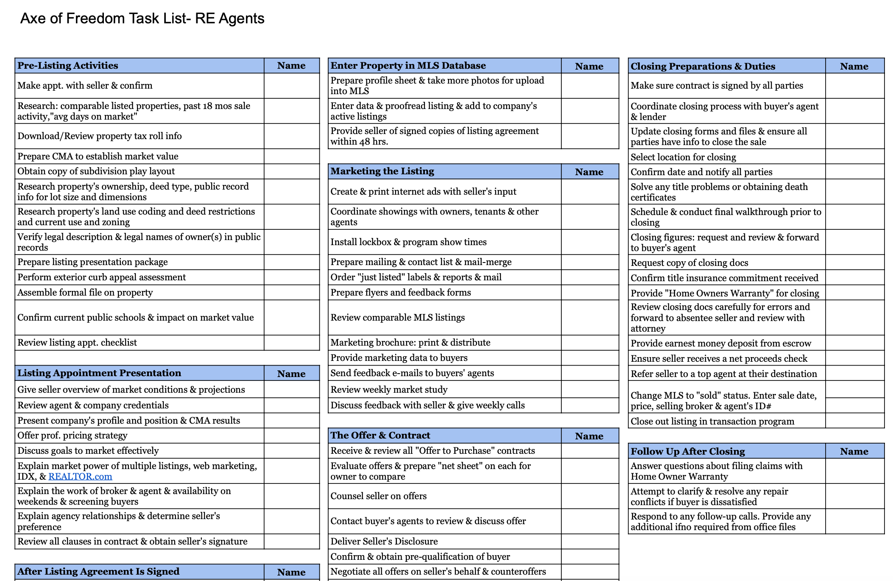

Slide 33
When hiring an assistant, they may take over the following tasks so that you can create more sales:
Manage contracts
Manage the escrow timelines and inform clients.
Manage your schedule and emails
Confirm appts the day before.
Manage your past client database
Answer phones
Attend open houses

Slide 34
THE DISC TEST IS A POWERFUL TOOL
The DISC Test can help you increase your chances to hire a good team member. But…. There are other processes when hiring that should be incorporated in order to ensure that you’ve hired the right person.
Skill Test, phone interview (phone skills), working interview, writing skills, other team member interview, background check, reference check, licenses, etc.

