Slide 1
Referrals From Your Facebook Friends
Scott Hudspeth
Brad Brondt

Slide 2
The Top 3 Thing For Massive Success!
Have as many conversations as possible every day! “13 per day = 1 referral”
Remind everyone that knows, likes and trust you, what you do for a living as often as possible using different platforms
Today our focus is Facebook
Never ever waste a conversation and Always, Always, Always ask for business/referrals…

Slide 3
First Things First
Are you friends on Facebook with
Past clients
Current clients
Family
Friends
Local business owners you frequent
CPA’s
Financial planners
Past school mates
Everyone and anyone in your local area that is a homeowner

Slide 4
Does Your Profile
Show that you are a Real Estate agent
Show your contact info, Mobile and Email
Text/Call 269-555-1212
Email me at scott@mybusinessemail.com
Do you have a decent looking header?
Fiverr.com is a great place to get one
Do you have a current pic of yourself

Slide 5
First Task
Make it a daily priority to friend everyone 30 per day!
If anyone friends you, accept them until 5:00 pm, no later.
Focus on friending and excepting 30 a day. Don’t go over 30.
Never accept a friend request after 5:00. Instructions to follow.
Focus on this daily and it will land you a ton of referrals and closings
As you grow your friend list your referrals will grow
Put this on your calendar and never stray from it.

Slide 6
The DM Facebook Strategy
DM (Direct Message) everyone of our friends on Facebook
Scripts to follow
Want a Grand slam (Brad talk to us about this)
Send a video DM to everyone of your friends on Facebook, super easy, way stronger with better conversions

Slide 7
DM Is Done From Your Personal Page Not Business Page

Slide 8
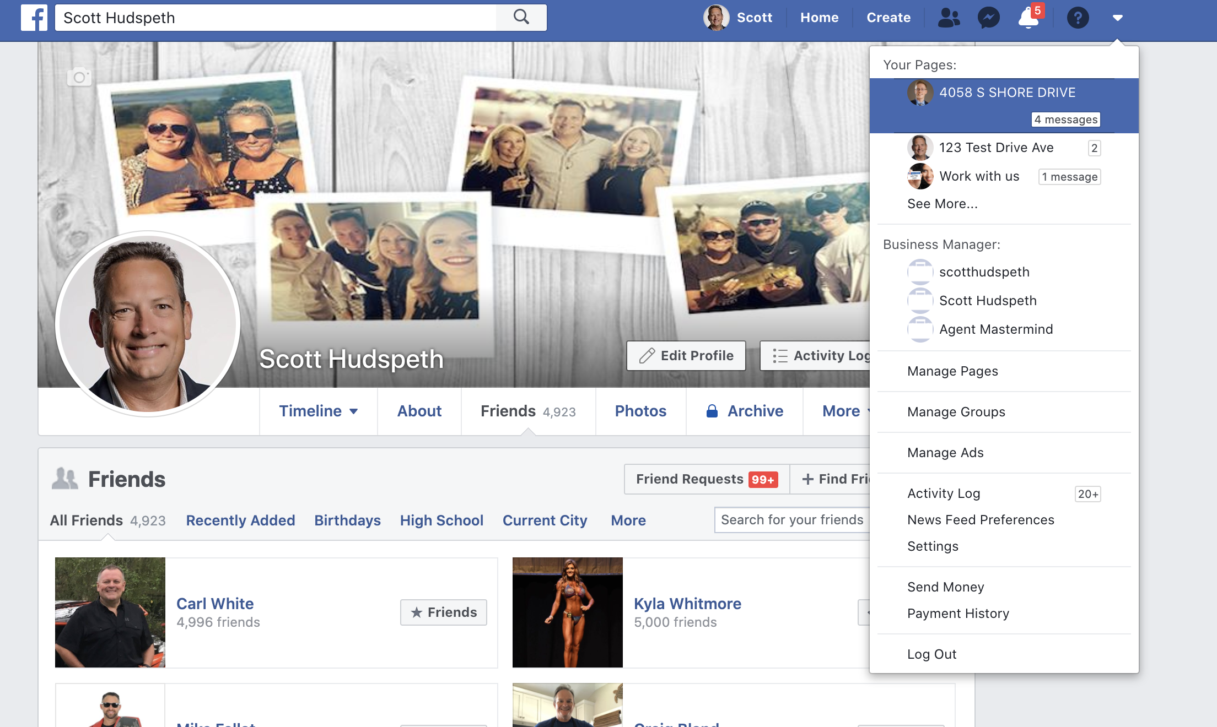
Let’s Get Started
Download your friend list

Slide 9
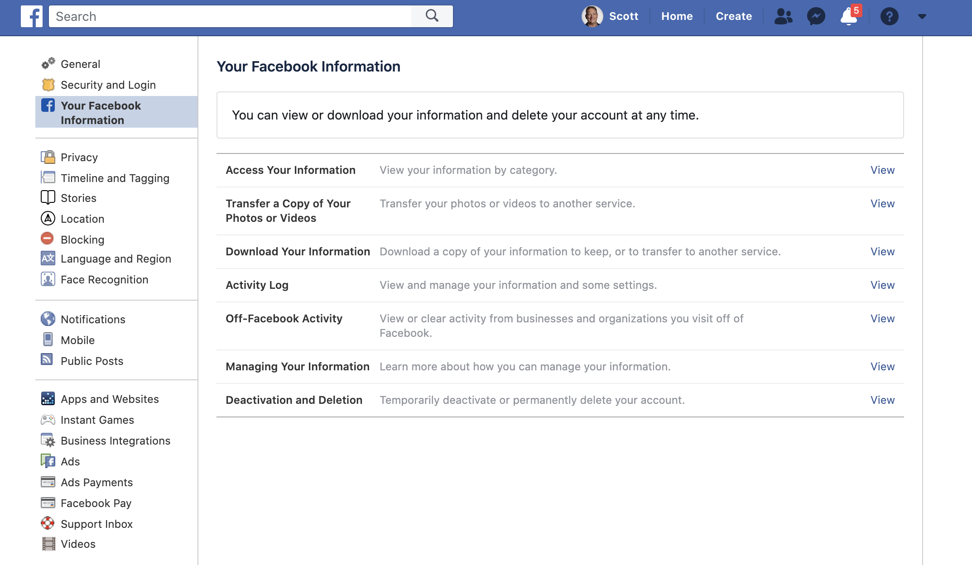
1st
2nd

Slide 10
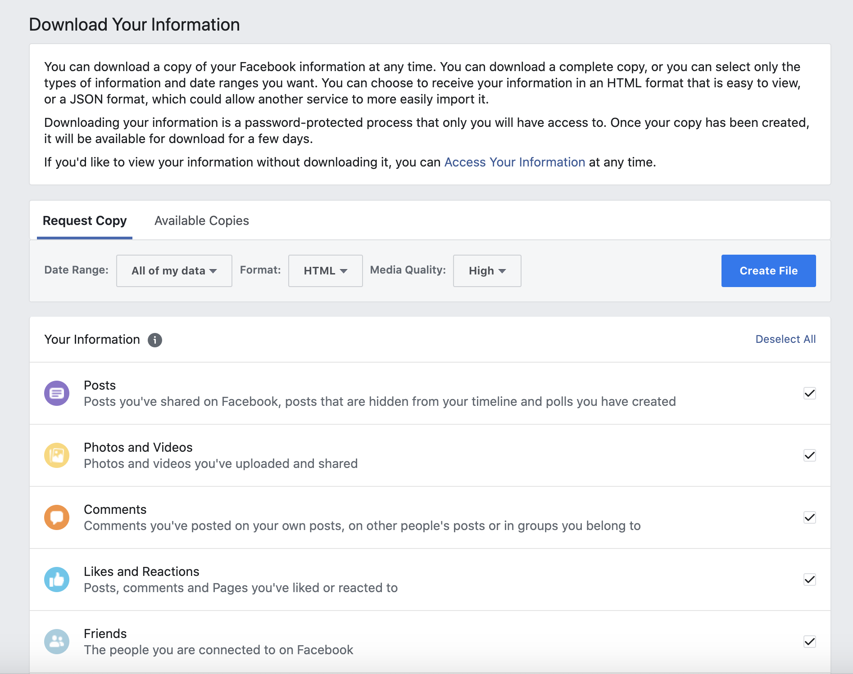
Click “Deselect All”

Slide 11
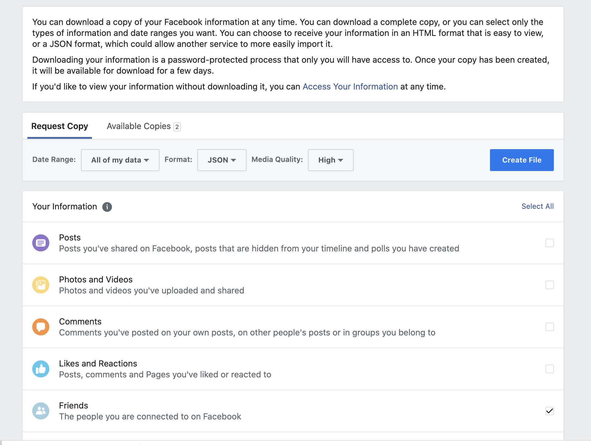
3rd “Create file”
1st “Change to JSON”
2nd “Check Friends box”

Slide 12
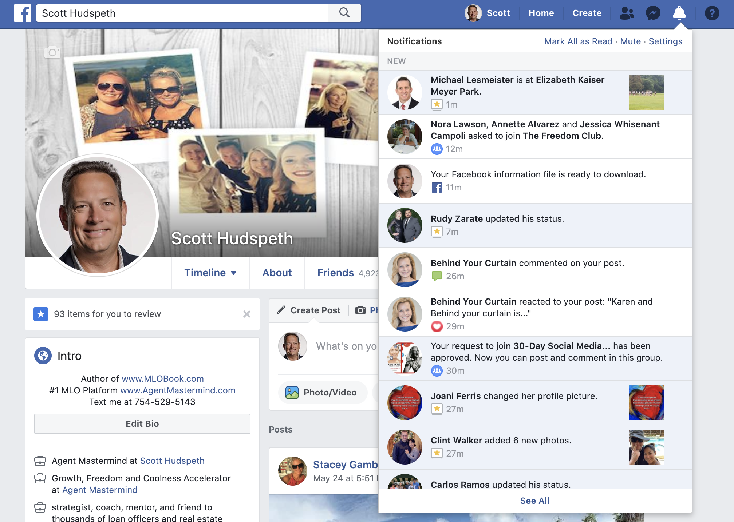

Slide 13
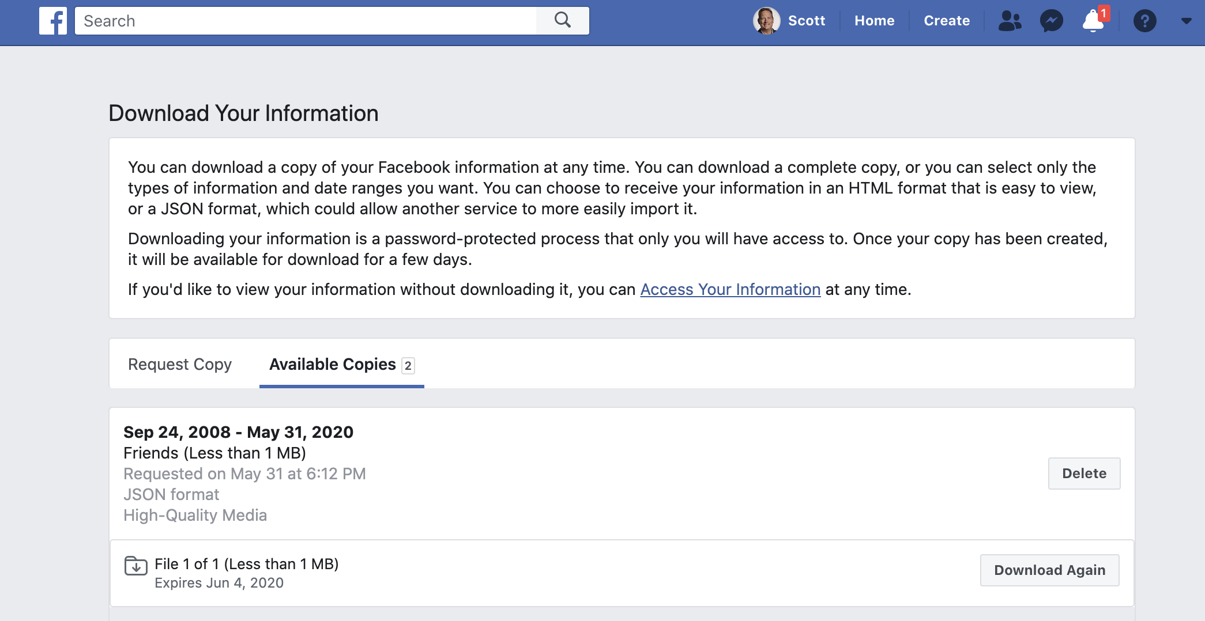

Slide 14
HOW TO EXPORT YOUR FACEBOOK FRIENDS From JSON to CSV Then to Excel
Step by step
https://www.contactmapping.com/blog/2019/8/12/how-to-export-your-facebook-friends-list-to-google-contacts
Site you need to covert JSON to CSV
http://www.convertcsv.com/json-to-csv.htm

Slide 15
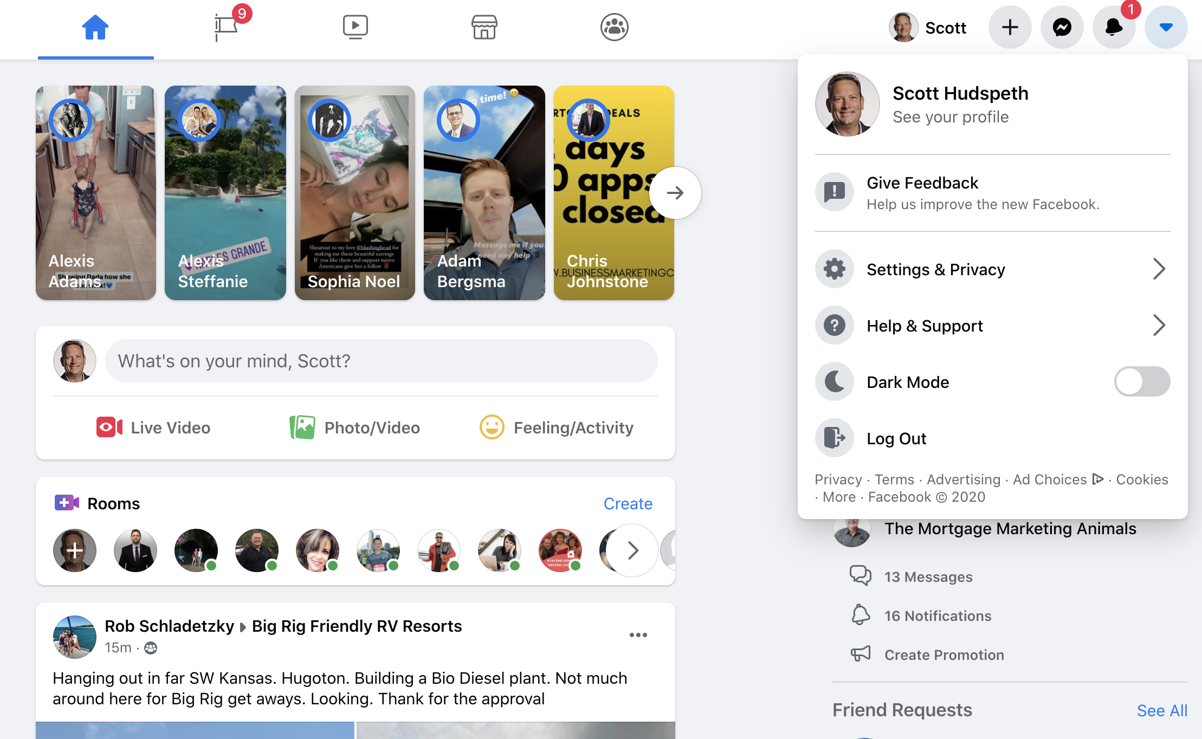

Slide 16
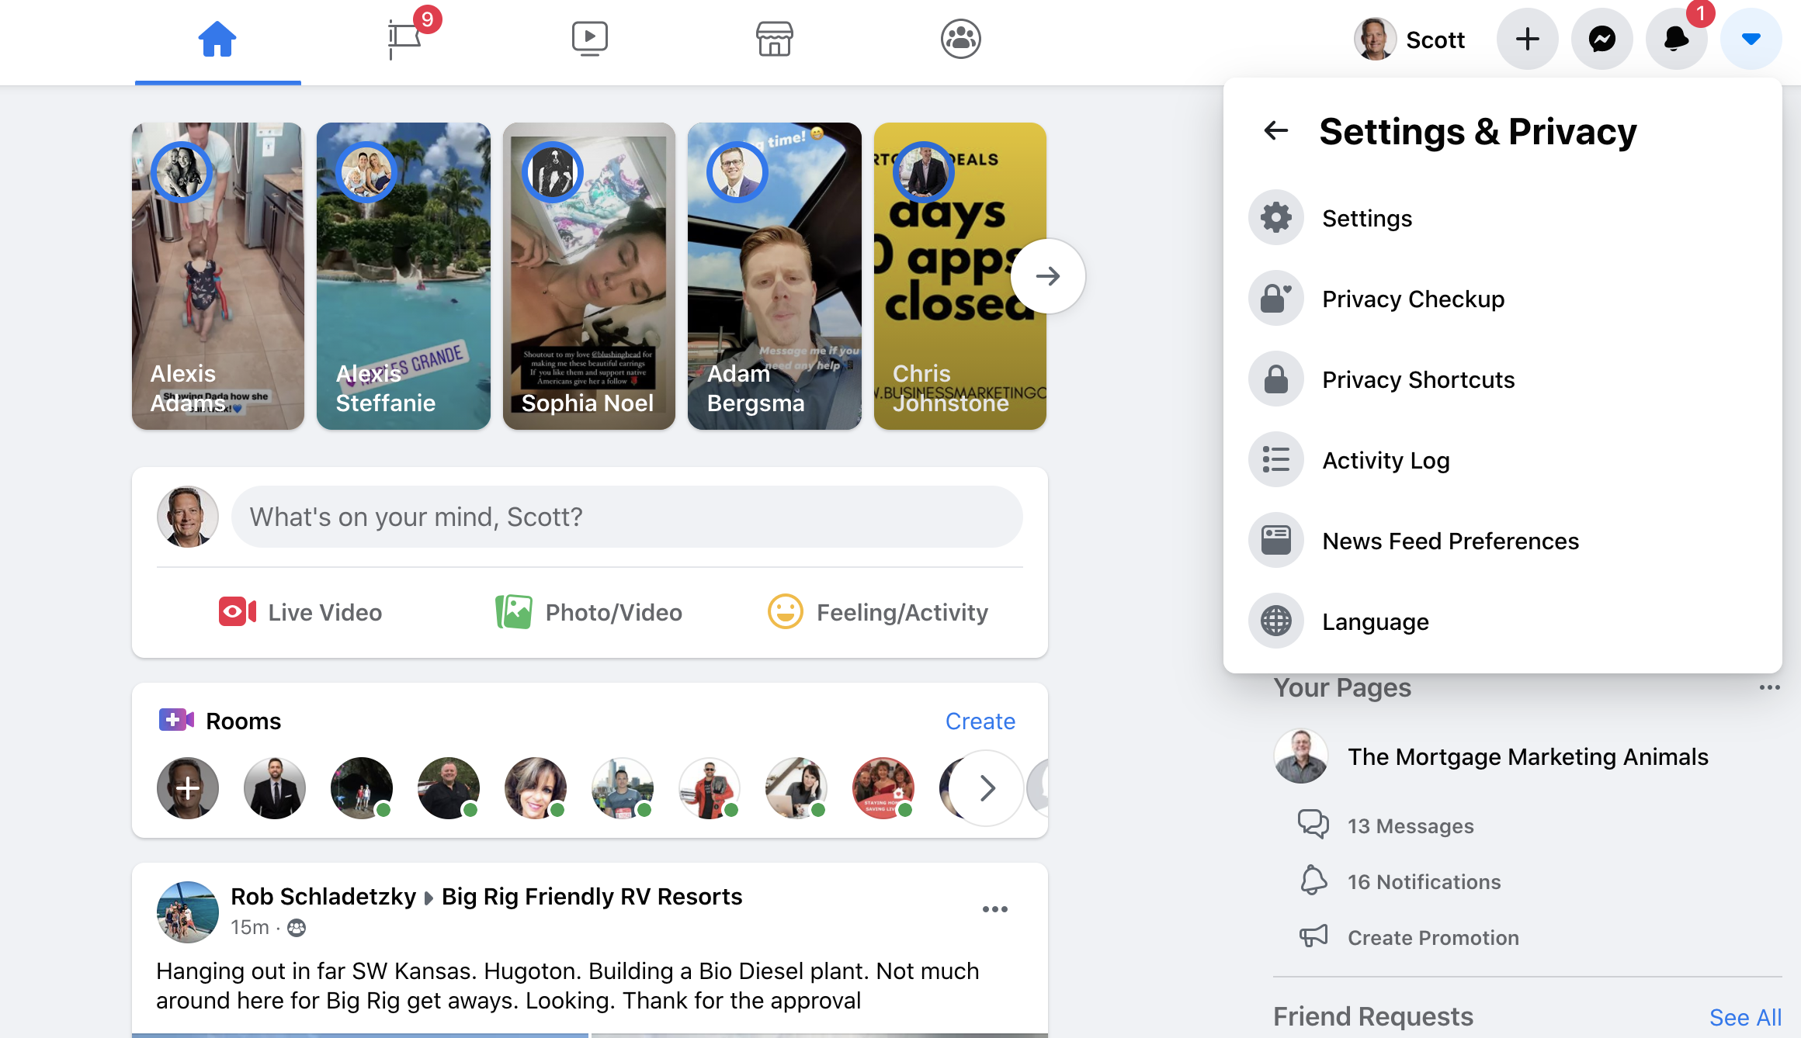

Slide 17
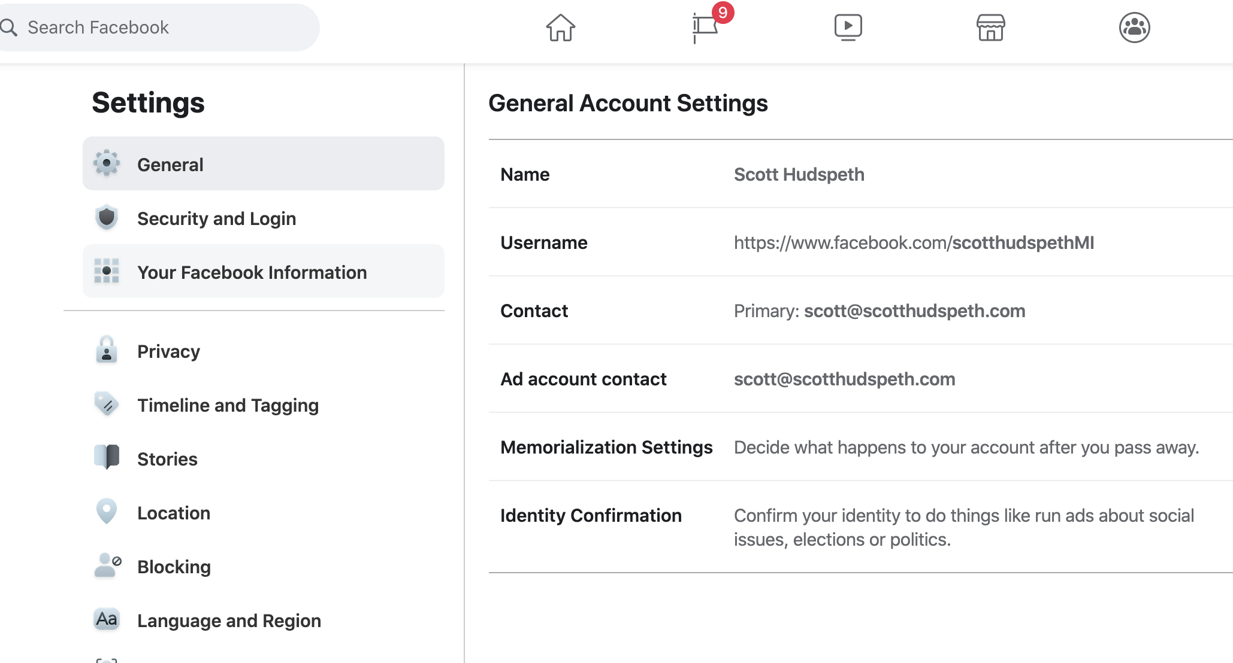

Slide 18
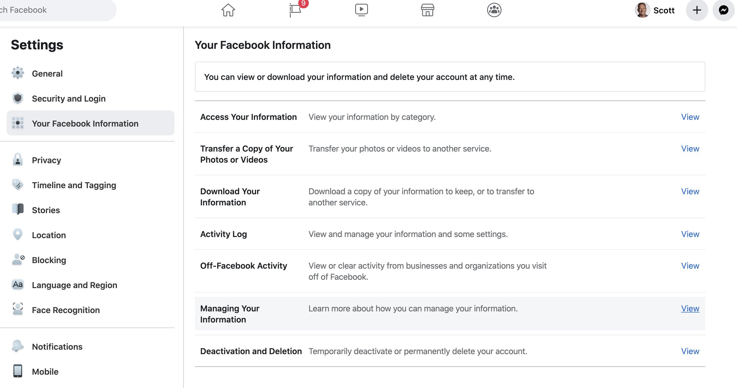

Slide 19
Click “Deselect All”

Slide 20
3rd “Create file”
1st “Change to JSON”
2nd “Check Friends box”

Slide 22
Script
Hey "First Name", was thinking about you and hope that you and your family are safe, healthy and enjoying this time together during these crazy times? I'm sure you know that rates are the lowest they have been ever which causes a feeding frenzy in the housing market and I wanted to see if open to a conversation about your short and long term goals when it comes to your current home or future home plans. You have 5 minutes to talk in the next couple days? Would love to share what a couple of my other clients are doing to benefit from these crazy times?

Slide 23
Another Option
Hey "First Name", was thinking about you and hope that you and your family are safe, healthy and enjoying this time together during these crazy times? Was wondering If you have 5 minutes to talk about your short & long-term housing goals. There are a lot of changes in the marketplace and wanted to let you know what's going so you can take advantage of what's happening! You have 5 minutes to talk in the next couple days?

Slide 24
Conversation Topics
Foreclosures
Moving Up
Moving Down
Moving to different states
Moving the city to the country
Refinancing and pulling cash for their first rental / another rental
Refinancing and pulling some cash for a 2nd home / lake home

Slide 25
When You Talk To Them
FROG them first and see how they are doing during this craziness. Most are over it and ready to get back to some sort of normalcy in their lives
FROG means
Family
How’s the family doing?
How the kids holding up?
How’s home school going?
Sending your kids back to school?
Recreation
Playing any new card or dice games during this lockdown?
What new things have you and the family been doing together
Explore any new recipes I need to know about?
Occupation
Everything ok at work?
Goals
What’s the first thing you and your family want or travel to once this is over?
Be upbeat and positive don’t be negative nelly

Slide 26
Never Waste A Call, Always Ask!
Always Always Always ASK THE QUESTIONS
ALWAYS ALWAYS ASK FOR REFERRALS!
Wanted to see if open to talking about buying or selling a home?
Rental property
2nd home
Foreclosures are going to be showing up very soon
Using Facebook Friends
I see we have several mutual friends on Facebook. But there is a lot of friends you have that I don’t know, would you mind if I reach out to them and use your name? Better yet, why don’t you give me 10 that you care about the most, I would have for them to miss out this amazing opportunity happening right now…

Slide 27
Facebook, Lets Get Some Referrals!
Using Facebook Friends
I see we have several mutual friends on Facebook, but you also have a lot of friends that I don’t know, way too many for me to help out.
Who are the 9-10 you care about the most that I can reach out to, I would hate for them to miss out on this amazing opportunity.
Brad Brondt – Video method that will get even more responses.

Slide 28
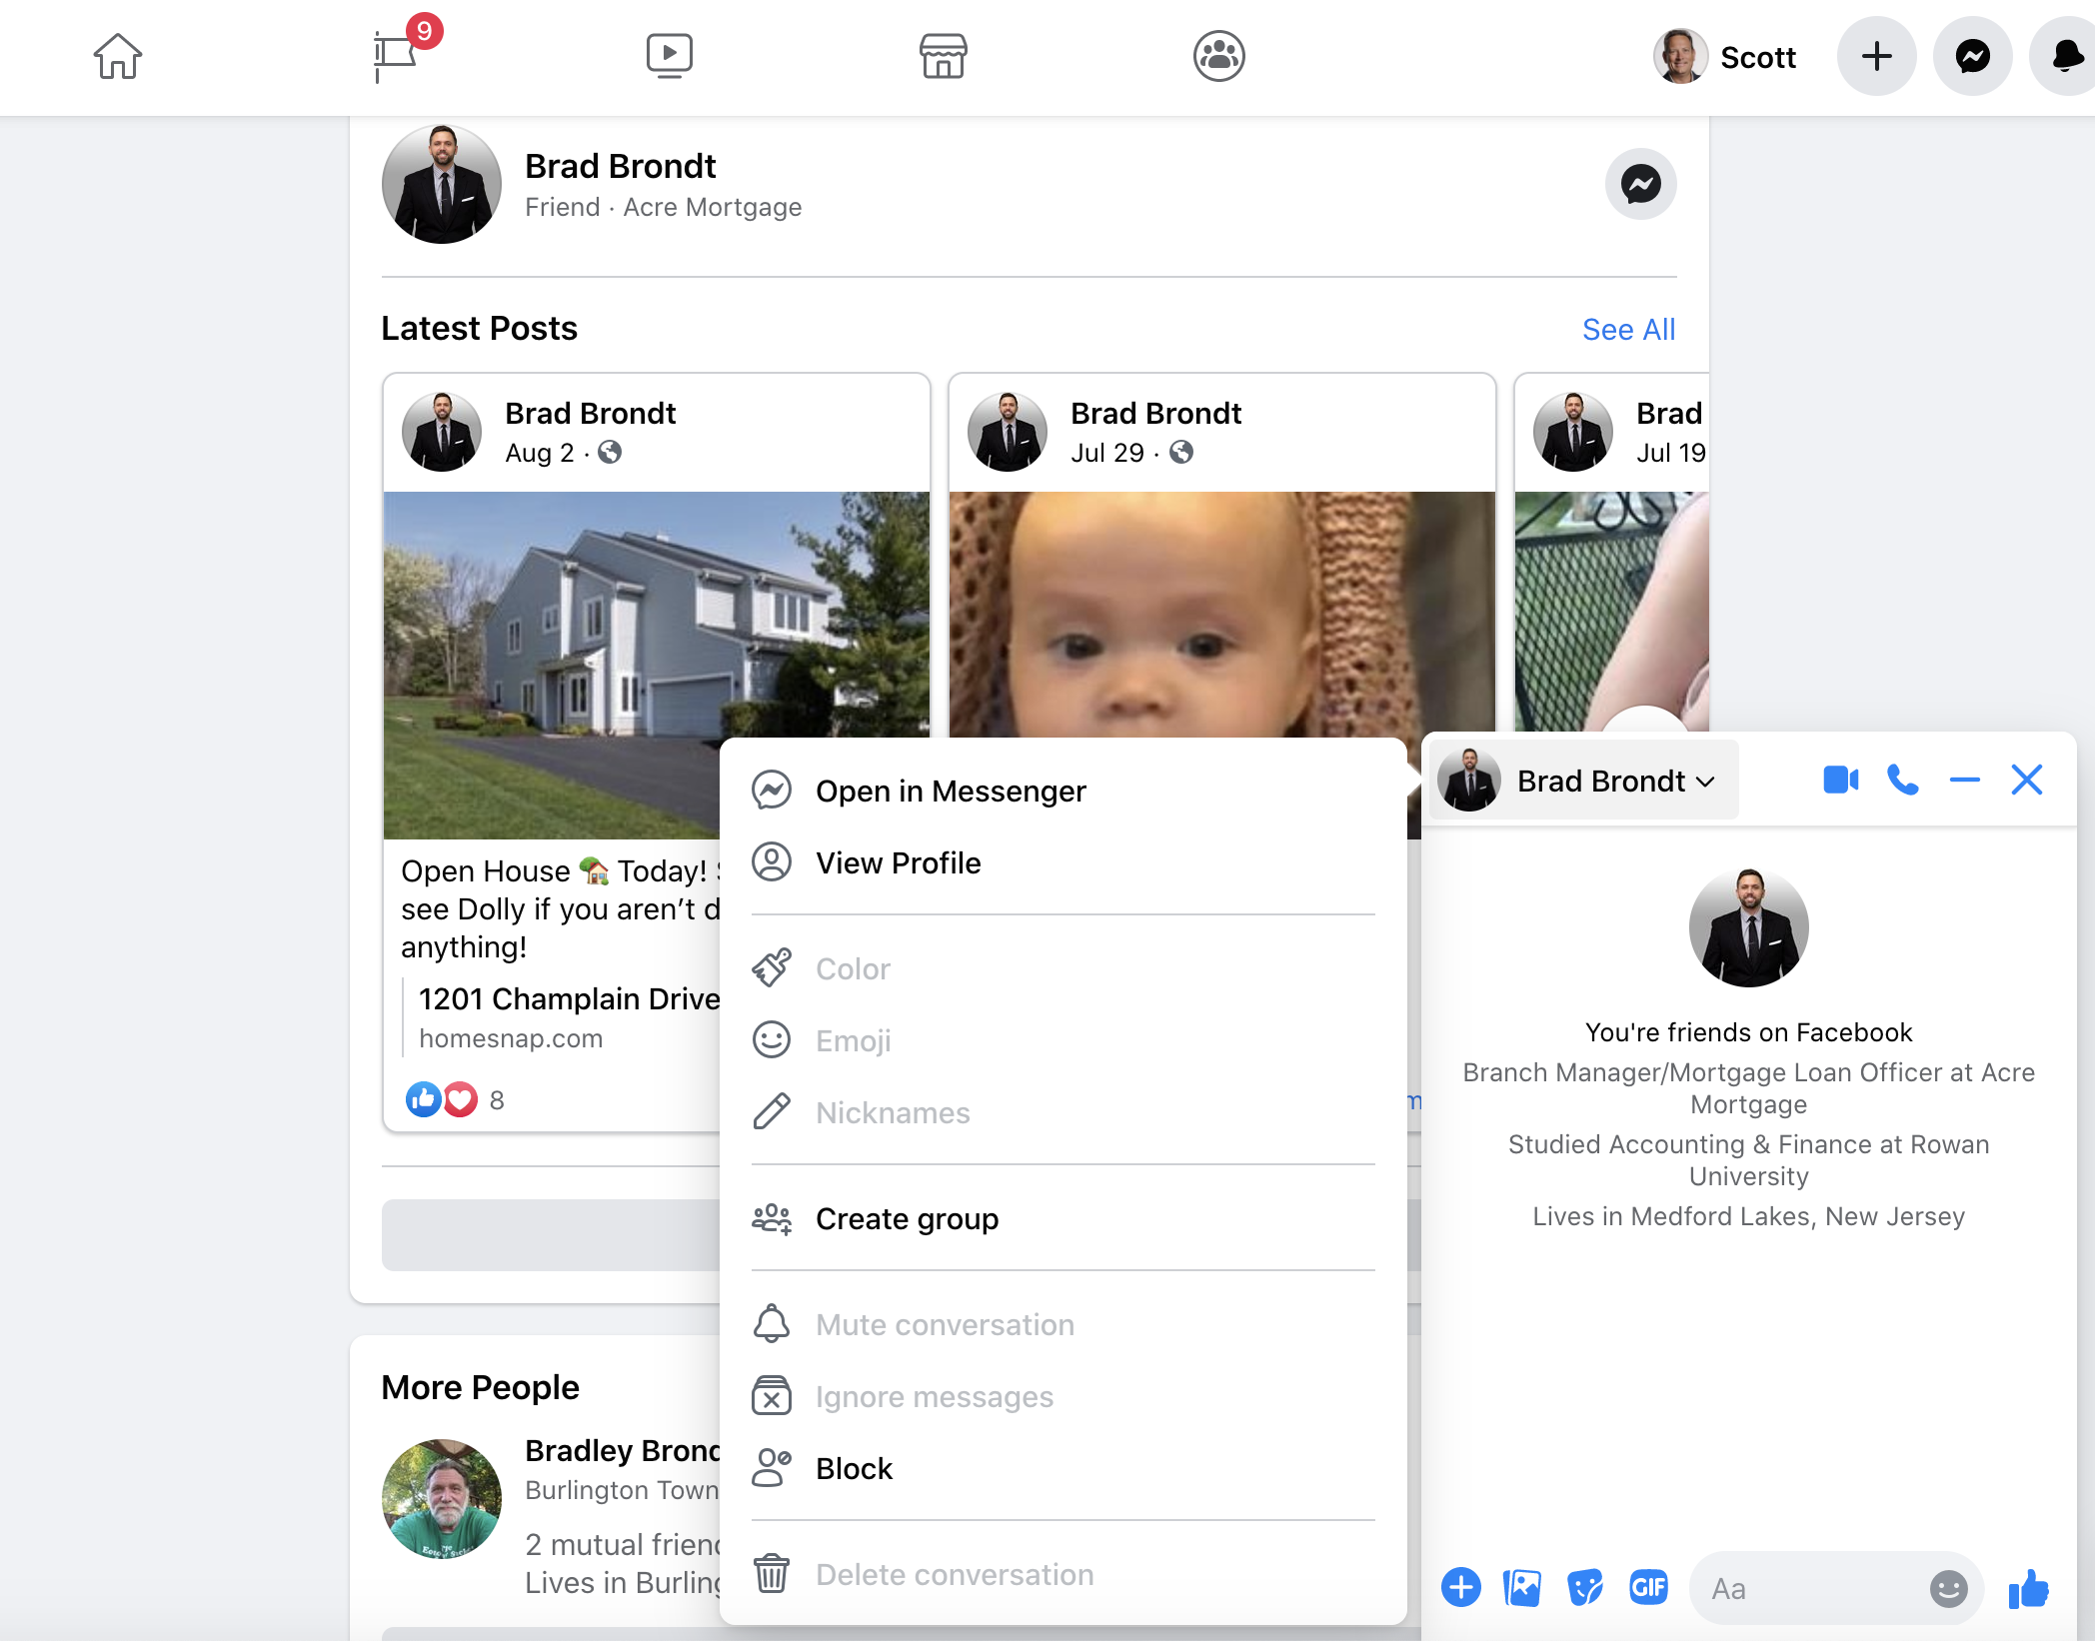
For Video
1. Click on Friends Profile
2. Click on Open In Messenger

Slide 29
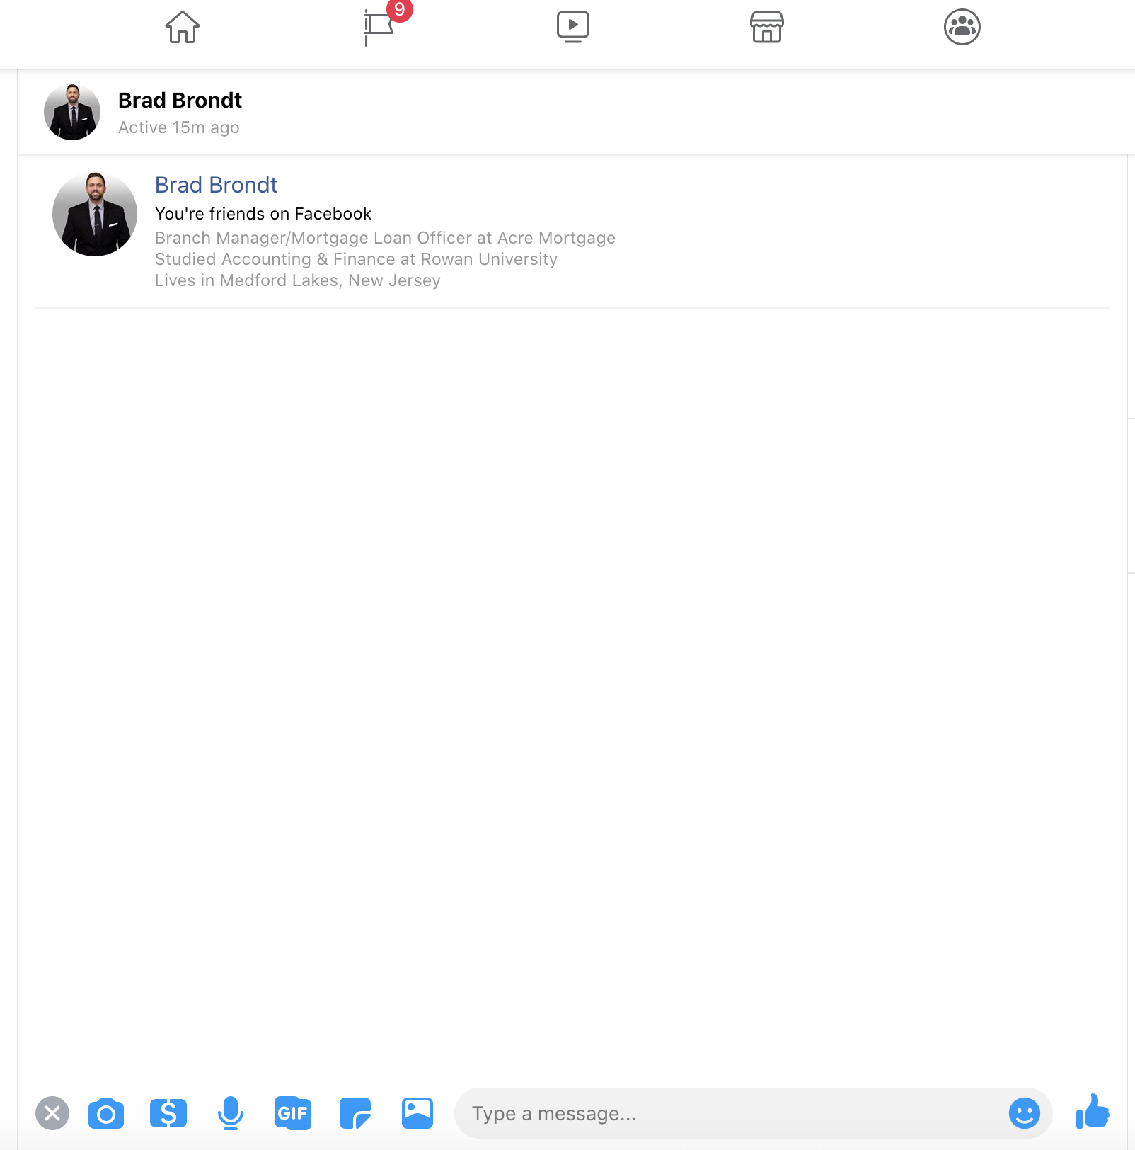

Slide 30
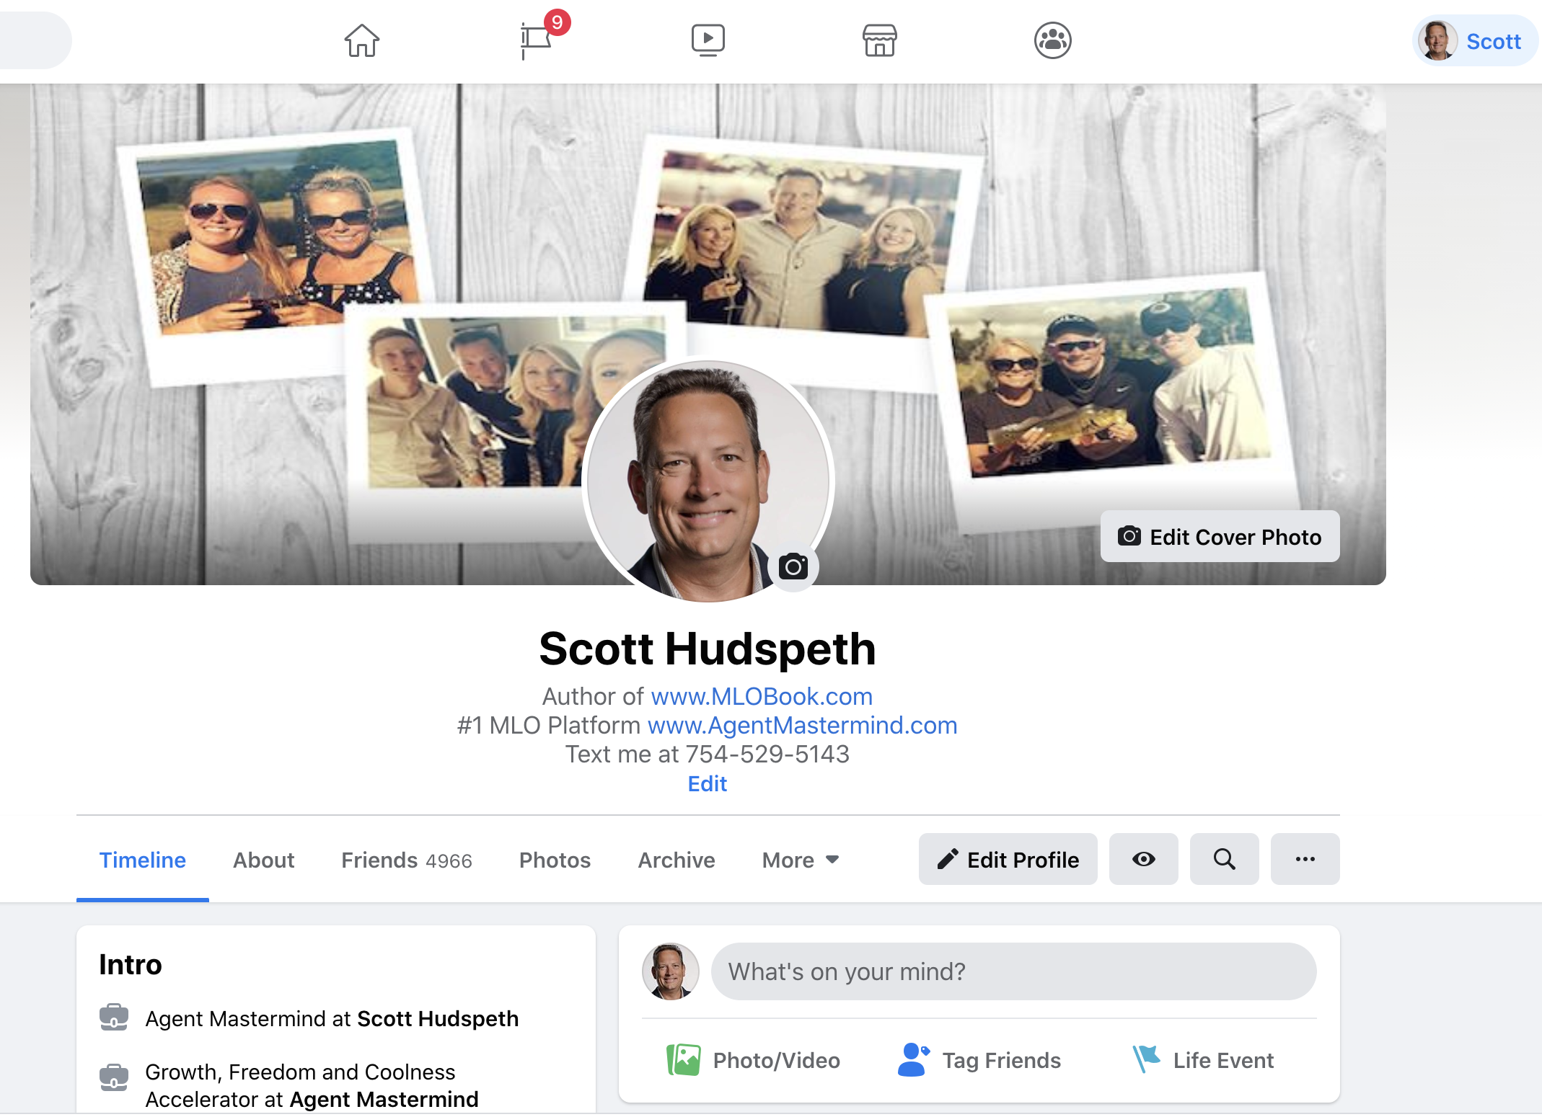
1st Click name
2nd Click friends

Slide 31
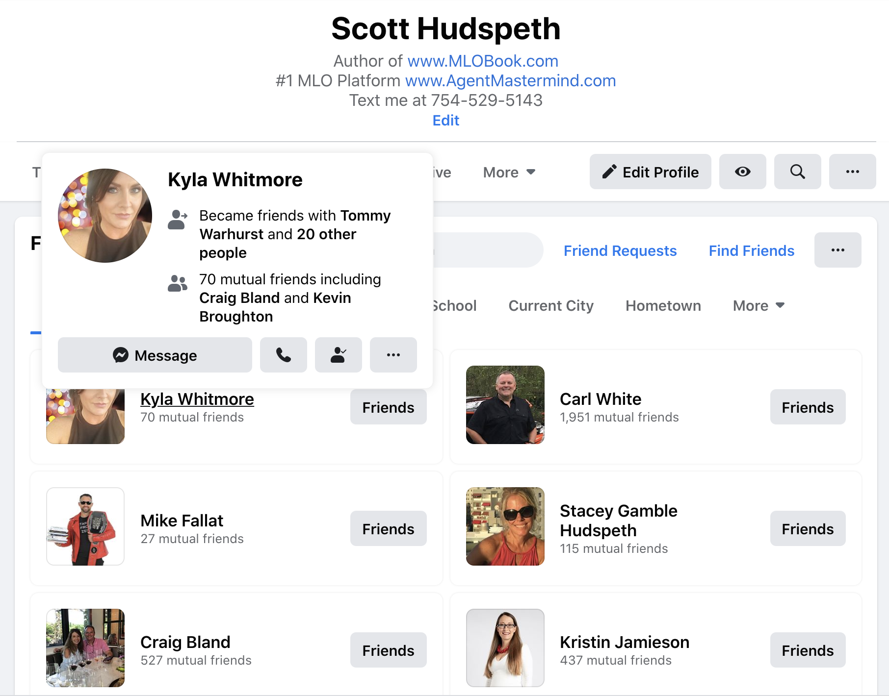
2. Click Messenger to send DM
1. Hold your mouse over name

Slide 32
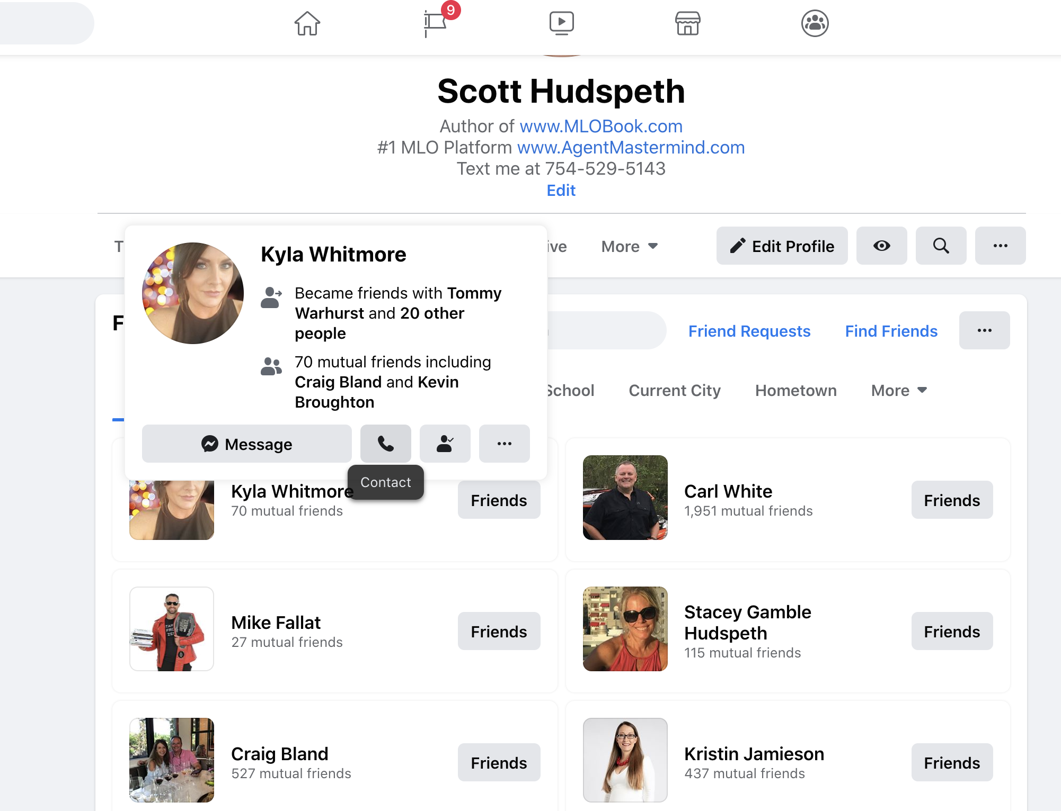
If They Say Yes! Call Them Immediately From Facebook

Slide 33
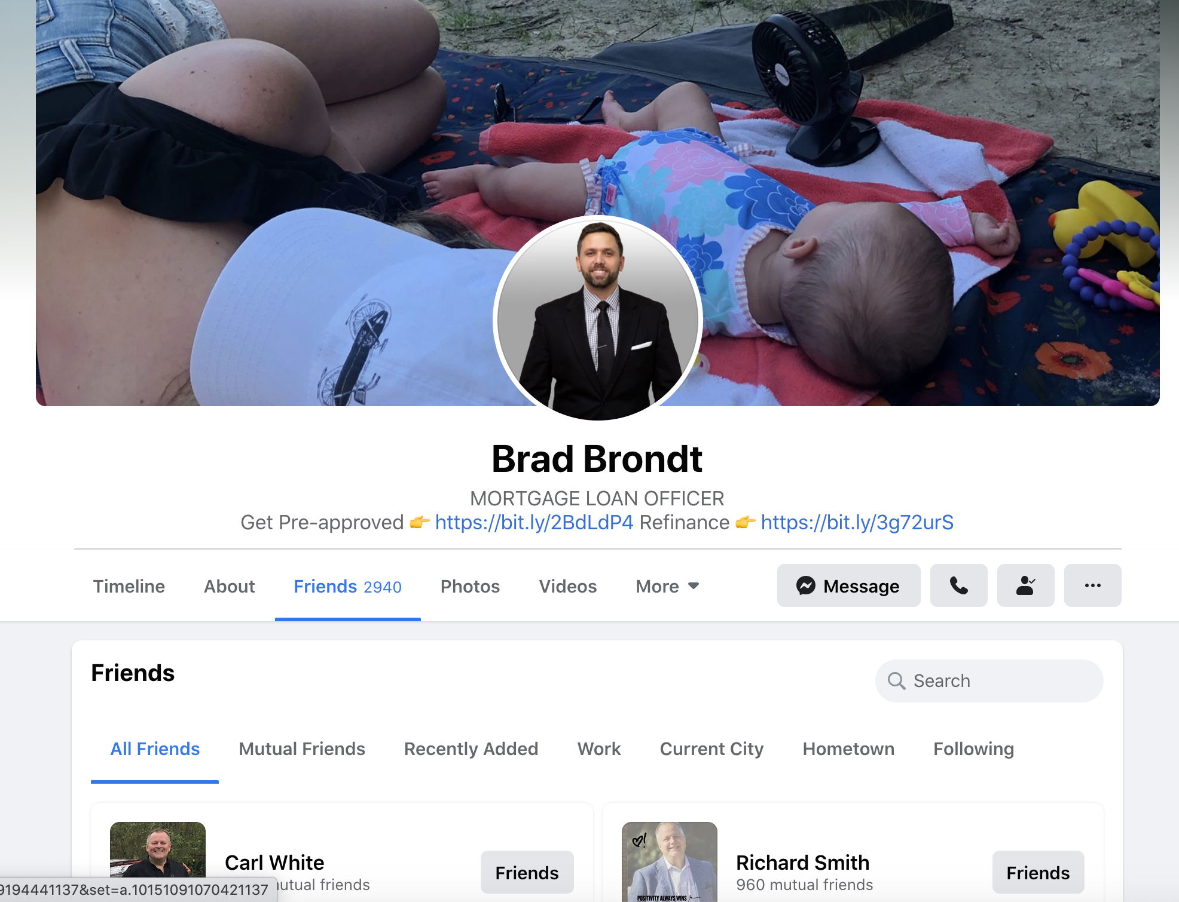

Slide 34
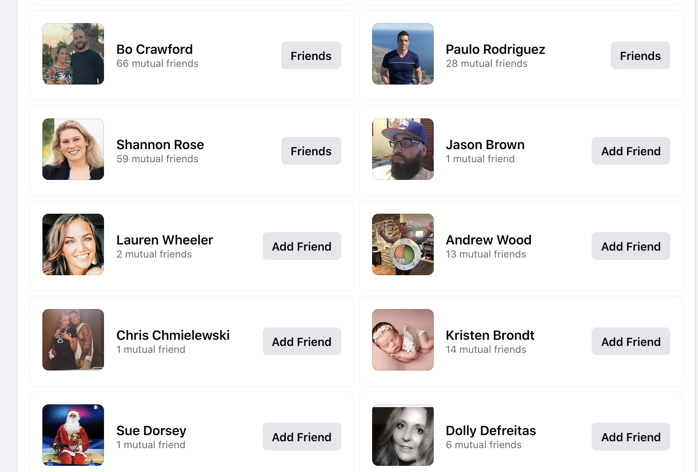

Slide 35
Friendly Reminder
Do this every day, 5 days a week until done
And then start over again!
Max 30 people per day or possible face “Facebook Jail”
Have your alerts on so that you see the responses
Don’t send 30 messages and then go play tennis for 3 hours
If you get a favorable response after any message address that message and have a conversation over the phone
Don’t go back and forth on DM, get their number and have a conversation. ☺

