Slide 1
How To Turn a $50 Facebook Ad Campaign Into a $5,000 Real Estate Commission...
even if you’ve never built a website or have no online marketing experience!

Slide 2
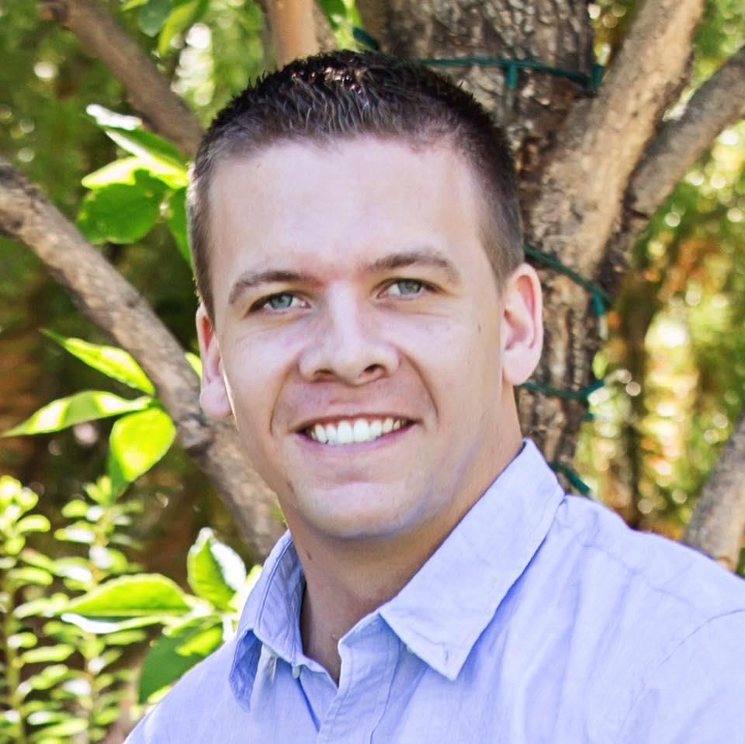
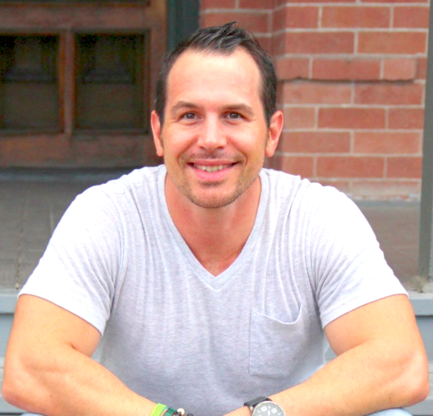
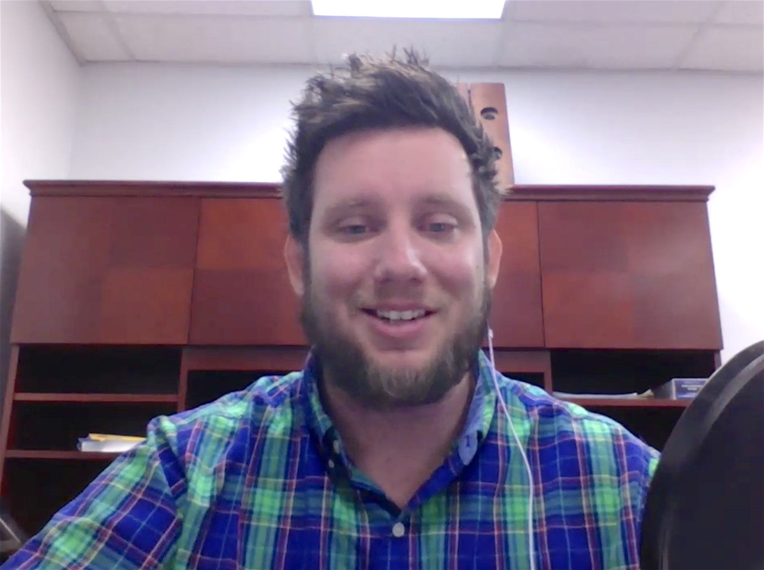
About Us
Dallin Greenberg
Kristian Cotta
Cory Smith
A Combined 25 Years Of Marketing And Sales
Spent the last 3 years learning and mastering the integration with marketing funnels and social platforms
Featured as a Periscope Summit speaker
Work alongside some of the top marketers in the world
Both Dallin And Kristian walked away from 6 figure sales jobs to capitalize on the power of the online funnel concept
Successfully run multiple ecommerce stores through advanced social media targeting

Slide 3
What We Are Going To Cover
The right website to send COLD traffic to
What’s a marketing funnel and why you NEED to implement it NOW!
How to get the MOST out of your web traffic
The RIGHT tools to get the job done

Slide 4
Email us:
Support@theleadsolution.com
Links Exclusively for Agent Mastermind Attendees
http://leadz.pro/agent_mastermind
http://leadz.pro/agentfunnelvault

Slide 5
-Give us 30 minutes
-Take some notes
-Put aside distractions
THIS IS GOOD STUFF!

Slide 6
Why Websites Struggle To Convert Traffic To Sales?
They aren’t any different than ALL the other people in their organization using THE SAME SITE! http://www.rmxsolutionsaz.com
Selling on the “ Personal Website” the parent company provides IS NOT EFFECTIVE!
Your company controls and stores ALL the activities that take place on the website.
The sites become “cookie cutter” and saturated with traffic.
You aren’t creating a UNIQUE place online for yourself

Slide 7
How Most People Do Paid Traffic...
Facebook Ad
Authority Website
(catalog, MLS, etc.)

Slide 8
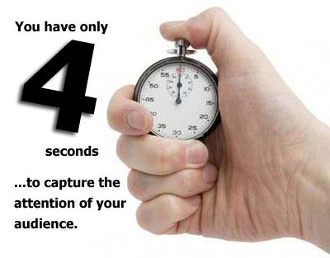
How Long Long Do You Have To Grab Attention?

Slide 9
MICRO COMMITMENTS
The concept of helping traffic focus on one thing at a time and take an action that leads to another action.
-can be done through an opt in, survey, poll, etc.
Every ACTION someone makes, the WARMER the lead becomes.

Slide 10
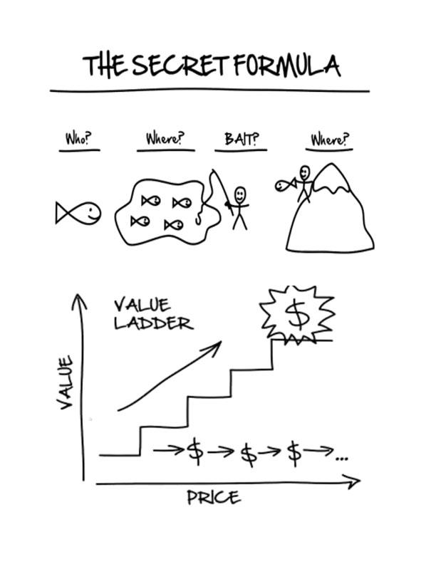

Slide 11
Why Doesn’t Your Website Convert Traffic To Sales?
Your website isn’t hitting the 5 key viewer elements…
Create a Need...
Create Emotion…
Create Urgency...
Create Trust...
Overcome the objection of “No Time No Money…”

Slide 12
Cory Smith
Traffic And Targeting Expert

Slide 13
What Is A Pixel?
The Facebook pixel is a piece of code for your website that enables you to measure, optimize and build audiences for your ad campaigns.
Measure cross-device conversions: See how your customers are moving between devices before they convert.
Optimize delivery to people likely to take action: Ensure your ads are being seen by people most likely to take the action you want them to take, like purchase or fill out a form.
Automatically build audiences for website visitors to retarget: Create Custom Audiences for people who take specific actions on your website, like visited a product page, added to cart or purchased a product.
Create Lookalike Audiences. Find more people who similar to your best customers.
Run dynamic product ads. Create relevant and timely ads on Facebook based on the products people have visited on your website.
Access Audience Insights. Get rich insights about the people who visit your website.

Slide 14
Email us:
Support@theleadsolution.com
Bonuses Exclusively for Agent Mastermind Attendees
http://leadz.pro/agent_mastermind
http://leadz.pro/agentfunnelvault

