Slide 1
Contract to Close

Slide 2
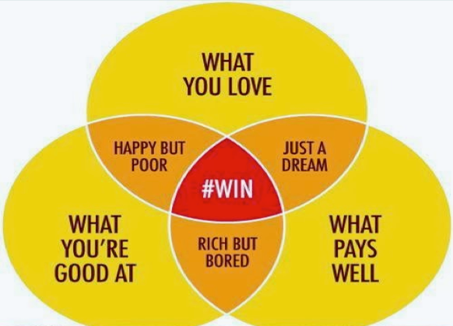

Slide 3
Hourly Wage / Would I
100,000 / 2080 hours = 48.08 dollars an hour
Would you pay someone $48 dollars an hour to do everything you do during a transaction

Slide 4
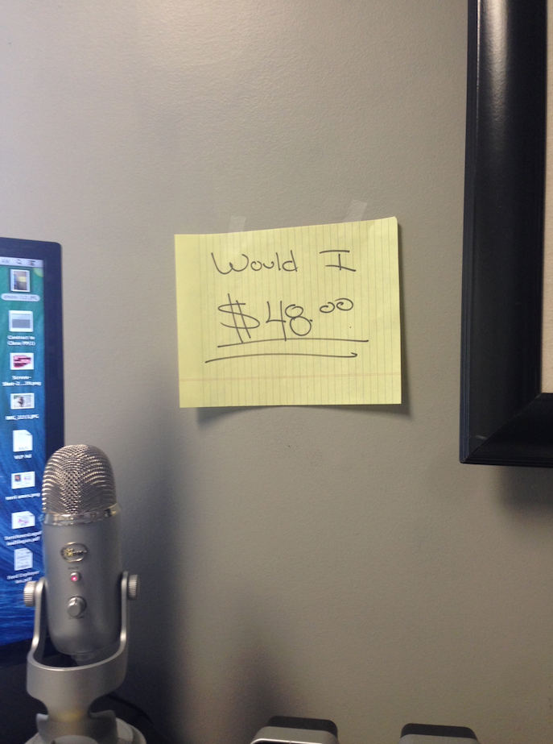
Would I?

Slide 5
R.E.A.D
Reduce
Eliminate
Automate
Delegate

Slide 6
80/20 Rule
Leverage through
People &
Systems

Slide 7
Mastering Contract to Close
Takes Time
Only effective way:
Systems &
People

Slide 8
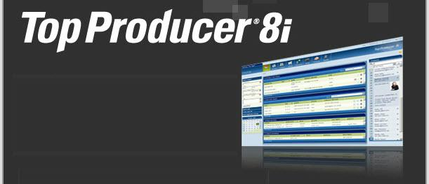
SYSTEMS
There are many Real Estate software systems to choose from. Examples:
Wise Agent
Sure Close
Top Producer

Slide 9
PEOPLE
In-house Staff
Virtual Assistants

Slide 10
Average Transaction
8-10 hours of phone calls
Paperwork
Lender
Title
Agent
Client
Data Entry
Amendments
E-mailing
Maintaining
Storing

Slide 11
Contract to Close
Mastering contract to close takes TIME and careful attention.
Systems help leverage TIME through automation and ease.

Slide 12
How To Chat Dustin
Dustin Curlee
210-493-6561
Owner@sold2close.com
www.facebook.com/groups/agentmastermind

