Slide 1
The Business of Real Estate
Differentiate your Brand
Presented by real estate experts
John Agostinelli & Chris Michaud

Slide 2
“EA$Y MONEY provides a well-researched and fully documented view of the Great Housing Boom/Bust by two real estate insiders. Agostinelli and Michaud’s attention to history is particularly …They were also attentive to the principles of real estate finance, including its cyclical nature and mean reversion. This allows them to make informed judgments about what the future may hold if we continue down the same path and to suggest alternatives that will strengthen and add more stability to our housing finance market.” Edward Pinto, Resident Fellow, American Enterprise Institute, Center on Housing Risk

Slide 3
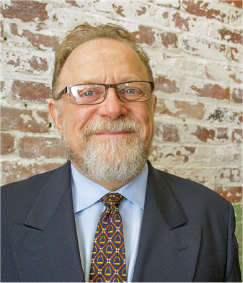
Chris MichauD
CM
Bio
President-elect MAR REALTORS 1991
Land developer and real estate investor
Owned several real estate franchises
30+ years in the business
Part time lobbyist for MAR
Author – guest speaker – Real estate guru

Slide 4
Chris Michaud
CM
JA
Focus
Real Estate Services
Consulting
Training Investors
Investment Programs
Coaching

Slide 5
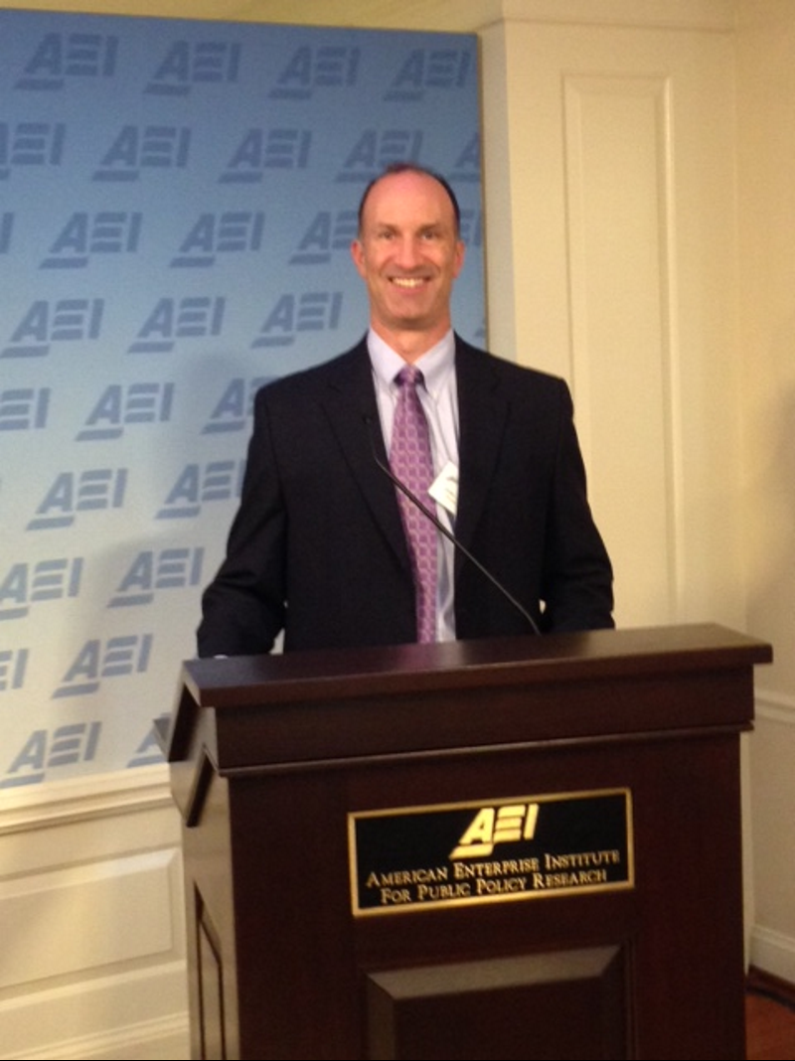
John Agostinelli
JA
Bio
Banking industry 9 years, 6 at FDIC
Spec home builder
Real estate broker and franchise owner
Sold hundreds of bank owned properties
Real estate investor 20+ years
Author, guest speaker, housing policy commentator
Notes:
Sold properties in over 60 different towns

Slide 6
John Agostinelli
JA
Current Focus
Real Estate Agent and Investor Services:
Joint Ventures
Coaching/ Mentoring
Private Funding
Real Estate Brokerage

Slide 7
The Business of Real Estate
JA
Business Plan

Slide 8
The Business of Real Estate
JA
Marketing Plan

Slide 9
The Business of Real Estate
JA
Strategic Plan

Slide 10
Getting back to basics
JA
We all know that people do business with people that they know, like and trust.
Know:
Use of technology
Real estate is a people business and always will be
Build and maintain those relationships
Call, meet for coffee, send a card
Connecting with other professionals

Slide 11
Getting back to basics
JA
Trust:
Be the expert
Demonstrate it
Sharing “great” and timely content
Gain credibility
How to do it
Consistency
Number of touches

Slide 12
Two Simple Business practices most commonly overlooked
JA
CM
Follow Up
Differentiation

Slide 13
Real Estate Cycle
JA
Poor Housing Policy
Increased Volatility
Where are we in the Real Estate Cycle?
Notes:
We are going to share some expert knowledge

Slide 14
Real Estate Cycle
JA
Notes:
We are in the expansion phase
Real estate cycle is local, don’t confuse with national trends; John example 2005
This is the subject of another whole presentation.
Will need to read the book.

Slide 15
Free Coaching session
CM
Email us with screen shot of
your book purchase – any version
put “Agent Mastermind” in Subject
participate in free group coaching
session with Q&A
Notes:
Knowledge of all of these points will help you as an investor

Slide 16
John Agostinelli
www.agostinelli.com
John@agostinelli.com
Phone: 508-561-2244
linkedin.com/in/agostinellijohn
Twitter: @AgostinelliJohn
facebook.com/AgostinelliRealtyGroup
Chris Michaud
www.acceptancegroup.com
Chris@acceptancegroup.com
Phone: 978-697-8568
linkedin.com/in/michaudchris
Twitter: @ChrisMichaud365
facebook.com/ChrisMichaud365

Slide 17
Questions?

