Slide 1
Real Time Referral Program How We Are Seeing Epic Growth!

Slide 2
We helped real estate agents that referred to us make an EXTRA $321,900 in commissions in the last 12 months alone by referring 29 “Real Time Referrals” that actually closed
1. Closing on time
2. Great communication during the loan process
3. Follow up on the leads like green on a pickle
4. Real Time Referral Program

Slide 3
Real-Time Referral Program
MONDAY - Check in with you to qualify (back up-qualify) all buyers for your offers. Check in with the clients to see how house hunting went over the weekend.
WEDNESDAY - We call your database, past clients, with an incredibly successful script checking in to tell them that you've been thinking about them, how much you appreciate them, loved working with them, and ask them how they’ve been. And, oh by the way, ask if they know of friends, family, or co-workers looking to buy or sell, to refer back to you real-time.
THURSDAY - Call all buyer leads and pre-qualified buyers to re-confirm pre-approval and keep them in the line-up for looking at homes over the weekend and ready to submit offers.
In summary, we touch the lead, we touch the partner. We have three guaranteed touch points with you per week to check in on current clients and upcoming clients for additional real-time referrals.
All referrals that we ask for go back to you immediately as a real-time referral.
Our team is always dedicated to close you on time, so you have more real-time referrals!
We will stay on top of all clients you send our way for pre-approval consistently so we do not lose track of any of the pre-approved and looking clients, which means more commission for you.
© 2022 Mortgage Marketing Animals. All rights reserved.

Slide 4
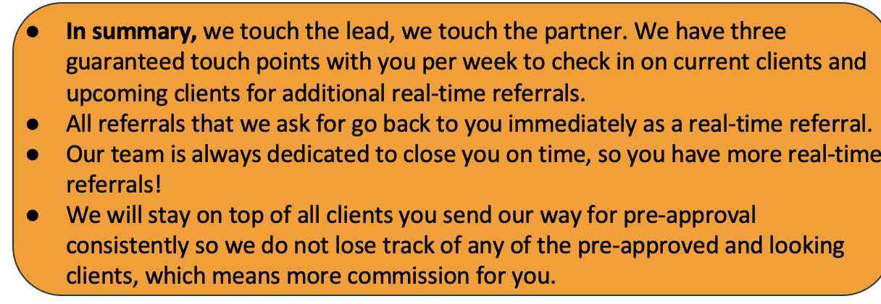
Real-Time Referral Program

Slide 5
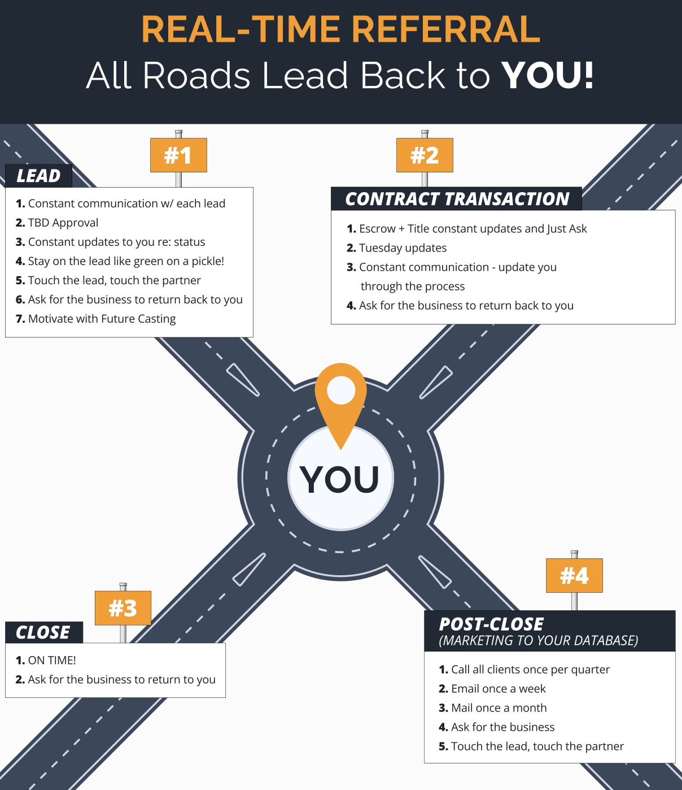

Slide 6
Real Time Referral Program “Your Leads Are Seeds”
Monday: Weekend Debrief
Tuesday- Just Ask
Wednesday- Past Database
Thursday- PAAL’s

Slide 7
Call the loan professional that sent you the invitation for today and turn on the power of the Real-Time Referral Program

